Slide 1


Pre-Op
Inspections
Is it SAFE?

Slide 2
Pre-op Inspections
Pre-op Inspection Certification Course
  Define product contact surfaces
  Define peripheral areas
  Define soil
  What is a clean product contact surface?
  What are the expectations of sanitation?
  What are expectations of a designated pre-op inspector?
  How to pre-pare for pre-op
  Pre-operational inspection and releasing an area to production
  Pre-op sheet example
  Pre-op Exercise

Slide 3
Why Sanitation?
We make food products for human consumption.
Prior to making food for human consumption the equipment and environment the food are to be made in have to be CLEAN.
In other words - Sanitation is essentially the First step in our processes
In light of what is at stake - It is critical that our sanitation processes are effective and verified.
Sanitation verification may be completed through a post cleaning inspection and / or a pre-operational inspection (pre-op)
When Sanitation isn’t RIGHT . . .
Notes:
For the purpose of this training – we will focus on pre-operational inspections.

Slide 4
Food-Borne Illness Facts
1 in 4 people will get sick this year due to food-borne illnesses
325,000 serious illnesses causing hospitalization annually
5,000 deaths a year
Estimates do not reflect unreported cases
Notes:
Mention the issue of the Bill Mar recall in 1998, also Wampler’s food. How did affected the business,the trust customers put on a brand name,the jobs.

Slide 5
Pre-Operational Inspections
A pre-operational inspection is a visual verification of the line, equipment or processing area to assess its readiness to produce a safe food product.

Slide 6
Successful Pre-Operational Inspection
We need to inspect equipment
And the environment
It’s not just about looking at product contact surfaces
We need to look CLOSELY
Close enough to be proactive on identifying issues – before they bite us
We need to work as a team – because the more sets of eyes involved the more we see and the higher degree of success we achieve

Slide 7
Product Contact Surfaces
A product contact surface is any area of any equipment that comes in DIRECT contact with food products and or ingredients
Often referenced as Zone 1 areas
Examples:
  Tanks, blenders, and kettles
  Pipes, pumps, and valves
  Belts and conveyors
  Fillers
  Utensils – pails, shovels, knives, scrappers, etc.

Slide 8
What are peripheral areas
A peripheral area is defined as all areas (environment) in a GMP room other than the product contact surfaces
Zone 2 peripheral areas are close to or directly above product contact areas; examples: frame work, side panels, overheads, control panels
Other GMP room peripheral areas (Zone 3) include all other areas in the room; walls, overheads, doors, drains, supply cabinets, hand wash stations, towel dispensers, footbaths, floor, floor mats, floor stands, vents, air units, etc.
Additional peripheral areas (zone 4 areas) may include coolers, vestibules, hallways, maintenance shops, locker room, etc.

Slide 9
Sanitary Zones
Zone 1 –
All direct product contact areas; pumps,
conveyors, kettles, scrappers, etc
Zone 2
All in-direct product contact areas; control panels, equipment framework,
Zone 3
Phones; mules; forklifts; walls; drains
Zone 4
Bathroom doors, cafeteria, halls
Notes:
The following graph provides another way of looking at a GMP room zone areas.

Slide 10
The pre-operational inspection should include the entire production area to assure the environment is ready for food processing.

Slide 11
The pre-operational inspection should be performed no more than one shift (maximum of 8 hours, with 4 hours recommended as the maximum length of time) before production startup to assure possible causes of contamination are minimized.

Slide 12

Pre-Operational Inspections
During visual and swab checks, operators should use their sense of smell and feel for greasy surfaces and note and correct improper drainage, dead-ends, and pockets.

Slide 13
Soils – Defined
Soil is defined as anything that should not be there
Debris – examples: packaging scraps, trash, dirt, lubrication, grease, oil
Product soil buildup – proteins & fats
Films – bio-films, hard water scale build-up, and soap films
Flaking paint, rust or metal shavings
Flaking plastic from belting and other equipment
Bacteria – as in APC, Mold, Yeast and Coliforms
Notes:
It is important to remember that the Federal Food, Drug, and Cosmetic Act deems a food to be “adulterated if it has been prepared, packed, or held under conditions whereby it MAY have become contaminated with filth or whereby it MAY have been rendered injurious to health.”
Even if a food is not physically adulterated it is considered adulterated if the environment in which it was produced is not sanitary.
Section 402(a)(4) of the Food, Drug, and Cosmetic Act

Slide 14
What are the expectations of persons completing sanitation
  To Clean, self inspect and document assigned area of responsibility
  Understand how to clean assigned equipment and location area (room)
  Perform all work activities in a SAFE manner, according to company and plant procedures
  Be present for pre-operational inspection to complete any identified corrective actions
Notes:
The sanitation process training details will be covered in more detail in the module on the 7-steps of wet and dry cleaning, and supported by specific plant sanitation training.
After sanitation is complete the person responsible for specific areas complete the sanitation and self inspection, and communicate to the appropriate person(s) that the area is ready for pre-operational inspection.

Slide 15
Pre-op Inspection Pre-requisites
Understand your facility’s sanitation program
Understand your facility’s Hazard Communication program
Ability to perform LOTO per facility procedures and requirements
For some facilities you may also need to be able to perform pre-operational clean equipment swabs
Notes:
Adequate inspection requires understanding your facility’s sanitation program: the type of sanitation tools used, the type of soil being cleaned and the challenges associated with the type of soil being cleaned relative to the type of equipment being cleaned.
Examples:
Is the soil removed easily or is it difficult?
Where are the hiding places on the equipment?
Sanitation involves the use of chemicals (that may be hazardous). Persons performing pre-operational inspections need to know what chemicals where used during sanitation and the possible hazards associated with the said chemicals prior to performing pre-operational inspection.
Pre-operational inspection requires “breaking the plane” on many types of equipment, and therefore requires the use of lock out tag out (LOTO). Note – if equipment is locked out for sanitation --- it also needs to be locked out for inspection. LOTO requires specific training for specific pieces of equipment prior to LOTO.
In some instances the person performing pre-operation inspections may also be required to swab equipment for microbiological verification of clean. Swabbing also requires specific training to insure that it is done correctly.

Slide 16
What are the expectations of a
Designated Pre-op Inspector
Understand proper cleaning and inspection techniques
To ensure that equipment and area are cleaned to an acceptable level – and ready for producing FOOD for human consumption
  CLEAN IS CLEAN AND THERE IS NO IN BETWEEN
Be able to identify any issues related to poor cleanliness and cleaning
Communicate issues to responsible party for corrective action and provide instruction on proper re-cleaning techniques

Slide 17
What are the expectations of a Designated
Pre-op Inspector continued:
Easily recognize any potential SAFETY risks associated with the equipment in your area (examples: pinch, amputation and crush points, hot surfaces, automatic starts, etc.)
Be able to identify and communicate any SAFETY issues to responsible parties
Be able to identify and communicate damaged or un-cleanable equipment
Correctly document the cleanliness of an area and equipment, any identified issues and the corrective actions taken.

Slide 18
“…plant management
must always be
diligent in checking to
see that all sanitation
procedures are
properly implemented
all of the time.”
Donna F. Schaffner, M.SC
Associate Director of Food Safety, QA & Training at Rutgers University Food Innovation Center
Food Safety Magazine, December 2014/January 2015
Vol. 20, No.6

Slide 19
How to prepare for Pre-op
Wear plant required PPE (hearing, eye, bump hat, etc.) as required by your facility
Wear plant appropriate GMP barriers (apron, poly sleeves, disposable vinyl gloves as required per plant)
Cleaning chemicals should be secured prior to pre-op, but be aware chemicals have been used in the area – be aware of the hazards associated with chemical use
Tools needed for pre-operational inspection: working flash light, locks and tags, pen, and pre-op sheet

Slide 20
Pre-Op Tools of the Trade
Lockout Lock(s) and Tag(s)
Flashlight(s)
Inspection Mirror (stainless)
Digital Camera
Spatula(scraper)
Note Taking Materials
Small rare earth magnet

Slide 21
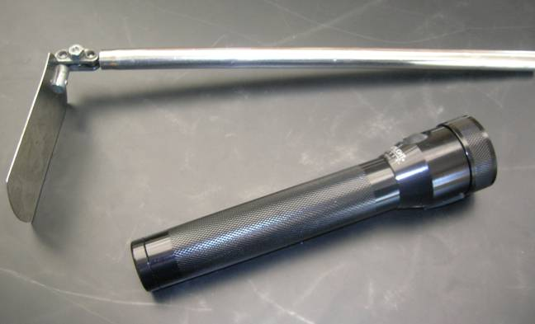
Success Tools

Slide 22
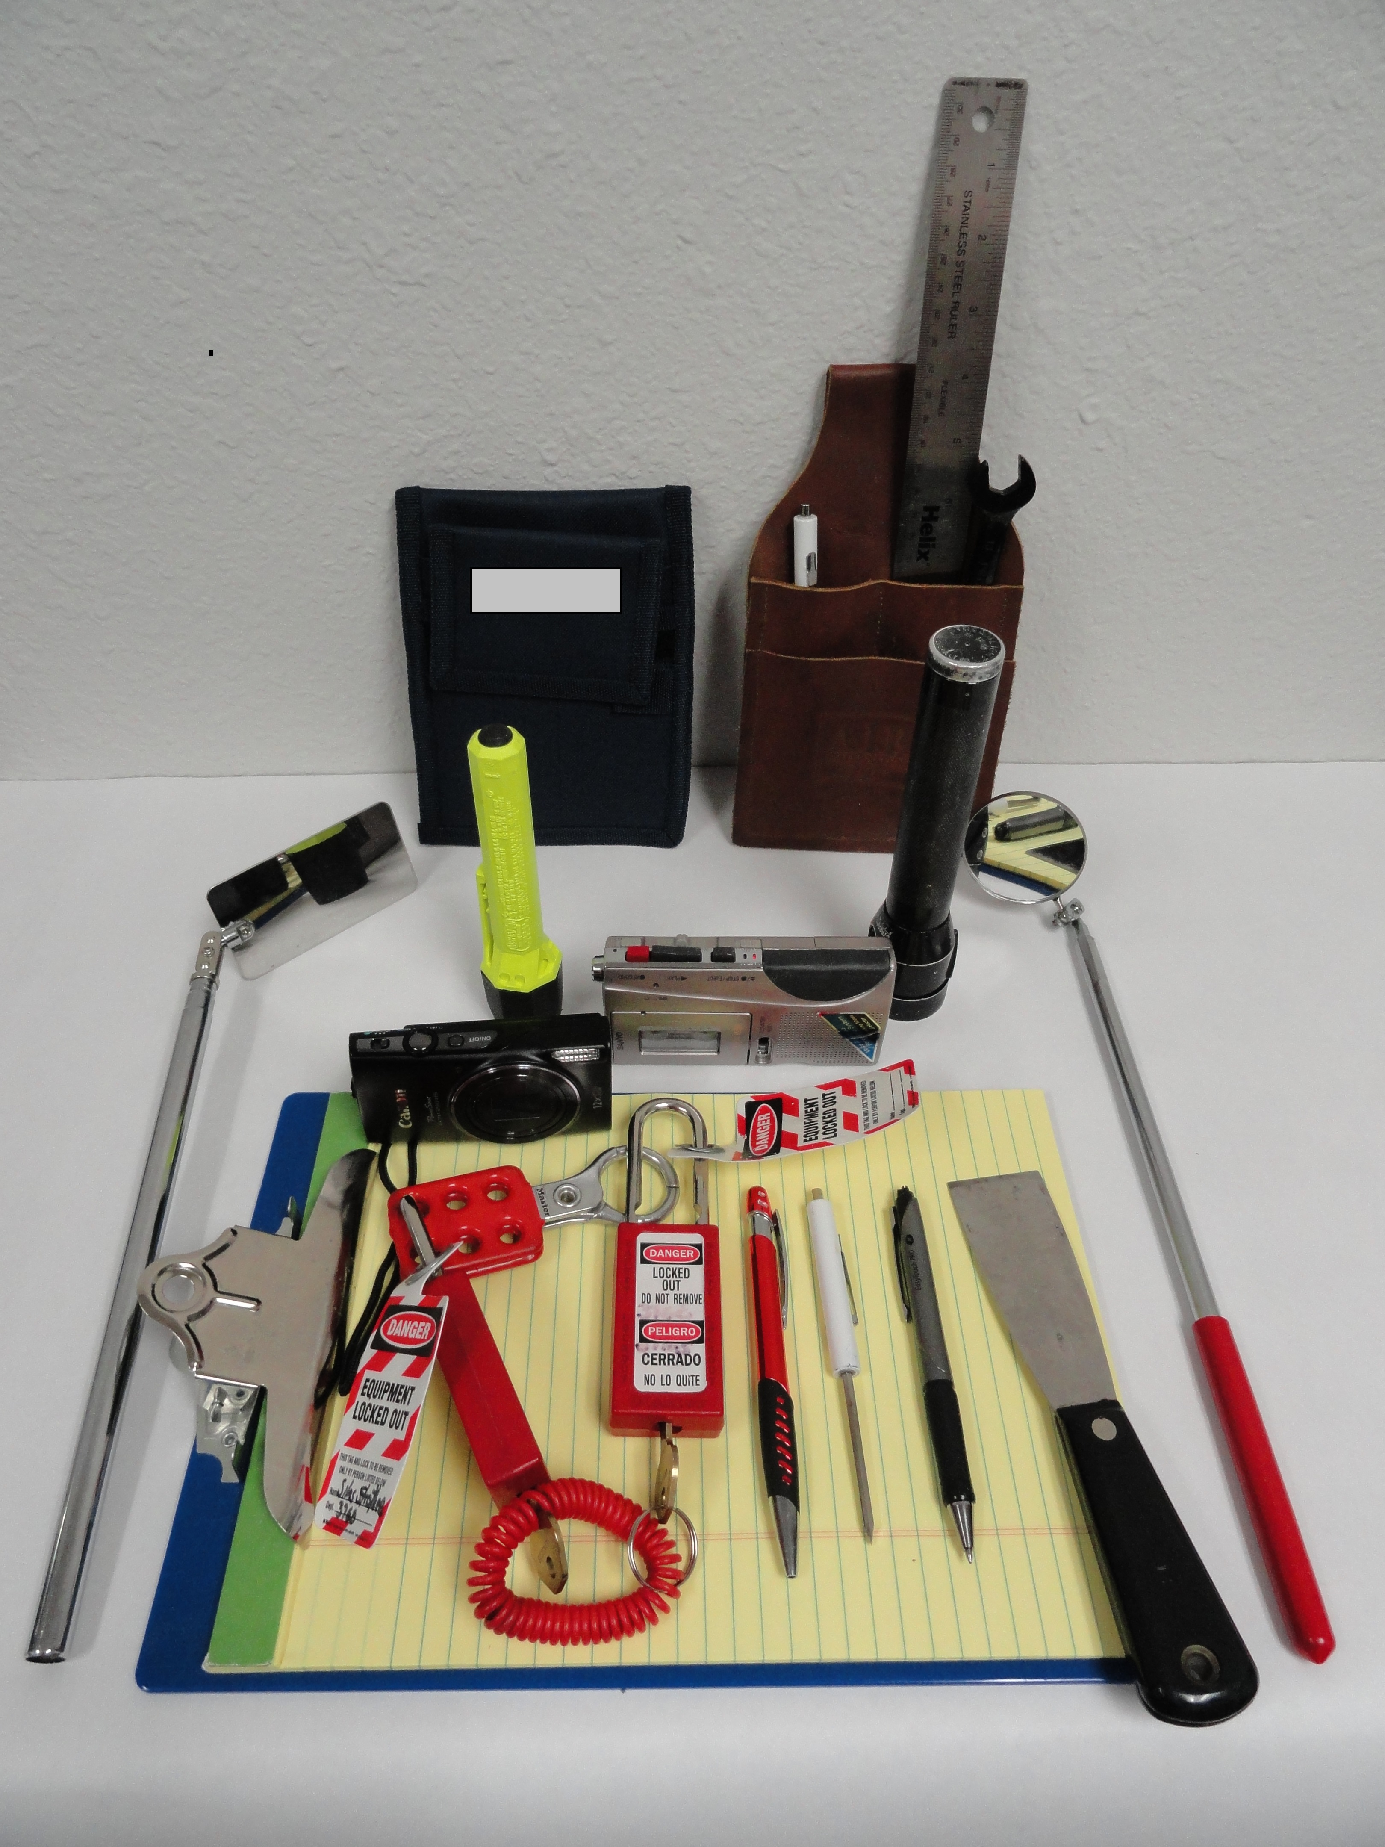

Slide 23
Successful Pre-operational Inspection Results
No product residues
No extraneous materials
Food production environment clean
Areas needing work orders or period cleaning – identified
Any corrective actions needed are documented
Prior
TO RELEASING EQUIPMENT FOR FOOD PRODUCTION

Slide 24
What is a clean product contact surface?
Direct contact surfaces NO visible soils or films
Indirect contact surfaces visibly clean and dry
No visible condensation, dust or debris on overhead surfaces above product contact surfaces
No detectable foul odors
Notes:
At Kraft – “CLEAN IS CLEAN” and there is no in between. No visible soils – means NO VISIBLE SOILS.

Slide 25
How to Pre-op a product contact surface
Insure that area and equipment to be pre-oped has been documented as cleaned and inspected
Indicate on sheet the date and time of inspection
If pre-op process requires breaking the plain on equipment – ensure equipment is locked out and tagged out
Ensure that all equipment was properly disassembled
Use a working flash light to visually inspect all direct and indirect contact surfaces – remember to check hard to reach areas and soil hiding spots
Carefully feel direct product contact surfaces for residual soil build-up

Slide 26
How to Pre-op a product contact surface cont.
Use your sense of smell to detect off odors (decomposing organic matter, chemical residues, etc.)
Reject any equipment not meeting acceptable levels of clean for corrective action and re-inspection – in some facilities this may require the use of a HOLD tag
Communicate the need for corrective action to responsible party or area supervisor / team leader
After corrective action, complete re-inspect the equipment and area
After pre-op is successfully completed communicate release of the equipment and area to operations
Complete pre-op documentation including rejected areas, all corrective actions and re-inspections
Know the difference between an issue that needs immediate corrective action and an issue that needs a W.O. notification or communication
E-mail is a great tool for issues that do not require immediate corrective action
Notes:
Equipment CAN NOT be released for operation until all equipment and the environment are acceptable for producing food for human consumption.
There must be a pre-operational check sheet for each day equipment runs food product.
Pre-operational check sheets will be retained for one year plus shelf life per sanitation controls policy A- --

Slide 27
Pre-Operational Inspections
THE HOW
Front to back
Top to bottom
Left to Right or Right to left
Inspect disassembled parts
Check gaskets for debris and wear
Check bolts (screws) and nuts for burrs, debris, wear
Check edges for wear and product debris
Look for cracks in stainless surfaces
Product contact surfaces should be clean & dry
Check product lines (pipes) for debris and water
Look for dried water and or chemical residue
Check corners of pans for debris
Look for missing/broken parts
Feel small parts for grease/oil/product residue
Feel along the edges and bottoms of conveyors/tables/belts Check equipment legs and feet for leaks (holes, splits)

Slide 28
Pre-Operational Inspections
THE HOW (continued)
Check floor drains/gutters for standing/smelly product or water
Check overheads for condensation/ product debris /other debris
Check floors for packaging materials, product debris, standing
water, parts
Check air handling unit vents and duct work for condensation, product debris, other debris
Check room temperature

Slide 29
The Inspection is NOT Complete
Until . . .
The Documentation is Complete

Slide 30
Pre-op Check Sheet Example
Pre-operation inspection sheets differ somewhat from plant to plant, but all pre-op sheets should contain the following information.
  Time and date blanks
  Line and area designation
  Equipment list column
  Clean and inspect column
  Acceptance column
  Reject column
  Corrective actions column
  Operator and inspector sign-offs

Slide 31
Pre-Operational Inspection Documents
Does the Pre-Operational visual inspection program cover processing equipment in the entire process?
Does the plant have a documented Pre-Operational visual inspection program to verify effective cleaning of processing equipment? ( Written procedure or policy)
Do inspection documentation forms include the following: Identification of the process, details of breakdown of equipment, name of inspector, result of inspection(pass/fail)?
Do Pre-Operational visual inspection deficiencies have documented corrective actions?

Slide 32
Sanitation Pre-Op Inspection - Processing
Name: _________________ Line 1 Date: _______________
Area | Critical Inspection areas | Findings / Corrective Actions | P or F | Followup Inspection Results
Peelers and Barrel Washers | Peeler inclines, weigh hoppers, vessels, discharge augers, transition chute, Barrel washer drums, exit chutes, peel scan belts
Preheat and Trim | Grizzly, body inside and out, augers, hydrosieves and plate heat exchanger. Trim belt, frame and all area tanks.
Guns/Grader Shakers | All tanks, knife housing inside and out, dewatering chain, flumes, grader shakers, hydrosieve and sliver rollers, regrader
ADR Loop | Belts, shakers and framework, Sorter belts & catch pans, lenses and lights, motor catch pans, ADR belts, cameras, exit scrapers, defect removal shaker & incline belt
Blancher | Incline belt, feed shaker, body, chain, interior, exit shaker and hood & side gutters, SAPP tanks, dex tank
Dryer | Incline belt, Infeed shaker, diffuser screens above chains, chains top and bottom, floor, transitions, exit shaker
Fryer | Infeed chain, fryer bed & catch pan, hood, drive motor, oil miser chains and scrapers, exit shaker, precool chain & catchpan & belt wash
Pre-Cool and Freeze Tunnel | UHMW runners under tunnel chains all along tunnel, UHMW runners under chain on bottom sides at tunnel exit, space between chains on top and bottom sides.

Slide 33
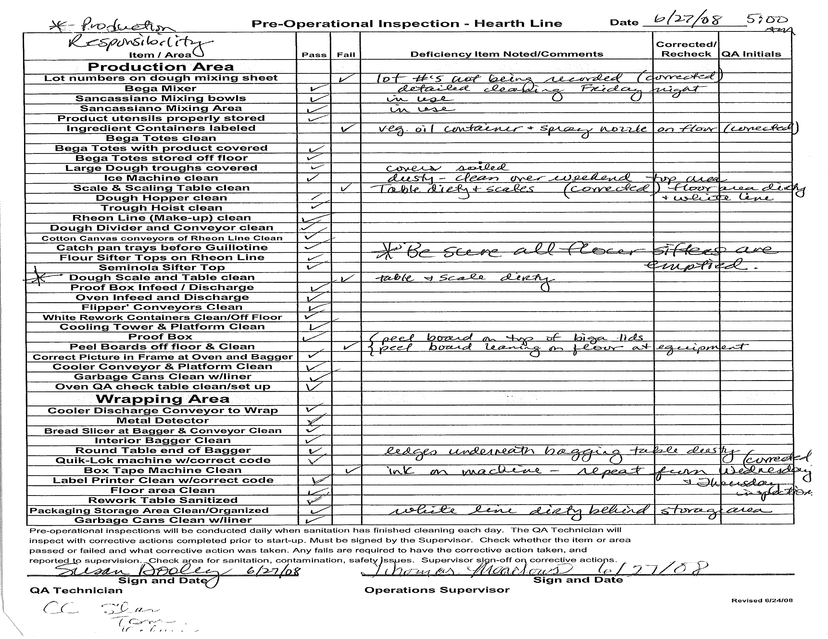

Slide 34
Key items to look for when inspecting: (use a flashlight!)
Mold, slime (pink, green, yellow, brown), starch, old product or product residue, loose strings on belts & wrapped around head or tail rolls, belt damage, grease, food contact tools must be stored in sanitary solution, 5S & tools in proper place.

Slide 35
Pre-Operational Inspections
Are individuals assigned to complete post sanitation/pre-operational inspections trained and qualified?
Has training been verified? (are the inspectors doing what they have been trained to do?)
Has pre-operational training program been validated?(is the pre-operational inspection program delivering the desired results)

Slide 36
Pre-Operational Inspection Quiz
Example
Name three examples of soils.
Name examples of product contact surfaces
Name four examples of a peripheral area.
Name 2 pre-requisites for a pre-op inspector.
When is a pre-op inspection required?
How long do completed pre-operational check sheets need to remain on file?

Slide 37
Pre-Operational Inspection Quiz Answers
Name three examples of soils.
  Possible answers: Food soils, packaging debris, bio-films, mineral deposits
Name examples of product contact surfaces
  Possible answers: conveyors, kettles, tanks, scrappers, filler spots, etc.
Name four examples of a peripheral area.
  Possible answers: Coolers, hallways, control panels, vents, air units, door foamers, floor mats, floor stands, walls, floors, drains.
Name 2 pre-requisites for a pre-op inspector
  Possible answer: Able to perform LOTO, understand sanitation process and techniques, understand facility hazard communication program and may need to complete clean equipment swabs
When is a pre-op inspection required?
  Answer: After equipment is cleaned and inspected and prior to every production run.
How long do completed pre-operational check sheets need to remain on file?
  Answer: Shelf life of product plus one year

Slide 38
Sanitation Pre-operational Inspection
Sanitation is not complete until sanitation pre-operational inspection is completed
Successfully
What is at stake?
Safe Food Production
YOU need to be able to answer the question – Is it SAFE?
With a YES
Before running food product

Slide 39
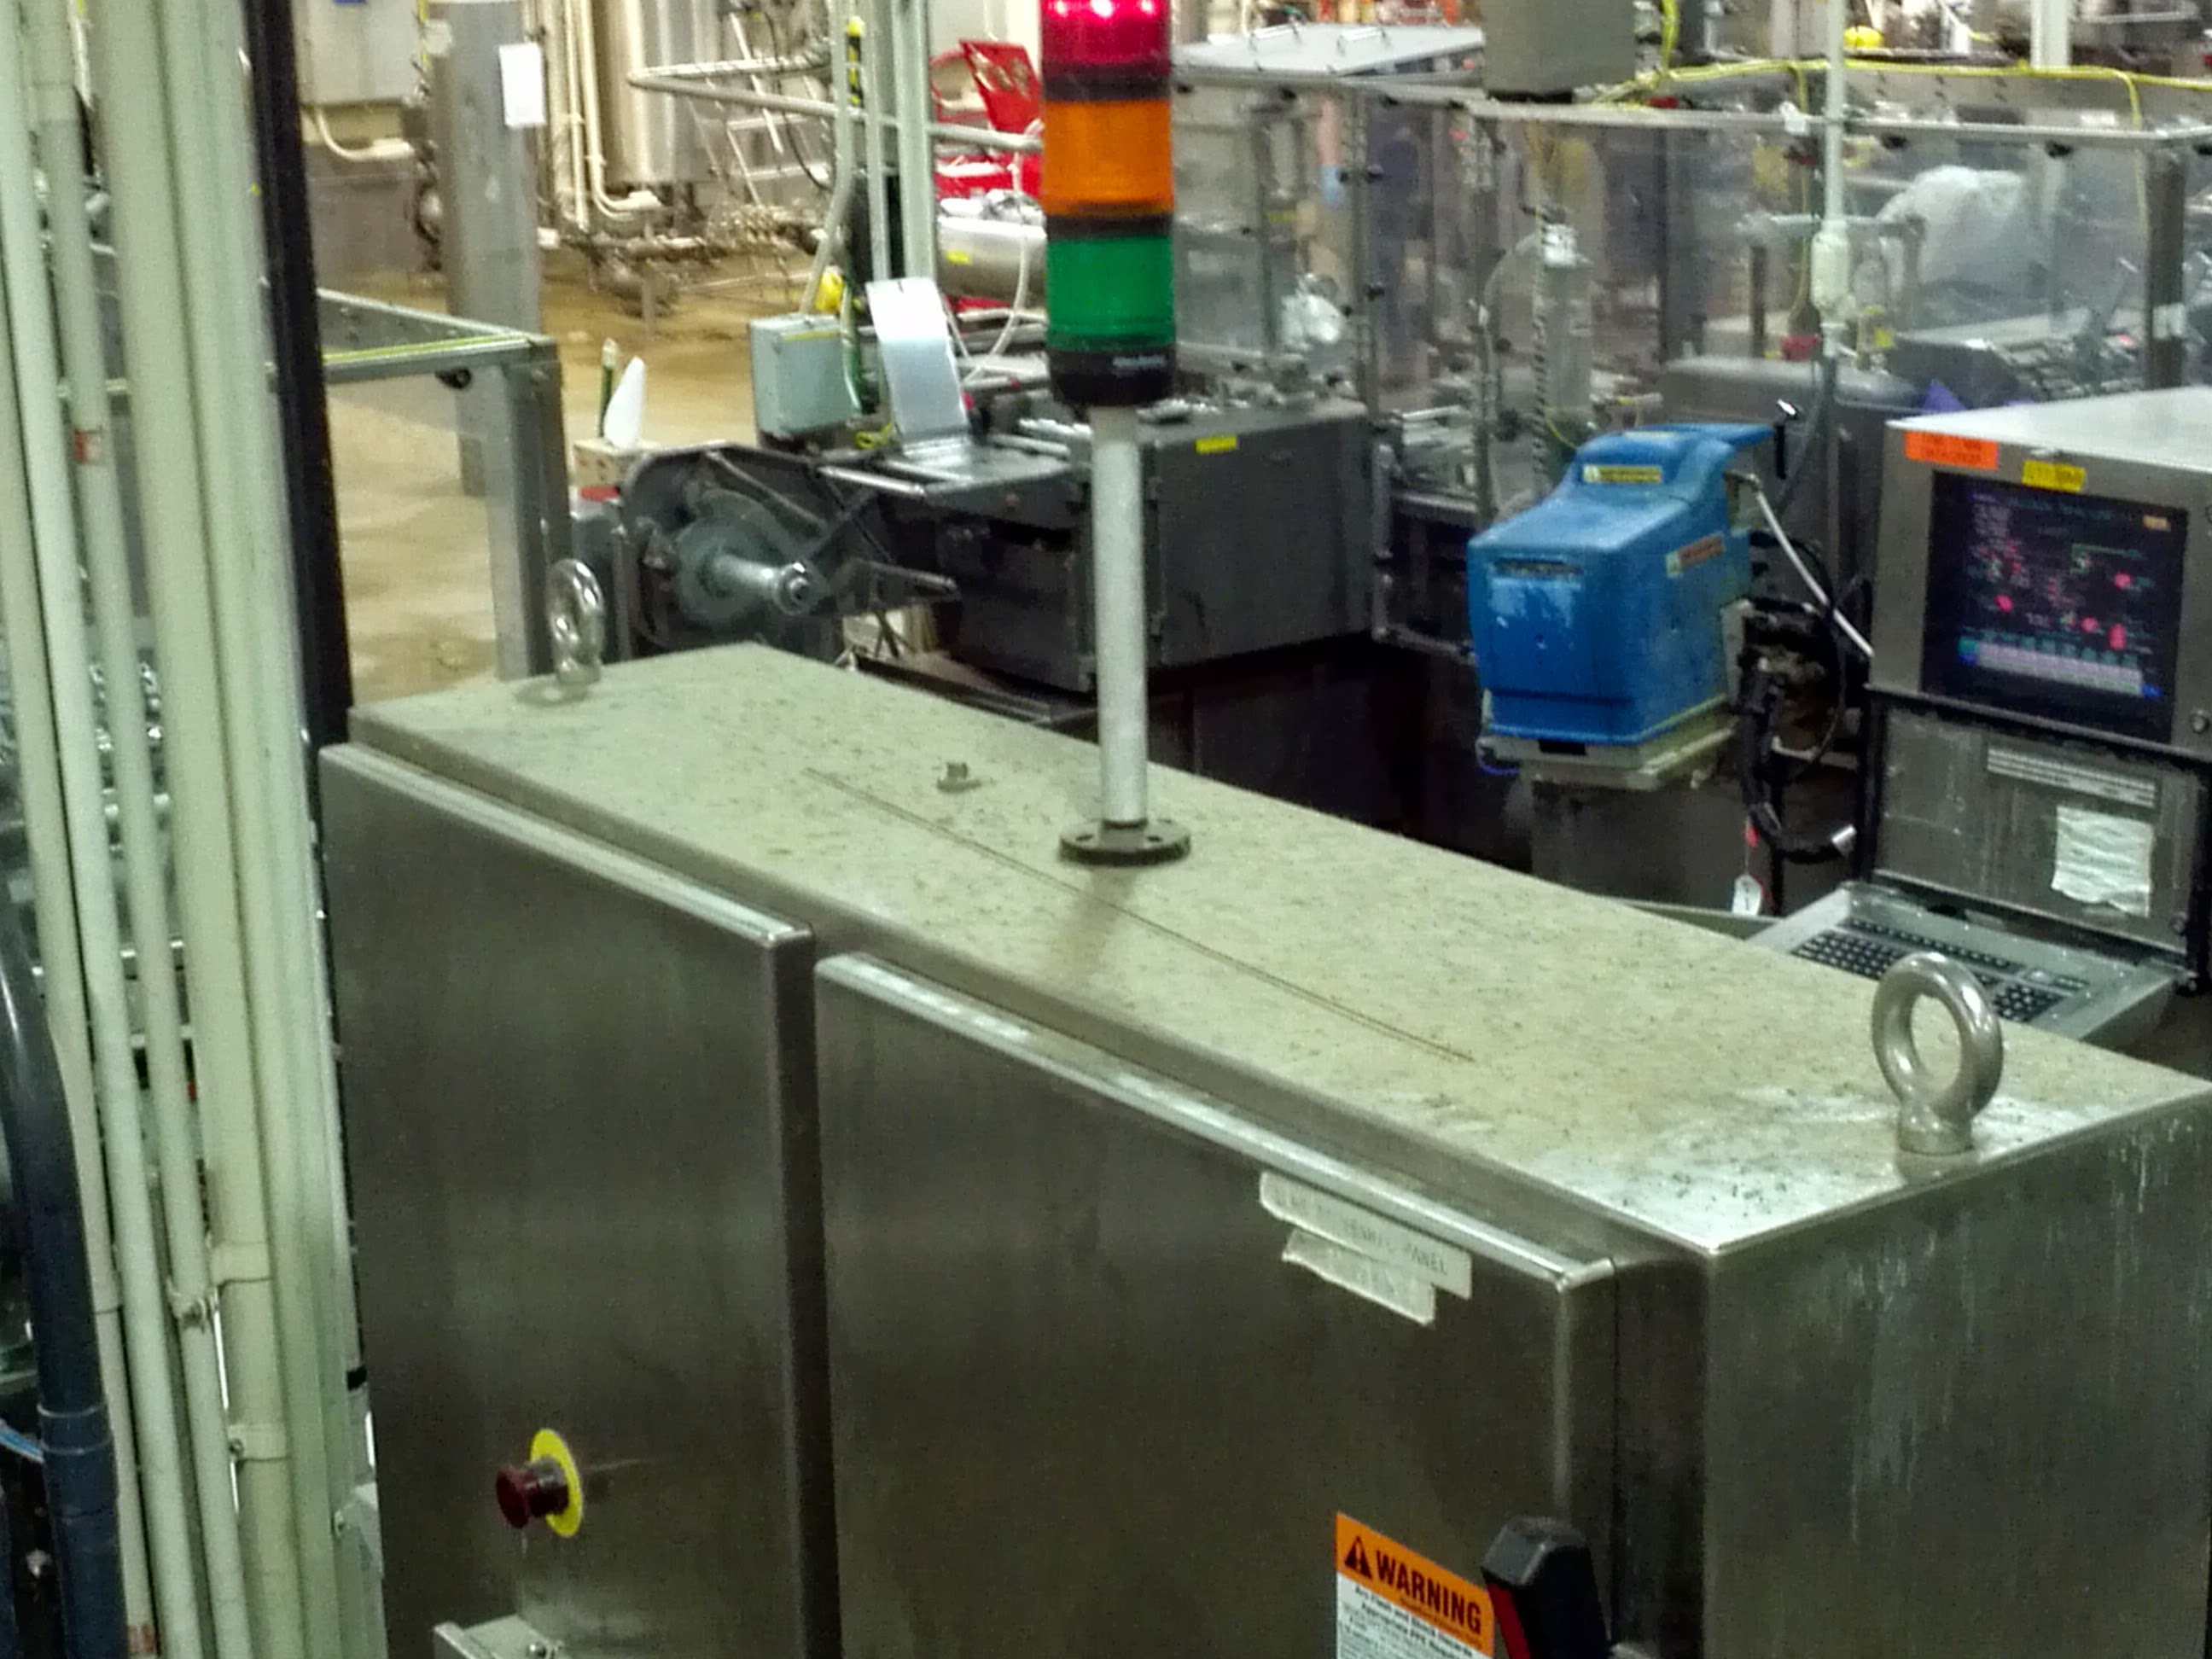

Slide 40
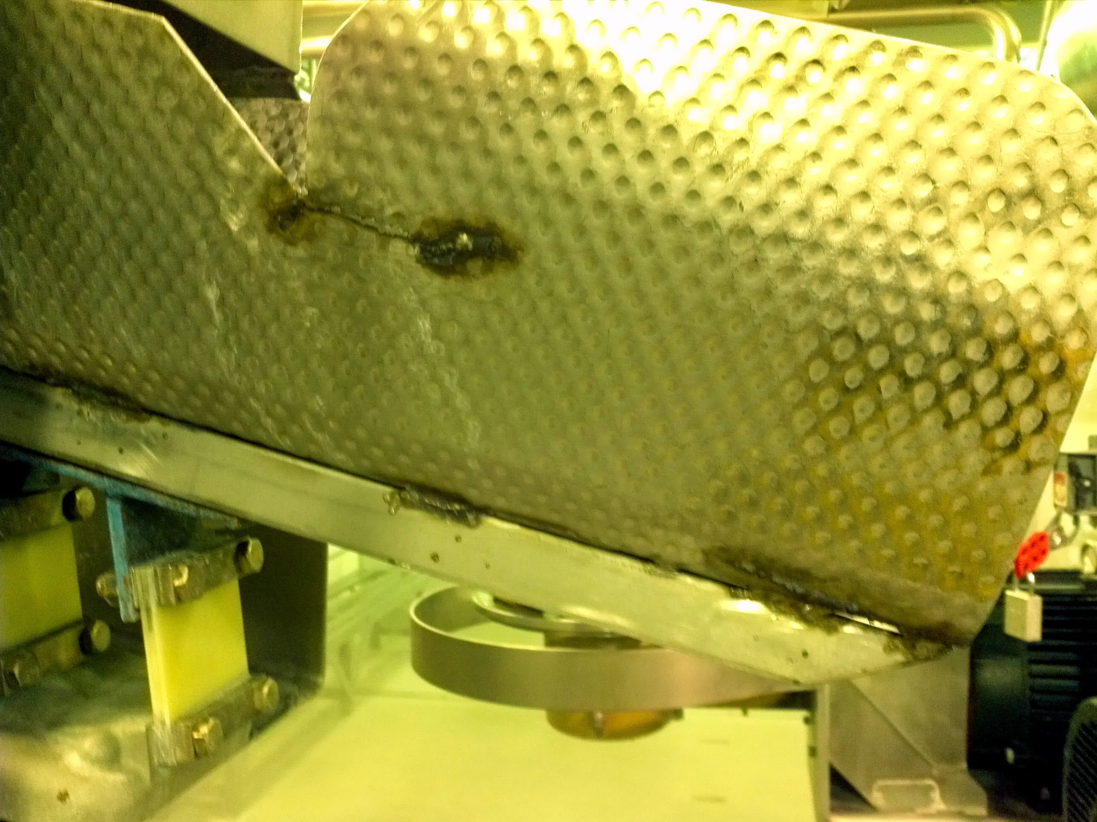

Slide 41
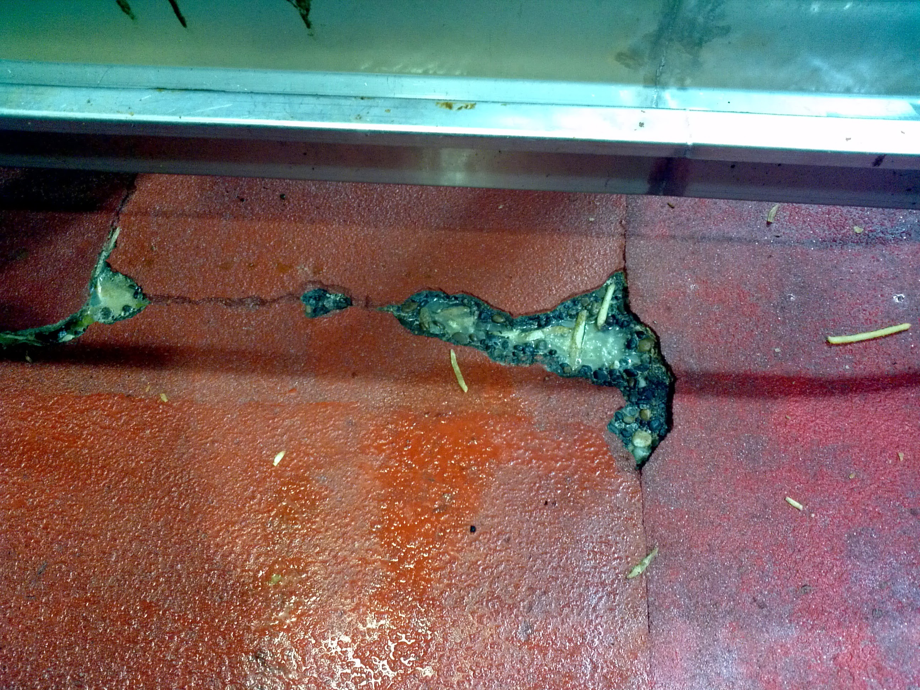

Slide 42
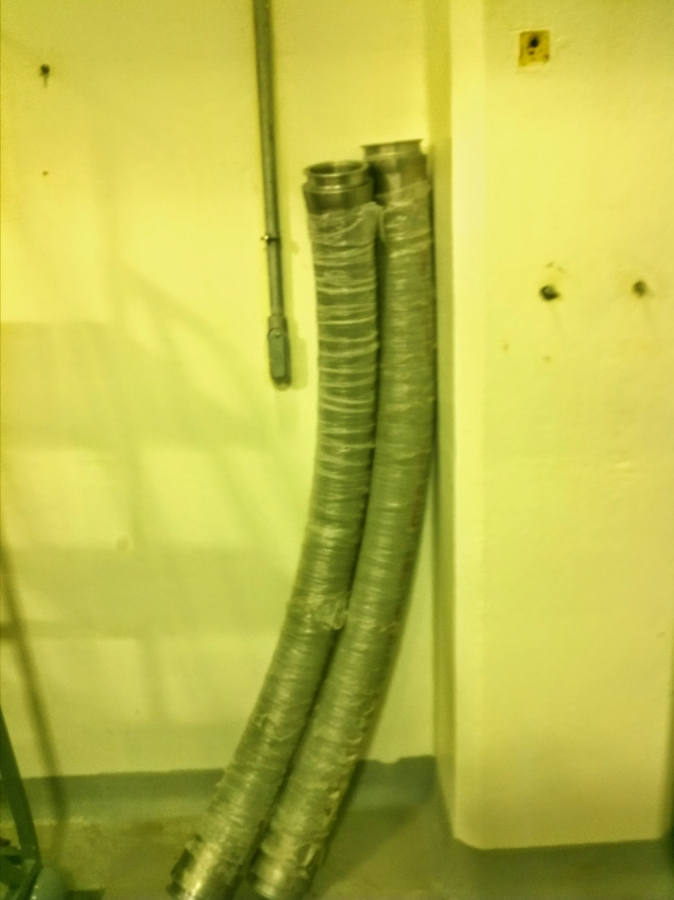

Slide 43
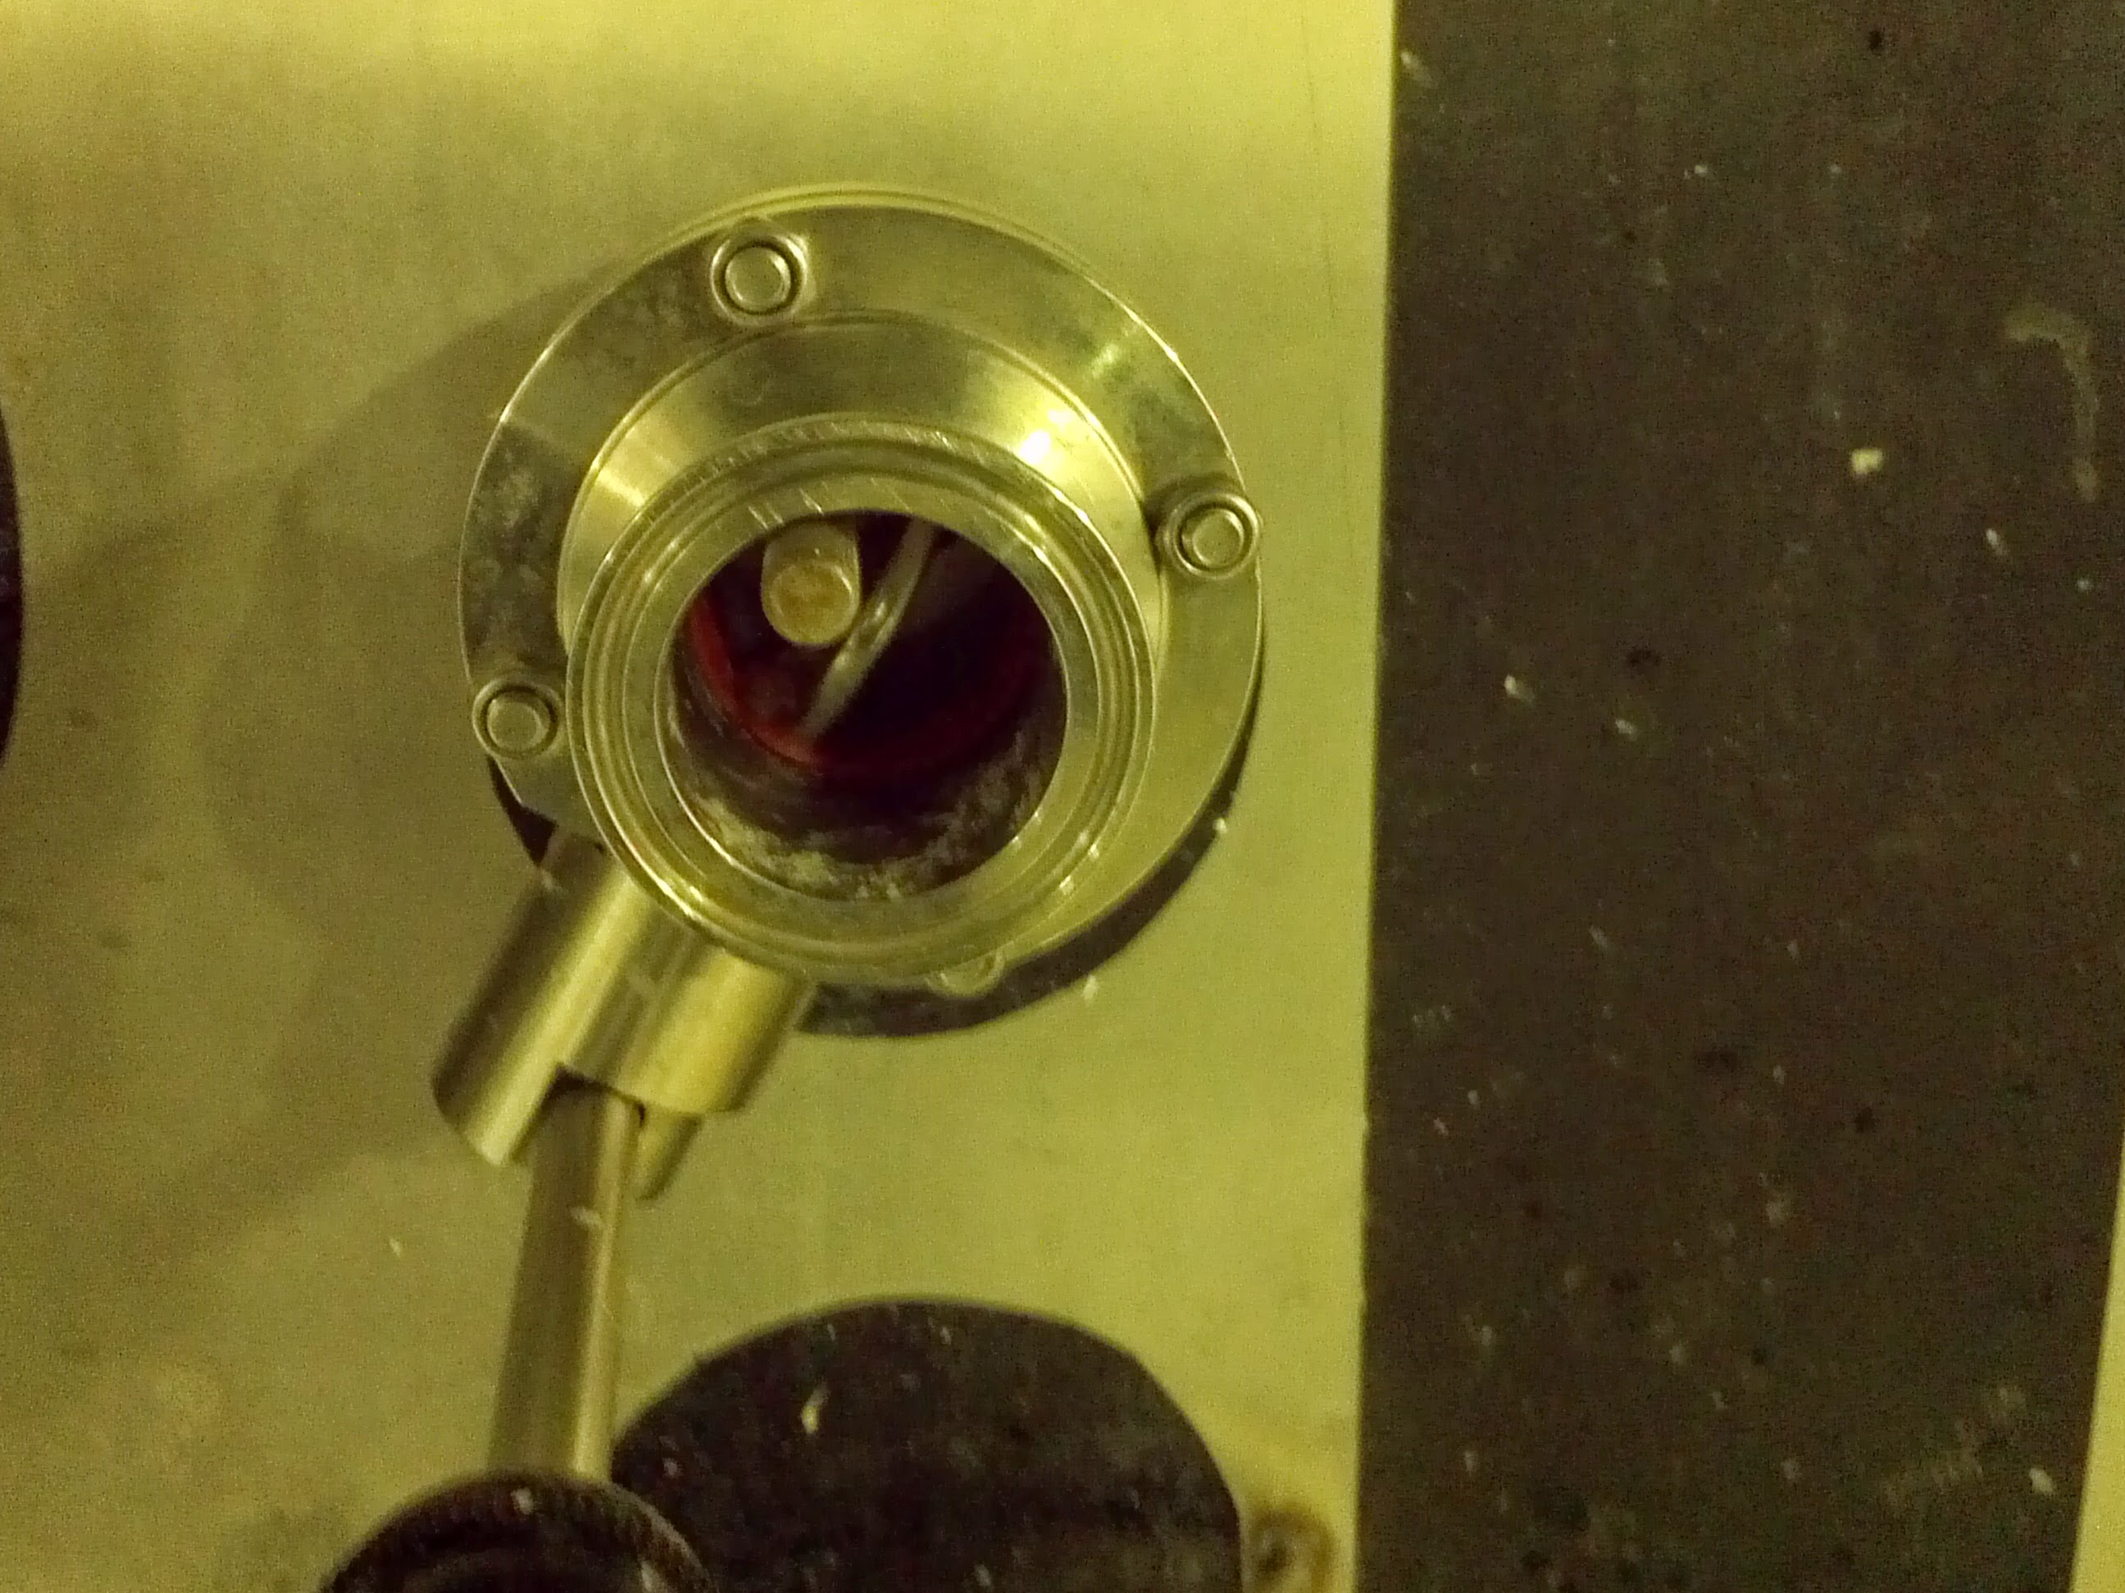

Slide 44
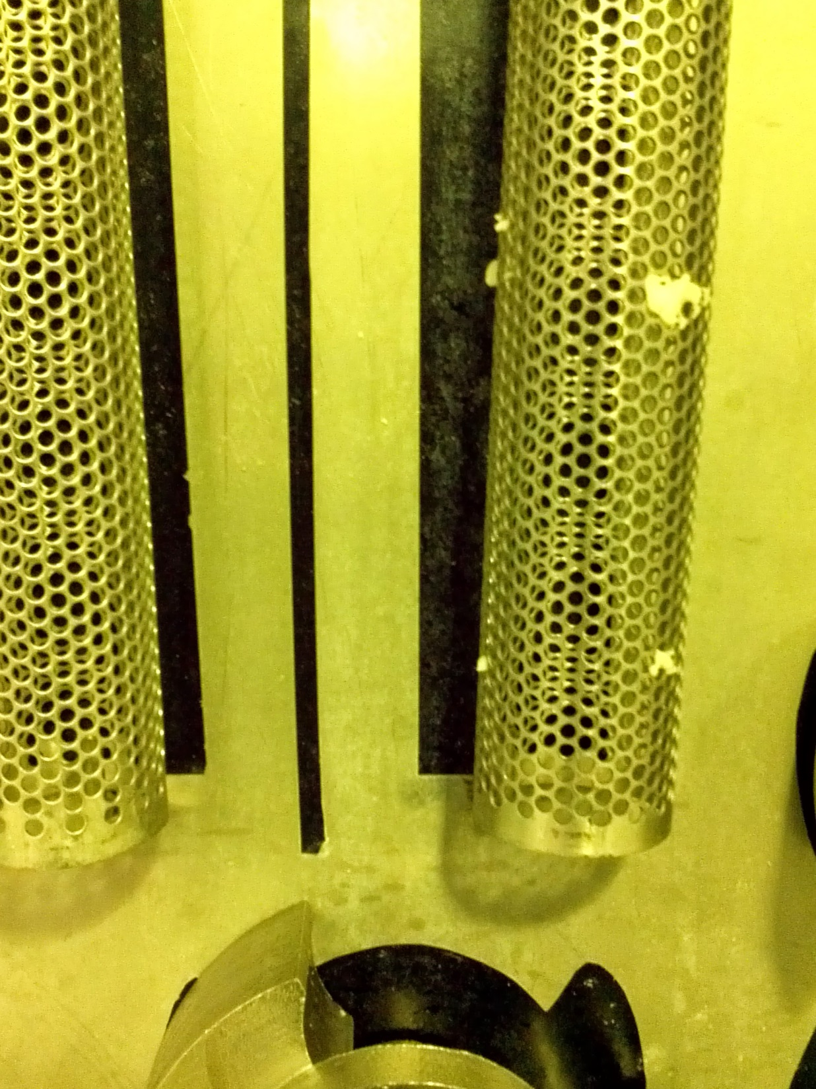

Slide 45
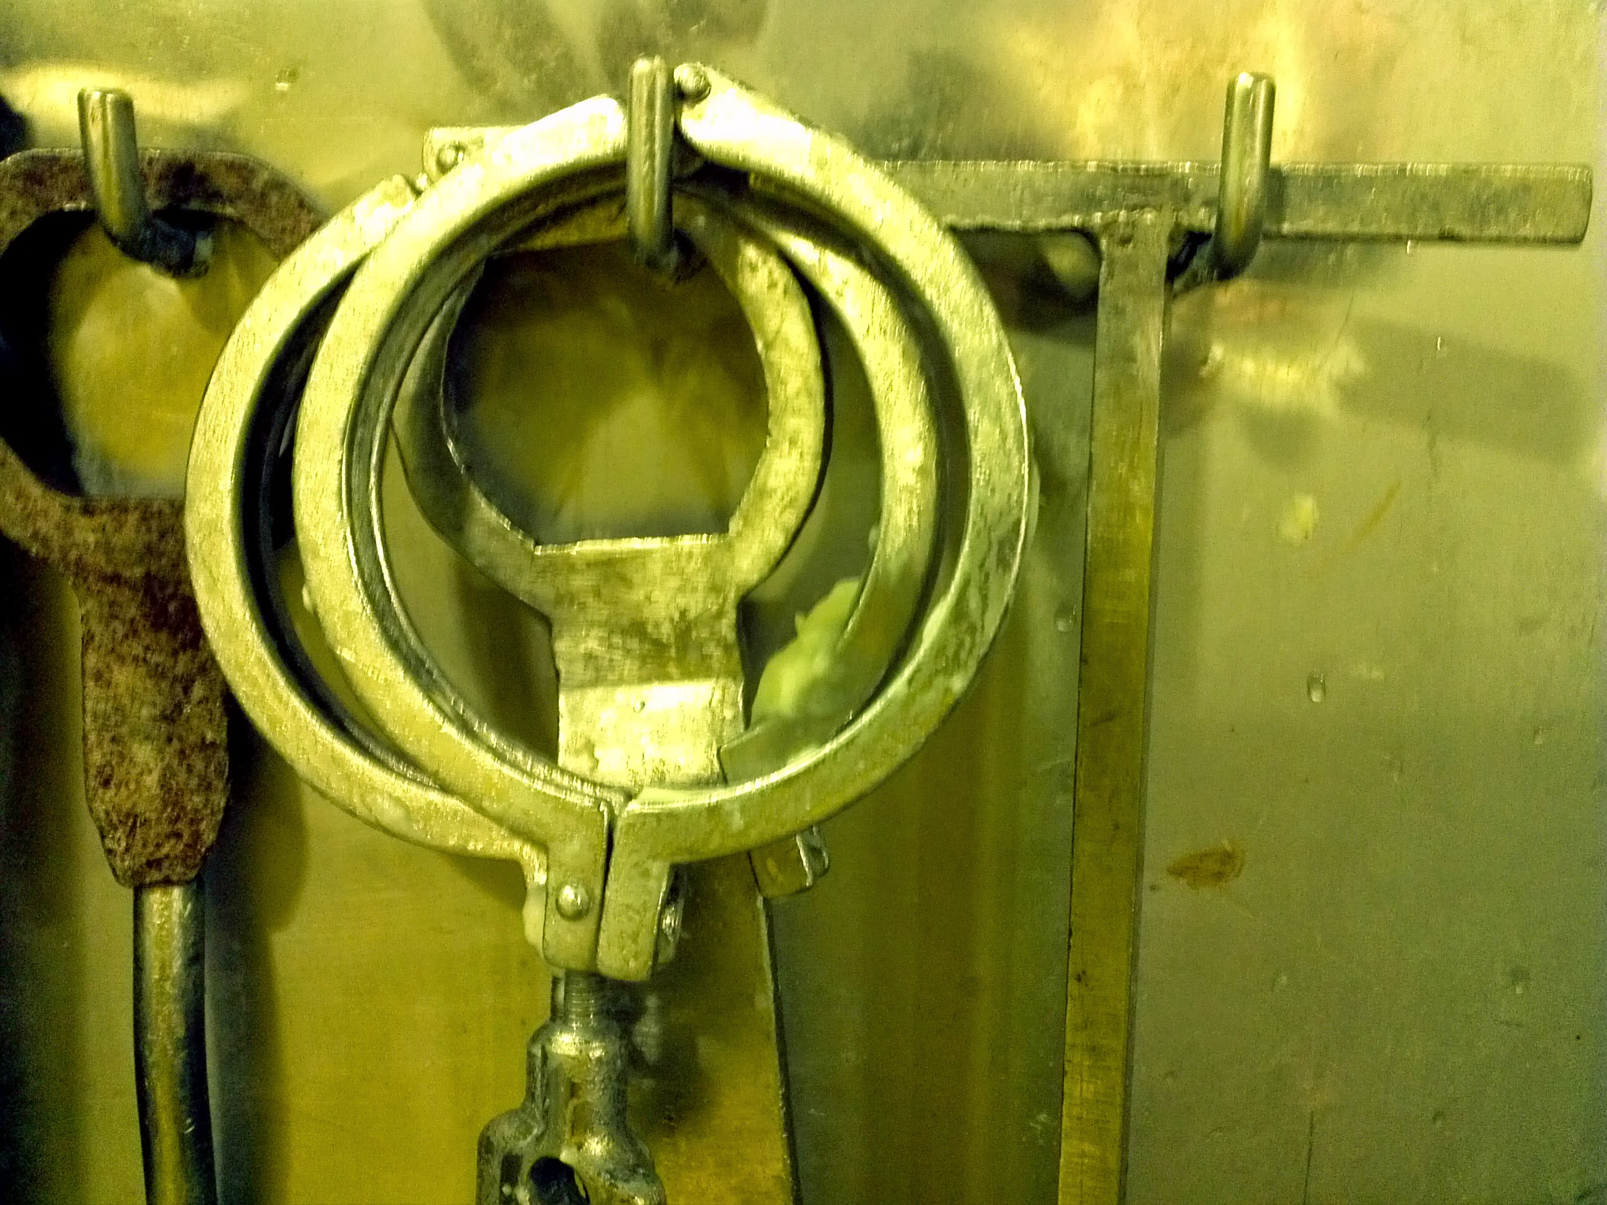

Slide 46
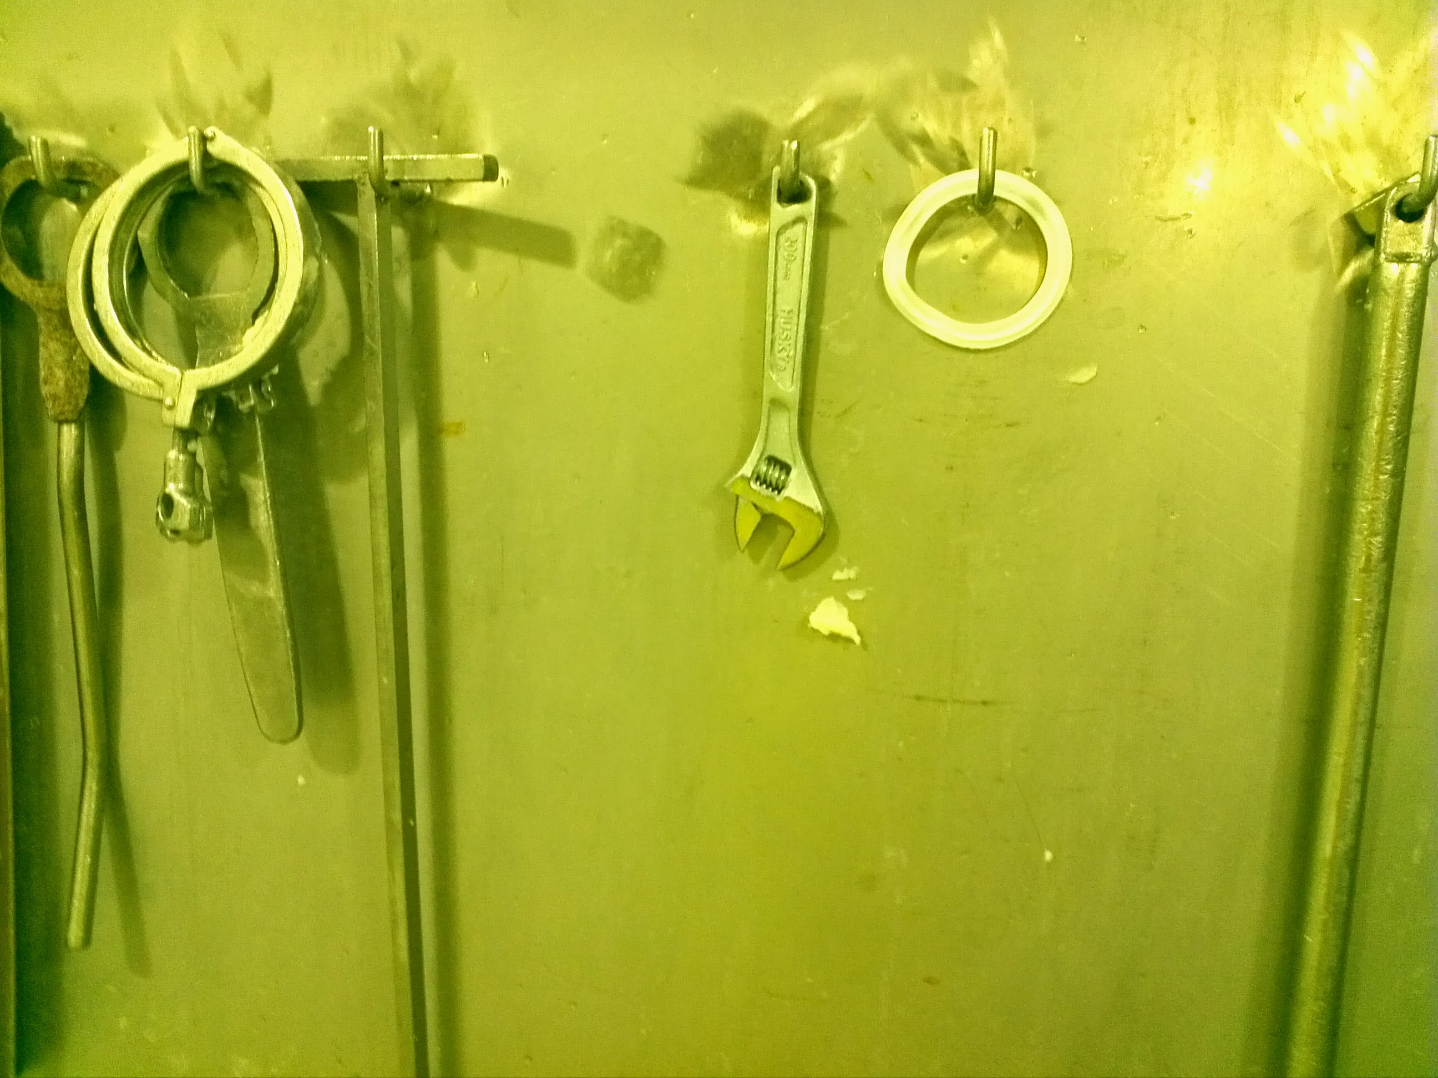

Slide 47
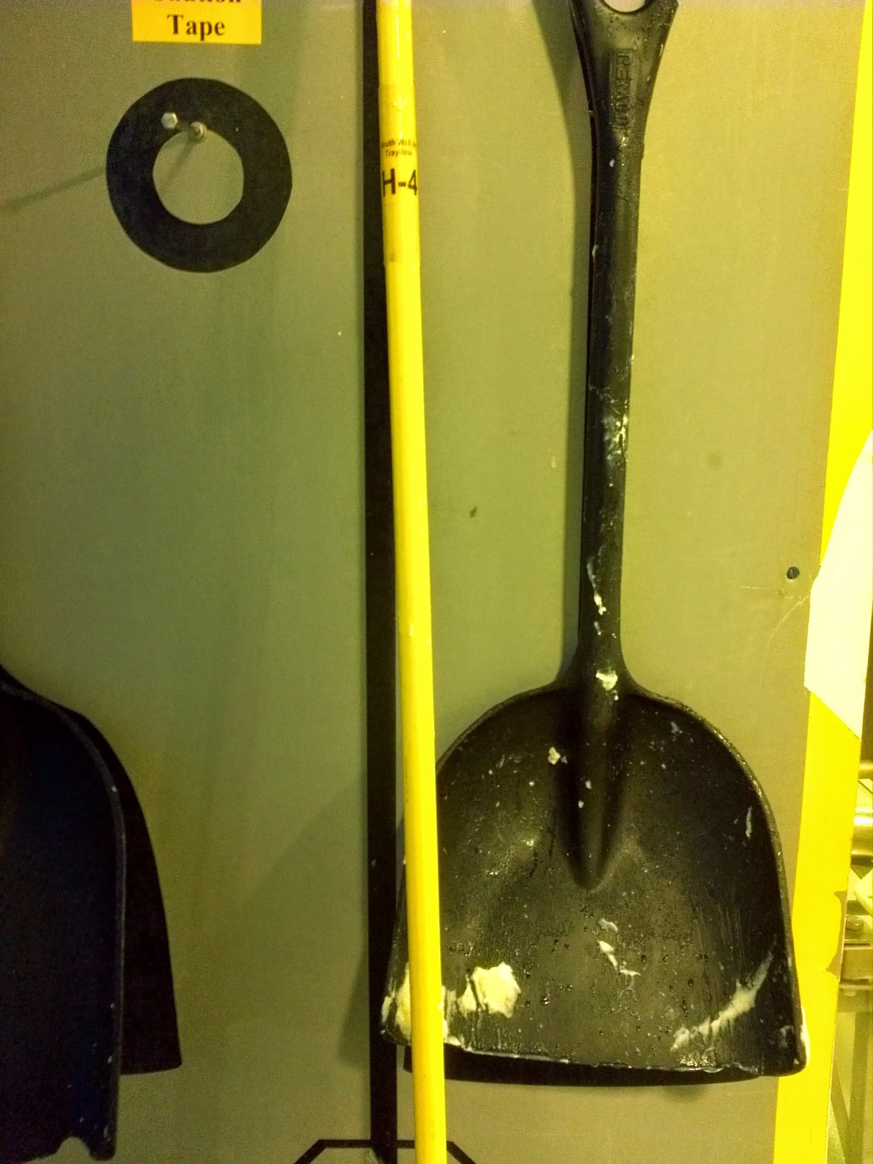

Slide 48
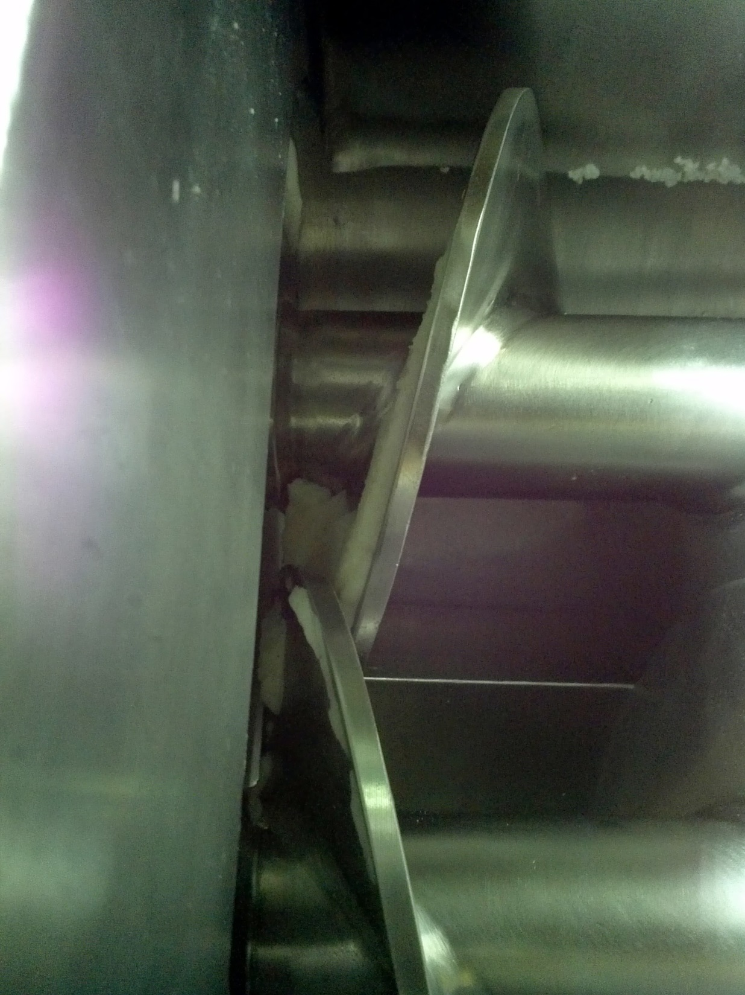

Slide 49
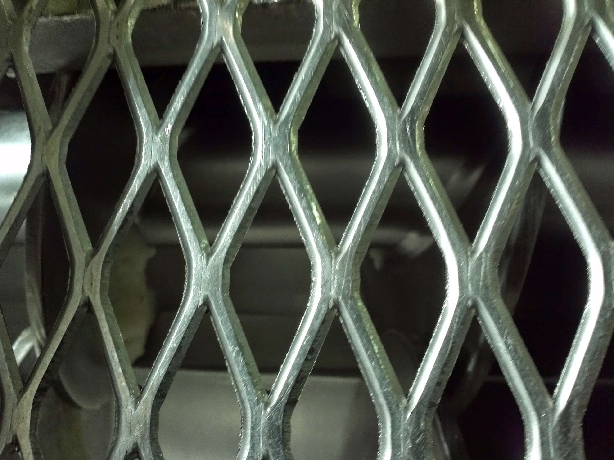

Slide 50
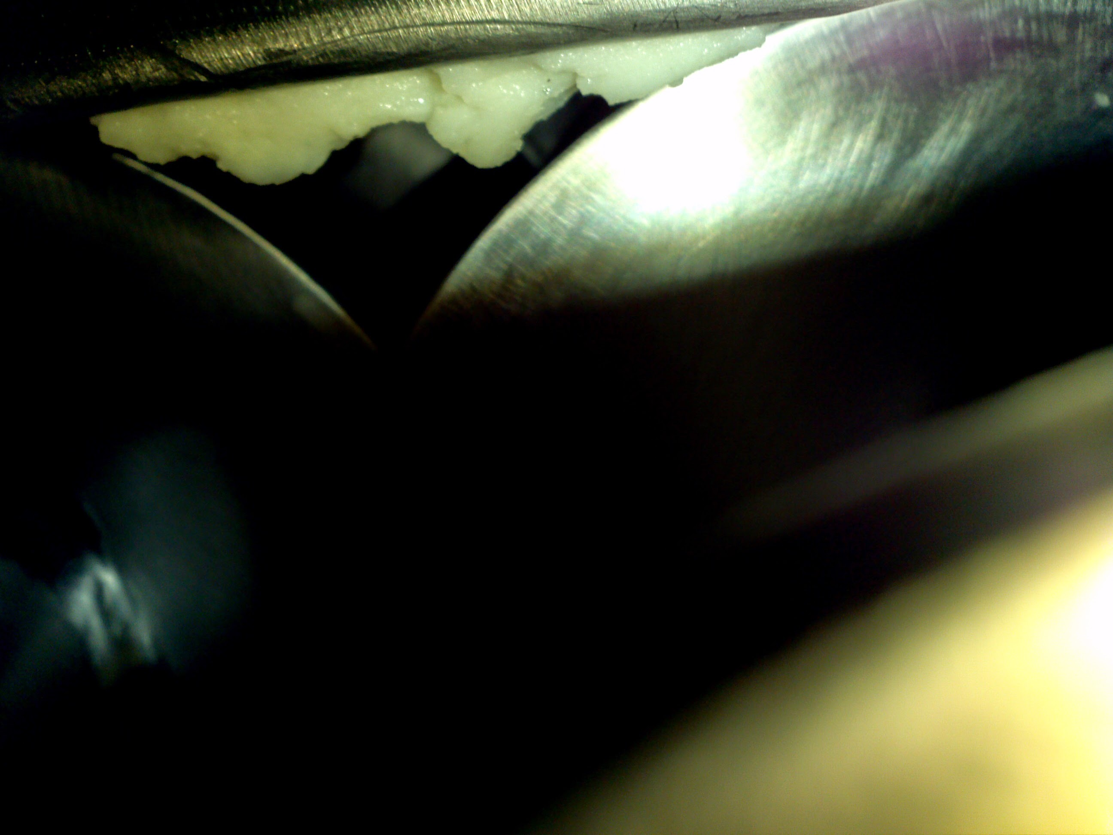

Slide 51
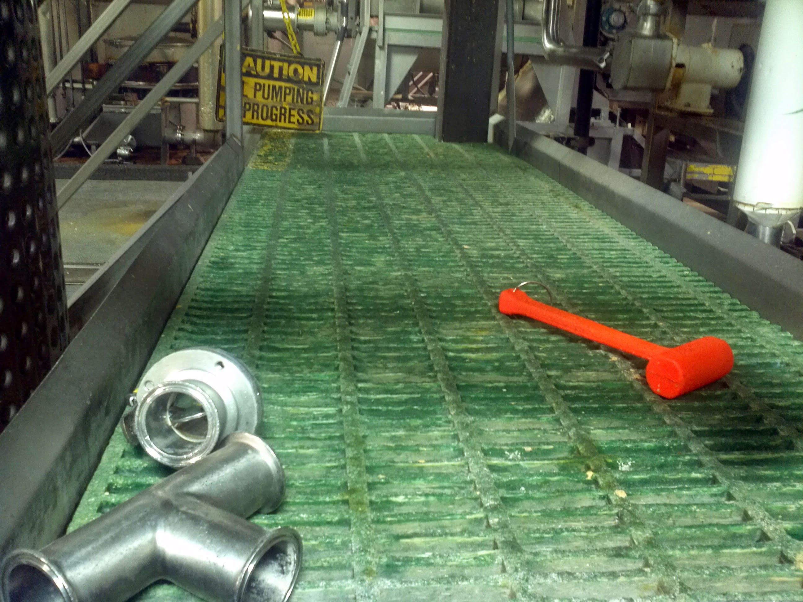

Slide 52
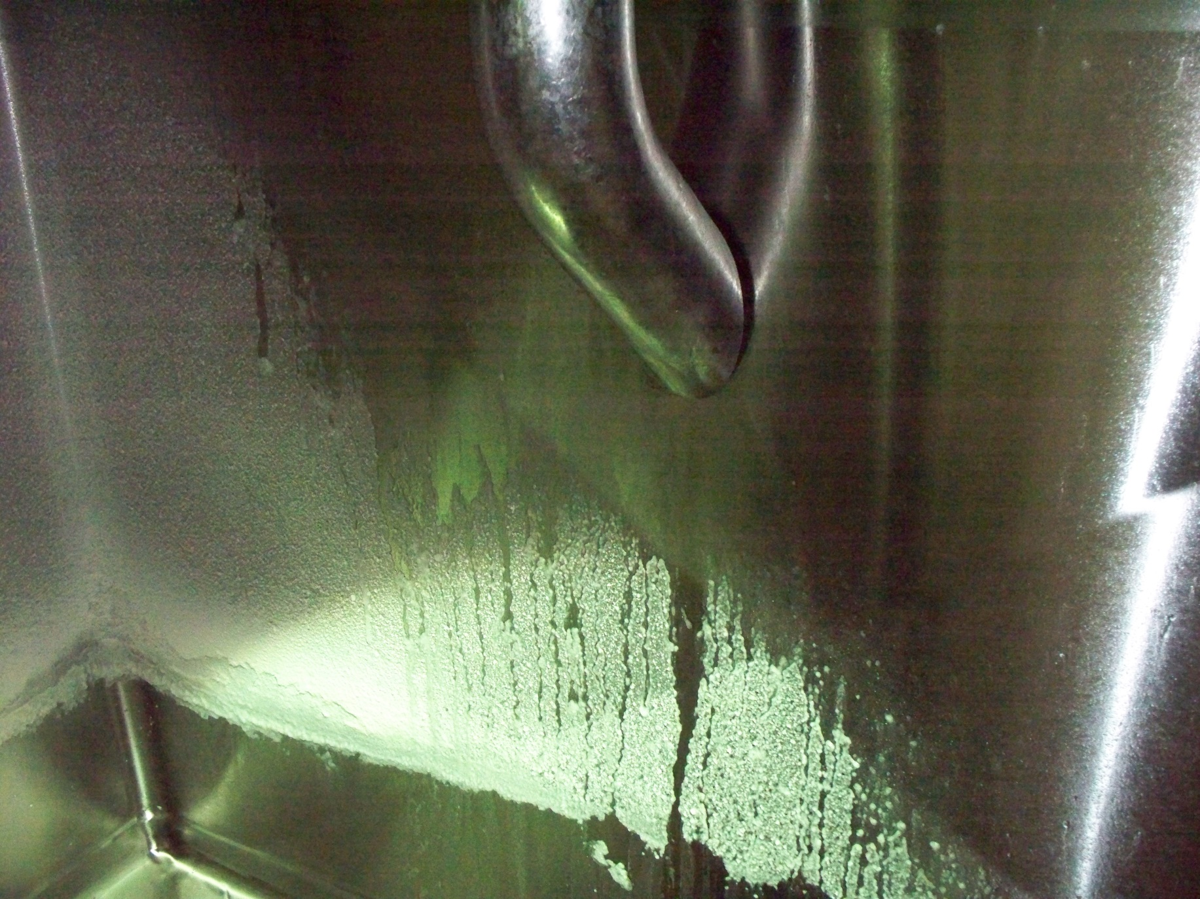

Slide 53
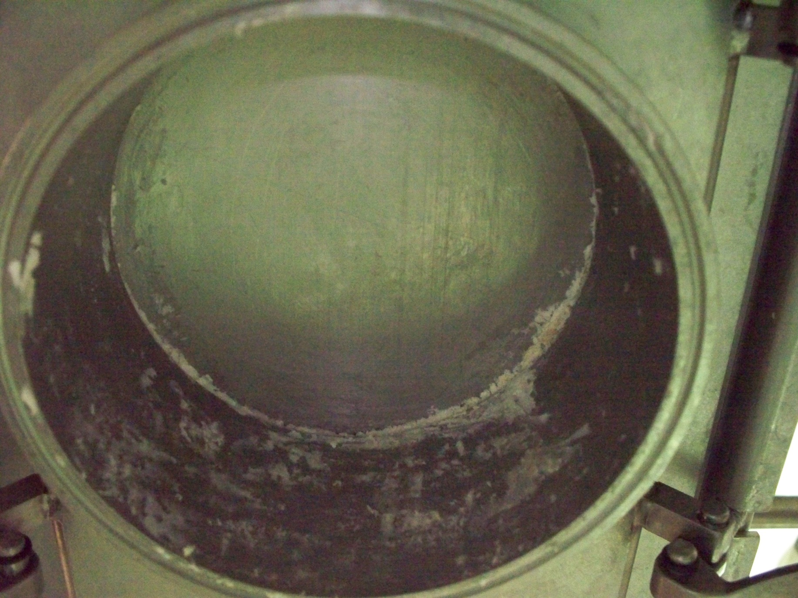

Slide 54
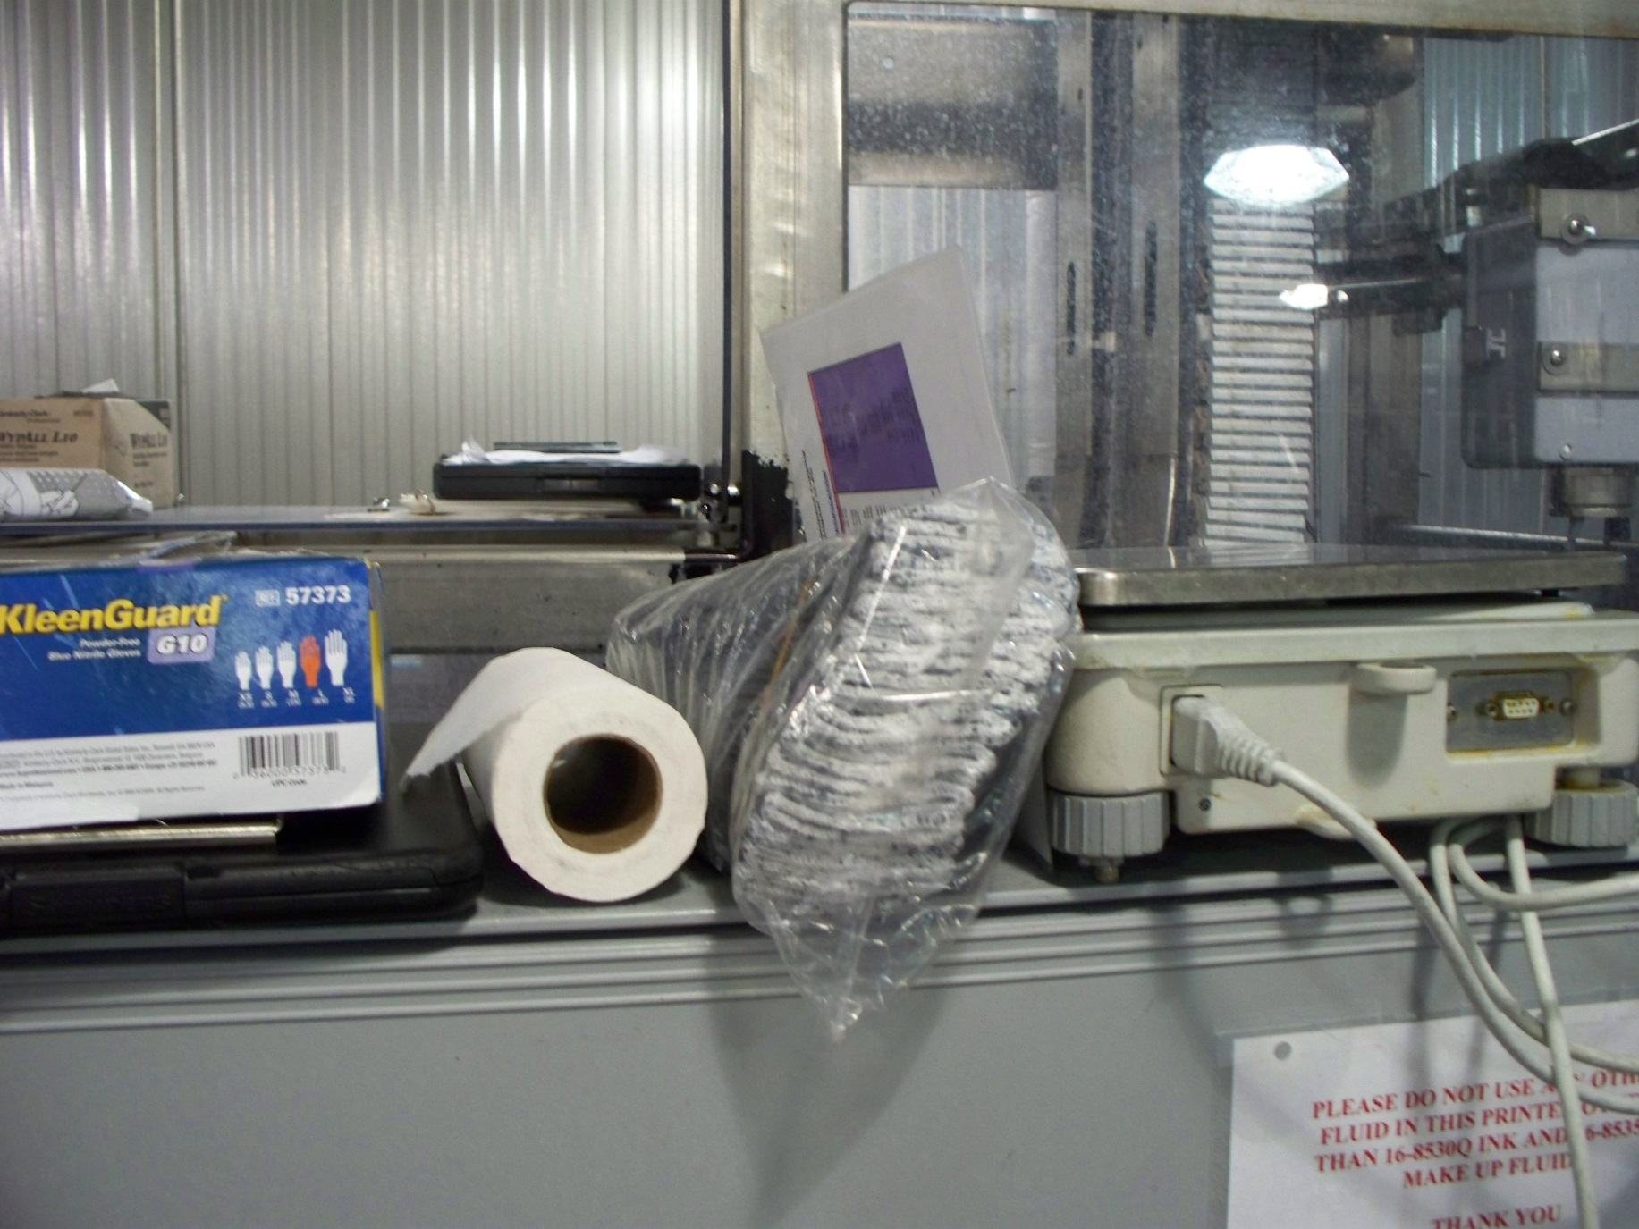

Slide 55
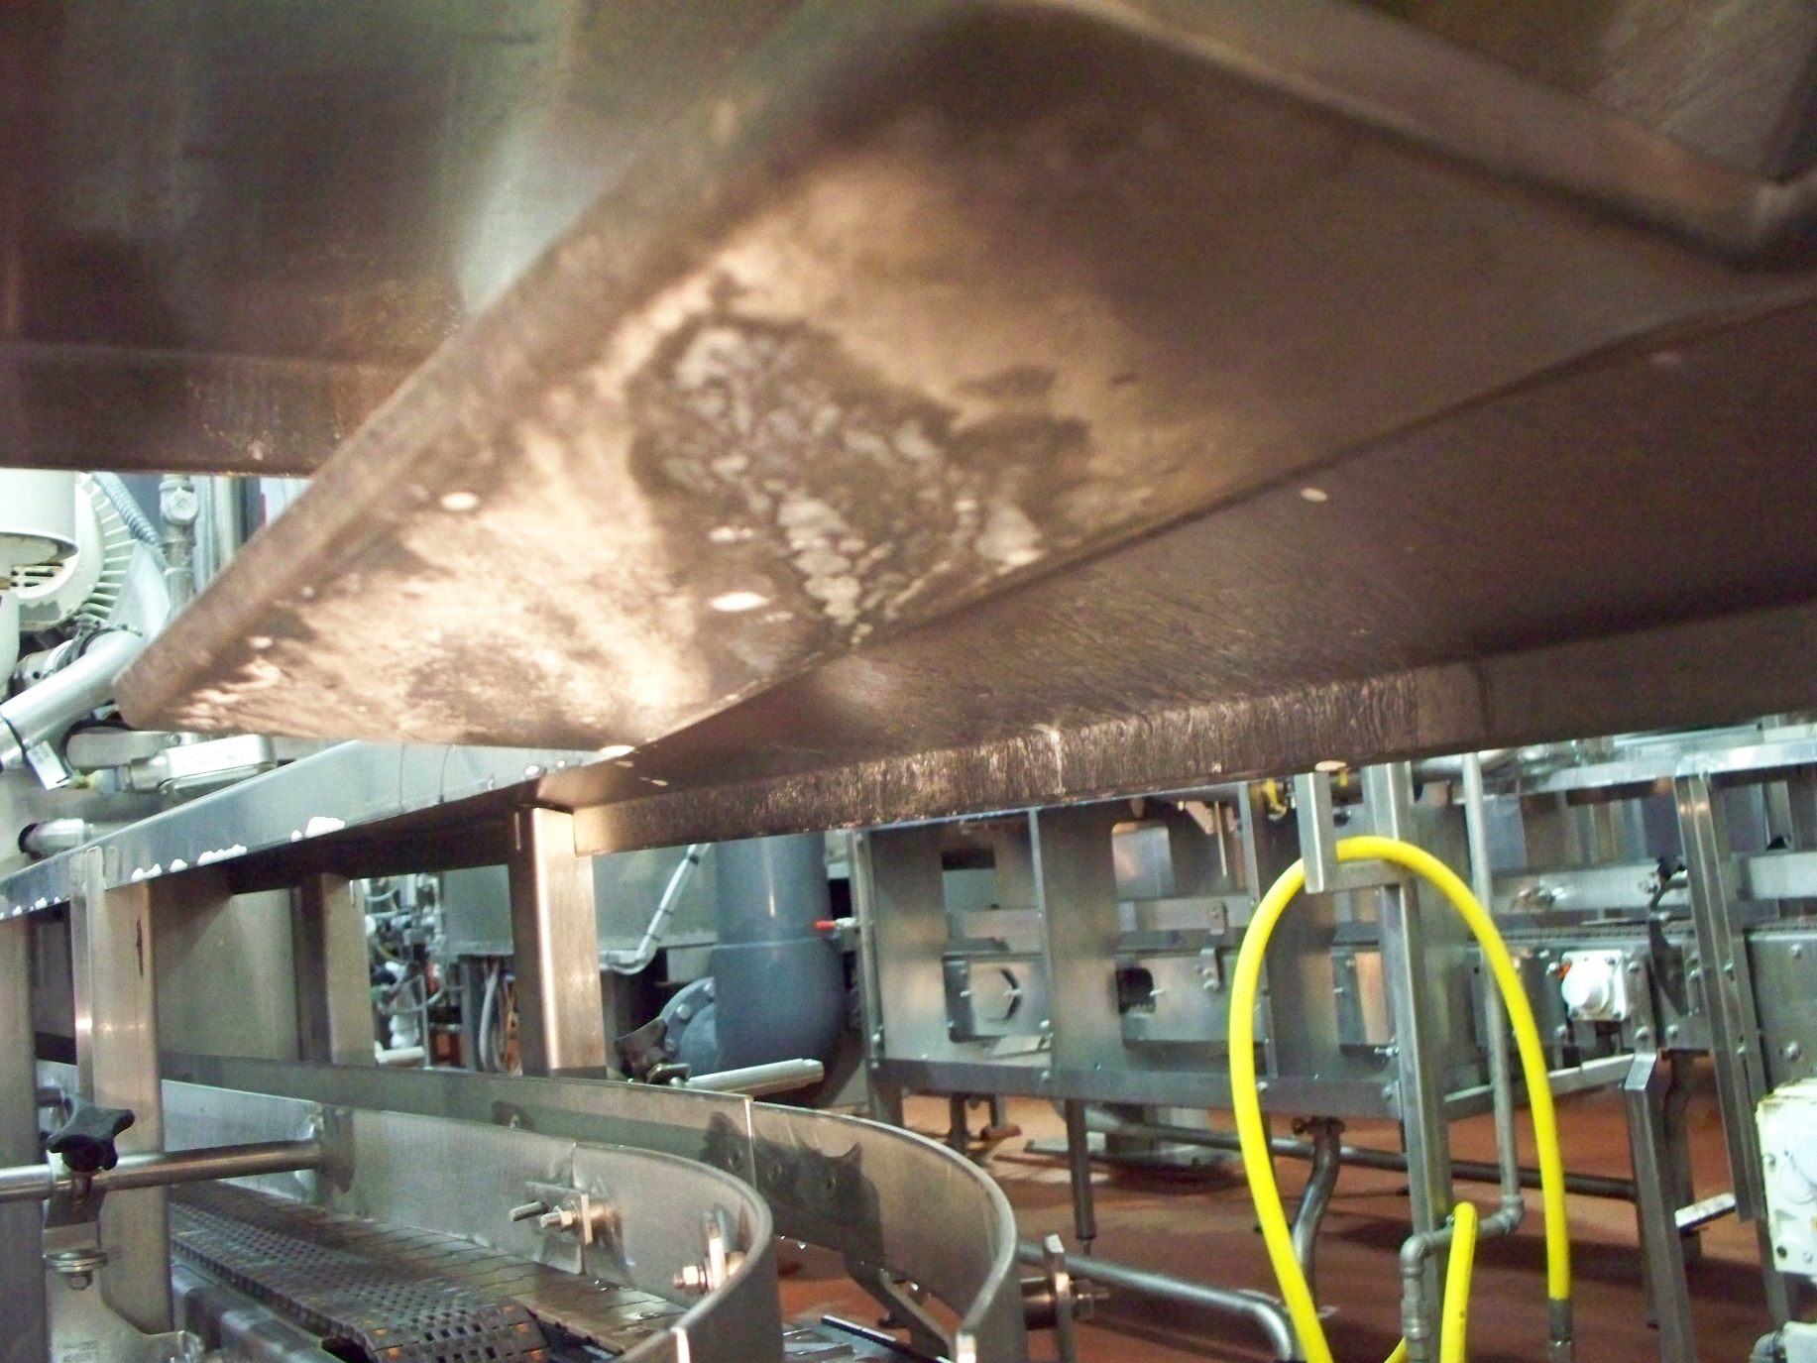

Slide 56
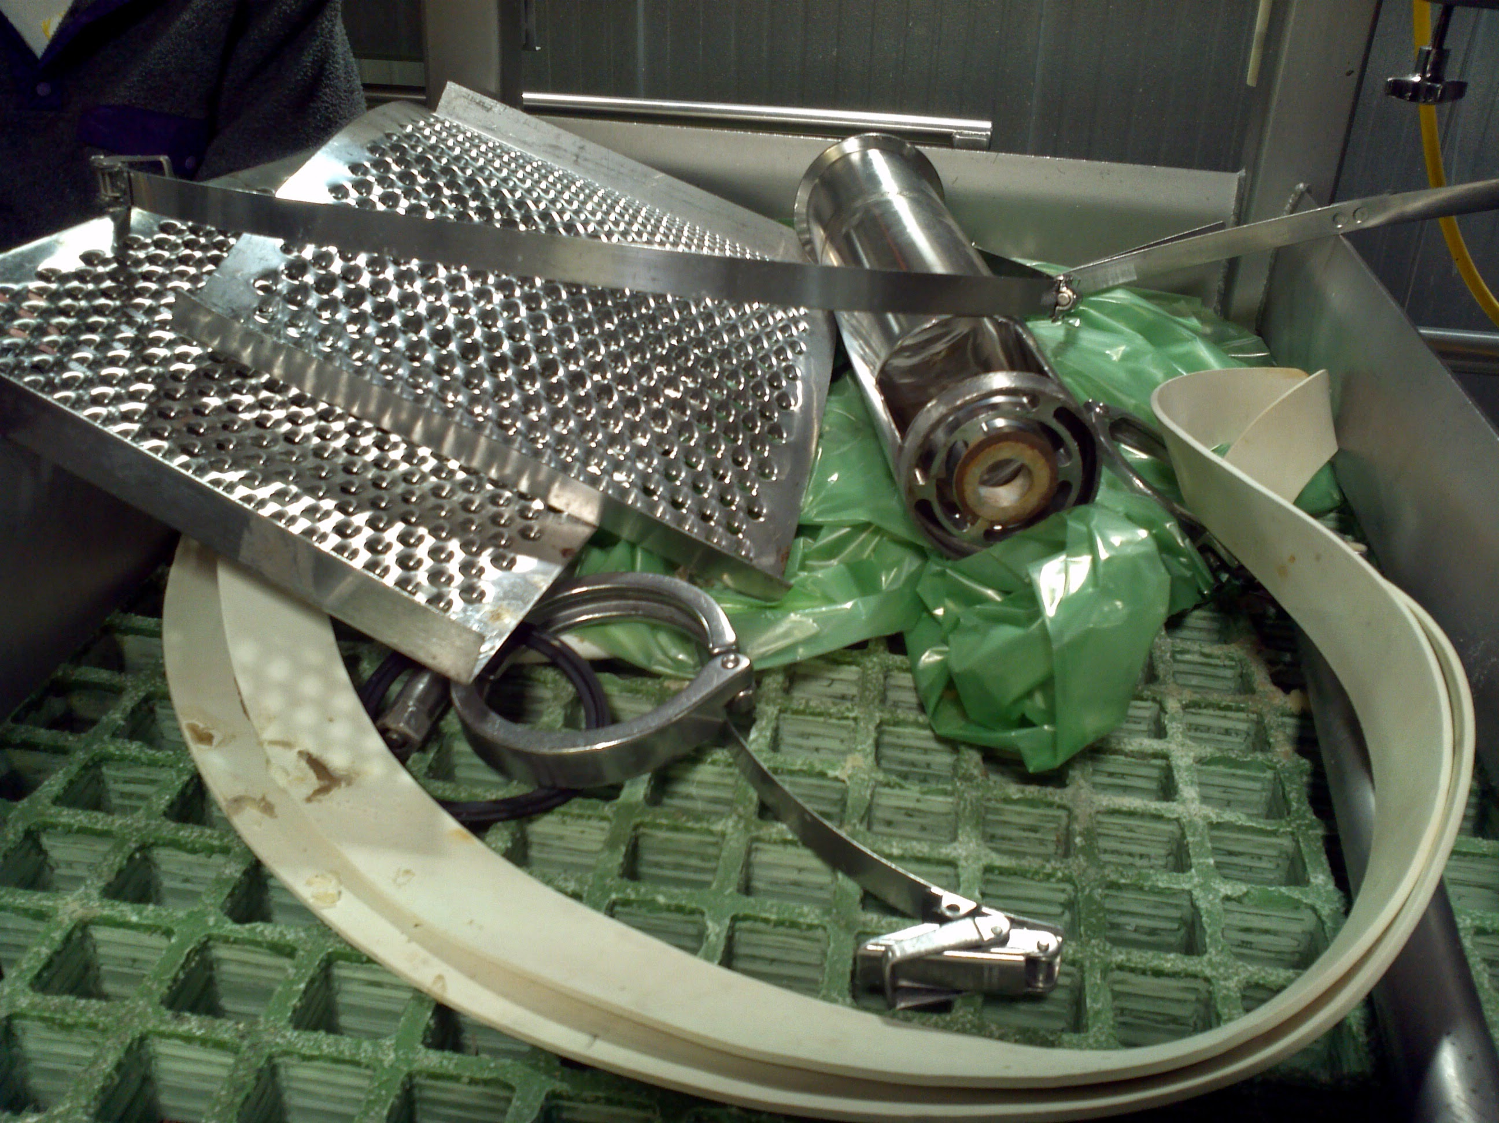

Slide 57
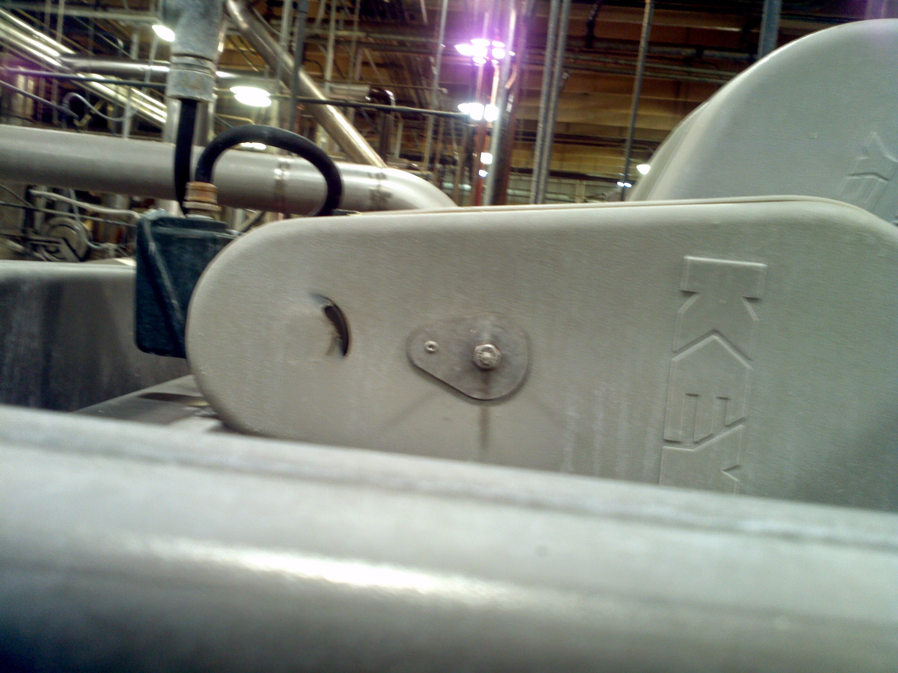

Slide 58
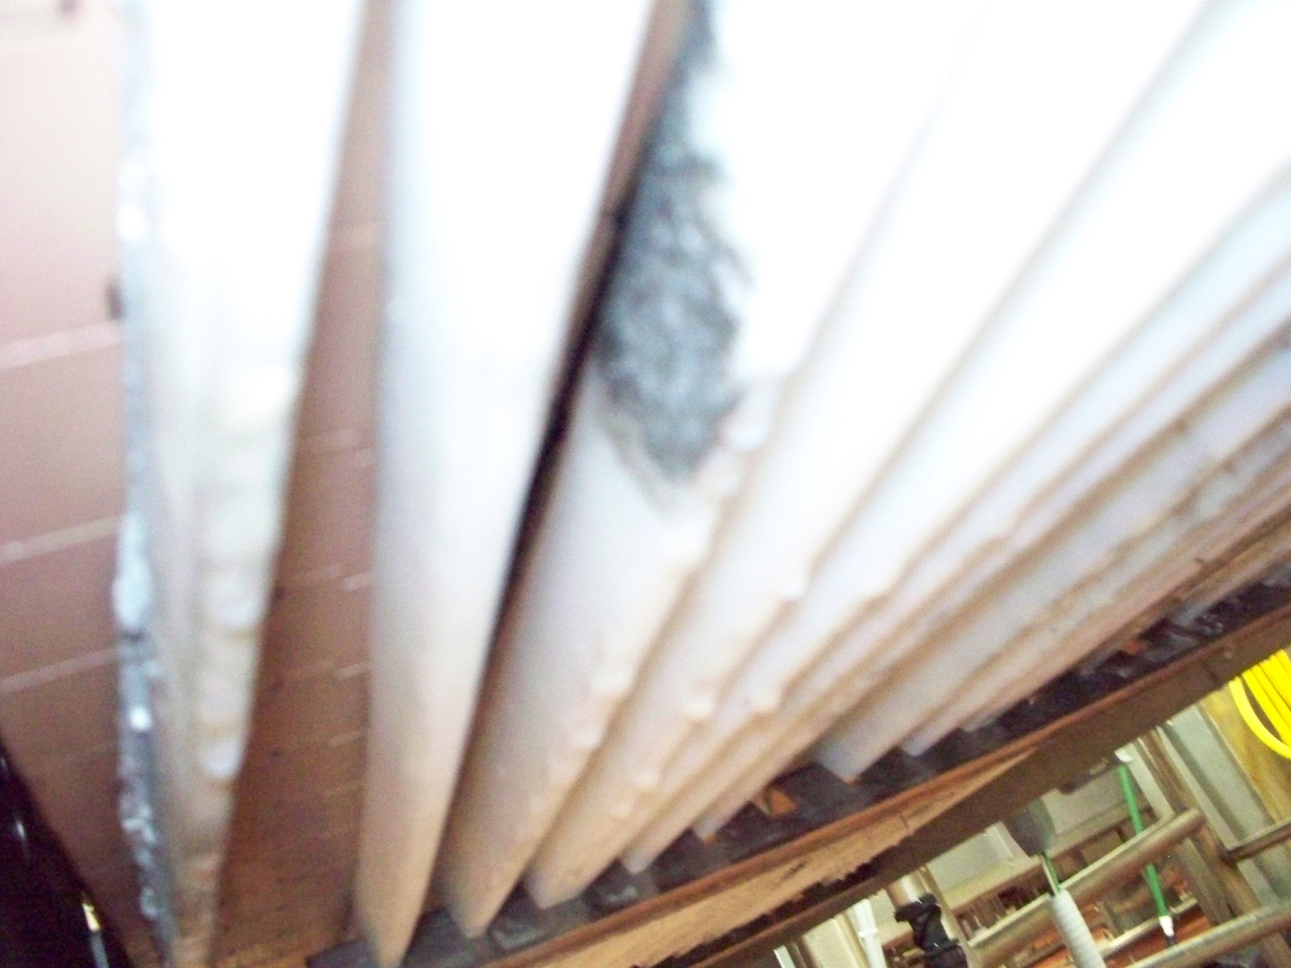

Slide 59
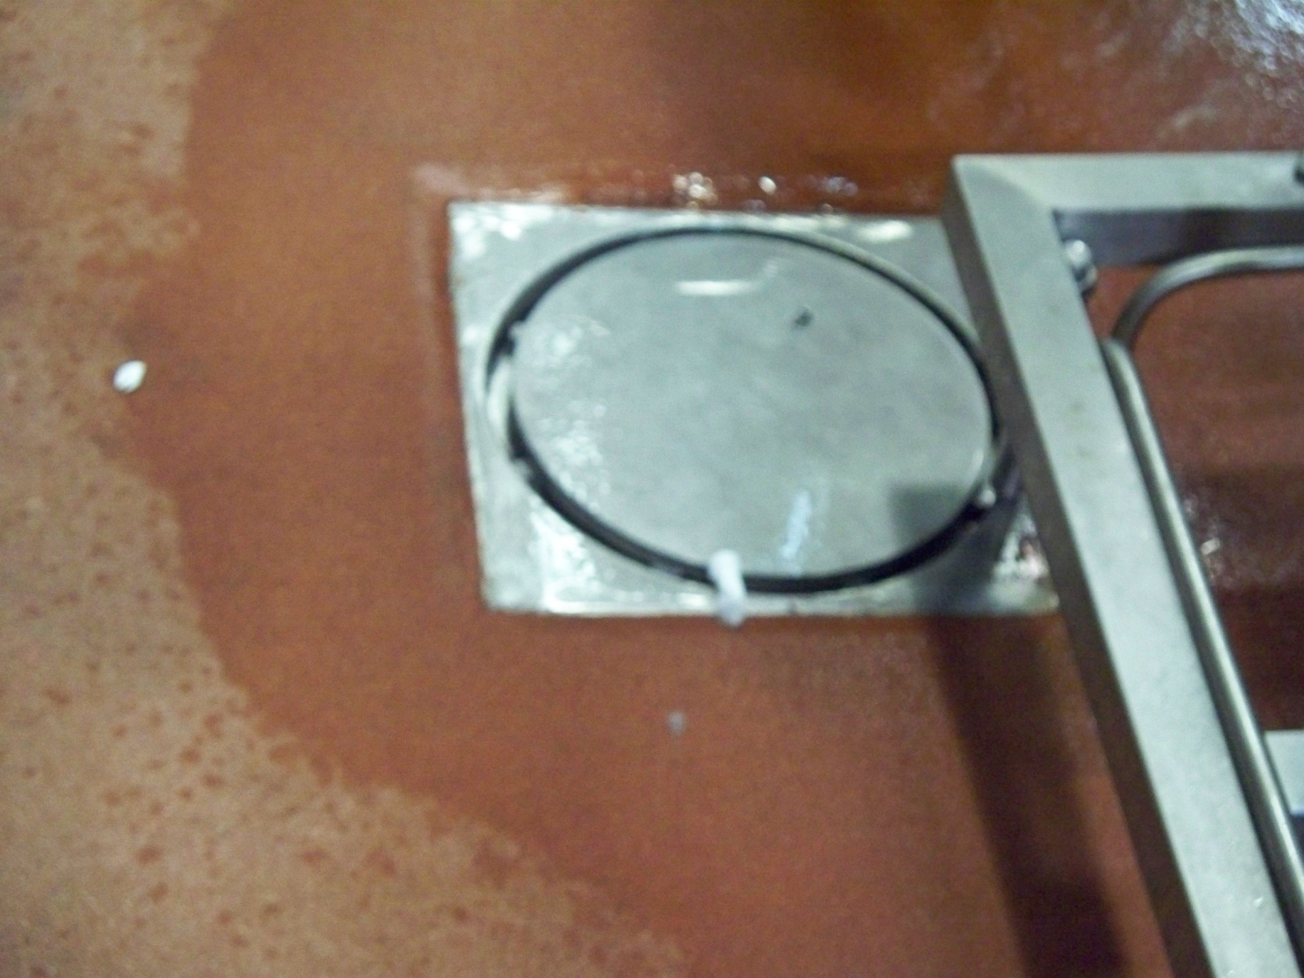

Slide 60
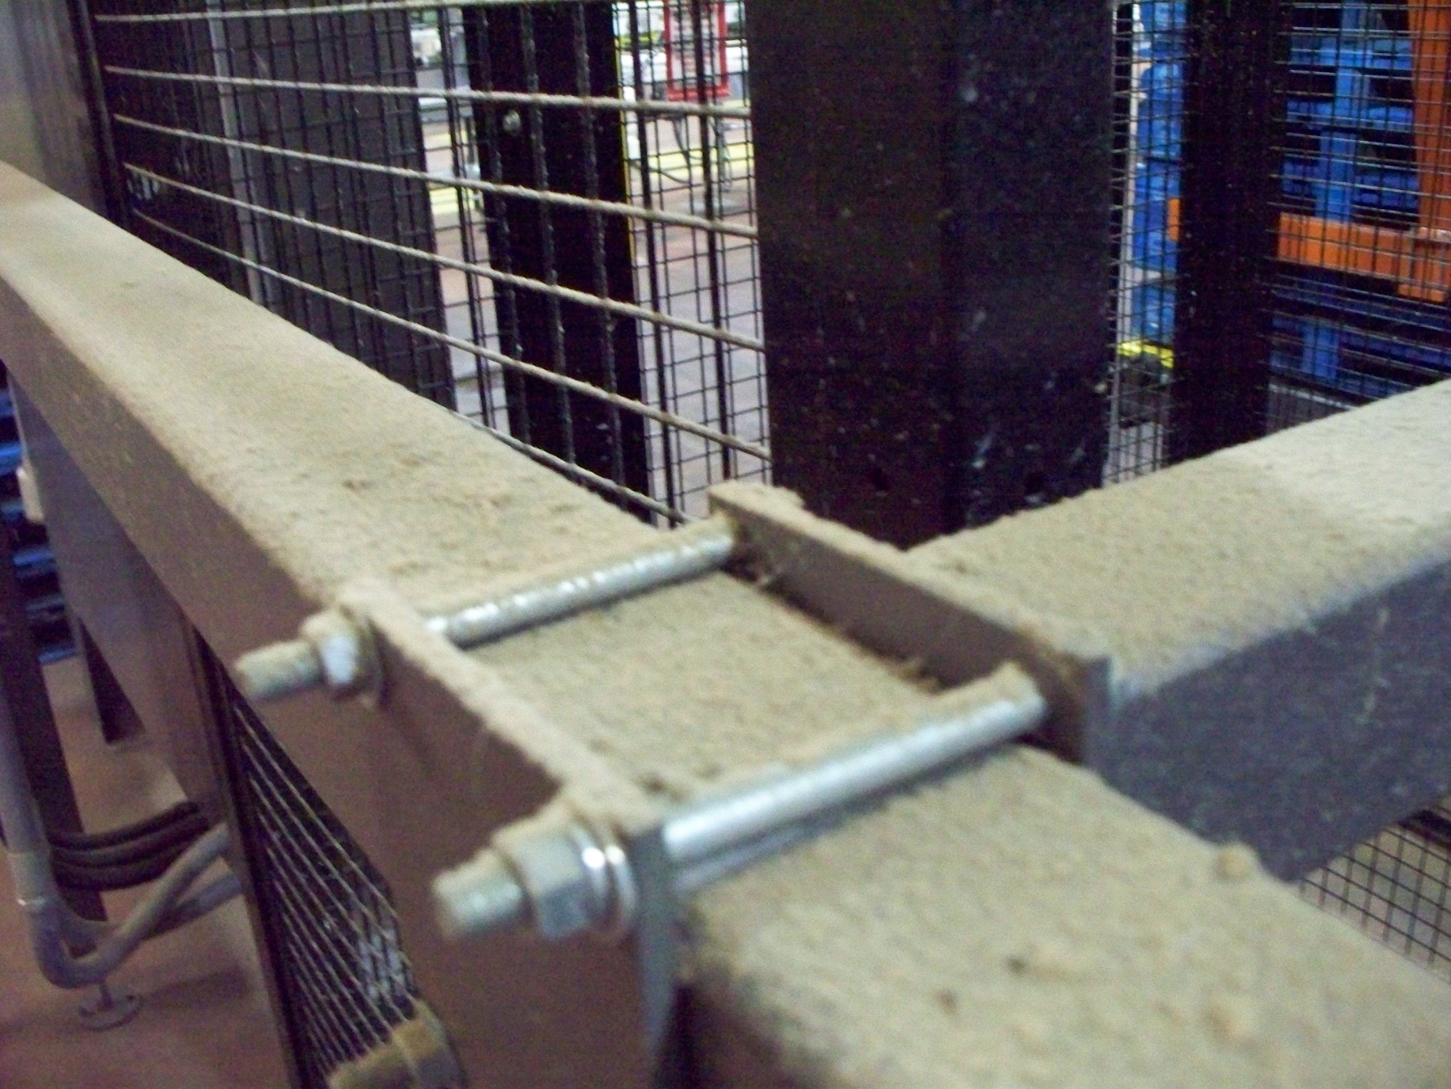

Slide 61
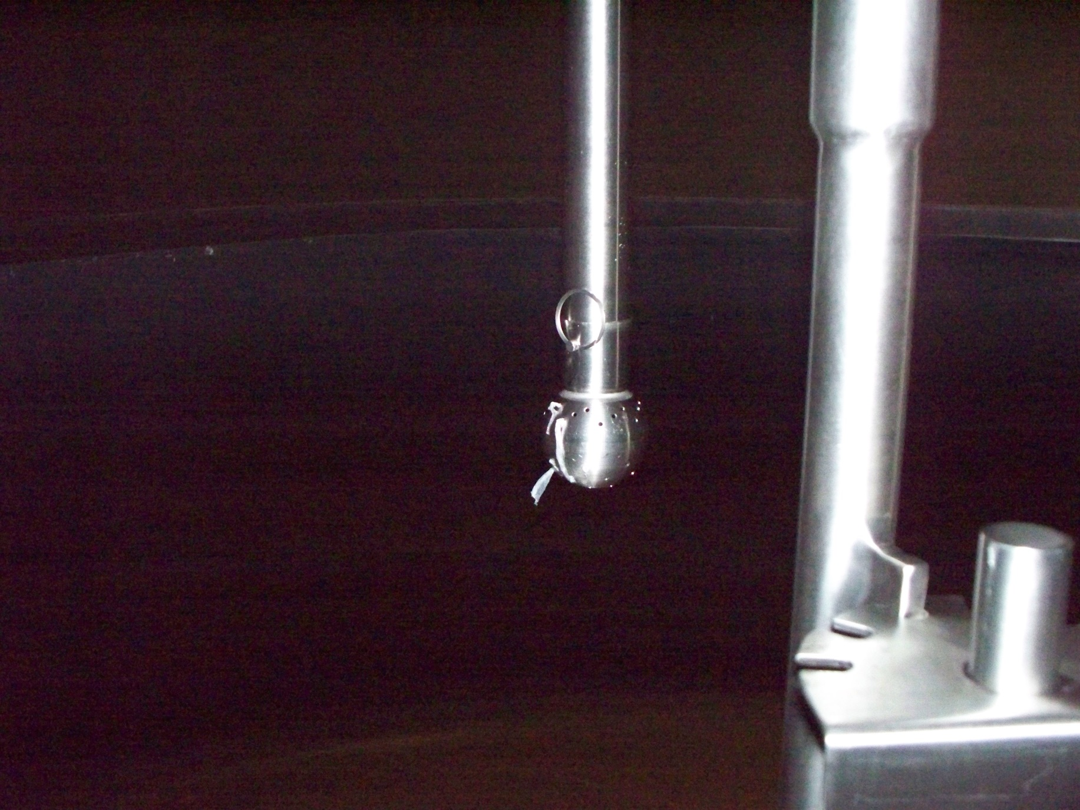

Slide 62
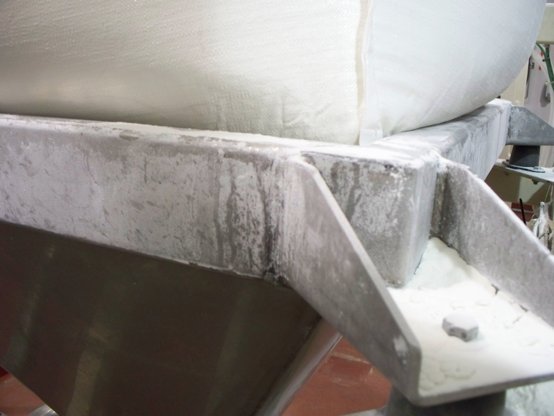

Slide 63
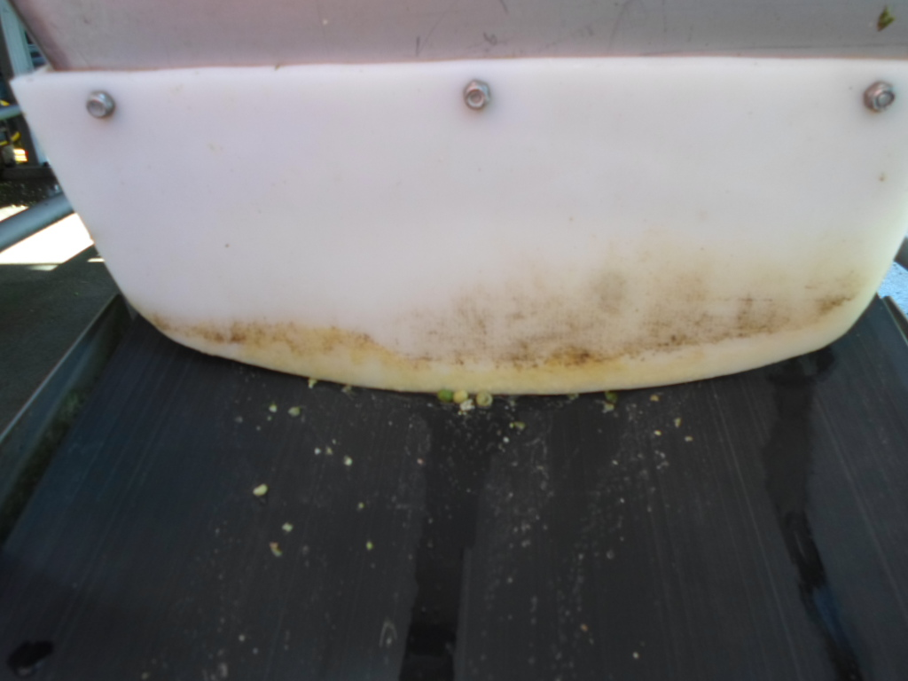

Slide 64
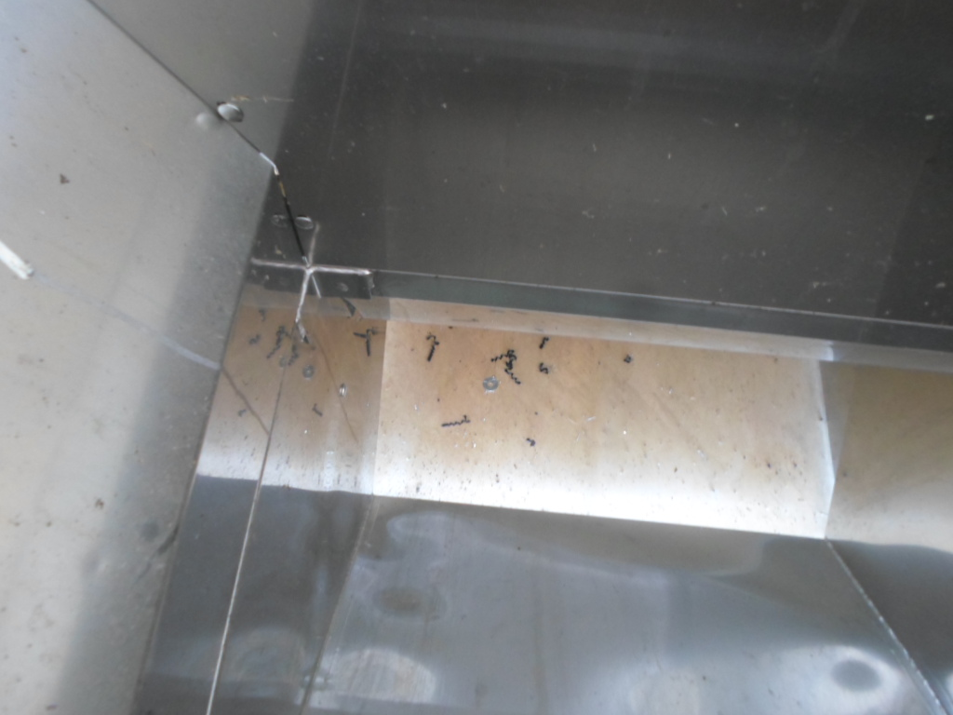

Slide 65
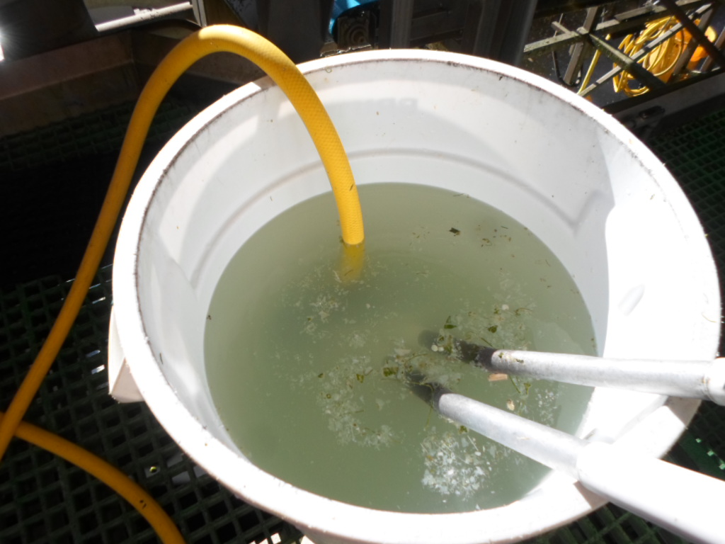

Slide 66
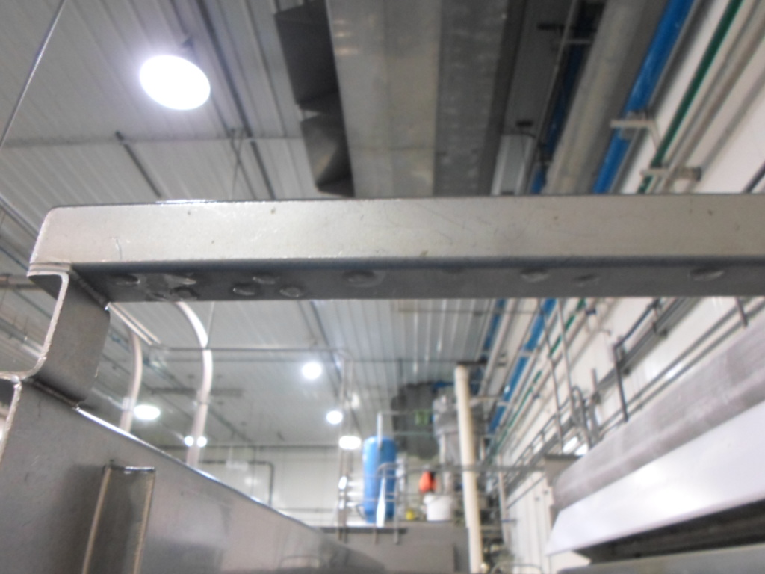

Slide 67
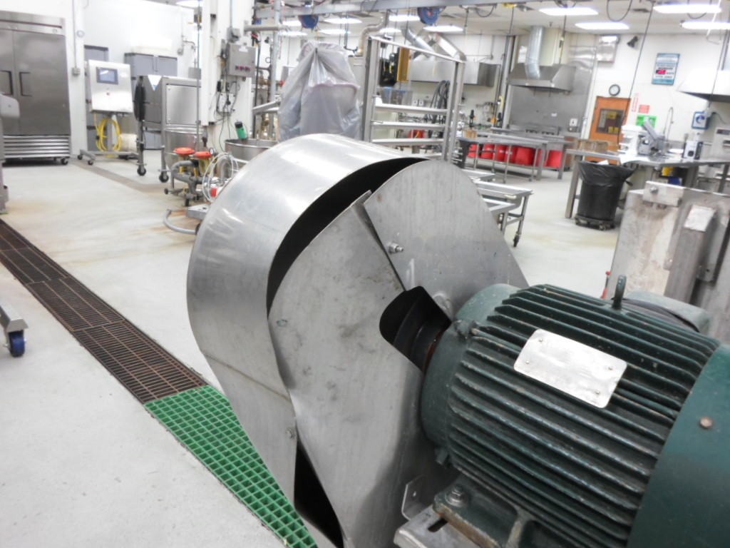

Slide 68
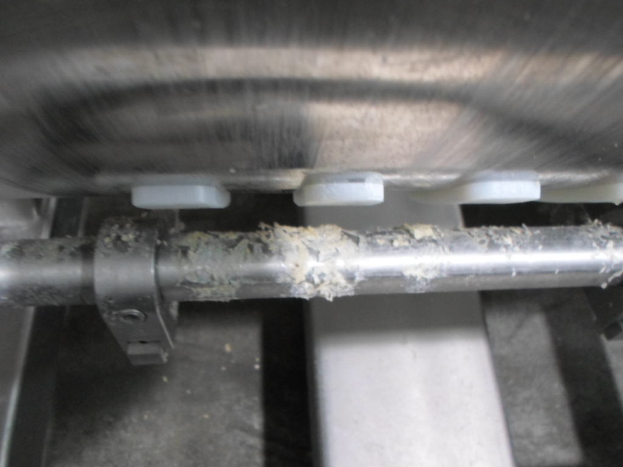

Slide 69
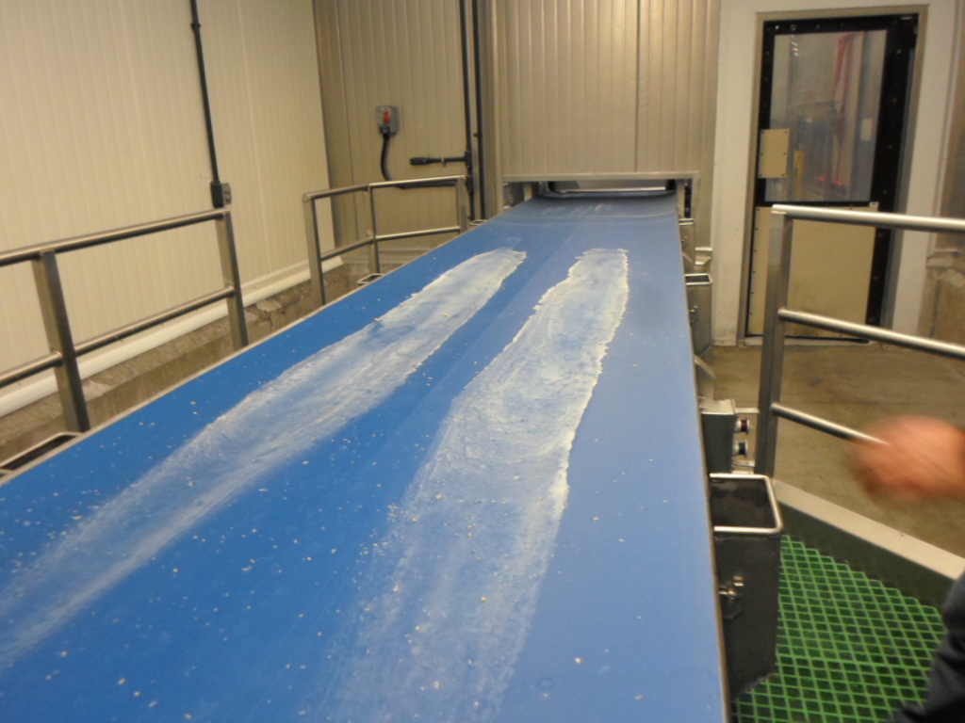

Slide 70
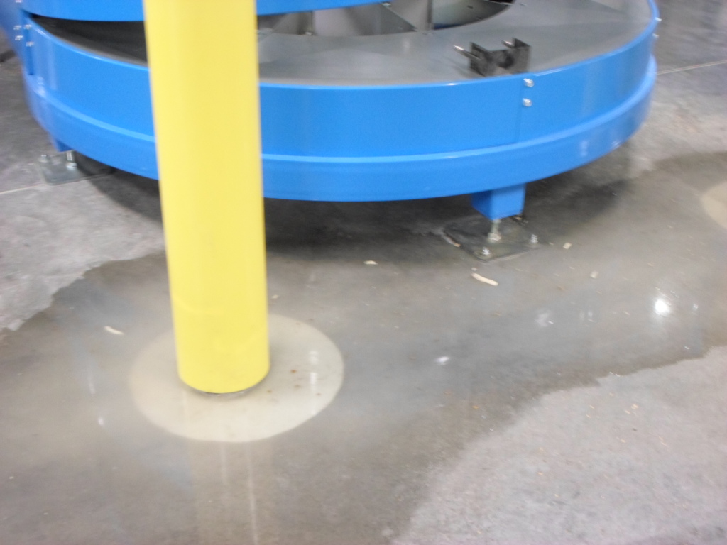

Slide 71
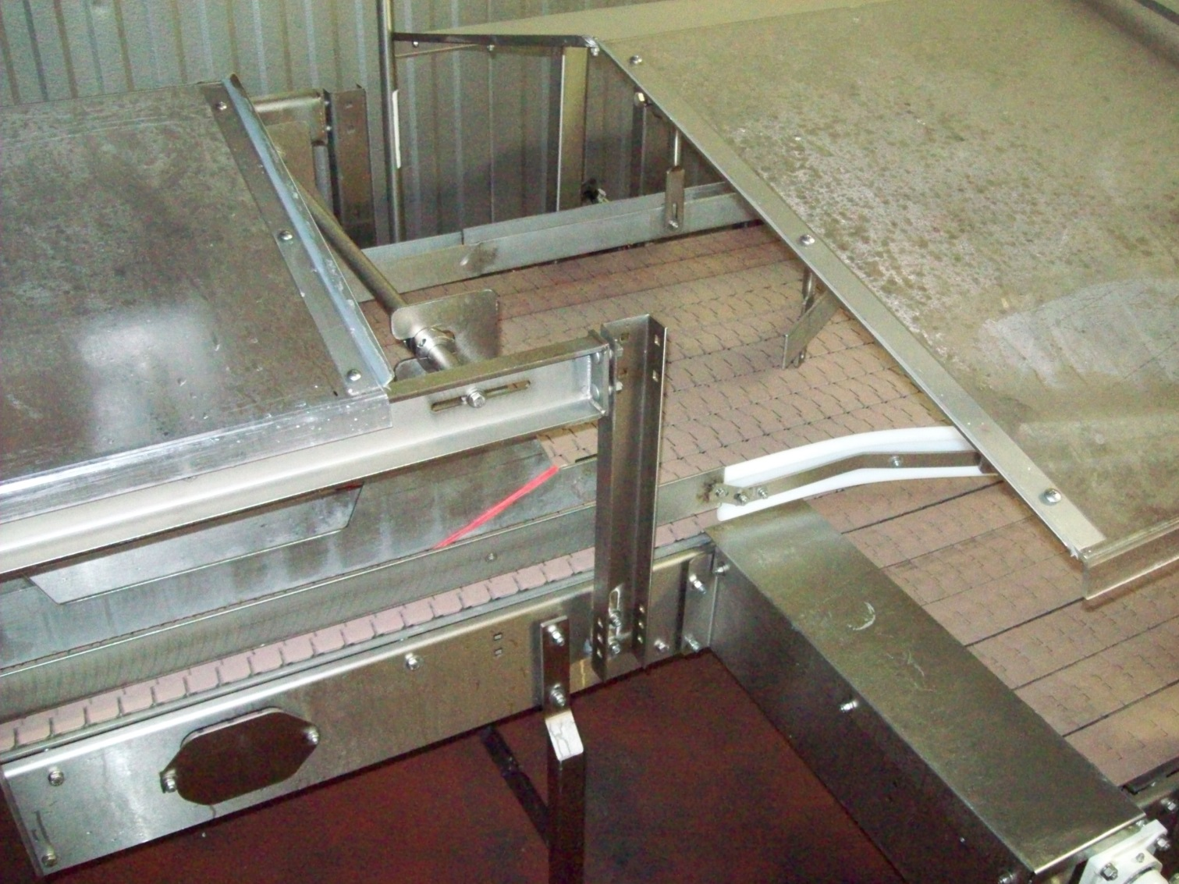

Slide 72
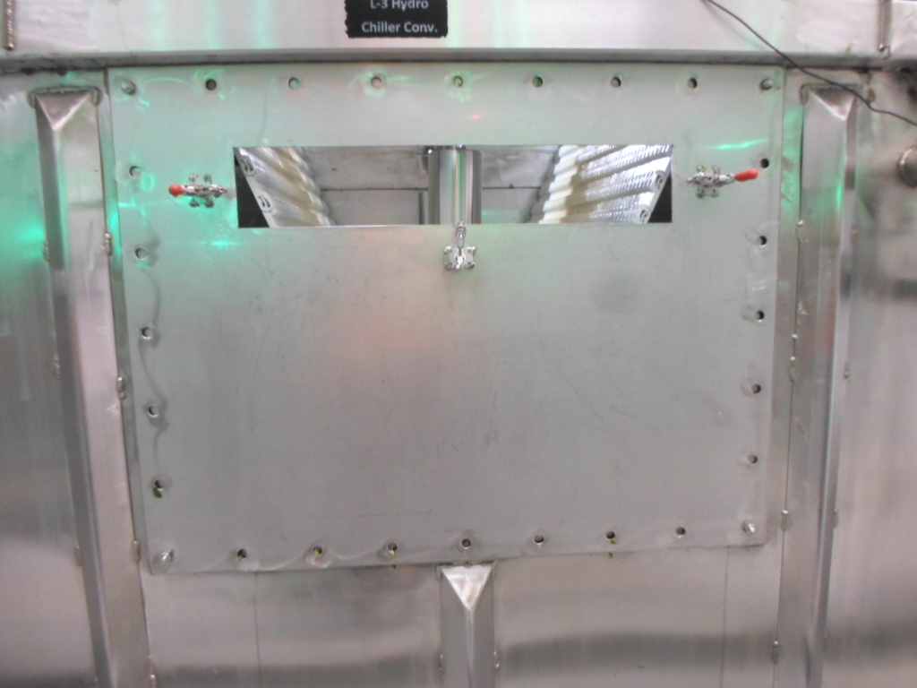

Slide 73
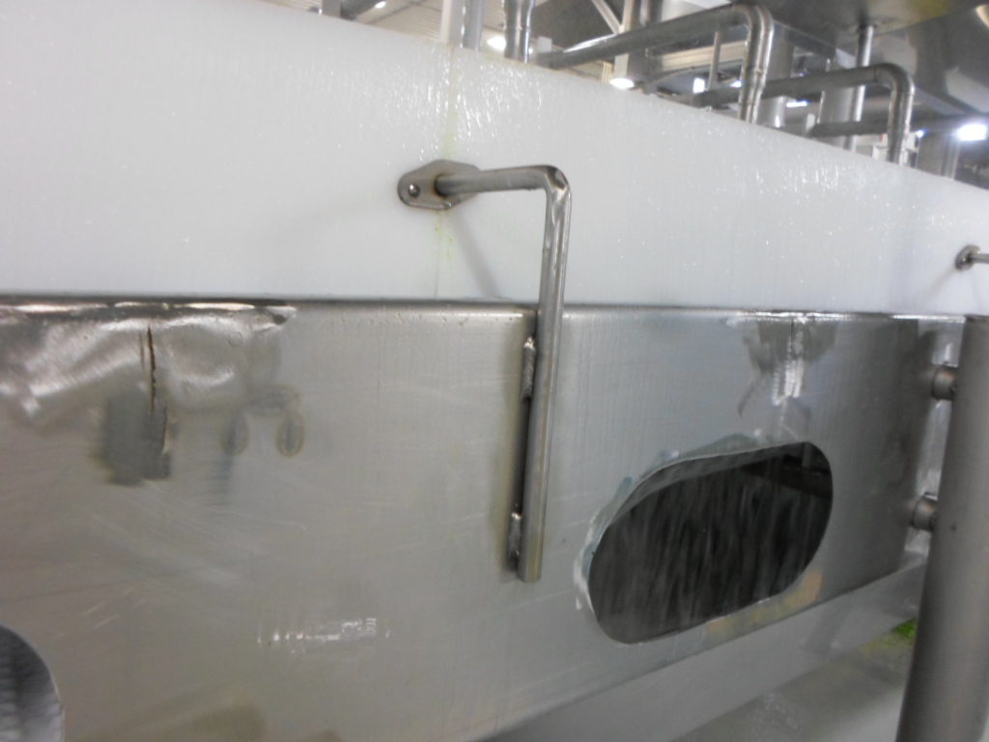

Slide 74
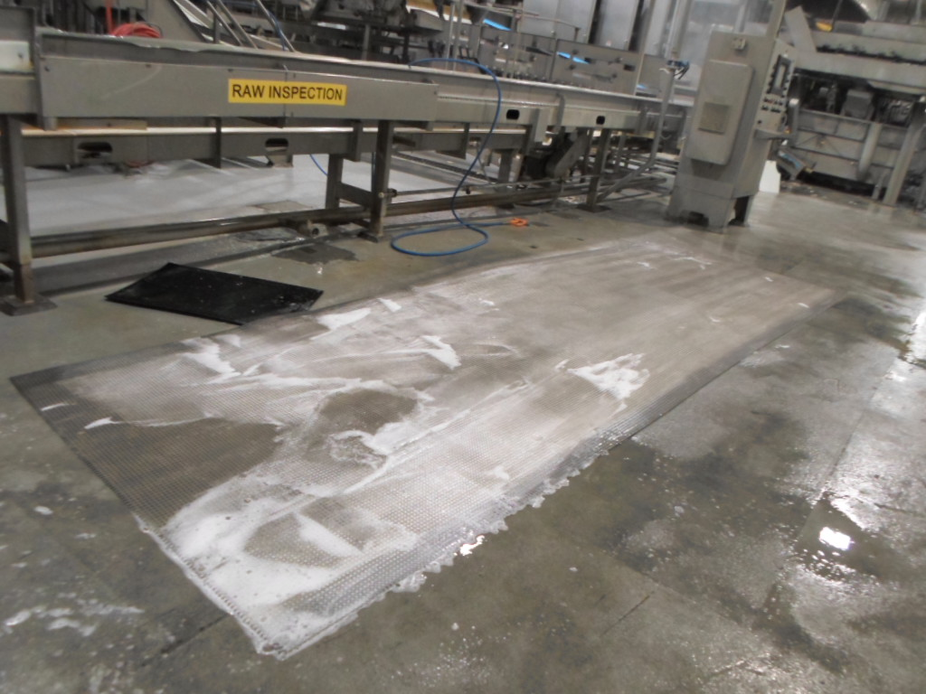

Slide 75
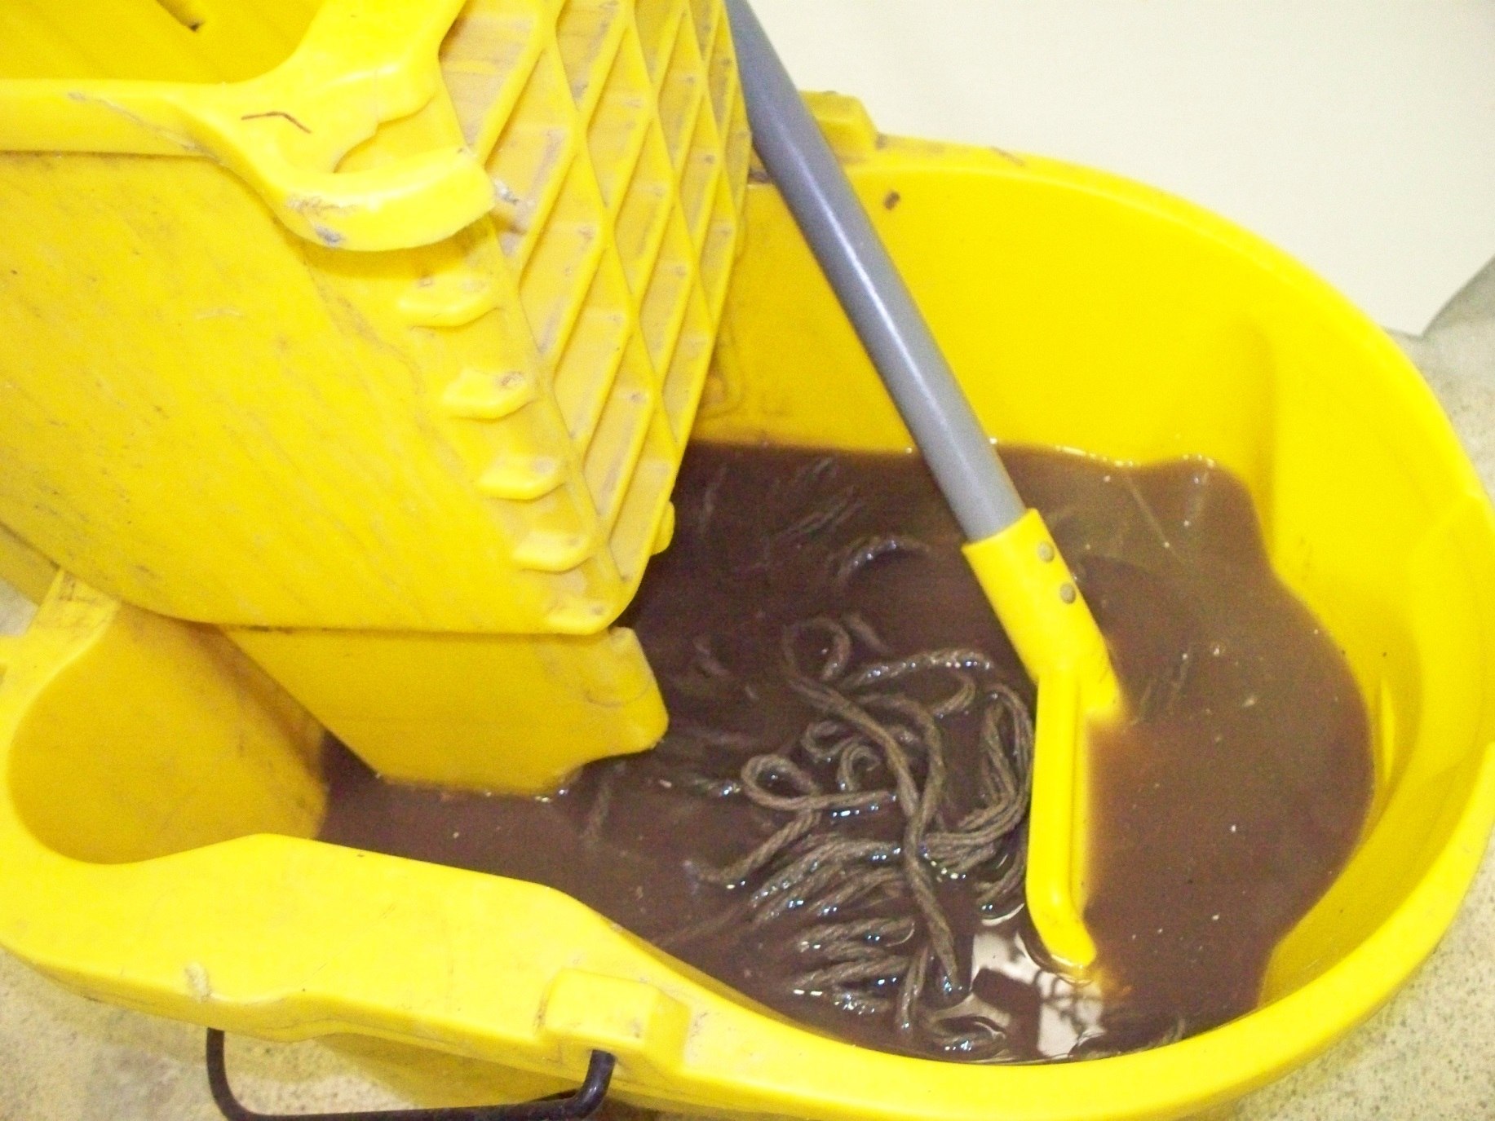

Slide 76
THANK YOU
Any Questions???

