Slide 1
Pathogens and Lawyers: All to be Avoided
Bruce Clark, JD
9.22.17

Slide 2
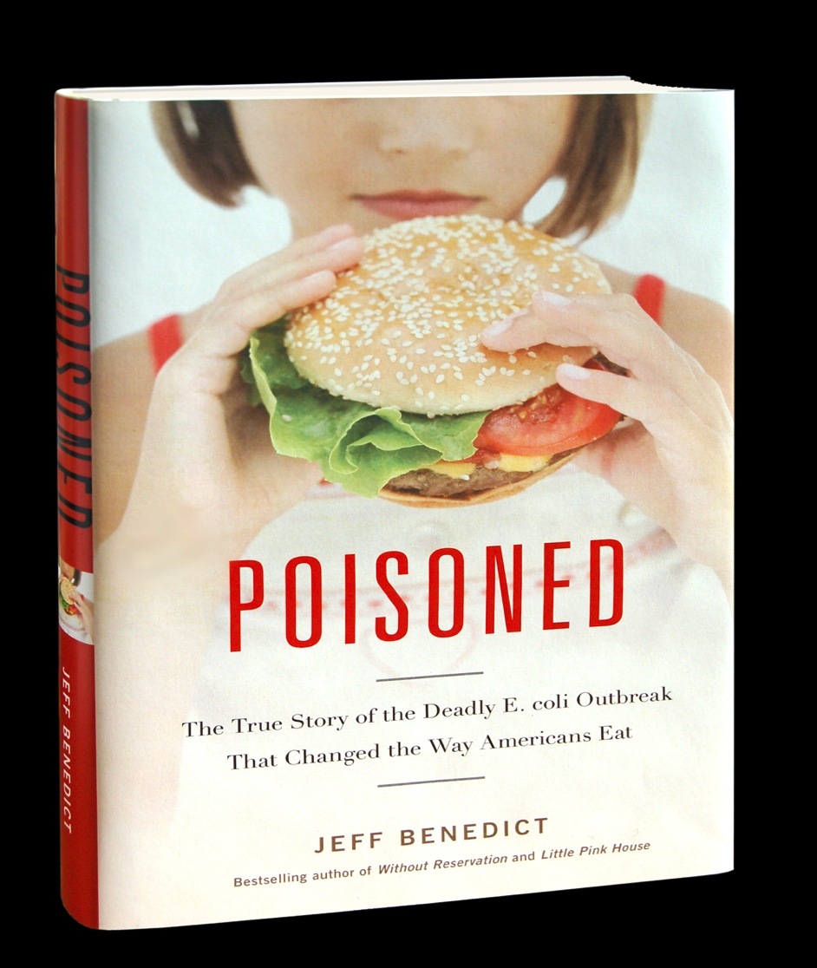
The World Changed with Jack In the Box
The CDC estimates that 48 million foodborne illness cases occur in the United States every year. At least 128,000 Americans are hospitalized, and 3,000 die after eating contaminated food.

Slide 3
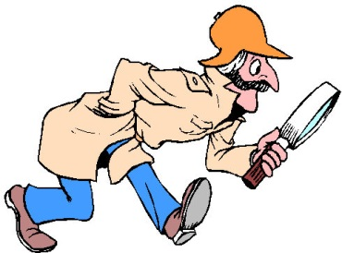
Jack In the Box Gave Rise to PulseNet in 1996
ISOLATES REPORTED TO PULSENET
Year | Human Isolates | Non-human isolates
1996 | 254 | 5
2012 | 58,799 | 4,337
PulseNet tracks foodborne illness like the FBI tracks criminals.

Slide 4
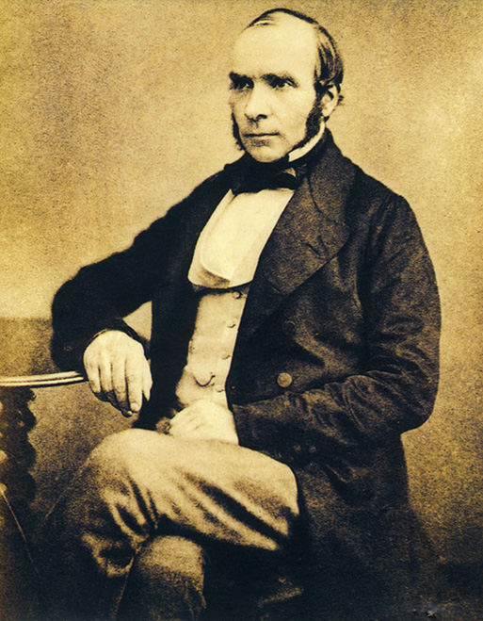
After JIB…epidemiology became sexy!
“Epidemiology is the field of public health and medicine that studies the incidence, distribution, and etiology of disease in human populations.
The purpose of epidemiology is to better understand disease causation and to prevent disease in groups of individuals.”
~ from “Reference Guide on Epidemiology,” in REFERENCE MANUAL ON SCIENTIFIC EVIDENCE, at p. 333 (2nd Ed. 2000)
John Snow, M.D., 1813-1858
A Father of Epidemiology

Slide 5
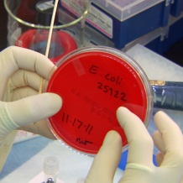
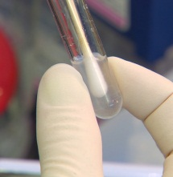
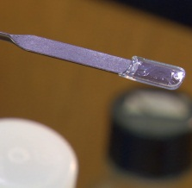
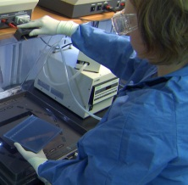
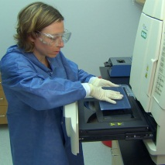
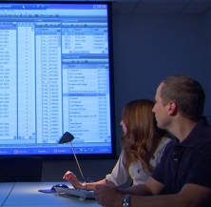
The gel is stained so that DNA can be seen under ultraviolet (UV) light. A digital camera takes a photograph of the gel and stores the picture in the computer.

Slide 6
Scientists at state or local public health departments enter patterns of DNA fingerprints into an electronic database.
These patterns are transmitted to CDC and filed in CDC’s main PulseNet computer.
If patterns from different labs match, the PulseNet team will alert all involved PulseNet labs of a possible foodborne outbreak.

Slide 7
New Weapon: Genome Trakr

Slide 8
Public Health Surveillance
All states have agencies tasked with monitoring bacterial and viral illnesses associated with food consumption.
The scope of the investigation varies from case to case.
It is very difficult to dispute a health department- confirmed outbreak or even an isolated case.
Health departments do not point the finger prematurely. Most epidemiologists will not confirm an outbreak without 95% confidence in a particular conclusion.

Slide 9
FoodNet: CDC’s Active Surveillance
Established in 1995
Now includes 7 states: CT, GA, MD, MN, NM, OR, and TN and selected counties in CA, CO and NY
Surveillance area includes 15% of the US population – approximately 47 million persons in 2010

Slide 10
FSMA and Surveillance
The Food Safety Modernization Act (FSMA) enhances CDC’s surveillance responsibilities. CDC is charged with these tasks:
Coordinating and integrating federal, state, and local foodborne illness surveillance systems
Increasing participation in national networks
Facilitating the timely sharing of information
Developing improved epidemiology and laboratory tools
Improving attribution of illness to specific foods

Slide 11
Top 5 Pathogens – 2011 estimates
Pathogen | Estimated number of cases | %
Norovirus | 5,461,731 | 58%
Salmonella nontyphoidal | 1,027,561 | 11%
Clostridium perfringens | 965,958 | 10%
Campylobacter spp. | 845,024 | 9%
Staphylococcus aureus | 241,148 | 3%
Pathogen | Estimated number of hospitalizations | %
Salmonella nontyphoidal | 19,336 | 35%
Norovirus | 14,663 | 26%
Campylobacter spp. | 8,463 | 15%
Toxoplasma gondii | 4,428 | 8%
E. Coli (STEC) O157 | 2,138 | 4%
REF: http://www.cdc.gov/foodborneburden/2011-foodborne-estimates.html

Slide 12
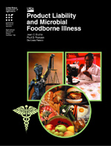
Foodborne Illness is Expensive
For five foodborne pathogens,* medical costs, productivity losses, and costs of premature death total:
$6.9 BILLION
* Campylobacter, Salmonella (non-typhoidal), E. coli O157:H7, Listeria monocytogenes, and other Shiga-toxin producing strains of E. coli.

Slide 13
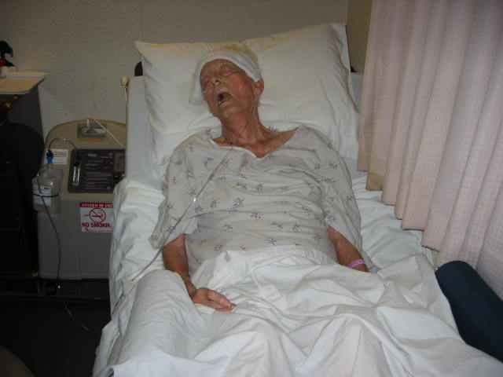
The Real Cost

Slide 14
Strict Product Liability
Strict Liability
Are you a manufacturer?
Was the product unsafe?
Did product cause injury?
Punitive Damages /Criminal Liability
Did you act with conscious disregard of a known safety risk?
Negligence
Are you a product seller?
Did you act “reasonably”?
Notes:
14

Slide 15
Who is a Manufacturer?
A “manufacturer” is defined as a “product seller who designs, produces, makes, fabricates, constructs, or remanufactures the relevant product or component part of a product before its sale to a user or consumer.”
Notes:
15

Slide 16
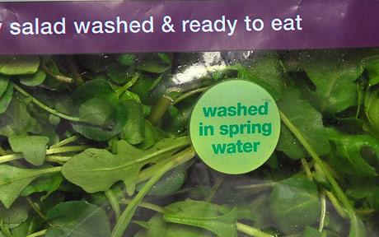
Is this a “manufactured” product?

Slide 17
Why Strict Liability?
It puts pressure on the party (manufacturer) which most likely could prevent/correct the problem
It puts the burden of cost on the party that profited from the defective product’s sale
It puts the focus on the product, not the conduct of the manufacturer—causation becomes the central question

Slide 18
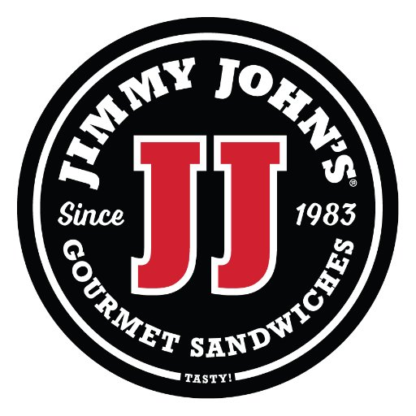
E. coli O157, cucumbers, and FSMA
Mexican farm grown
Imported to McAllen, TX
Distributed in CO by separate entity
Cases in two stores
Whose “product”?

Slide 19
RCW 7.72.050 Seller Liability-Exception
A product seller is only liable if it were negligent; it is not strictly liable
BUT, a product seller “shall have the liability of a manufacturer…if:”
There is “no solvent manufacturer” or
Court determines highly probable claimant could not enforce a judgment v. manufactuer

Slide 20
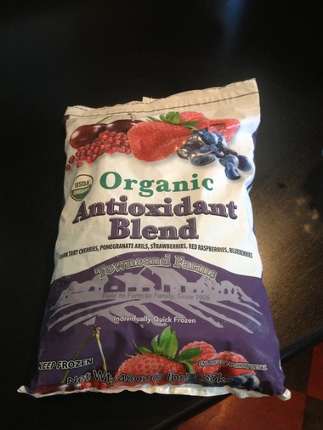
Hepatitis A in Townsend Farms Frozen Berry Blend
165 ill persons in 10 states
Illness onsets ranged from 3/16/2013 to 8/12/2013
42% hospitalized
100% reported eating Townsend Farms Organic Anti-Oxidant Blend
Those who bought the product got it at Costco
REF: http://www.cdc.gov/hepatitis/Outbreaks/2013/A1b-03-31/index.html

Slide 21
Product Trace Back
Outbreak strain is “genotype 1B,” rarely seen in the Americas but circulates in North Africa and Middle East.
Genotype 1B seen in 2012 outbreak in British Columbia related to frozen berry blend with pomegranate seeds from Egypt
Also seen in 2013 European outbreak linked to frozen berries.

Slide 22
Origin of Contaminated Ingredient?
Townsend Farms Inc., Fairview, OR
Product label lists ingredients from the US, Argentina, Chile and Turkey.
Contaminated product?
Turkey!

Slide 23
FSMA—Produce Safety Rule
Compare LGMA
Using industry to help define problem and fixes
Science based
Costs and compliance; size matters

Slide 24
A CORE PROBLEM: Safety is Invisible
“For the most part, food safety is a credence attribute, meaning the consumers cannot evaluate the existence or quality of the attribute before purchase, or even after they have consumed [it].”
E. Golan, et al., Savvy Buyers Spur Food Safety Innovation in Meat Processing, AMBER WAVES, April 2004,
Notes:
THERE IS NO PRICE-PREMIUM FOR SAFETY, BECAUSE SAFTEY IS NOT PERCEPTIBLE.
WHEN DECIDING TO BUY, I CANNOT KNOW IF THERE IS E. COLI IN THE GROUND BEEF.
I ALSO CANNOT KNOW EITHER DURING OR RIGHT AFTER I EAT THE GROUND BEEF.
AND IF I NEVER TRACE MY ILLNESS BACK TO ITS FOOD SOURCE, THE MANUFACTURER PAYS NO PRICE FOR NOT MAKING IT SAFER.

Slide 25
What Would You Pay for Safety?

Slide 26
Will You Buy It?

Slide 27
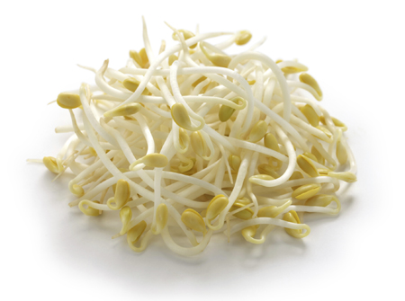
What Foods Should I Avoid?
At least 55 sprout-associated outbreaks have occurred worldwide affecting a total of 15,233 people since 1988

Slide 28
What’s Safe? Is the Wrong Question
An estimated 3,000 people die each year of foodborne illness in the US
An estimated 610,000 people die each year of heart disease—1 in every 4 deaths
Risk factors: diabetes; obesity and overweight; physical inactivity; poor diet
Computers kill more Americans than food

Slide 29
News Flash: Nuts Are Good!
Association of Nut Consumption with Total and Cause-Specific Mortality: NEJM (Nov. 2013)
Followed over 115,000 persons for over 30 years to determine relationship of nut consumption with death
Hazard ratio for those who ate nuts seven or more X/week: 0.80
Robust finding when variables controlled
Filbert growers, get on this!

Slide 30
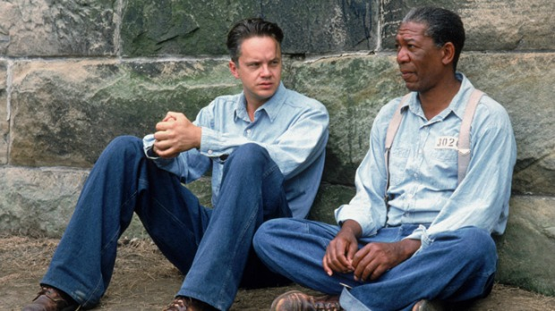
You Can Go to Jail
Peanut Corp. of America
Quality Egg
CO cantaloupe--Listeria
Allegations Include:
Mail Fraud
Wire Fraud
Introduction of Adulterated and Misbranded Food into Interstate Commerce with Intent to Defraud or Mislead
Conspiracy

Slide 31
Will 3rd Audits Save Me?

Slide 32
Whose Your Expert?

Slide 33
WCGW?

Slide 34
What Does USDA/FSIS Say?
“Most foodborne illness outbreaks are a result of improper handling or contamination when meals are prepared. Sanitary food handling and proper cooking and refrigeration should prevent foodborne illnesses.”
Translation: it’s your fault!

Slide 35
I’ve Got One Word for You:
INSURANCE

Slide 36
What Have I Learned?

Slide 37
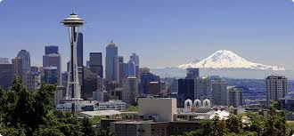
Questions?
Bruce T. Clark
1012 1st Ave
Floor 5
Seattle, WA 98104
(206) 346-1888
bclark@marlerclark.com

