Slide 1
WAFFP
FSMA Pain Points
Sept 21 – 22, 2017
Chelan WA
Charles m. Breen
Cmbreen llc

Slide 2
“. . . as we know, there are known knowns; there are things we know we know. We also know there are known unknowns; that is to say we know there are some things we do not know. But there are also unknown unknowns -- the ones we don't know we don't know.”
Donald Rumsfeld
Feb 12, 2002

Slide 3
FSMA is still new
No enforcement history, so –
  No way to be sure you are compliant until FDA or State inspection
  Inspection quality dependent on knowledge base of Investigator/Inspector
  Promise of TAN remains unfulfilled
  FDA Program Alignment implemented but glitches to be expected

Slide 4
Training does not equal education
Learning curve cuts both ways
  Recent importer inspection CSO appeared unfamiliar with FSVP rule, unaware of FSSC 22000 certification as a verification measure
  Importer is a marketing and sales office of foreign manufacturer and clueless about food safety documentation
  Product not high risk, baked cookie item, per FDA’s SECG

Slide 5
Training does not equal education
Establishing a strong Food Safety Culture (FSC)
  One large food processor with 42 plants struggling to implement a meaningful FSC initiative
  Employees well trained in what to do, but not why they do it
  “Salmonella is bad. We have to keep it out.” Could not say how his job was related to keeping it out

Slide 6
What is a strong Food Safety Culture?
What indicators of a strong FSC will FDA look for?
Are there tangible net benefits other than avoidance of negative events?
How do you measure ROI for implementing FSC?

Slide 7
Hard to find good employees
FSMA requires everyone be a qualified individual from Day 1 on the line
Persistent high employee turnover
Better retention after about 12 – 18 months on the job, but see first item

Slide 8
Return of § 402(a)(4) Enforcement
Nov 2016: Valley Milk Producers seizure
Insanitary conditions, plus
Environmental Salmonella positives
“The Complaint further alleges that the defendant articles of food are adulterated within the meaning of 21 U.S.C. § 342(a)(4) in that they have been prepared, packed, or held under insanitary conditions whereby they may have become contaminated with filth and/or may have been rendered injurious to health.

Slide 9
Return of § 402(a)(4) Enforcement
Aug 2017: Taylor Farm Inc. Londonderry, VT Warning Letter (cheese manufacturer)
Insanitary conditions, plus
“The presence of non-pathogenic Listeria species, including Listeria innocua, is indicative of conditions that are suitable for survival and/or growth of pathogenic Listeria monocytogenes.”

Slide 10
Whole Genome Sequencing Pains
Listeria monocytogenes recalls
Environmental sampling results
Whole genome sequencing tying current niche populations to past populations, and illnesses to current inspections
Applying updated agency guidance for control of Lm for ready-to-eat (RTE) food

Slide 11
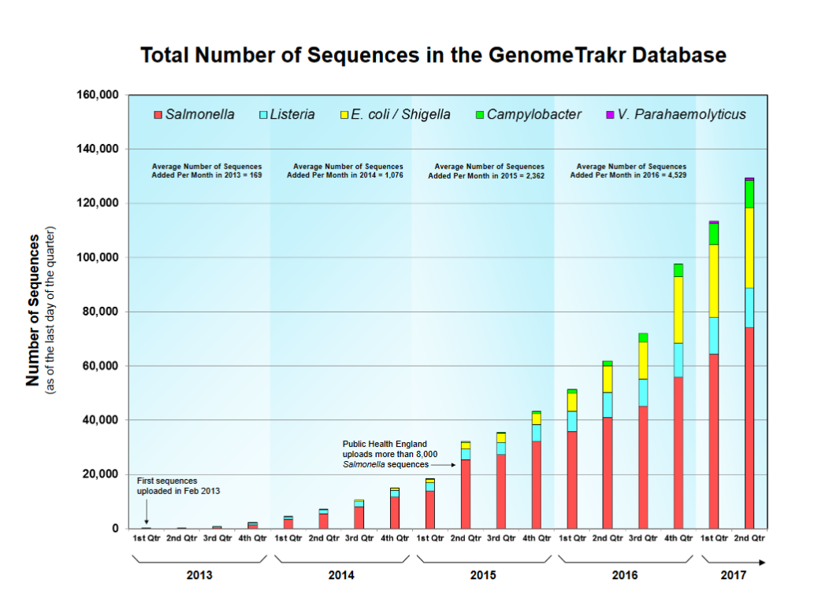

Slide 12
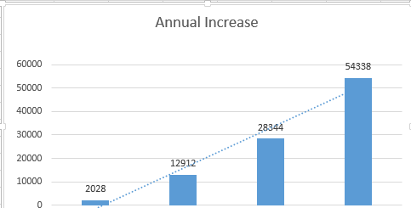
FDA WGS GeneTrackr database growth rate
2013 2014 2015 2016

Slide 13
Environmental Sampling Pain Points
How far should a firm go to characterize environmental positives?
What benefit does WGS offer a food facility?
What are the negative consequences?
What would FDA and/or Marler Clark do with the data?

Slide 14
Agency Guidances
Year | Number
2011 | 2
2012 | 2
2013 | 1
2014 | 2
2015 | 2
2016 | 13
2017 (to date) | 6
2016 big year
Two in early Jan 2017, Lm in RTE food, and Produce Safety
Two more majors in 2017, Food Defense Plan Builder, and Food Safety Plan Builder

Slide 15
Lessons not universally learned
Monitoring records, original or ‘true copy,’ challenging to organize
Sanitation – not related to safety – is not a hazard control
Pre-planned corrective actions for ‘what if’ failures for each control
Re-cleaning/sanitizing is not a Corrective Action
Hazard Controls

Slide 16
Lessons not universally learned
There is no such thing as a generic Food Safety Plan
Use current plan to build on but learn what’s different about FSMA!
Modify the Food Safety Plan before making a new product
Food Safety Plan

Slide 17
Supply-chain/FSVP management
Documentation of assurances deadline extended, but no guidance yet
Contract requirements from and to suppliers and customers lack consistency
Third-party business opportunity?

Slide 18
Unintended consequences
More detailed CGMPs, preventive controls, et al., offer:
  New tools for 3rd party civil lawsuits
  B2B and insurance claim lawsuits
  Potential opportunities as expert witnesses for food safety consultants
“Unintended” does not mean “unpredictable”

Slide 19
Questions?

