Slide 1
Food Safety Concerns with the Clean Label Movement
WAFP
September 21, 2017
Chelan, WA
By
Gale Prince, CSF

Slide 2
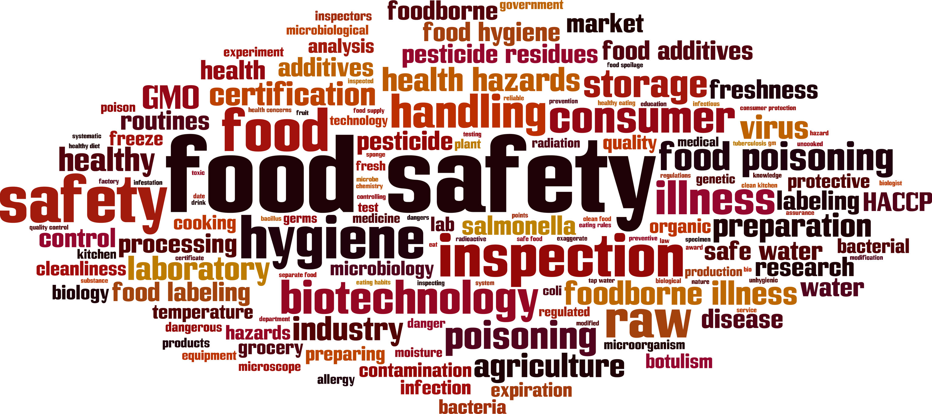
Food Safety Challenges

Slide 3
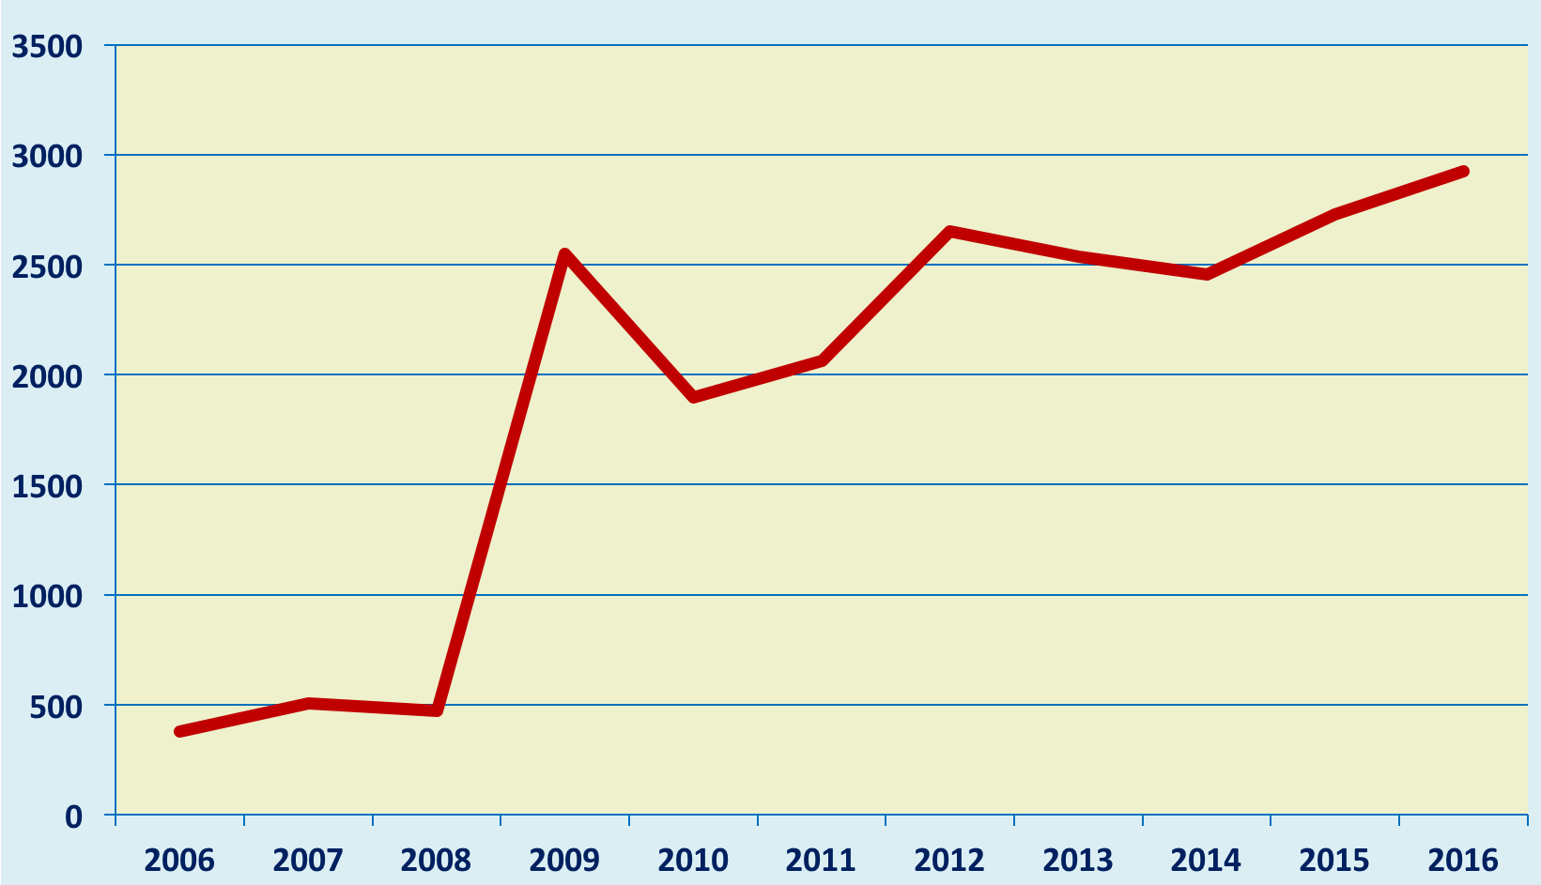
FDA Trends by Number of Recalled Products
Notes:
There were a total of 2916 products removed from retail shelves in 2016 due to recalls. That equals 7.99 items per day based upon 365 calendar days. Is recalls were conducted by 639 FDA regulated firms. There were 82 FDA regulated firms in 2016 that had multiple food recalls. This is a 49% increase over 2015. 40 of the 2016 recalls involved 10 or greater production codes.

Slide 4

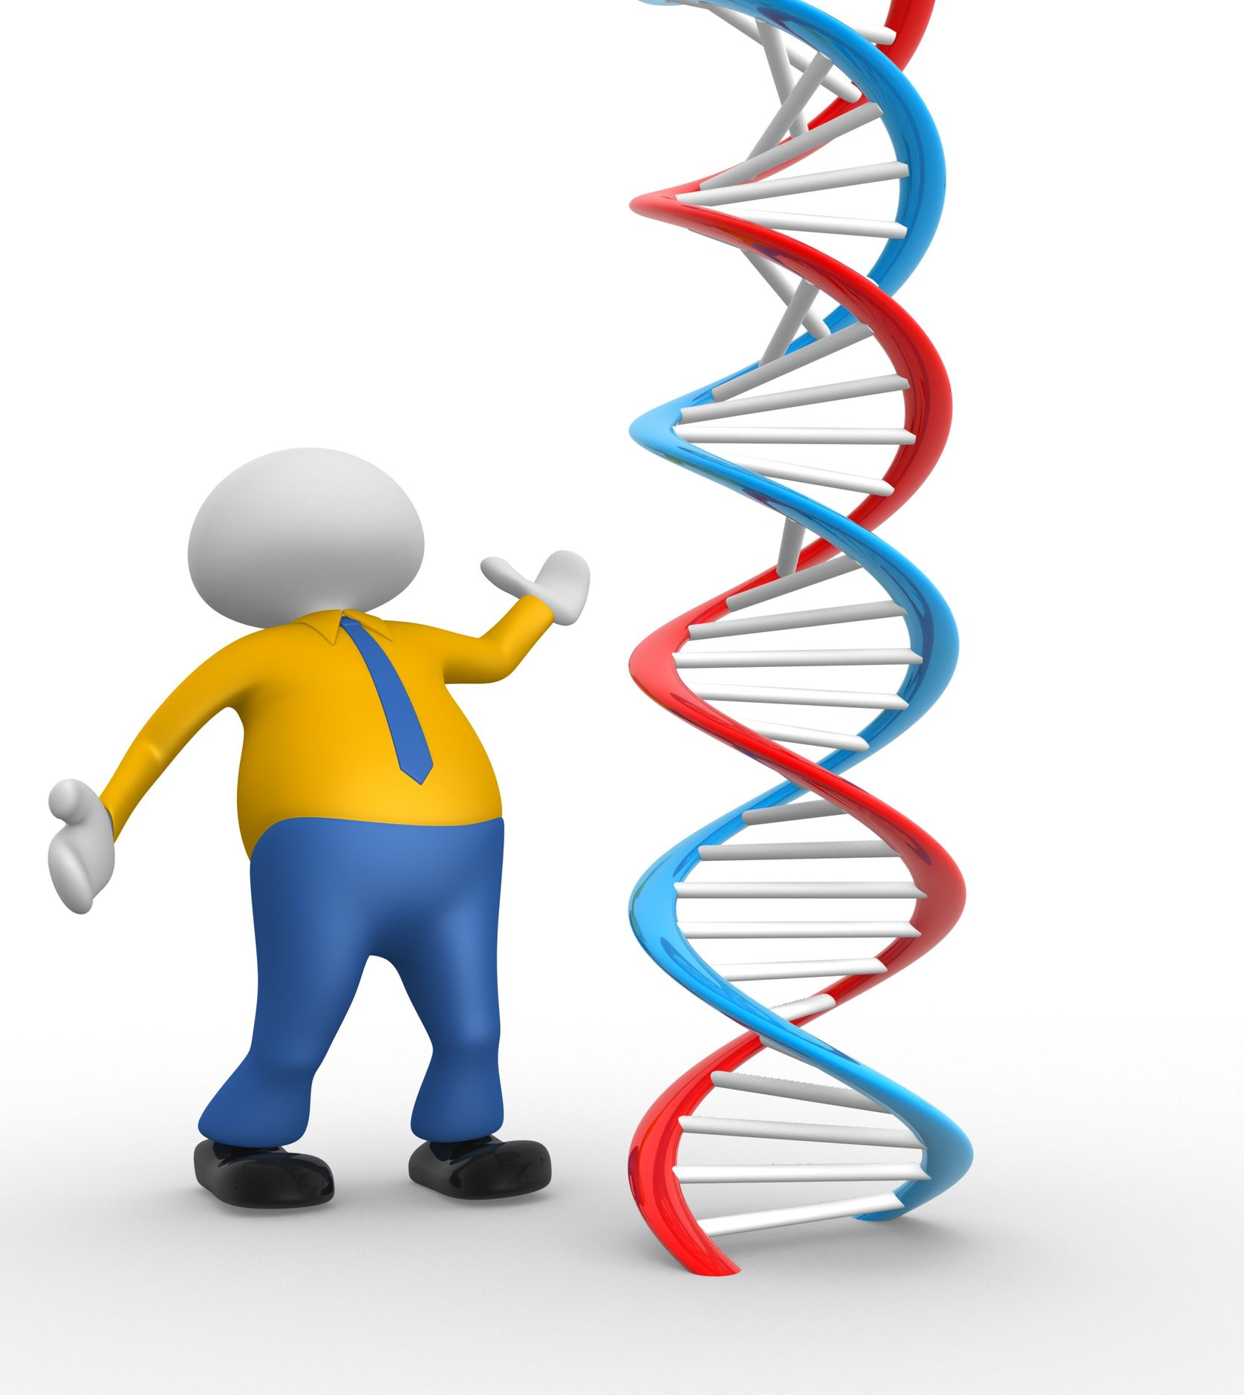
We live in a Micro World

Slide 5
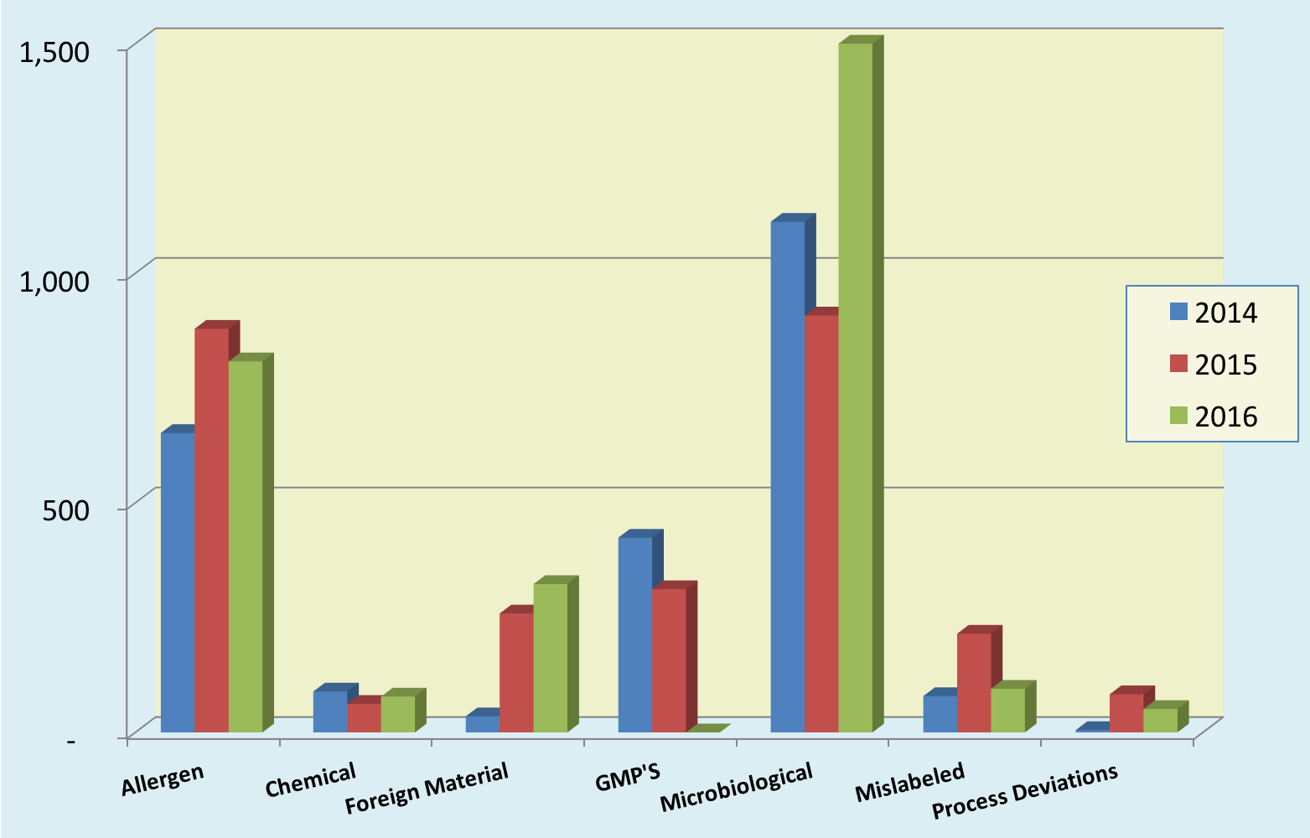
Recalls By Reasons – 2014 to 2016
Notes:
In 2016 52% of the recalls were due to microbiological problems. Of the microbiological recalls 51% were do to listeria monocytogenes and 27% was due to salmonella.27.7% were due to allergens of which 25% of them were related to milk allergens.

Slide 6
Major Contributing Factors to Recent Recalls
Non-Compliance with current Good Manufacturing Practices (published 1978)
Failure to maintain food processing facilities and equipment
Non-Compliance with their own SOP’s
Weaknesses in HACCP analysis
  Knowledge of their product
  Knowledge of their supply chain
Traceability – inability to track product

Slide 7
Evolutionary Changes
Food production consolidation
Product changes
  Complexity
  Extended shelf life
  Global impact
Complexity of food distribution
Consumer has changed
Science has changed
Epidemiology
Notes:
7

Slide 8
Epidemiology Advancements

Slide 9
Epidemiology Tools Are Changing and Improving
FoodNet - 1996
PulseNet – 1996
  Nationwide – 2001 Now World Wide
Pulsed-field Gel Electrophoresis (PFGE) - 1984
DNA Fingerprinting Technology – 2005
FDA Reportable Food Registry - 2007
FDA CORE Team
Regulatory Inspections – Swab-a-thons – 2010
Whole Genome Sequencing - 2013
CDC National PulseNet Database going back to 1995

Slide 10
Recent Multi State Food Safety New Foods Involved 2006-2016
Sprouted Nut Butter Spreads
Rotisserie Chicken Salad
Frozen Raw Tuna
Cucumbers
Carmel Apples
Sprouted Chia Powder
Raw Cashew Cheese
Tahini Sesame Paste
Pomegranate Seeds
Artisan Cheese
Cantaloupe
Papayas
Hazelnuts
Hydrolyzed Vegetable Protein
Pepper ( black, red and white)
Pistachios
Pet Food
Ice Cream

Slide 11
What does this tell us?
Electronic communications
DNA technology advancements
Identification of commonality
Identification of a food and/or an ingredient
Patient sample
Swab-a-thon (FDA inspections)
Database of over 50,000 finger prints on file that traces back to mid 1990’s
Whole Genome Sequencing

Slide 12
The Year 2007
An evolution
In
Food Safety

Slide 13
Food Safety Changed in 2007
Spinach and Carrot Juice – September 2006
Peanut Butter – February 14, 2007
Contaminated Pet Food with Melamine – March 16, 2007
Later came problems of Canned chili and PCA
Consumer voiced concern regarding pet food – March/April/May 2008

Slide 14
Food Safety Changed in 2007
Contaminated Pet Food with Melamine – March
Consumer voiced concern regarding human food – April
Drove trends to buy local / buy Organic
Major changes in the what we eat
  Good or Bad?
Drives social changes in food composition
Created food safety issues

Slide 15

iPhone Launched
June 29, 2007
Twitter
Facebook
You Tube
Electronic Marketing

Slide 16


Slide 17

Power of Social Media
Houston MOM
School Lunch
Social Media
258,000 Tweeters
41 Congressman told Sec of Ag end “Pink Slime”
Within days plants closed
What did it cost consumers?

Slide 18


Slide 19

Clean Label – Ingredient statements
“If you cannot pronounce it, you should not eat it!”
Notes:
At the core there is mistrust- big is bad and small is good. Not familiar, uncertainly, lack of confidence, misinformation. This allows for predatory journalism. It is a Demoralizing of food processed food.

Slide 20
Social Media Drove Movement for Clean Food Label
Increased consumer awareness
  Buy local
  Organics
  Cage free
  Grass Fed
  Nutrition labeling
  GMOs
  Natural
More food choices than ever
  Global cuisine, ethnic varieties
  Supermarkets, farmer’s markets, online sales
Revolutionary home delivery
Notes:
More to what the food is not than what it is.

Slide 21
Clean Food Label
How do you define?
Notes:
Label is more of what it is not what it is

Slide 22

Turn Back the Clock
Fair Packaging and Labeling Act of 1966
  Identity of the product – common or usual name
  Name of Business – responsibility statement
  Net quantity of contents
  Listing of ingredients
Food Additives Amendment
of 1958
  Generally Recognized as Safe

Slide 23
What is a Clean Label
Fewer Ingredients
Common/kitchen names
Natural ingredients
Minimally processed
Free from …
Uncluttered label

Slide 24
Clean Label – Food Safety Risk
Reduced Salt
Removal of ingredients you cannot pronounce
Removal of preservatives
Results
  Food Safety Hazards
  Short-term and long-term

Slide 25
Need for Scientific Review
Any change in a food formulation needs to be reviewed by a hazard analysis before production
  Chemical
    pH
    Water activity
    Process
    Packaging
    Shelf life
    Consumer expected uses and abuses
    History of the food

Slide 26
Need for Scientific Review
Direct impact of an ingredient removal?
Synergistic effects with other ingredients?
May weaken the food safety hurdle effect
An automatic reduction of X% salt without challenge studies is opening an opportunity for problems!
What is the impact on shelf life for the consumer?

Slide 27
Need for Scientific Review
Salt
  As a Preservative – Cave man discovers food preservation could be achieved with salt
  Reduce or Eliminate salt - drastic change in shelf life
  Replace sodium chloride with other salts may change preservative effects
  Celery powder may look friendly but it is sodium nitrate

Slide 28
Need for Scientific Review
Removal of gums and starches may change water activity and ability for micro growth
Reduction of sugar in a product may reduce shelf life and increase spoilage opportunities for microbial growth

Slide 29
Need for Scientific Review
Preservatives with a long history of safety and has served the food industry well
  Sodium benzoates
  Sorbates
  Propionates
  Nitrates
  Ascorbates
Acids
  Vinegar

Slide 30
Need for Scientific Review
Reformulation would require:
  Challenge studies
  Shelf life studies
  Organoleptic studies
  Labeling review- Nutrition facts, ingredient statement, label claims, etc.

Slide 31
Concerns with use of Alternatives
Is it allowed in the product?
Generally Recognized as Safe?
Regulatory limits?
Effects on the product?
Sensory impact?
Shelf life impact?
Consumer intended use?
What is the economic impact?

Slide 32
Need for Scientific Review
Resources:
  FDA Bad Bug Book
  FDA Food Code and Appendix
  FDA FSMA Draft Guidance for Industry – Hazard Analysis and Risk – Based Preventive Controls for Human Food, August 2016

Slide 33



A Clean Label and Food Safety is more than ...

Slide 34

Requires a Scientific Review

Slide 35
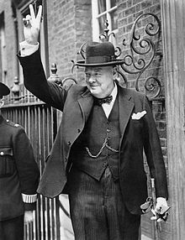
Importance of History
“Those Who Do Not Learn From History Are Doomed to Repeat It!”
Source: Winston Churchill

Slide 36
Our Responsibilities
Moral
  To do what is right for our customers
Legal
  To meet regulatory requirements
Both as a Corporation and each of us Personally
Notes:
36
36

Slide 37
Responsibilities
Notes:
37
37

Slide 38
Complacency
Notes:
38
38

Slide 39
Complacency
WE Cannot Accept A Complacent Attitude With
FOOD SAFETY
Notes:
39

Slide 40

Meeting Consumer Expectations
Food Safety

Slide 41
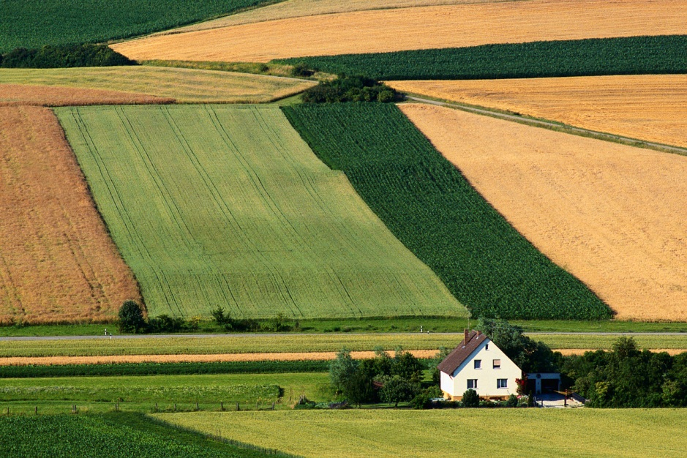
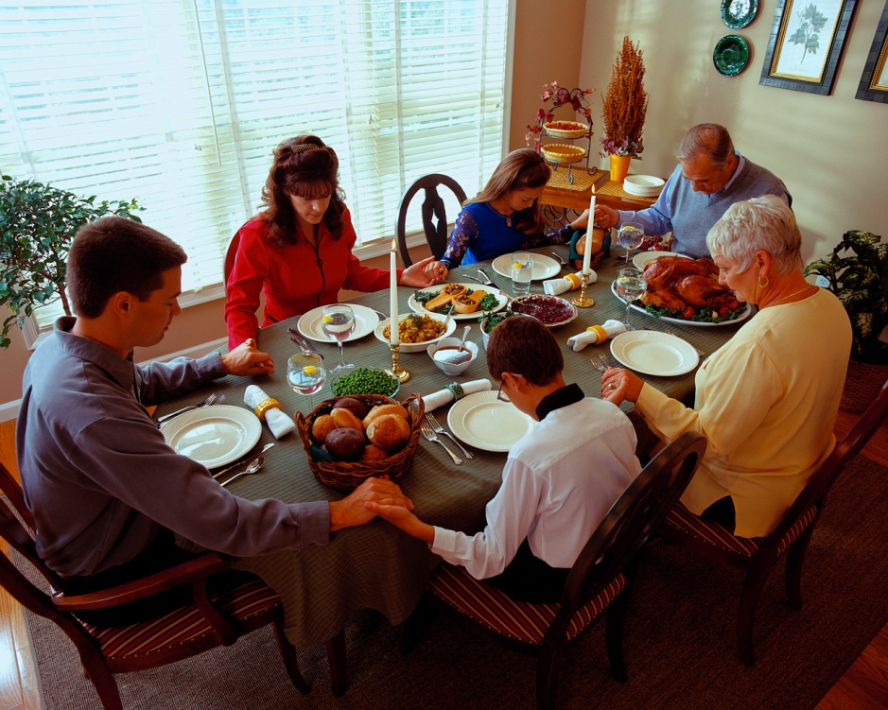
Food Safety
A Shared Responsibility

Slide 42
Food Safety is a Journey
Not a Destination!
You must continue to strive for improvements each and every day
in fulfilling consumer expectations.
Notes:
42
42

Slide 43
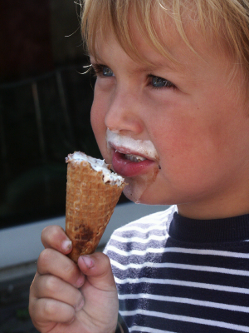
Thank You!
Gale@galeprince.com

Slide 44



