Slide 1
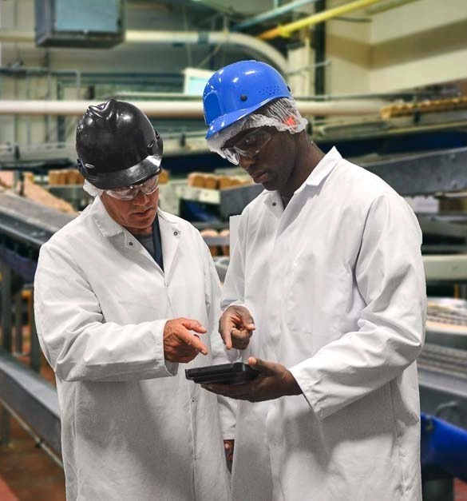
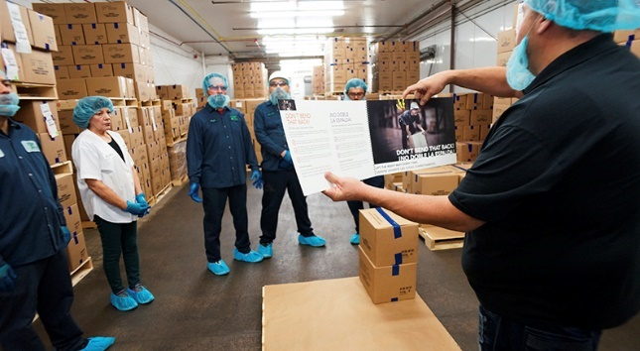
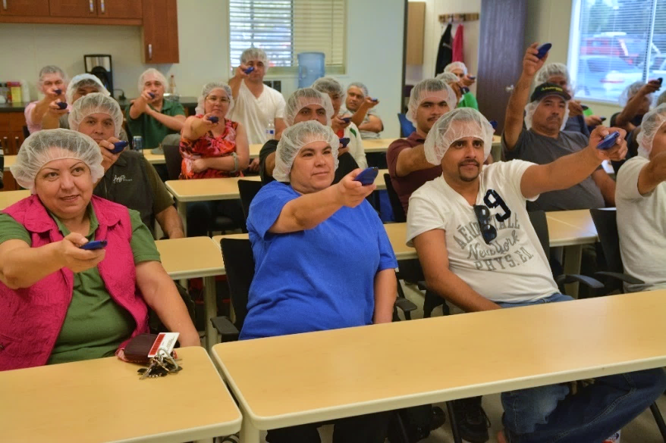
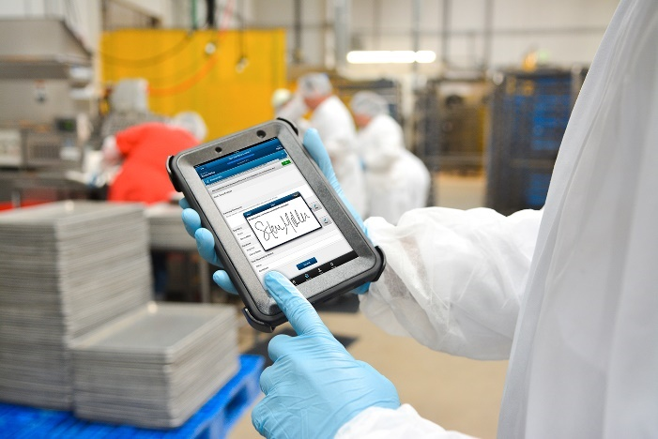
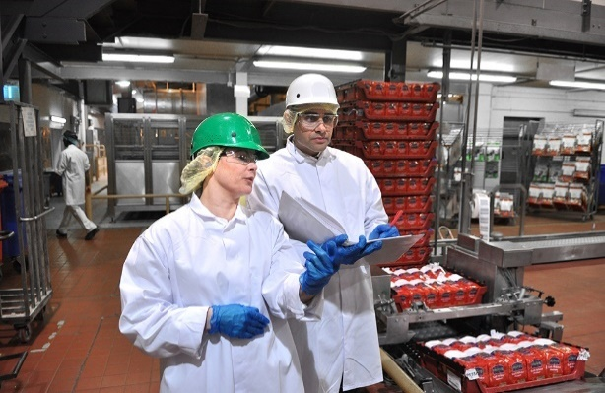
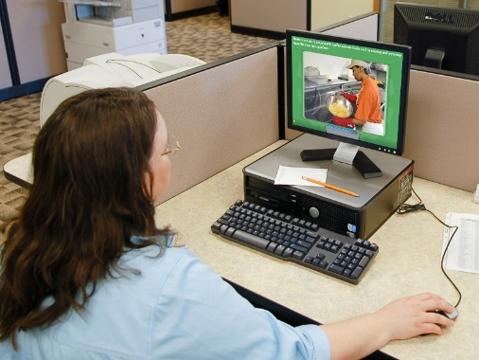
SMART ACTION AT WORK
WA Association for Food Protection
September 2017

Slide 2
Areas of Focus
Industry Challenges
Creating Engagement to Drive Smart Action
ROI of Engagement
Q&A

Slide 3




Industry Challenges Keep Increasing
$30M
70%
$250B
average business cost of a single food recall²
workers are either unengaged
or actively disengaged¹
annual cost of
workplace injuries in the U.S.³
¹Gallup ²Fortune ³OSHA
Notes:
70% disengaged workers: “What does it mean for you if your workforce is not engaged?” We’ll review stats on financial impact of disengaged workers shortly.
Note: The $30M business cost of food recall includes factors beyond direct costs, such as lost sales, costs associated with brand damage control, etc. An earlier study from Deloitte/FMI/GMA found DIRECT costs of a food recall to be $10M.

Slide 4
Aberdeen Group Research Shows…
“49% of organizations indicated that their main challenge for rolling out learning is ensuring that what is taught is actually understood and utilized on the job.”
FROM LEARNING TO KNOWLEDGE: BEST-IN-CLASS METHODS FOR ENABLING EMPLOYEES TO PROPEL THE BUSINESS FORWARD March 2016 Zach Lahey, Research Analyst, Human Capital Management. Aberdeen Group

Slide 5
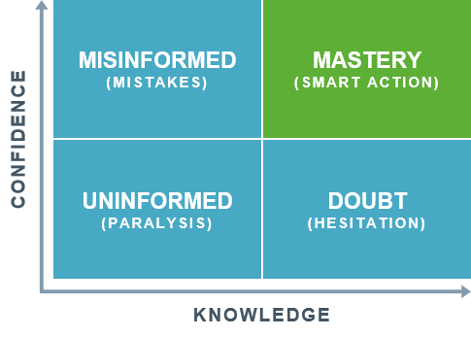
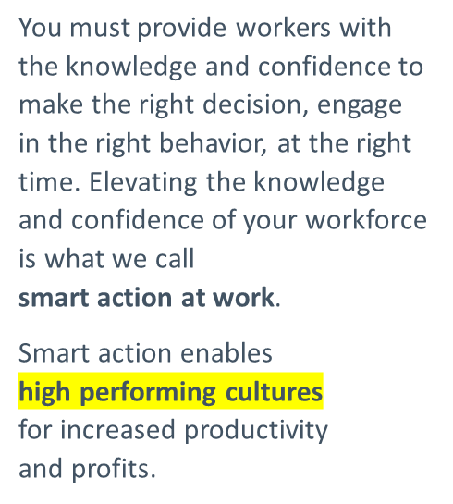
Knowledge with Confidence Drives Smart Action

Slide 6
Training is Only the Beginning!
The Forgetting Curve
Without systematic reinforcement, original training is not applied correctly
As much as 80% of content is forgotten within 30 days when not reinforced¹
¹Ebbinghaus Forgetting Curve

Slide 7
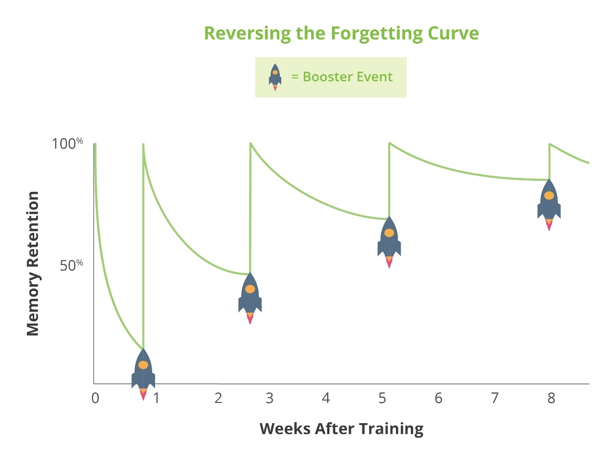

Repetition + Reinforcement = Retention
Intentional “booster events” that reinforce training content are proven to reverse the forgetting curve
In time, direct reinforcement is needed less frequently for worker to retain knowledge
“Always On” awareness materials ensure content stays top-of-mind
Reversing the Forgetting Curve

Slide 8
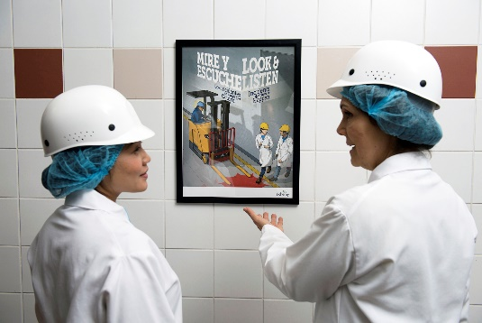
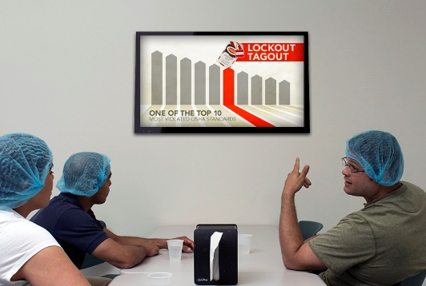
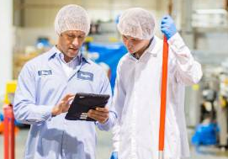
Creating Engagement with Coordinated Communications
Huddle Talk Guides
Blueprint to engage and instruct workers
70% of supervisors say the huddle guide approach is highly effective
Coordinated Posters
Reinforce discussion topics with strategically placed posters
Digital Signage
Reinforce key
training topics
Improve control and message quality to entire company
Employee Observations
Increase supervisor/employee interaction and communication
Validate employee understanding
Digital Signage
Reinforce key
training topics
Improve control and message quality to entire company
Notes:
Posters, digital signage, huddle guides all coordinated to use the same imagery/message to reinforce one another, and the initial training.
Huddle guides and observations are direct engagement. Digital signage and posters are “always on” reminders. Learning experts validate a mixture of these types of active and passive booster events is best.

Slide 9
Because It Works

Slide 10
Benefits
Picks up where training drops off
Utilizes & engages the Supervisor
Leads to better application of knowledge
Increases awareness
Stops the “loss” and reverses the trend

Slide 11
The ROI of Engagement
Research consistently shows companies with more engaged employees perform better in key metrics:
15%
30%
26%
20%
Greater
Customer Satisfaction
Greater
Employee
Productivity
Less
Employee
Turnover
Less
Employee
Absenteeism
Source: “Global Trends in Employee Engagement” (North American results cited ), Aon Hewitt/Queens University

Slide 12
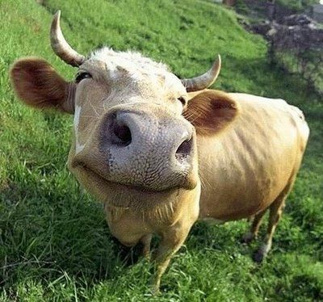
In Summary
One and done doesn’t get it done
Holistic & blended learning
Extend learning throughout the operation
Combats the forgetting curve
It works!

Slide 13
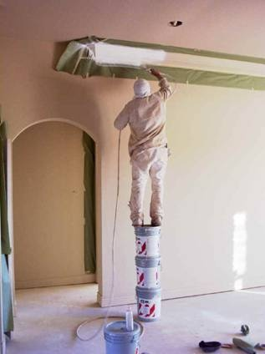
REMEMBER:
Bad decisions make good stories…and usually the evening news.

Slide 14
Kristi Reynolds
Northwest Area Representative
(425) 466-1126
kristi.reynolds@alchemysystems.com

