Slide 1
Detection and Control of Biofilm
Sterilex
Alex Zeman
09/11/17

Slide 2
Goals of Today
What is biofilm and why is it important?
How is biofilm detected?
How to control biofilm?

Slide 3
What is Biofilm?
Biofilm is a grouping of cells that stick together, embedded in a self produced matrix of extracellular polymeric substance composed of proteins, polysaccharides and other materials.

Slide 4
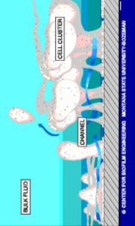
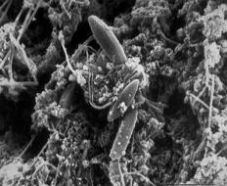
Pathogens Reside in Biofilm
Natural habitat for microorganisms
Natural biofilms are multi-species
Microorganisms in biofilm express resistance (1000 times the dose of sanitizers required)
Conventional disinfectants have limited effectiveness against biofilm
PLANKTONIC
SESSILE

Slide 5
Issues In The Control of Biofilm
Biofilms more likely in wet, inaccessible areas and on corroded and soiled surfaces:
Not sufficient to kill the surface organisms – must remove the reservoir
Failure to remove means repopulation in 48 hours – normally 168 hours to re-establish
Underneath conveyor belts
Weld cracks
Drains
Complex grinder parts
Catheters
Jacuzzi water lines

Slide 6
Evidence of Biofilms
Organoleptic signs
Analytical signs
Product signs
Visual, rainbow appearance
Slimy feel on equipment
Sour or musty odor
Spike in generic microbiological counts/hot spots
Increase in environmental Listeria positives
Increased failures with ATP devices
Loss of shelf life
Spoilage
Product micro failures

Slide 7
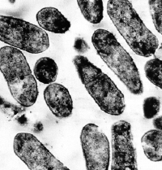
Sanitation Effectiveness Verification
Physical verification
Organoleptic (site, smell, taste)
Microbiological verification
Bioluminescence/ATP (immediate results)
Aerobic plate count (results in 2–3 days)
Environmental monitoring (results in 3–5 days)
Indicon Gel Hygiene Indicator
7
Notes:
7
Organoleptic: Another term for affecting an organ or the whole organism and is used to reference the impact on site, smell, test, touch)
ATP / Bioluminescence: measuring Adenosine triphosphate (ATP) picked up by a swab.
Reacts with the enzyme luciferase (tail of firefly).
Light measured as a (RLU) relative light unit.
Manufacturers can report on different scales
ATP does not differentiate from product residue, bacteria, yeast, or mold = something is there or it is not.
Not felt to be a replacement for micro
Not recommended when there are target organisms, example Lactobacillus in pourables.
Uses: Post clean validation, troubleshooting
Limitations:
Visible residue can interfere with light emission and result in false negatives.
Chemical quenching: acid conditions can break down the enzyme & result in false negative
Sanitizer reactions: Check with manufacturer to ensure swabs can compensate for presence of sanitizers and what the limits are.
APC: Provides count of bacteria that grows aerobically in 2 days @ 30C
Yardstick of sanitation effectiveness / can help identify problem areas
Low plate count does not = good (need trends) / high count = possible problem.
Need neutralizing solution for present sanitizers (calibrate w/your micro) Letheen broth = chlorine / soy lecithin = quats / polysorbate 80 for phenolic sanitizers???
Pathogen Environmental Monitoring: Micro sensitive products that are RTE are often monitored by regulatory environment. Industry monitors environment for indicator organisms to identify potential niches. Allows corrective actions prior to product impact and consumer impact. New regulations to require PEM in RTE meat. Frequency and follow up activity based on risk (alternative).

Slide 8
ATP Bioluminescence Testing
Most commonly used method
Advantages
Quick and immediate results
Measures level of sanitation by looking for levels of ATP common in food (and bacteria)
Can track and trend results
Disadvantages
Expensive
Does not give you the levels of bacteria on surfaces, just food residues
Can only pick up what the swab can reach
Sterilex Training
Notes:
8

Slide 9
Microbiological Testing
Results in 24–48 hrs.
Inexpensive
Various methods
Contact plates
Dipsticks
Petrifilm or pour plates
Air testing
Establish internal microbiological standards (10, 50, 100 cfu/square cm)
Develop a testing program and establish a frequency of testing
Track and trend data
Critical for ready-to-eat processes (e.g., Listeria monocytogenes)
Sterilex Training
Notes:
9

Slide 10
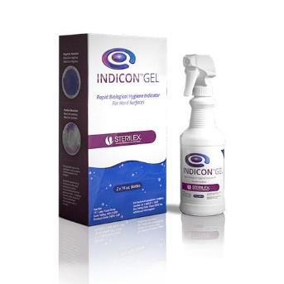
Introducing: Indicon™ Gel
Indicon Gel Product Video

Slide 11
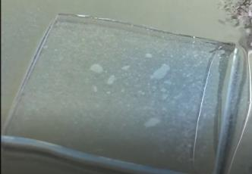
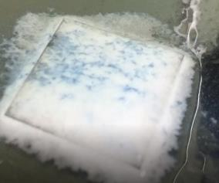
Indicon™ Gel
Rapid biofilm detection
Screening tool with a specific ability to detect biofilm
Cost effective
Training tool
Pre-op QC tool
Does not react with protein/fat soils
Blue colored gel that rapidly creates bubbling action upon contact with biofilm
The lack of a positive reaction from Indicon Gel does not guarantee that the surface is free from microorganisms. Indicon Gel is not meant to take the place of routine microbial monitoring or organism specific diagnostic tests.

Slide 12
Indicon™ Gel Website Landing Page
http://www.sterilex.com/indicongel
Access to product videos, tech data sheets, ability to contact us for more information
Disclaimer
“The lack of a positive reaction from Indicon Gel does not guarantee that the surface is free from microorganisms. Indicon Gel is not meant to take the place of routine microbial monitoring or organism specific diagnostic tests.”
12

Slide 13
Product Features and Benefits
FEATURES
BENEFITS
Easy and safe to use
Ready to use spray gel
Allows for detection on large surface areas
Micro-bubble reaction is readily visible on a variety of surfaces
Not regulated for transport
Freely rinseable
Shelf Life: 9 Months
Rapidly detects the presence of invisible biofilm harborage niches
Provides a cost-effective, quick visual indication of the presence of biofilm on a surface which may contain microorganisms such as Listeria, Escherichia coli (E. coli) or Salmonella
Perfect for “seek and destroy” applications
Reaches areas a swab cannot
13

Slide 14
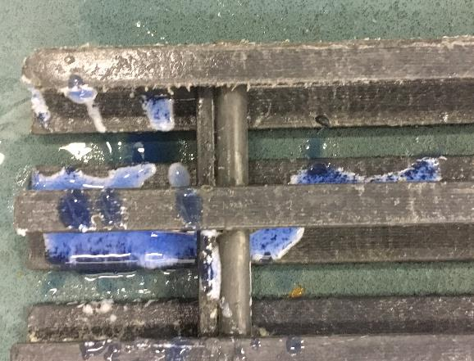
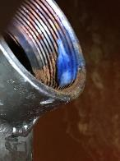
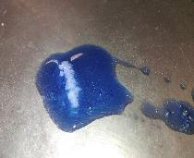
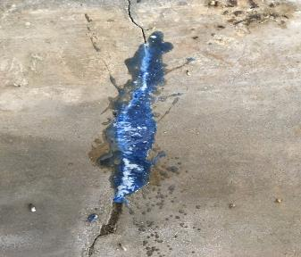
Visually Identify Harborage Niches

Slide 15
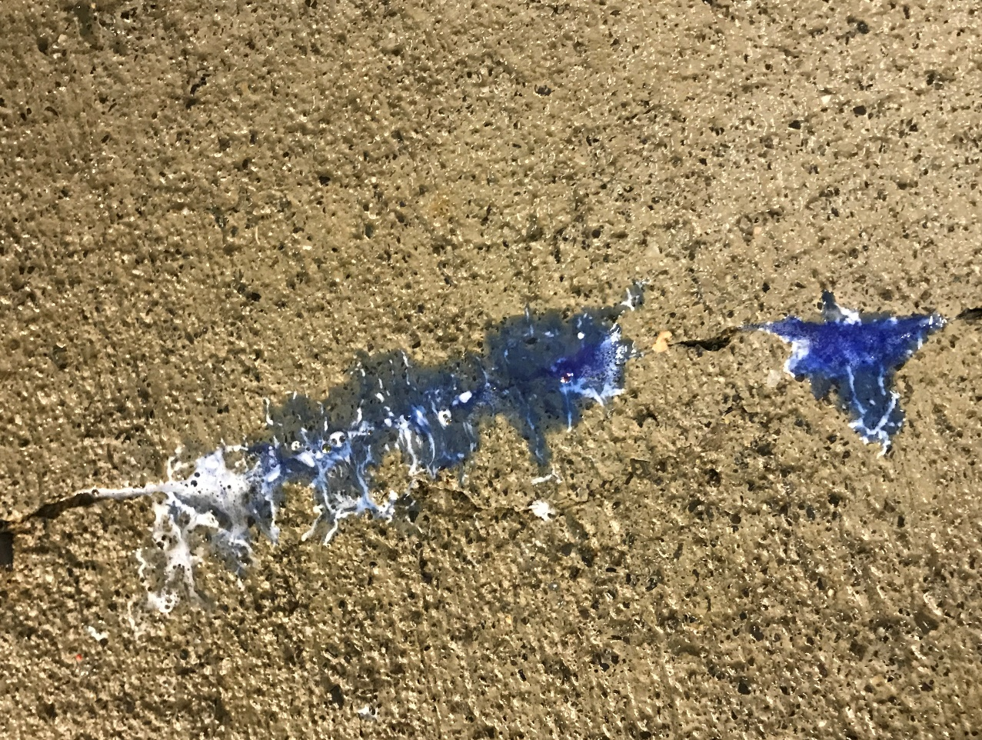
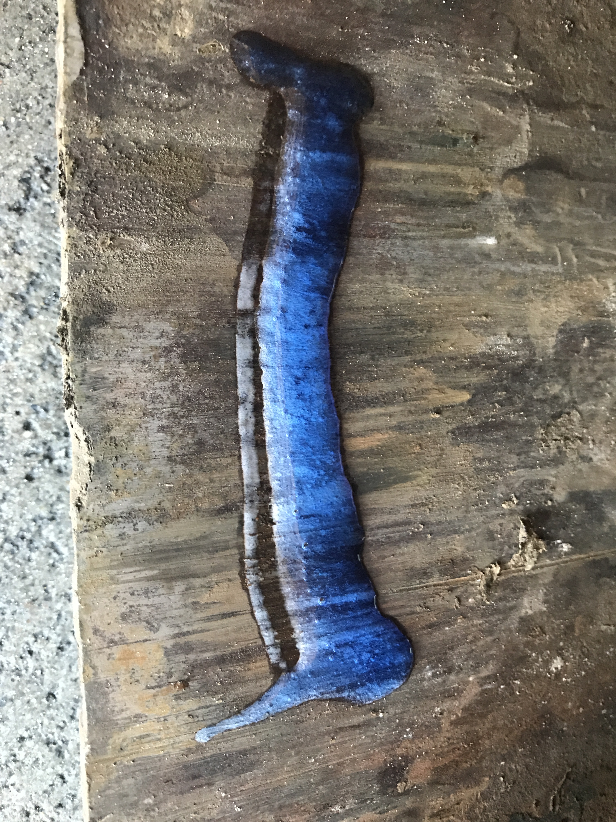
Indicon™ Gel Field Trials

Slide 16
Indicon™ Gel Usage Instructions
Indicon Gel Instructional Video
Prepare surface
Rinse off any chemical or food residue (especially chlorine or blood)
Ensure that all sanitizer is dried prior to application
Prevent formation of artificial large bubbles
Avoid shaking bottle
Prime sprayer at least 5 times before use
Explain to customers that positive is rapid microbubble growth, not initial large bubbles
Applying to a vertical surface
Spray from left to right across a vertical surface
Thin line of Gel will “stick” much better than spraying in one spot
Evaluate result
Wait at least two minutes for a positive – reaction time may be species dependent
Evaluate growth of white microbubbles
Lack of a positive result does not guarantee a clean surface
16

Slide 17
Indicon™ Gel Biofilm Videos
Tested on, and videos available for:
Listeria
E. coli
Salmonella
Pseudomonas
Staph aureus
Candida albicans
Very effective at detecting food pathogens including Listeria
Limit of detection appears to be around 10^6 CFU/mL
Indicon Reaction to Salmonella Biofilm
Indicon Reaction to Listeria Biofilm
Indicon Reaction to Pseudomonas Biofilm
Indicon Reaction to Staphylococcus Biofilm
Indicon Negative Control

Slide 18
How are Biofilms Treated?
Hand Scrubbing
Impossible to scrub every niche
Time consuming in certain areas like drains
Burn Off Biofilm
Oxidizing chemistries such as chlorine bleach and PAA react with the outer layers of film first
Can require up to 1000x the normal dose of sanitizer to remove
Use specifically designed biofilm removal chemistry
Sterilex PerQuat Technology is the only EPA registered biofilm removal chemistry
Effectively removes biofilm and kills pathogens within biofilm.
The usual precautionary measures are to be adhered to when handling chemicals

Slide 19
Biofilm Treatment with Different Sanitizers
Key: Access of disinfectant to target organisms
Bacteria rapidly colonize dirty surfaces and residual biofilm
Sterilex biocides are superior in biofilm-protected environments
Sterilex biocides excel in removal of the biofilm matrix and accessing biofilm-protected microorganisms
Before Bleach
After Bleach
Before Quat
After Quat
Before Glutaraldehyde
After Glutaraldehyde
Sterilex completely removes biofilm
Before PerQuat®
After PerQuat®

Slide 20
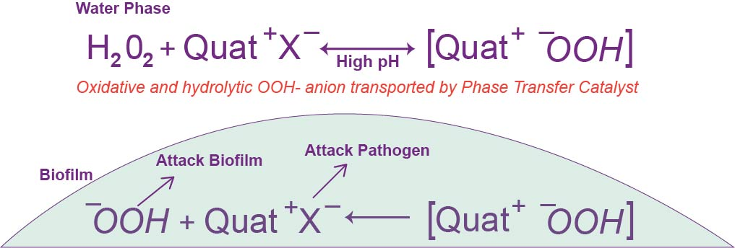
Sterilex PerQuat® Technology
Disassociating H₂O₂ in an alkaline environment and pairing it with a positively charged Quat, forms intimate ion pair soluble in both lipid and aqueous phases

Slide 21
Sterilex Food C&S Product Line
Can be used everywhere in a plant including on food contact surfaces and drains.
Food pathogens including:
Listeria monocytogenes
Escherichia coli 0157:H7
Salmonella choleraesius
Sterilex Ultra Disinfectant Cleaner and Activator
EPA: 63761-8
Sterilex Ultra CIP
Formulated with anti-foam
CIP/HTST/Injector treatment
Sterilex Ultra Soft Metal Safe Activator
Replace Sterilex Ultra Activator
Compatible with wide variety of aluminum surfaces
Perfect for overheads, freezers, coils, etc.
Sterilex Ultra Step EPA: 63761-10
Same PerQuat® chemistry in dry form
EPA registered solid floor sanitizer
Less dusty
Blue color
Indicon Gel – NEW !
Biofilm Indicator
Not to replace ATP swabs
Rapid detection as quick as 30 seconds

Slide 22
Example Use Sites
Food Contact Surfaces
Grinders
Conveyors
Environmental Surfaces
Drains
Walls
Other Harborage Areas
Chillers/HVAC (SM Safe)
Coils (SM Safe)
Dryers
RTE/Clean Rooms
Brine Injectors (CIP)
Brine Chillers (CIP)
Floors
Freezers (SM Safe)
Central Sanitizing Systems
Lube Lines

Slide 23
Contract Information
Alex Zeman
Regional Sales Manager – West
Sterilex
720-299-3828
alex.zeman@sterilex.com

