Slide 1
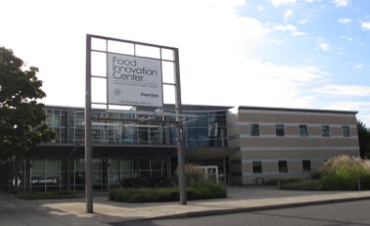
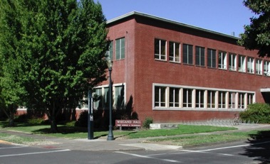
- Food Safety Initiatives and Updates -
September 21, 2017
WAFFP 66th Annual Conference
Jovana Kovacevic, PhD
Assist. Prof. and Extension Specialist, Food Safety
Coordinator, FSMA Western Regional Center to Enhance Food Safety
jovana.kovacevic@oregonstate.edu

Slide 2

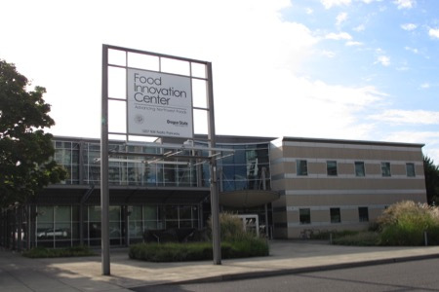
Food Safety @ OSU
FST-Corvallis
FIC-Portland
Seafood-Astoria
NWREC-Aurora

Slide 3
Food Safety @ OSU
FST-Corvallis
FIC-Portland
Seafood-Astoria
NWREC-Aurora

Slide 4

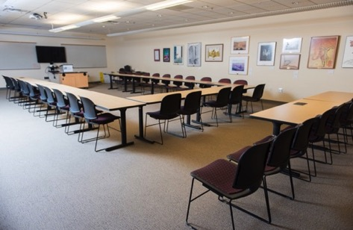
FIC-Portland
Opened in 1999
An urban OSU Agricultural Experiment Station
Joint venture between OSU and Oregon Dept. of Agriculture (ODA)
Pilot processing plant and kitchen for lease
33,000 ft² of offices, laboratories and meeting rooms
Large classroom, conference room and focus group rooms

Slide 5
FIC’s Mission and Goals
….Advancing Foods in the Northwest and Beyond
FIC
Add value to the Northwest agricultural and food sector industries.
Deliver excellent client-oriented services in a timely manner.
Be accessible to diverse audiences.
Provide relevant and quality educational training and workshops for clients.
Be leaders in sensory testing, product development, and food safety.
Train future leaders in the food sector.
Photo source: FIC

Slide 6
FIC Food Safety Program
Dr. J. Kovacevic
Food Safety Education and Research
  Education
    Enhancing food safety education and training at FIC to align it with FSMA requirements
  Research
    Integrative Approaches to Improve Food Safety: Applied research meets genomics

Slide 7

Food Safety @ FIC - Education
Food Safety Modernization Act (FSMA) training workshops
  FDA-approved curriculum for FSMA Preventive Controls for Human Food rule and Produce Safety rule
  Needs assessment for food safety training;
  simplified and advanced FSMA-related food
  safety workshops

Slide 8
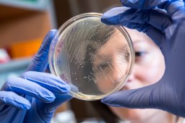
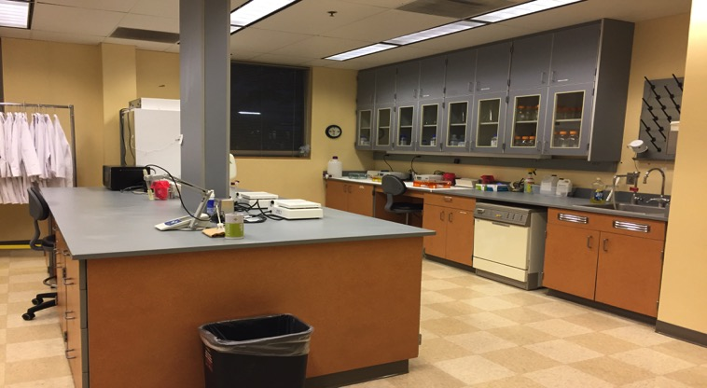
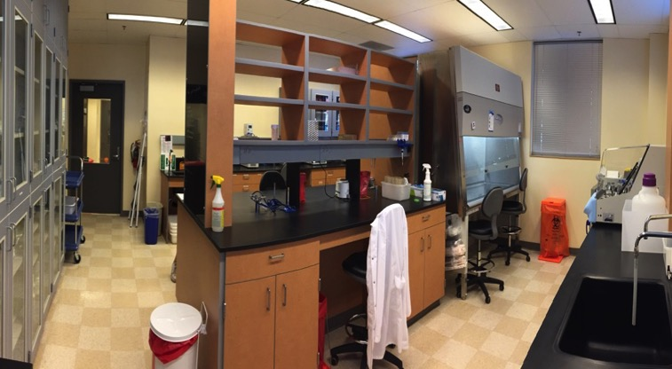
Food Safety @ FIC – Research
Joined FIC in Sept. 2016
  Assist. Prof. and Food Safety Extension Specialist
  Coordinator of WRCEFS
Two new Food Microbiology Labs created
BSL-1 Lab
Photos source: FIC
BSL-2 Lab

Slide 9
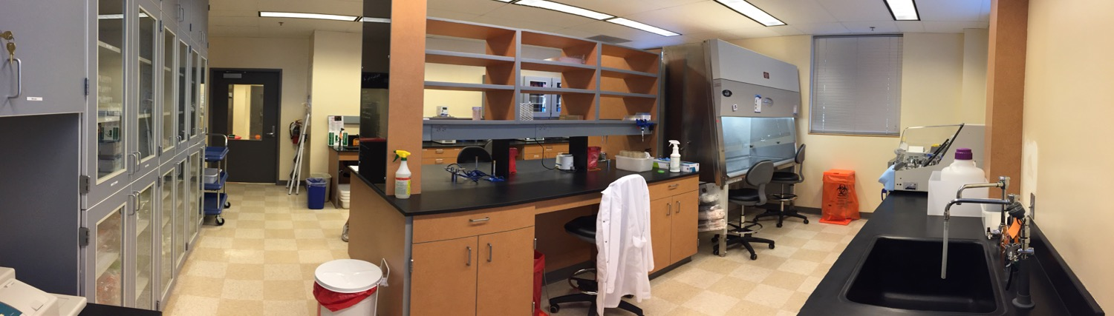
Food Safety @ FIC – Research
Integrative approaches to improve food safety throughout the farm-to-fork food chain
(Large focus on Listeria research)
Molecular methods to improve surveillance and track contamination sources
Stress response and survival in the farm-to-fork chain
Antimicrobial resistance and co-selection

Slide 10
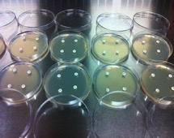
Western Region Listeria Research Program
Prevalence studies
Contamination troubleshooting
Environmental swabbing &
employee training
Strain Characterization
Surface contamination
and biofilms
Genotypic
MLST
WGS
And other DNA/RNA methods…
Phenotypic
Susceptibility to sanitizers and other antimicrobials
Strain identification and speciation
AMR
Growth under food-
chain stress conditions

Slide 11
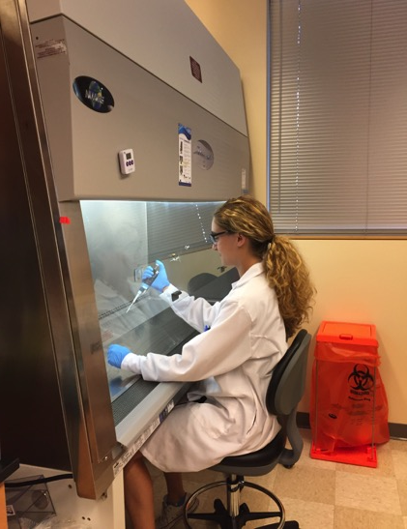
Food Safety @ FIC
Examples of recent and current projects
Integration of FSMA produce safety outreach and education into extension initiatives in Oregon (co-PIs: Dr. J. Waite-Cusic and Dr. L. Santamaria)
Sources and control of Listeria in PNW produce industry (co-PI: Dr. Waite-Cusic)
Mobile solution app and food recall information system for small specialty crops food processors (PI: Dr. Q. Ling)
Efficacy of traditional and non- traditional eco-friendly “green” sanitizers on Listeria monocytogenes
Efficacy of heat-shock treatments in milk to inactivate Salmonella, Shiga toxin-producing E. coli (STEC) and L. monocytogenes (PI: Dr. Waite-Cusic)
Evaluation of the growth of pathogenic and non- pathogenic Vibrio parahaemolyticus at different temperatures and their susceptibility to natural antimicrobials (co-PI: Dr. Christina DeWitt)
Use of genomic tools to trace Listeria spp. contamination and harborage sites in food processing facilities. (Project done in collaboration with the British Columbia Center for Disease Control)
MS Student, Cara Boucher

Slide 12

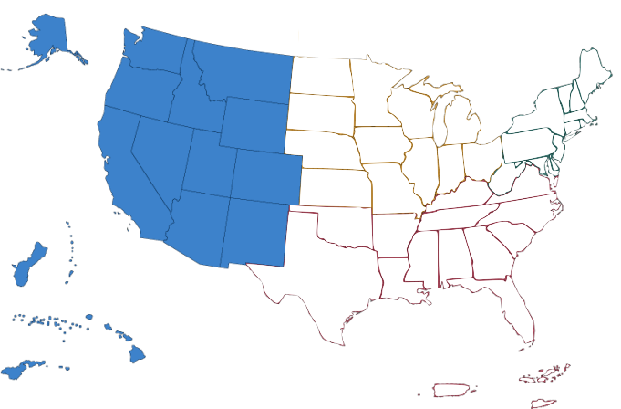
Western Regional Center
One of four USDA/FDA funded regional FSMA training coordination centers in 2015
  Western Region – Oregon State University
  Southern Region – University of Florida
  NE Region – University of Vermont
  Central Region – Iowa State University
  National Coordinating Center - IFPTI – Battle Creek, MI
Principal Investigators: Drs. Bob McGorrin, Christina DeWitt, Jovana Kovacevic and Michael Morrissey
Source: www.sare.org
13 western states and 2 Pacific Island Nations
*retired Dec. 2016

Slide 13




Western Regional Center
    Mountain sub-region: Dr. Marisa Bunning
    Northwest sub-region: Dr. Barbara Rasco
    Southwest sub-region: Dr. Linda Harris
    Pacific sub-region: Dr. Aurora Saulo
*retired Dec. 2016

Slide 14

Western Regional Center at OSU
Train-the-Trainer FSPCA and PSA Workshops
Add-on Curriculum
Coordination with other Regional Centers and NCC
Communication
Cadre of Trainers, Lead Trainers, Lead Instructors
Technical assistance
Evaluation
Training of Stakeholders

Slide 15
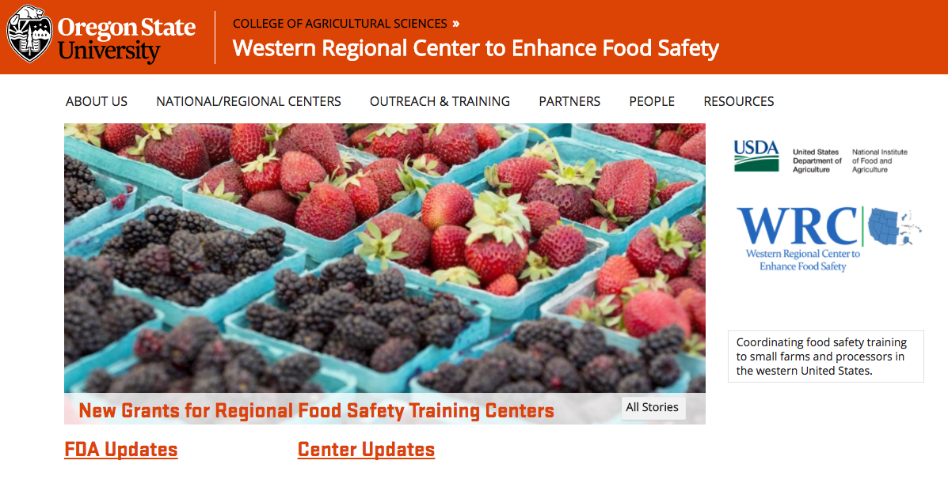
For more information visit: https://agsci.oregonstate.edu/wrfsc
Upcoming Trainings
PSA Train-the-Trainer Course - 11/9-10/2017 - Vancouver, WA
Grower Training - 10/7/2017 - Pullman, WA
Grower Training - 11/7/2017 - Medford, OR
Grower Training - 11/7/2017 - Idaho Falls, ID
…and many more!

Slide 16
Food Safety @ OSU
FST-Corvallis
FIC-Portland
Seafood-Astoria
NWREC-Aurora

Slide 17
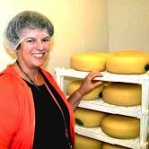
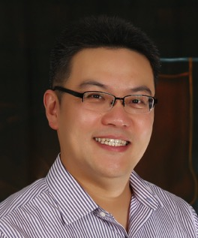
Food Safety – Corvallis Campus
Joy Waite-Cusic, Ph.D.
Assist. Prof. of Food Safety Systems
Food Science and Technology, CAS
Lisbeth Goddik, Ph.D.
Professor and Extension Specialist Dairy Processing
Food Science and Technology, CAS
Also…
Dr. Mark Daeschel – retired in 2017 but still teaching and consulting
Center For Small Farms & Community Food Systems
Si Hong Park, Ph.D.
Assist. Prof., Food Safety Biologist
Food Science and Technology, CAS

Slide 18
Food Safety – Corvallis Campus
Joy Waite-Cusic, Ph.D.
Assist. Prof. of Food Safety Systems
Food Science and Technology, CAS
Lisbeth Goddik, Ph.D.
Professor and Extension Specialist in Dairy Processing
Food Science and Technology, CAS
Also…
Dr, Mark Daeschel – retired in 2017 but still teaching and consulting
Center For Small Farms & Community Food Systems
Si Hong Park, Ph.D.
Assist. Prof., Food Safety Biologist
Food Science and Technology, CAS

Slide 19
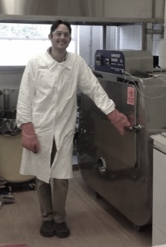
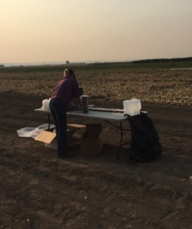
Waite-Cusic Food Micro Lab
Finished Product
Joy Waite-Cusic, Ph.D.
Assist. Prof. of Food Safety Systems
Food Science and Technology, CAS
”Band-aid” spoilage of chocolate milk (spoilage)
Foam destabilization of fluid milk (spoilage)
Reconditioning process of Oregon nut butters associated with a Salmonella outbreak
Hop beta acids as “clean label” antimicrobials to prevent L. mono growth in deli meats
Examples of recent and current projects
On-Farm Research
Processing Environment
Contaminated irrigation water and onions (MCES)
Dehydration processes to inactivate Salmonella and STEC in jerky production
Microbiological quality of surface water used for irrigation of specialty crops
Steam blanching to kill Salmonella on in-shell hazelnuts
Cattle feeding trials to reduce STEC shedding (EOARC)
Efficacy of sanitizers to reduce Salmonella on naturally contaminated hazelnuts
Prevalence studies of Salmonella in hazelnuts
State-licensed poultry producers and Salmonella
High pressure processing to kill L. mono and E. coli O157:H7 in cheese
Salmonella Dublin shedding immediately after calving
Propylene oxide treatment as an effective strategy to inactivate Salmonella on tree nuts (commercial-scale)
Risks of biosolids as biological soil amendments
Impacts of milk hauling practices on microbial load of fluid milk
Slide courtesy of:
Dr. Joy Waite-Cusic

Slide 20
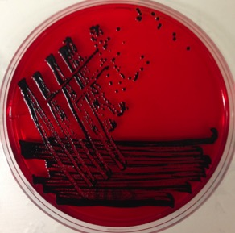
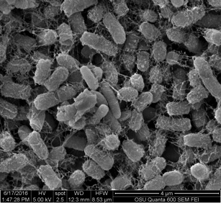
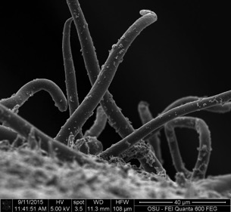
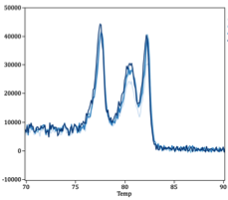






Waite-Cusic Food Micro Lab –
Research Capabilities
BSL-2 Lab and Greenhouse:
Salmonella spp.
Pathogens
Joy Waite-Cusic, Ph.D.
Assist. Prof. of Food Safety Systems
Food Science and Technology, CAS
Listeria monocytogenes
Shiga toxin-producing E. coli
And others….
Extensive culture collection
(clinical, food, and environmental)
Spoilage organisms
Processing Capabilities: e.g., thermal, dehydration, high pressure
(scale: bench, pilot, and commercial)
Surrogates
Indicators
Non-Pathogens
Method Development, Validation, and Evaluation
Biofilm Formation and SEM Imaging
Strain Characterization
Genotypic
Phenotypic
DNA Amplification Assays – various strategies
Whole genome sequencing very soon!

Slide 21
Food Safety – Corvallis Campus
Joy Waite-Cusic, Ph.D.
Assist. Prof. of Food Safety Systems
Food Science and Technology, CAS
Lisbeth Goddik, Ph.D.
Professor and Extension Specialist in Dairy Processing
Food Science and Technology, CAS
Also…
Dr, Mark Daeschel – retired in 2017 but still teaching and consulting
Center For Small Farms & Community Food Systems
Si Hong Park, Ph.D.
Assist. Prof., Food Safety Biologist
Food Science and Technology, CAS

Slide 22
Dr. Si Hong Park
Slide courtesy of:
Dr. Si Hong Park
Brief Background
B.S & M.S. Food Science and Biotechnology, Kyung Hee Univ. South Korea
Ph.D. Cell and Molecular Biology, Univ. of Arkansas, Fayetteville, USA
Post-doc. Food Science, Univ. of Arkansas, Fayetteville, USA
Tenure-track faculty in FST starting from Aug. 2017
Areas of Specialization (Expertise)
Food safety: Detection and identification of foodborne pathogens
Microbiome sequencing in foods and food animals and WGS
Collaborative Interests
1. Effects of food supplements (antimicrobials, prebiotics and probiotics) on gut microbiota of humans and animals (microbiome).
2. Identification of antibiotic resistant genes in foodborne pathogens via WGS
3. Interaction between host and foodborne pathogens in gene expression levels
Position Responsibilities
1. 60% research, 30% teaching and 10% service
2. Serve as a committee member for department, college and university
3. Mentor undergraduate and graduate students
4. Write local and national grants
5. Write and review grants
6. Editorial board member

Slide 23

Dr. Si Hong Park
Slide courtesy of:
Dr. Si Hong Park
Food Safety (Microbiology)
Molecular biology
Foodborne pathogens
Salmonella, Campylobacter, Listeria, E. coli O157:H7, and MRSA
Various molecular techniques
Metagenomics
Bioinformatics
Genomics
Transcriptomics
Proteomics
Detection and control
of foodborne pathogens
Different virulence
gene expressions
for survival under stress
Host response against foodborne pathogens

Slide 24
Food Safety – Corvallis Campus
Joy Waite-Cusic, Ph.D.
Assist. Prof. of Food Safety Systems
Food Science and Technology, CAS
Lisbeth Goddik, Ph.D.
Professor and Extension Specialist in Dairy Processing
Food Science and Technology, CAS
Also…
Dr, Mark Daeschel – retired in 2017 but still teaching and consulting
Center For Small Farms & Community Food Systems
Si Hong Park, Ph.D.
Assist. Prof., Food Safety Biologist
Food Science and Technology, CAS

Slide 25
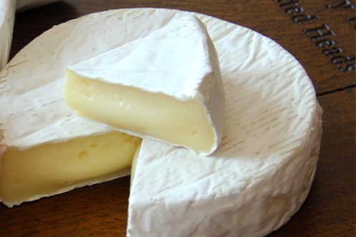
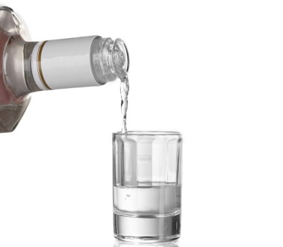
Projects started in 2016
Danton Batty (Dr. Waite-Cusic):
  Manipulate calcium content in soft ripened cheeses to develop product that withstands HPP treatment (modifying fermentation conditions)
  Validate concept: Inoculate surface with L. monocytogenes, expose to HPP
Derrick Risner: (Dr. Hughes)
  Ferment whey to wine then distill to vodka
  Investigate feasibility of process as whey treatment for medium size cottage cheese/greek yogurt production and small-size cheese companies.

Slide 26
Other food safety initiatives @ OSU
NWREC-Aurora
Seafood-Astoria
http://oregonstate.edu/dept/NWREC/
http://osuseafoodlab.oregonstate.edu/
Seafood HACCP (Dr. Christina DeWitt)
HPP and SERS research projects in collaboration with FIC and others from OSU
Depuration and Vibrio project with Dr. Waite-Cusic
Produce safety trainings in collaboration with FIC & ODA (Dr. Luisa Santamaria)
Together with Doretta Claycomb (FIC) participating in NIFA FSOP grant led by Dr. Jang Ho Kim, U. Idaho

Slide 27
Questions?
Visit us at:
FIC … https://fic.oregonstate.edu/
OSU FST … http://oregonstate.edu/foodsci/
Western Regional Center… https://agsci.oregonstate.edu/wrfsc
Small Farms … http://smallfarms.oregonstate.edu/
OSU Seafood Lab … http://osuseafoodlab.oregonstate.edu/
Jovana Kovacevic, PhD
Assist. Professor and Extension Specialist, Food Safety
Food Innovation Center, Oregon State University
jovana.kovacevic@oregonstate.edu
(503) 872-6621

