Slide 1
School of Food Science
University of Idaho
and
Washington State University

Slide 2
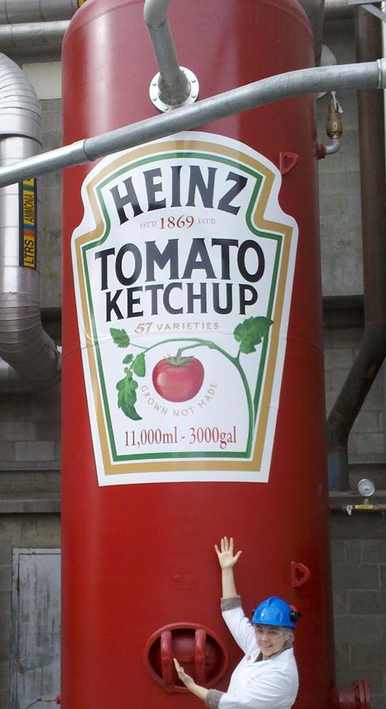
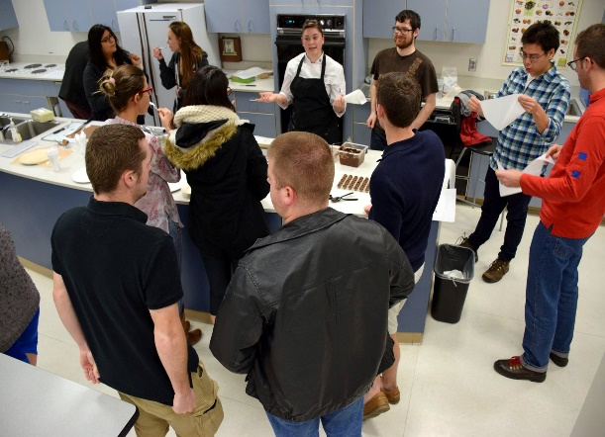
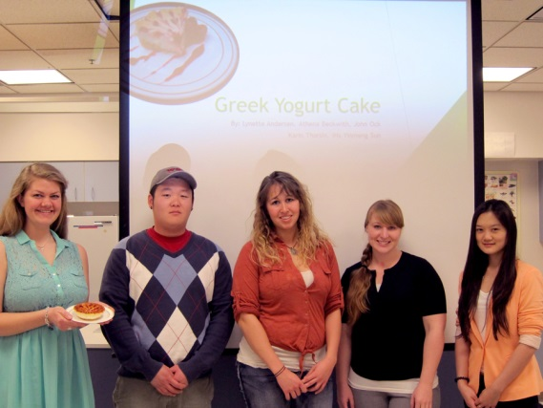
Education for Job Readiness
Students on either campus
BS, MS (or MS Online) and PhD
Coursework PLUS:
Industry Internships
Club and Team Projects
Undergraduate Research
On campus employment in WSU Creamery, Pilot Plant and labs

Slide 3
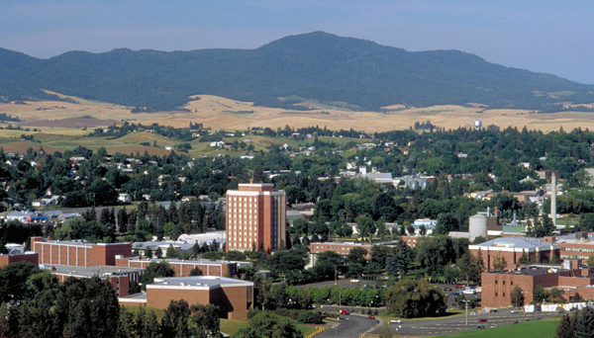
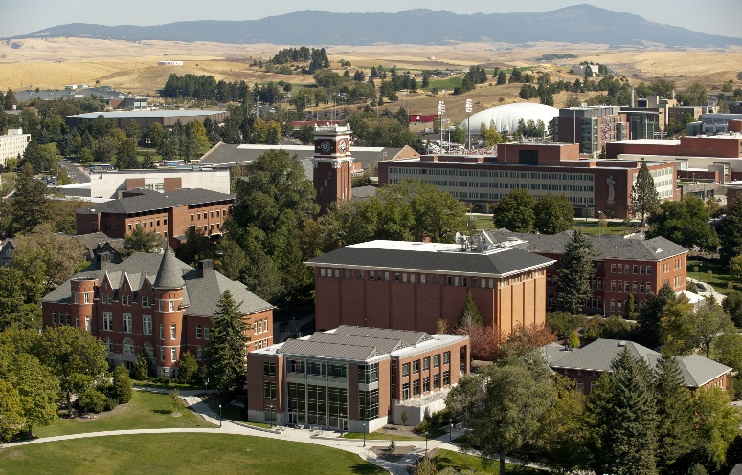
Our Goals
Provide strong applied science-based degrees and professional education
Increase safety, quality and value of Pacific Northwest foods
Develop new technologies and products to meet domestic and international market demands for food

Slide 4
Our Goals
Investigate functional and nutritional properties of food and food components
Assist agricultural community to remain competitive
Promote economic and environmental sustainability in agriculture and food processing

Slide 5
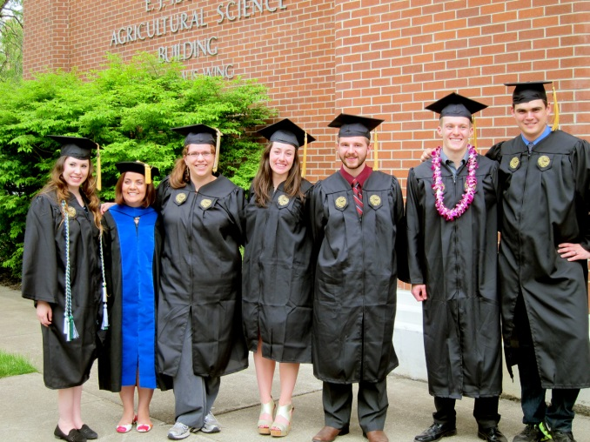
Our Staff and Students
26 staff
3 program managers
WSU Pilot Plant: Frank Younce
WSU Creamery: John Haugen
U Idaho Food Tech Center: Josh Bevan
110 undergraduate students
100 graduate students
47 students on campus
53 MS AG Food Science and Management

Slide 6
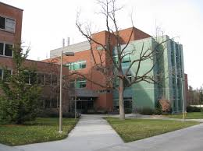
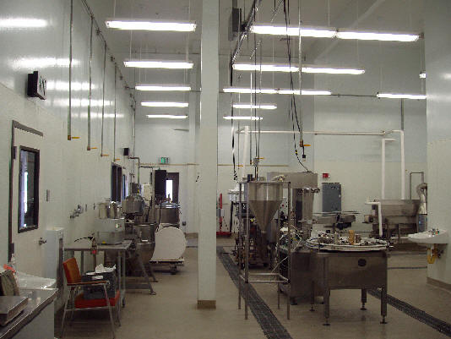
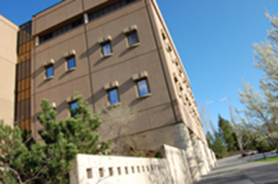
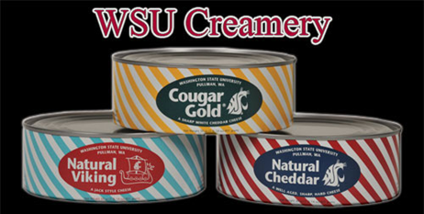
Combined Facilities
Moscow
Ag Science Building
Ag Biotech Building
Revamping Food Research Center!
Caldwell
Food Technology Center
Boise
Water Center, Food Processing Extension, TECH–HELP
Twin Falls
Dairy Extension, TECH-HELP, CSI
Pullman
FSHN Building
Research and teaching labs
Food processing pilot plant
Sensory center
WSU Creamery and Ferdinand’s
Dairy processing pilot plant
WSU Tri Cities Campus
Everett/Mt Vernon

Slide 7
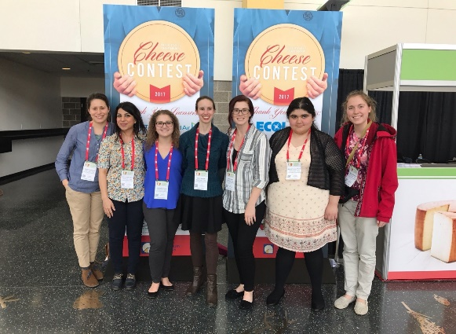
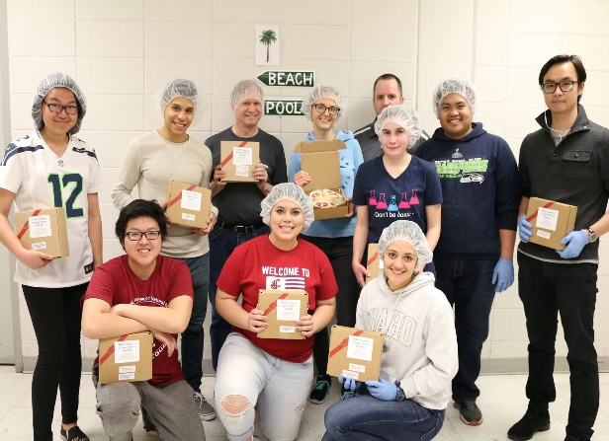
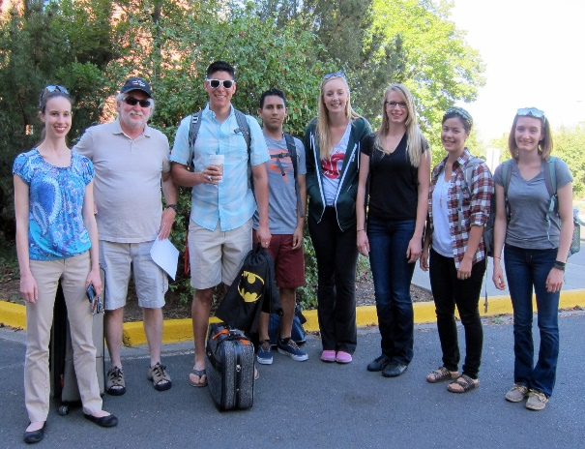
Dairy Foods Program
Option for BS in Food Science
BUILD DAIRY Program
Center for Agriculture, Food and the Environment
Research dairy and food processing focus
Dairy professor position currently being advertised
Goal is to build capacity for the dairy industry
Academic programs
Product development teams
Club activities
Dairy product judging teams
Work opportunities

Slide 8
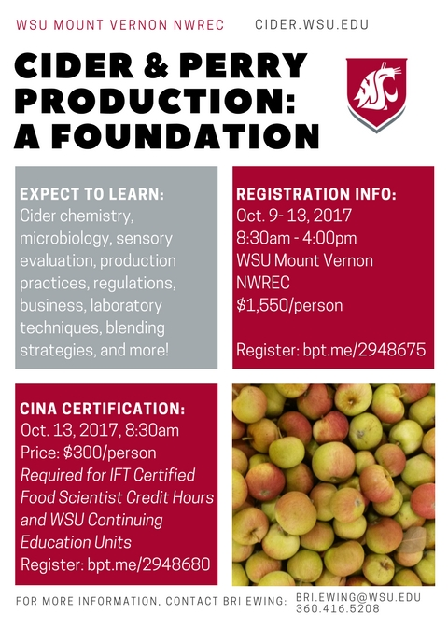
Cider, Perry, and Fermentations

Slide 9
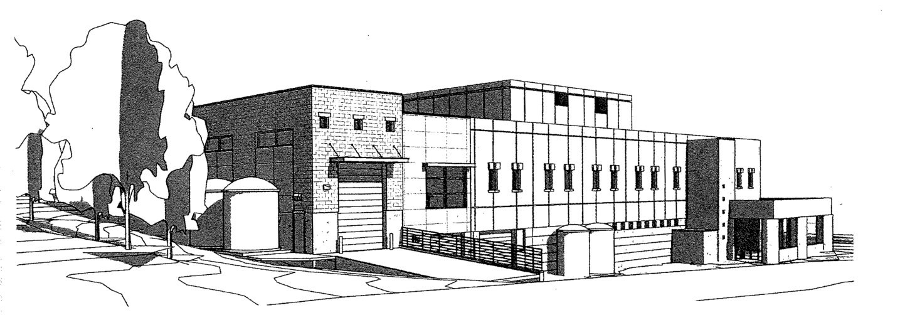
WSU Creamery Expansion
Construction completed -June 2017!
$4M building costs covered by Creamery revenues
Recommendations on equipment for the facility specifically for filtration and concentration welcome

Slide 10
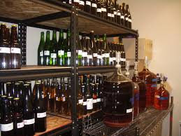
Fermentation Science
New degree option- science and technology of fermented foods and beverages started Fall 2016
Leverages current university expertise in dairy, cereal, fruit, wine

Slide 11
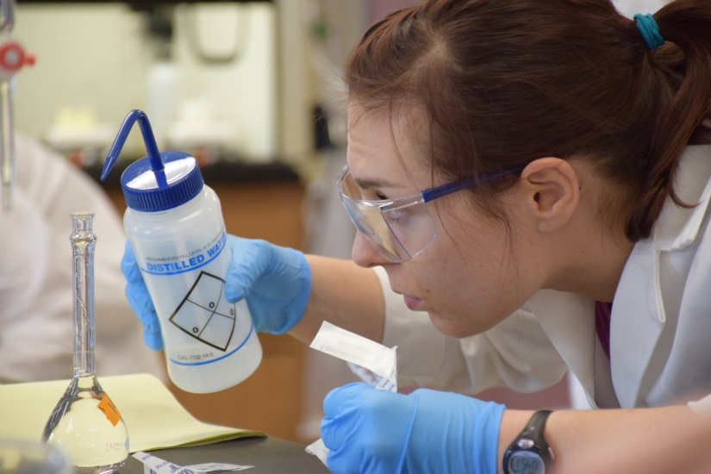
Professional Development
Online Programs
Certificate in Food Science
On-line Preventive Controls Qualified Individual training (FSMA) using FDA curriculum
MS AG - meets the growing need for food science professionals with management skills
Allows individuals to continue professional life while earning an advanced degree
Technology
Regulatory
Quality Management
MS Ag Food Science Management: msag.wsu.edu
Certificate in Food Science: https://online.wsu.edu/courses/foodscience/

Slide 12
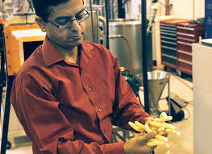
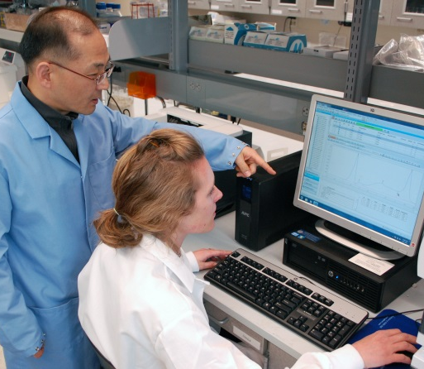
Program Visibility - Research Projects
Starch – nutrition, chemistry and functionality
Functionality of dairy ingredients
Food processing technologies – frying, thermal processing, dehydration, fermentation, packaging, novel technologies
Preventing foodborne illness – technologies to address emerging microbial risks – desiccation tolerance
Tasty nutritious, new products: pulse based snacks; fermented dairy foods
Fighting foodborne illness with natural additives
Water treatment – for industry and agricultural production

Slide 13
Industry Connections
Internships/Job Postings
Published to students, staff and faculty weekly
Resume Packet
Sent to employers in October and March every year
Company Recruiting Visits
Customized visits to connect with students
Promoting Food Science
Recruiting at high school and community colleges; on-campus events, 4H, FFA, Career Days
Newsletter and web presence
Emphasizing marketing and communications

Slide 15
WSU Food Processing and Safety Extension Team – Triangle of Expertise
Food Processing and Safety (Packaged Foods)
Consumer Food Safety
Produce Food Safety
Girish Ganjyal
Stephane Smith
TBD

Slide 16
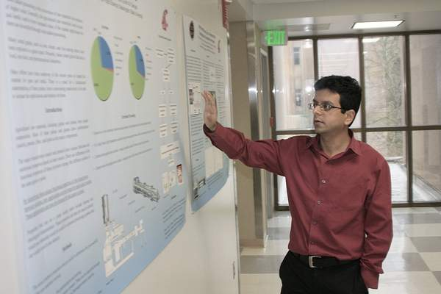
Food Processing and Safety Extension Program
Pulses
Apples
Cherries
Pomace
FSMA-PCHF
Food Ingredient Technology (FIT)
Extrusion Processing
Product Development
Basics of Sanitation
Food Safety and Sanitation Workshop
BPCS
Assistance with broader Industry Issues
Training Programs
Assistance to Individual Companies
Food Safety Plans
Validations
Process Authority
Product Development
Process Development

Slide 17
Food Processing and Safety Research Program
Physico- chemical changes in raw materials
Processing Technologies
Micro-structure Analysis
Thermal
Rheological
Chemical
Micro-CT Scanning
X-Ray Density Profiling
Extrusion
Frying
Direct Steam Injection

Slide 18
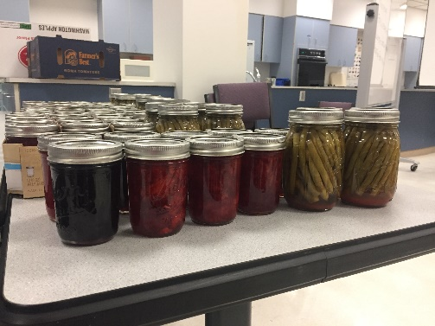
Consumer Food Safety Extension Program
Support & Education to:
Public
Direct to Consumer Markets
County Extension Offices
Advancing Food Safety Education
Food Safety Microbiology
Support for:
Process Authority
Product Development
Product Processing
Programs
FSMA-PCHF
Assist with BPCS
PSA Grower Training
Food Safety
Food Preservation
ServSafe
Addressing Broader Issues
Training Programs

Slide 19
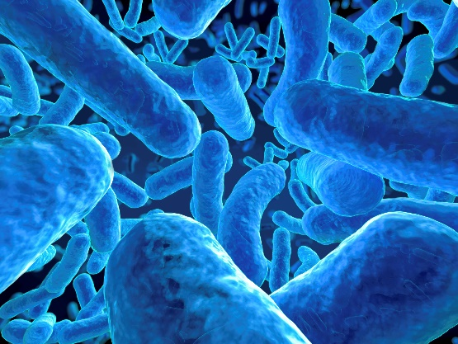
Consumer Food Safety Research Program
Microbial Growth on Surfaces/Foods
Microbial Survival
Broader Issues
Preservation processes
Food safety best practices
Consumer
Direct to Consumer
Markets
Projects by request

Slide 20
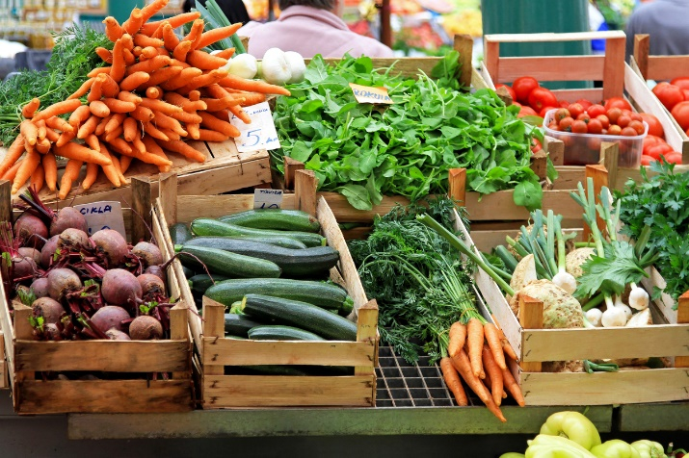
Food Safety Specialist – Produce Emphasis
Industry-relevant integrated extension and research program on food safety
Emphasis on raw agricultural products and minimally processed foods
Focus on foods produced in the Pacific Northwest
Lead statewide extension efforts in produce food safety.
Disseminate research.
Develop collaborative relationships with state and federal agencies and other organizations that develop or influence food safety policies.
Work with growers and ag commodity processors.

Slide 21
Upcoming Events
37th Annual Food Safety and Sanitation Workshop
Nov 7-8, Portland, OR
PSA Grower Trainings
October 7 (Grower Training), Pullman
Nov 9 (Grower Training), Vancouver
Nov 9-10 (Train the Trainer), Vancouver

Slide 22
Thank You!

