Slide 1
An Overview of the Washington State Shellfish Control Authority
Notes:
Change title
Add overview of topics

Slide 2
Overview
Molluscan shellfish in WA
Shellfish control authority and regulations
Company license types
Vibrio and biotoxins
Illness
Outreach
Tribal partnerships

Slide 3
What IS that….
Geoduck Clam

Slide 4
Oysters

Slide 5
Mussels

Slide 6
Scallops

Slide 7
What do they all have in common?
Molluscan bivalves species
Found in Washington state
Quite delicious
Products regulated by Shellfish Control Authority
Notes:
Molluscan bivalves
All varieties of oysters, clams, mussels, scallops (in-shell only)
Fresh, frozen,

Slide 8
What about…
Crab, lobster, abalone, squid?
Notes:
Add shrimp, crab, lobster, abalone
Note on WA state

Slide 9
DOH: Shellfish Control Authority
Dept of Health
Growing Area
WA Dept of Fish and Wildlife
DOH Lab
Licensing and Certification
Participant of the National Shellfish Sanitation Program
Notes:
Growing area section
-evaluate shellfish growing areas, classify shellfish growing areas based on the results of the evaluation, monitor shellfish growing areas for changes in water quality.
DOH has a memorandum of understanding with WA dept of Fish and Wildlife for patrolling growing areas based on risk assessement and emergency closures
-
DOH Lab
-MOU to process water/shellfish samples
-fecal coliforms to vibrio species to biotoxins

Slide 10
National Shellfish Sanitation Program
Federal/state cooperative program
Includes shellfish producing and non-producing states, federal agencies, and shellfish industry.
Sanitary control of shellfish produced and sold for human consumption
NSSP Guide for the Control of Molluscan Shellfish Model Ordinance
Notes:
The National Shellfish Sanitation Program (NSSP) is a federal/state cooperative program recognized by the Food and Drug Administration (FDA) and the Interstate Shellfish Sanitation Conference (ISSC) for the sanitary control of shellfish produced and sold for human consumption
The purpose is to promote and improve shellfish sanitation including oysters, clams, mussels, and scallops in interstate commerce through federal/state cooperation and uniformity of of state shellfish programs.
Includes agencies from shellfish producing states, like WA and non producing states, like Nevada along with the FDA, EPA, NOAA, shellfish industry and foreign goverments such as Canada and Mexico.
WA Dept of Health is the state shellfish control authority
From the NSSP, the Guide for the Control of Molluscan Shellfish Model Ordinance is developed and what NSSP member states use for the sanitary control of shellfish.

Slide 11
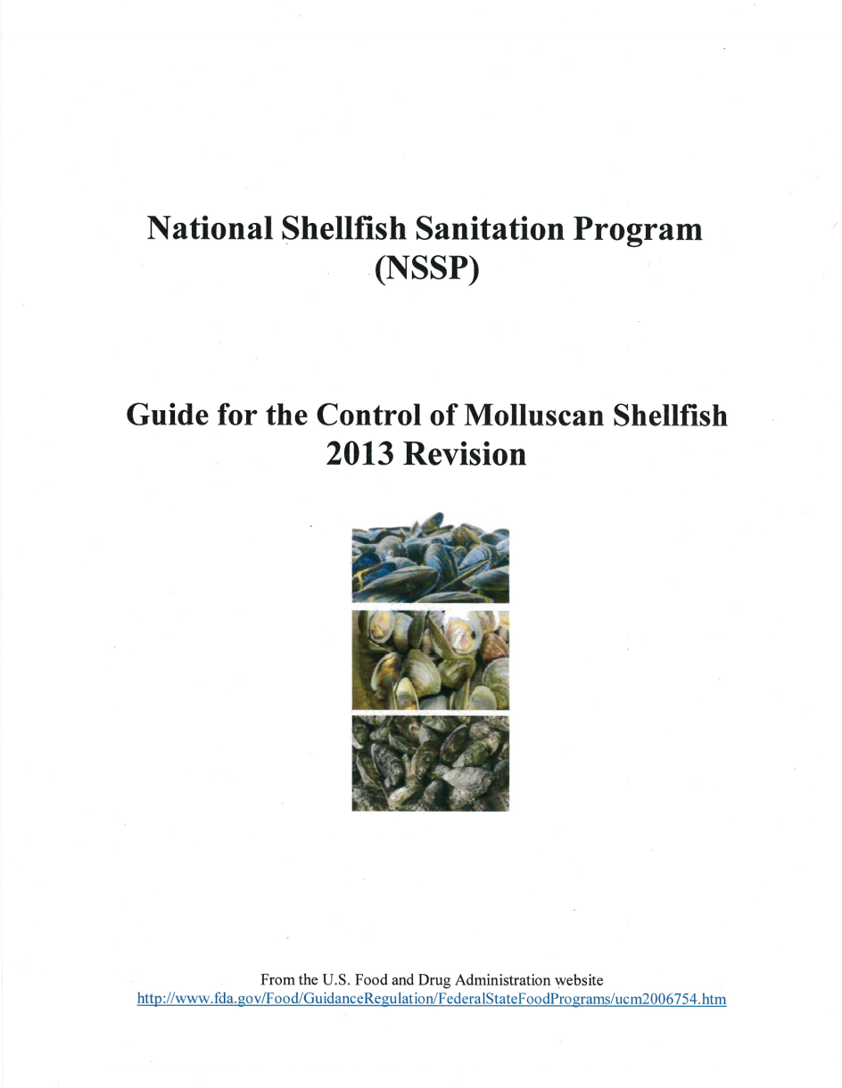
Regulations
The Model Ordinance guidelines ensure that the shellfish are safe and sanitary
WAC 246-282 Sanitary Control of Shellfish
Tribal Consent Decree (1994)
Notes:
This Ordinance establishes the minimum requirements necessary to regulate the interstate commerce of molluscan shellfish and to establish a program to protect the public health of consumers by assuring the sale or distribution of shellfish from safe sources and assuring shellfish have not been adulterated during cultivating, harvesting, processing, shipping or handling.

Slide 12
Licensing and Certification
Licenses
Operating license
Harvest site certification
Export certificates (DOH and NOAA)
Permits: bait, relay, seed, wet storage
325 + shellfish companies
Harvester
Dealers
Shellstock Shipper
Shucker Packer
Notes:
Each licensed company is assigned a unique certification number.

Slide 13
Harvesters
Harvest shellfish from open and approved areas for sale to a dealer within WA state
Inspected 1x/ year at minimum
Notes:
85 licensed harvesters
Each

Slide 14
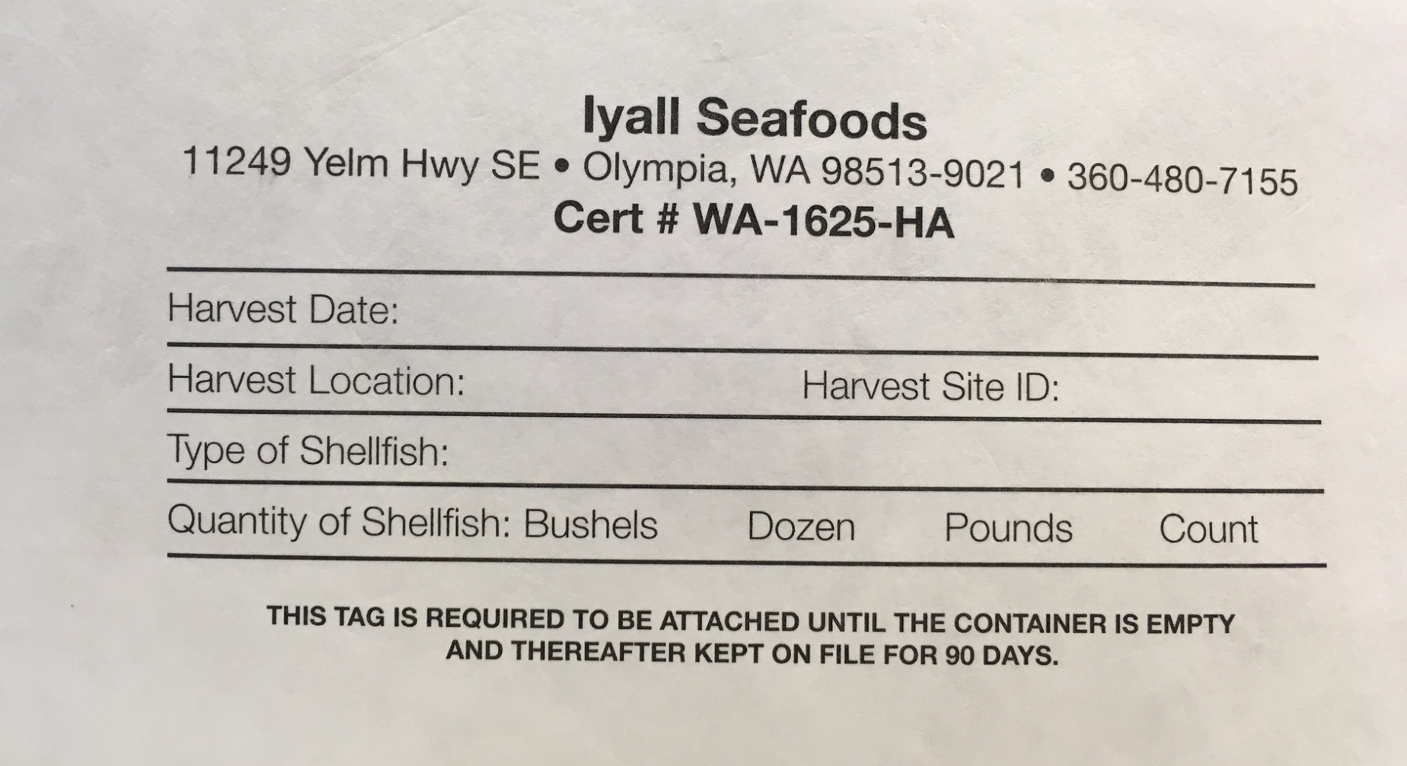
Harvesters
Notes:
Each company is required to tag their product. On their tag you will find, etc
Licensed company is assigned a unique certification number.

Slide 15
Dealer: Shellstock Shipper
Harvest
Buy shellstock
Sell to another dealer or retail establishment
In-state, out of state, or export
Inspected 2x/year at minimum
Notes:
218 shellstock shipper
Does not have to sell to a NSSP participating state

Slide 16
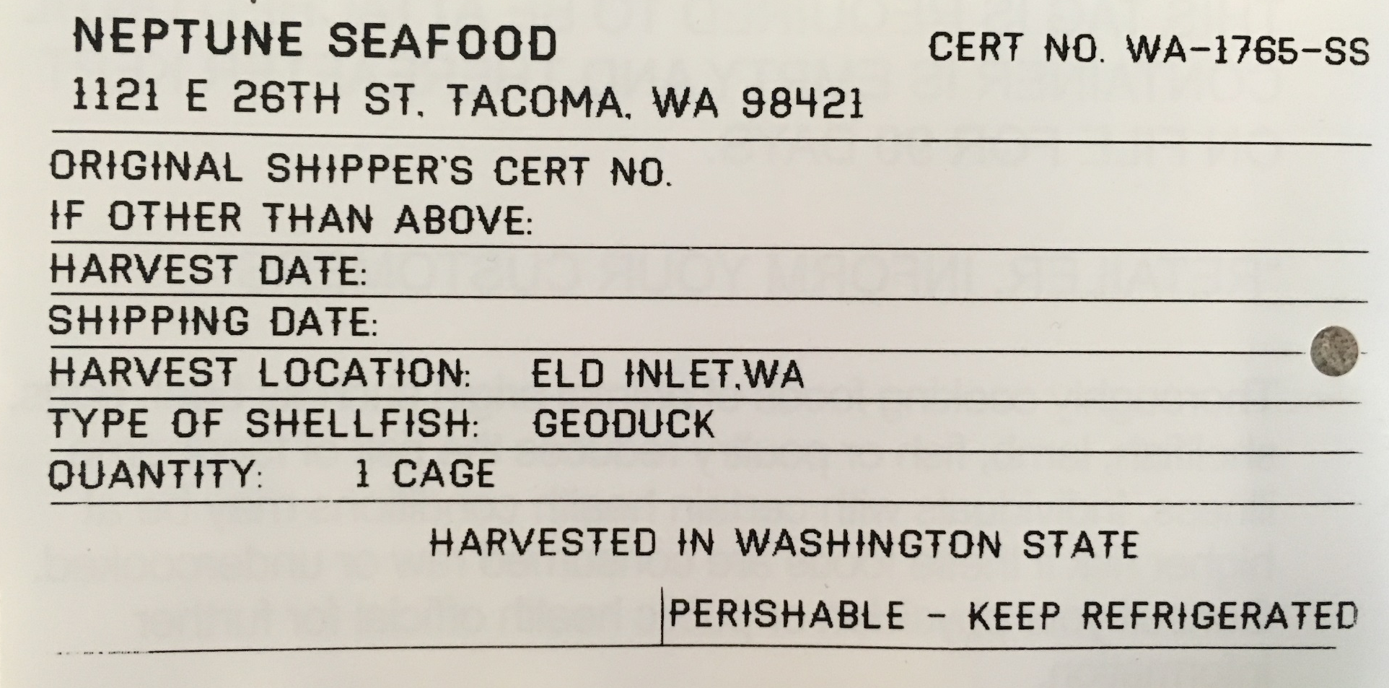
Shellstock Shipper

Slide 17
Dealer: Shucker Packer
Harvest
Buy shellstock
Can shuck!
Sell shellstock/shucked meats to dealer or retail establishment
In-state, out of state, or export
Inspected 4x/year at minimum
Notes:
22 shucker packers

Slide 18
Shucker Packer

Slide 19
= State Shellfish Control Authority (DOH)
= local health
Notes:
Talk through distribution and jurisdiction
As noted on previous slides, harvesters may only sell to dealers (so shellstock shippers and shucker packers) within WA. Dealers may sell to retail establishments or other dealers in which case the product be distributed within WA or out of state or out of the country.

Slide 20
What about……?
Notes:
If the product is further processed, such as smoking or canning, the product is no longer under the jurisdiction under the shellfish control authority.

Slide 21
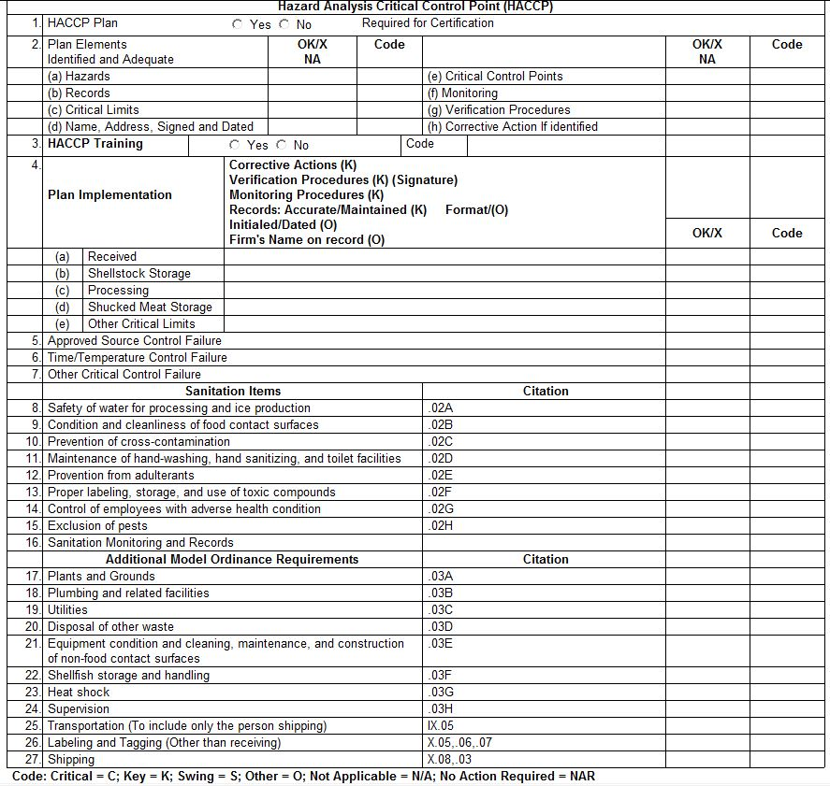
Inspections
Harvester
Time/temperature control
Storage/handling
Transportation
Tagging
Notes:
Harvesters are inspected at minimum 1x/yr

Slide 22
Inspections
Dealer
HACCP plan and implementation
8 key points of sanitation
Tagging/labeling
Transportation
Training

Slide 23
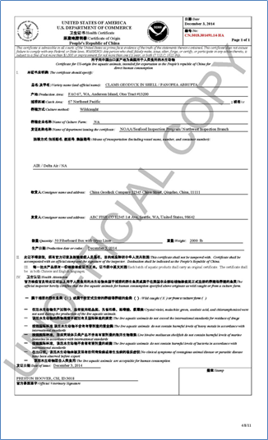
NOAA
Seafood Inspection Program
Contract to issue NOAA export health certificates for molluscan shellfish
Notes:
Moving away from routine items of DOH, unique items of our program
Molluscan shellfish companies participate in NOAA SIP program.
Collaboration on industry and environmental trends.
Provides a good service to the industry.

Slide 24
Summertime!!!
Fun, fun fun!
Bar-b-Que!
Vacation!
Notes:
But for a Shellfish Inspector, summertime triggers an entirely different range of thoughts. Where as many people are thinking about fun in the sun, and backyard barbecues, Shellfish Inspectors are thinking about public safety in regards to shellfish. And how our job function is important to food safety.

Slide 25
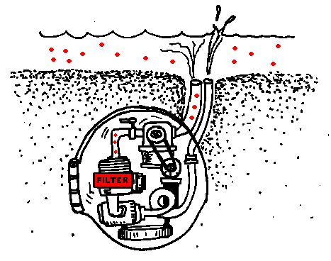
Shellfish are Filter Feeders
Notes:
Shellfish are filter feeders. So what that means is that they are sort of breathing water in and out constantly, and taking what nutrients are in the water to use for their health. But it also means that whatever is in the water, will be inside the shellfish. This is the reason why we focus on the beaches where shellfish grow. We do this by sampling water & sampling shellfish and then provide the public, shellfish growers, and shellfish dealers with the results. I’ll get into our sampling a bit more in a few minutes.

Slide 26
Vibrio Parahaemolyticus
Naturally-occurring bacteria
Common in warm marine and estuarine environments
Illnesses usually caused by eating raw or undercooked shellfish
Symptoms | Onset | Duration
Watery diarrhea, abdominal cramping, nausea, vomiting, and fever | 4-96 hours | 2-5 days
Notes:
So, as I said, shellfish are filter feeders and anything in the water will be in them. One particular bacteria we are focused on is Vibrio Parahaemolyticus. VP can be cooked out, but because Oyster are often eaten raw, we tend to focus on Oysters for VP.

Slide 27
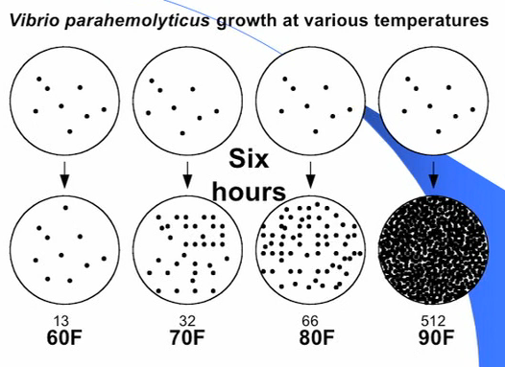
Vibrio Parahaemolyticus Continued
Highly temperature dependent
Post-harvest cooling important to limit growth
Notes:
This illustration shows how VP is highly temperature dependent. In the illustration as the temperature rises, the amount of bacteria that grows increases rapidly. This is why we need to cool our oysters to 50 degrees or less as soon as possible, to limit Vibrio growth.

Slide 28
Guiding Rules and Regulations
WAC 246-282-006 Washington State Vibrio Parahaemolyticus control plan.
Establishes rules for Washington state shellfish harvesters to proactively limit the growth of VP.
May 1 – September 30
Rapid cooling
VP Harvest Plan
Notes:
The guiding rules and regulation for dealing with Vibrio is in WAC 246-282-006.

Slide 29
Environmental Monitoring
Conduct monitoring year round and collect:
Tissue samples
Water, air and tissue temperature
Salinity
Public Health Lab evaluates the samples to quantify presence of bacteria and toxins.

Slide 30
Paralytic Shellfish Poisoning Diarrhetic Shellfish Poisoning Amnesic Shellfish Poisoning
Symptoms: Onset as soon as 30 minutes
Gastrointestinal
Vomiting, diarrhea, and abdominal pain
Neurological
Tingling of lips and tongue (PSP)
Muscular paralysis or incoordination (PSP)
Short Term memory loss (ASP)
DSP toxins have been shown to be tumor promoters
Notes:
Biotoxins can lead to development of 1 of these illnesses. PSP, DSP, ASP

Slide 31
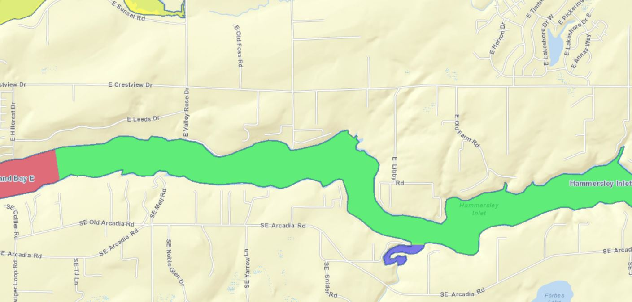
Hammersley Inlet
Notes:
Another area where we got involved is regarding a Norovirus outbreak in San Francisco. Using the shellfish tags that Rebecca talked about earlier, we were able to trace back the affected shellfish to Hammersley Inlet. (show where Hammersley Inlet is) Sampling water. Sampling Shellfish.

Slide 32
Actions taken by the Shellfish Program
Voluntary holds on harvesting during the investigation
Reviewed each case illness in association with other relevant cases
Closures and recalls
Press releases

Slide 33
Shellfish License and Harvest Site Certification
All licensed shellfish companies must have a Shellfish Operators License
All licensed shellfish companies must have a Harvest Site Certificate (HSC)
does not apply to wholesale-only dealers
The Shellfish License and HSC will list growing area and the harvest sites that a company can harvest on
These documents must be in your possession while harvesting i.e., person, boat
Notes:
I hope I didn’t paint too grim of a picture, because all these natural elements that could cause food protection issues, are manageable. That’s what we do as the Shellfish Control Authority. That’s what the industry does on their end to produce a high quality and safe product. A large portion of our job function is to work with the industry to produce safe results. … So, in order to do that,

Slide 34
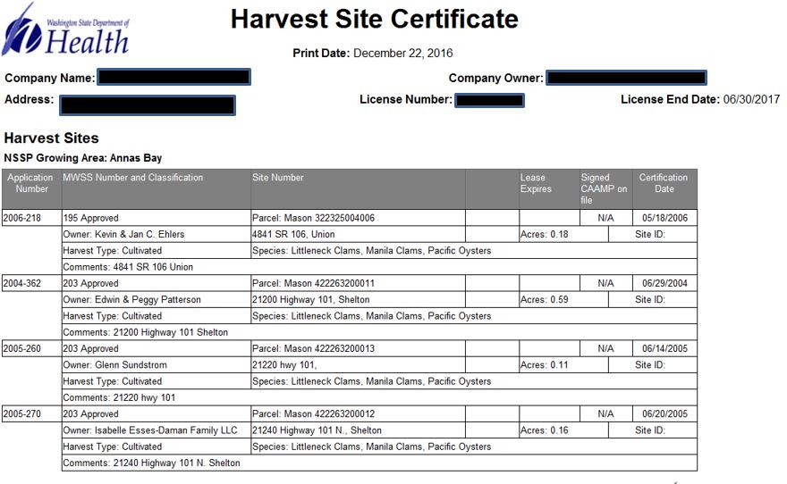
Required Documents for Harvesting
Notes:
We require that anyone harvesting a commercial quantity of shellfish have their Operators License and Harvest Sit Certificate on their person during the harvest.

Slide 35
Notes:
Here’s a little pictogram of the shellfish food production chain. The areas inside the box are the areas we regulate. As discussed earlier, as Shellfish inspectors, we’re often working with shellfish firms at their facility. But we also collaborate with firms out in the field, and on their ships when they are carrying commercial quantities of shellfish.

Slide 36
Outreach
September 7 & 8: Port Townsend Wooden Boat Festival – over 400 people visited our tent
September 29: Dungeness River Festival (Sequim)
October 6 – 8: Oysterfest (Shelton)
Notes:
We are also heavily involved in Outreach to our communities. Port Townsend. Dungeness River Festival. Oysterfest. Enviroscape picture. I staffed a booth at the Port Townsend Wooden Boat Festival. And the number 1 reason for kids and adults to come to our booth is because we had 2 LIVE GEODUCKS.

Slide 37
Tribal Partnerships
Tribal harvests
Tideflat surveys
Usual and Accustomed fishing rights
Notes:
One aspect of my work in particular, is tribal liaison for our shellfish program. So these are a few of the things I get to do as the tribal liaison… Tribal Harvests, Tribal surveys along the beach, and working with the tribes for usual and accustomed fishing rights. I took this picture during a tribal harvest up in Port Gamble Bay. You can see all the clusters of oysters on the beach. The tribal members take apart the clusters and bag them up for commercial sale. The treaties signed by the tribes and state of Washington have created a partnership where we are co-managers of the resource.

Slide 38
Enjoy!!!!
Its fun and good for you
Shellfish nutrition
Low in saturated fat
Contains omega-3 fatty acids
Especially good sources of high quality protein, minerals such as iron, zinc and copper and vitamins b-12
Notes:
Again, I think that our Shellfish Program in partnership with shellfish growers and dealers do a great job to keep our food safe, so I would say to enjoy it! But remember to cook your oysters…

Slide 39
Notes:
A shameless plug for our Washington State Department of Health…

Slide 40
Thank You!
Rebecca Stephany
rebecca.stephany@doh.wa.gov
Curtis Villa
curtis.villa@doh.wa.gov
Notes:
Here is our contact information if you think of any questions at a later date. If you have questions now, Rebecca and I will do our best to answer them.

Slide 41
Thanks
Alaska Ice Seafoods
Hama Hama Oyster Company
Iyall Seafoods
National Fish and Oyster
Neptune Seafoods
Olympia Oyster Company
WA Dept of Fish and Wildlife

Slide 42
Where Do I Find Answers?
Visit the DOH website @ doh.wa.gov / CommunityandEnvironment / Shellfish
Pollution closures: call DOH @ 360-236-3330 or the Local Health Department
Biotoxin closures: call the hotline 1-800-562-5632
WDFW closures: Sport Fishing Rule Pamphlet, click the link from the DOH website or call 1-866-880-5431

