Slide 1
Company Overview

Slide 2
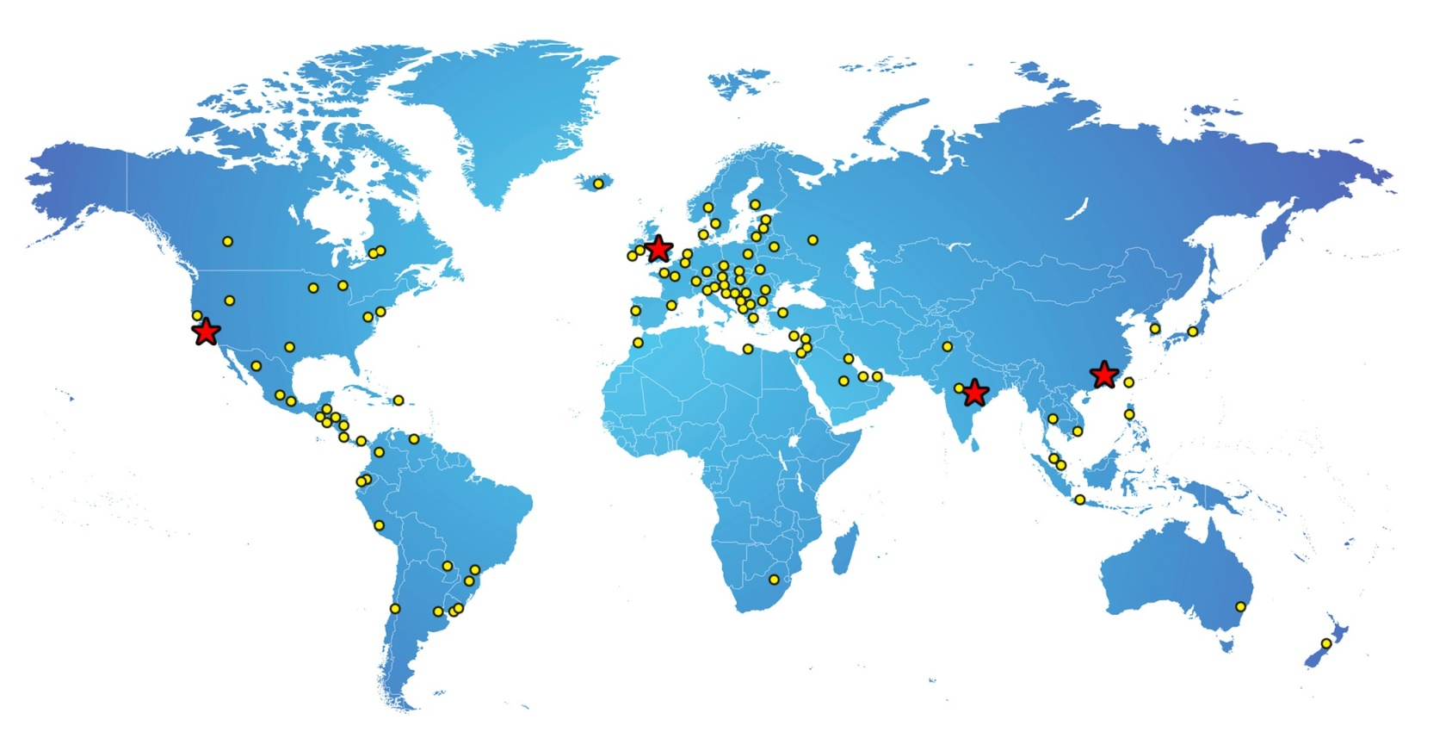
www.hygiena.com
Since 2001
Over 80 countries
Patented device designs
Manufactured in USA
Outstanding service & support
ISO-accredited facility
Notes:
Hygiena is a life science company that has been providing ATP cleaning verification and microbiology product solutions to the global market since 2001. With distribution in over 80 countries worldwide, our products span the globe. Our mission is to provide innovative technologies that are simple, easy to use, and reliable with excellent customer service and support. We manufacture all products under strict quality standards in an ISO-accredited facility.

Slide 3
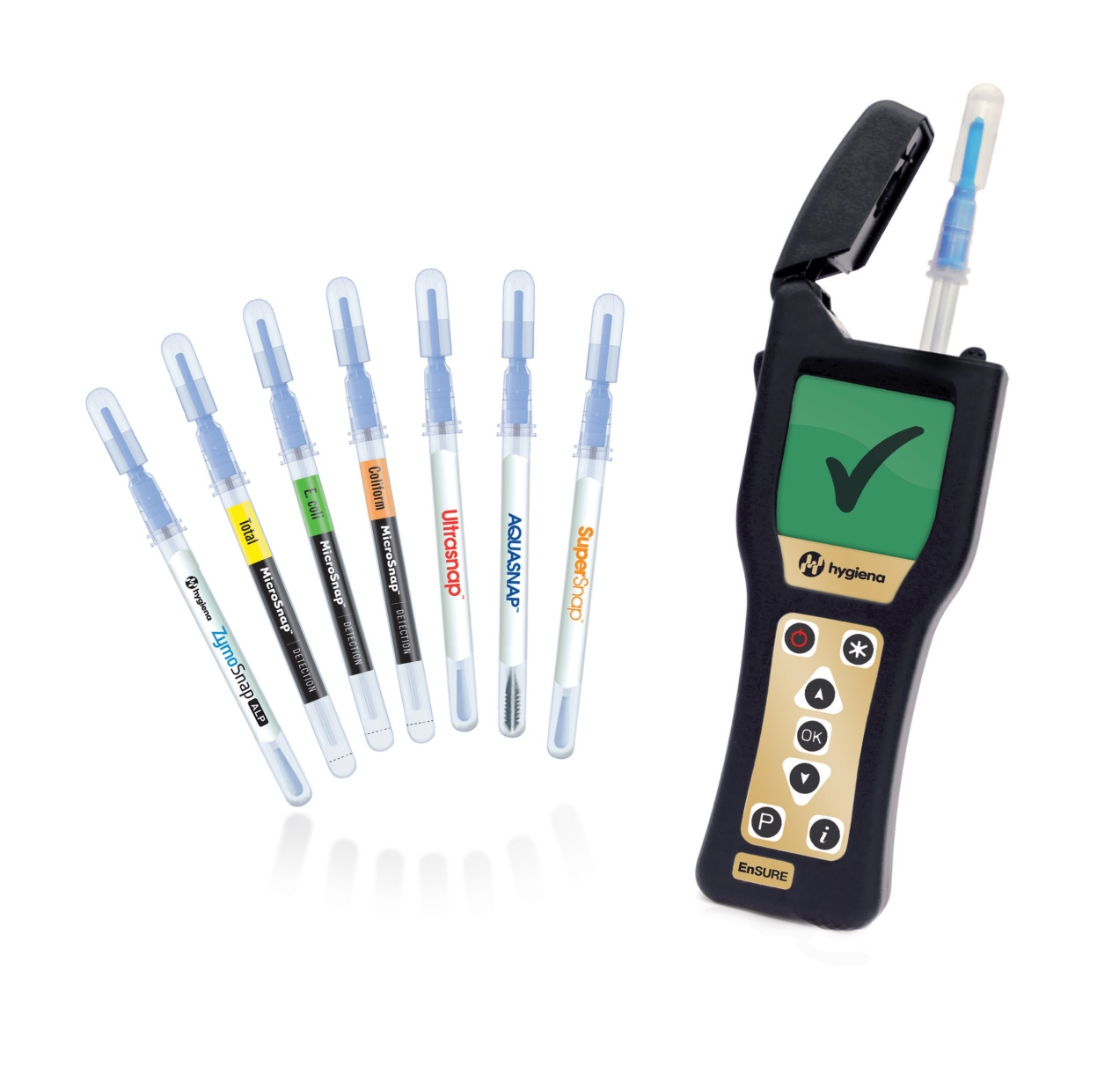
www.hygiena.com
Products Categories:
Hygiene monitoring
Surface monitoring
Microorganism testing
Allergen prevention
Sample collection

Slide 4
Anatomy of a Monitoring System
www.hygiena.com
3 Critical Components:
Instrument
Bioluminescence Chemistry
Test Device
Notes:
The instrument (luminometer) quantifies the bioluminescent reaction from the ATP test.
Chemistry facilitates the bioluminescent reaction that is measured by the instrument. The more reliable the chemistry, the more reliable the results.
Hygiena's test design maximizes sample collection and recovery, while using patented Snap-Valve™ technology to make activation easy.

Slide 5
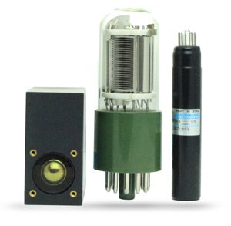
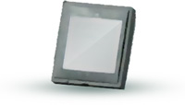
Component 1: Sensor
www.hygiena.com
Sensitivity
Durability
Power Requirement
Maintenance
Cost
Photomultiplier Tubes (PMT)
Photodiode (PD)
Notes:
Historically and even today, luminometers have used Photomultiplier Tube (PMT) sensors to detect low levels of light. However, with advancements in technology, new solid-state Photodiodes (PD) now have the ability to detect similar low levels of light and offer lots of additional benefits over PMT.
Hygiena instruments use advanced PD sensors and electronics, giving them the ability to detect lower levels of light than PMT based instruments.

Slide 6
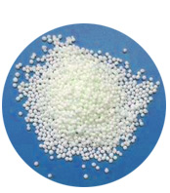
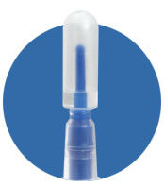
Component 2: Chemistry
www.hygiena.com
Variability
Accuracy
Manufacturing Cost
Lyophilized
Liquid-Stable
Notes:
Lyophilization has historically been the technology used to stabilize enzymes prior to use. Water is quickly evaporated out of the sample, leaving a pellet that can be reconstituted with a liquid. The pellet requires complex, expensive manufacturing, dry storage, and rehydration at point of use that causes larger variability from test to test.
Liquid-stable chemistry eliminates the need for lyophilization and stabilizes the enzymes in a liquid format. This eliminates costly manufacturing steps and reconstitution of the enzyme giving more reproducible results and better accuracy.

Slide 7
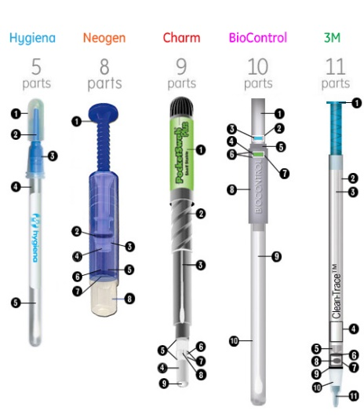
Component 3: Device Design
www.hygiena.com
Manufacturing Variance
Raw Materials
Sample Recovery
Cost
Notes:
Hygiena's test devices are made of less components than any other device. Fewer elements in the device means less room for error from manufacturing variance and less raw material costs.

Slide 8
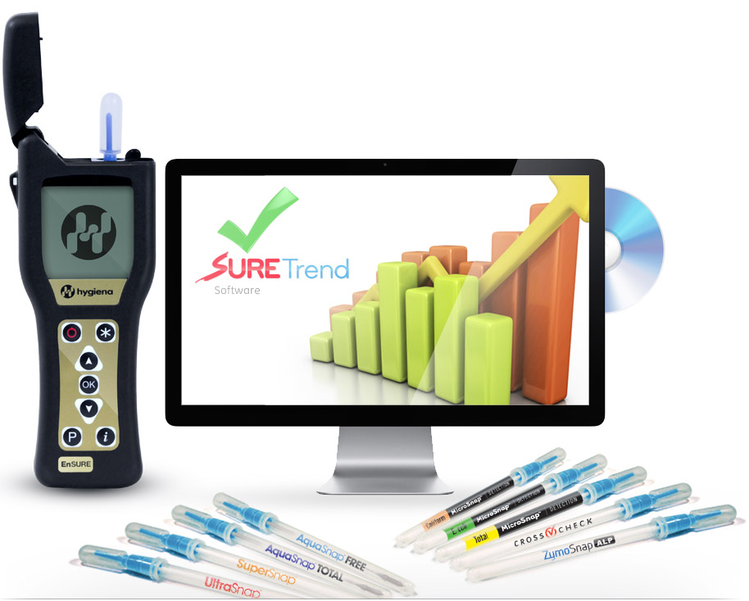
Multiple Quality Test System
www.hygiena.com
ATP
Water ATP
Microorganisms
Allergen
prevention
Enzyme tests

Slide 9
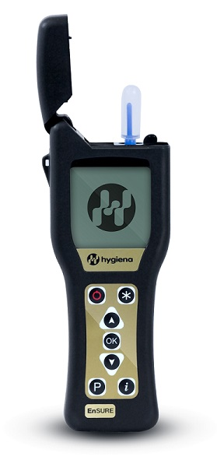
www.hygiena.com
Benefits
Extremely sensitive
Sensor stays in calibration, no maintenance
Lightweight, convenient for one-hand use
Powered by AA batteries for 8+ months
Displays locations, test plans, user names
Affordably priced
12 month warranty
Notes:
EnSURE™ is a quality monitoring system that uses one instrument platform to collect, analyze, and report data from multiple quality indicators. Using new state-of-the-art technology and patented designs, the EnSURE system is a simple-to-use, flexible, and accurate quality monitoring system.

Slide 10
SureTrend Data Analysis Software
www.hygiena.com
Track & trend results
Identify problem areas
Dashboard of important metrics
40+ preset reports
Network- and server-installable
Free with system – no license fees!
Download from the website

Slide 11
Surface ATP
www.hygiena.com
15 second results
Extremely sensitive
Efficient, easy-to-use
100% recyclable & non-toxic
Up to 50% cost savings
Outstanding repeatability, linearity, sensitivity, accuracy according to 3rd party laboratory study

Slide 12
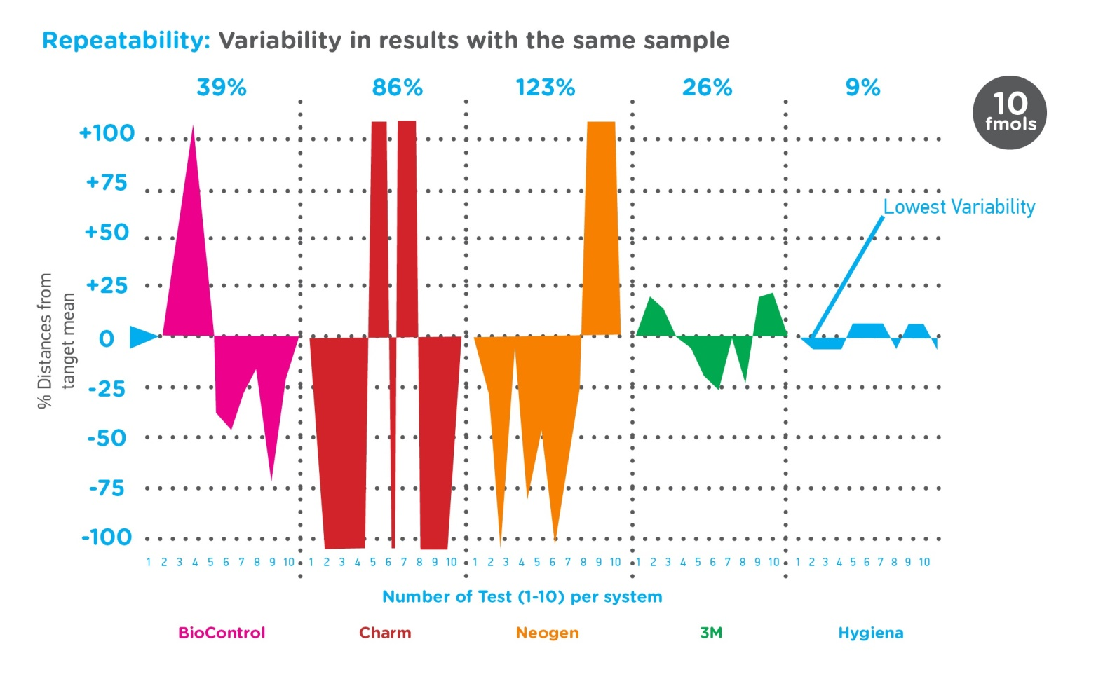
Low Device Variability
www.hygiena.com
Notes:
Repeatability is described by Coefficient of Variation (CV). The higher the CV, the greater the variability between each result with the same sample. More variability means the results are more inconsistent and unreliable. The graph shows that Hygiena systems consistently deliver dependable results with the lowest CV.

Slide 13
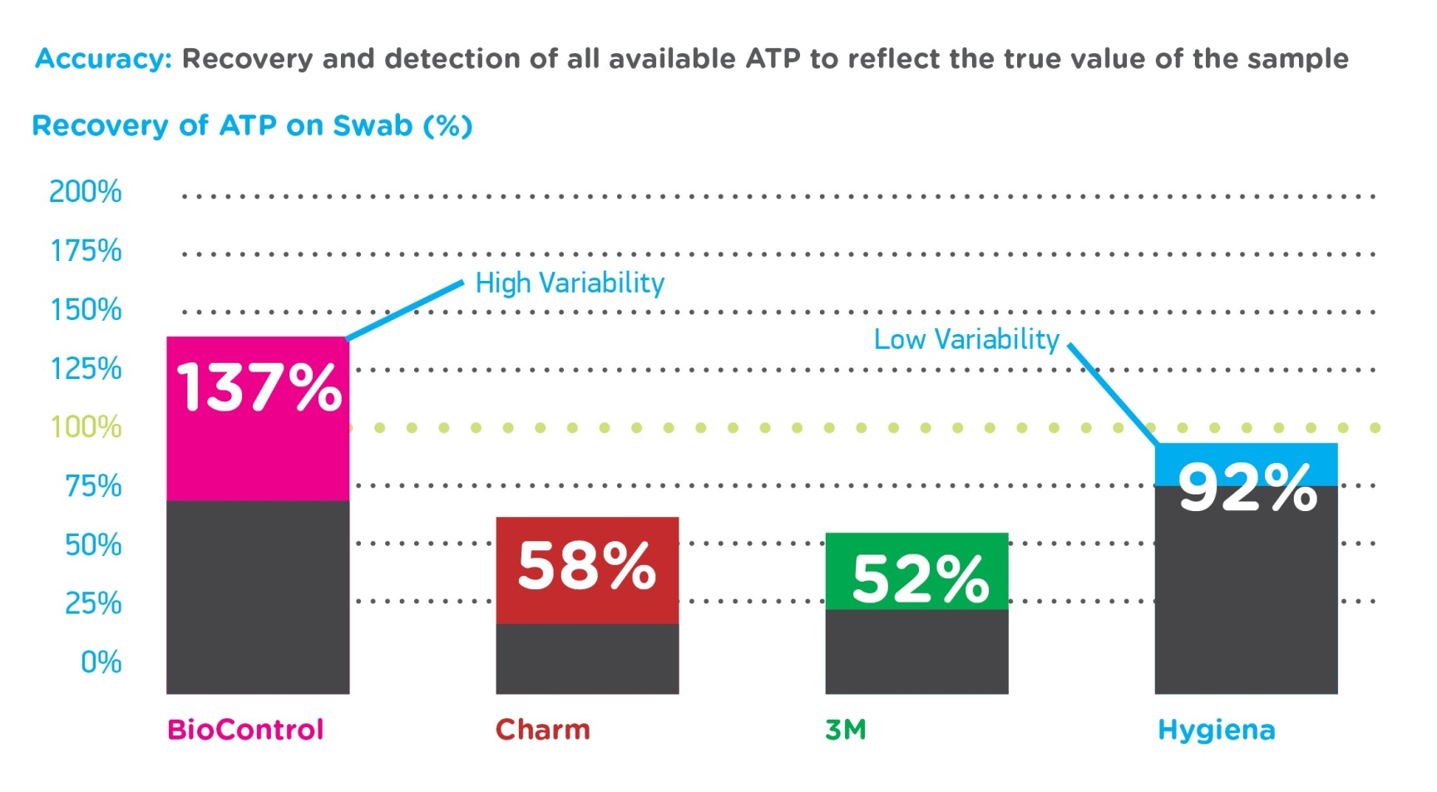
Highly Accurate
www.hygiena.com
Notes:
To test accuracy, 100 fmoles of ATP was added to each test device and measurements were taken (using 10 replicates) to determine how much of the available sample was actually detected. Results less than 100% indicate that only part of the sample was detected due to some interference within the system. Results over 100% indicate extra signal coming from the test device. Hygiena's system is the closest to 100%, thus the least variable.

Slide 14
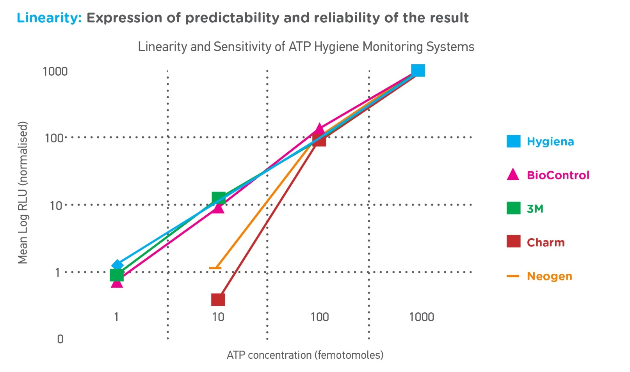
Reliable Results
www.hygiena.com
Notes:
The linearity graph shows a direct, proportional, straight-line relationship between RLU and ATP for the Hygiena system. The closer to linear a system can get, the more precise and reliable the results will be. Systems that deviate from linear offer less reliable results and less sensitivity.

Slide 15
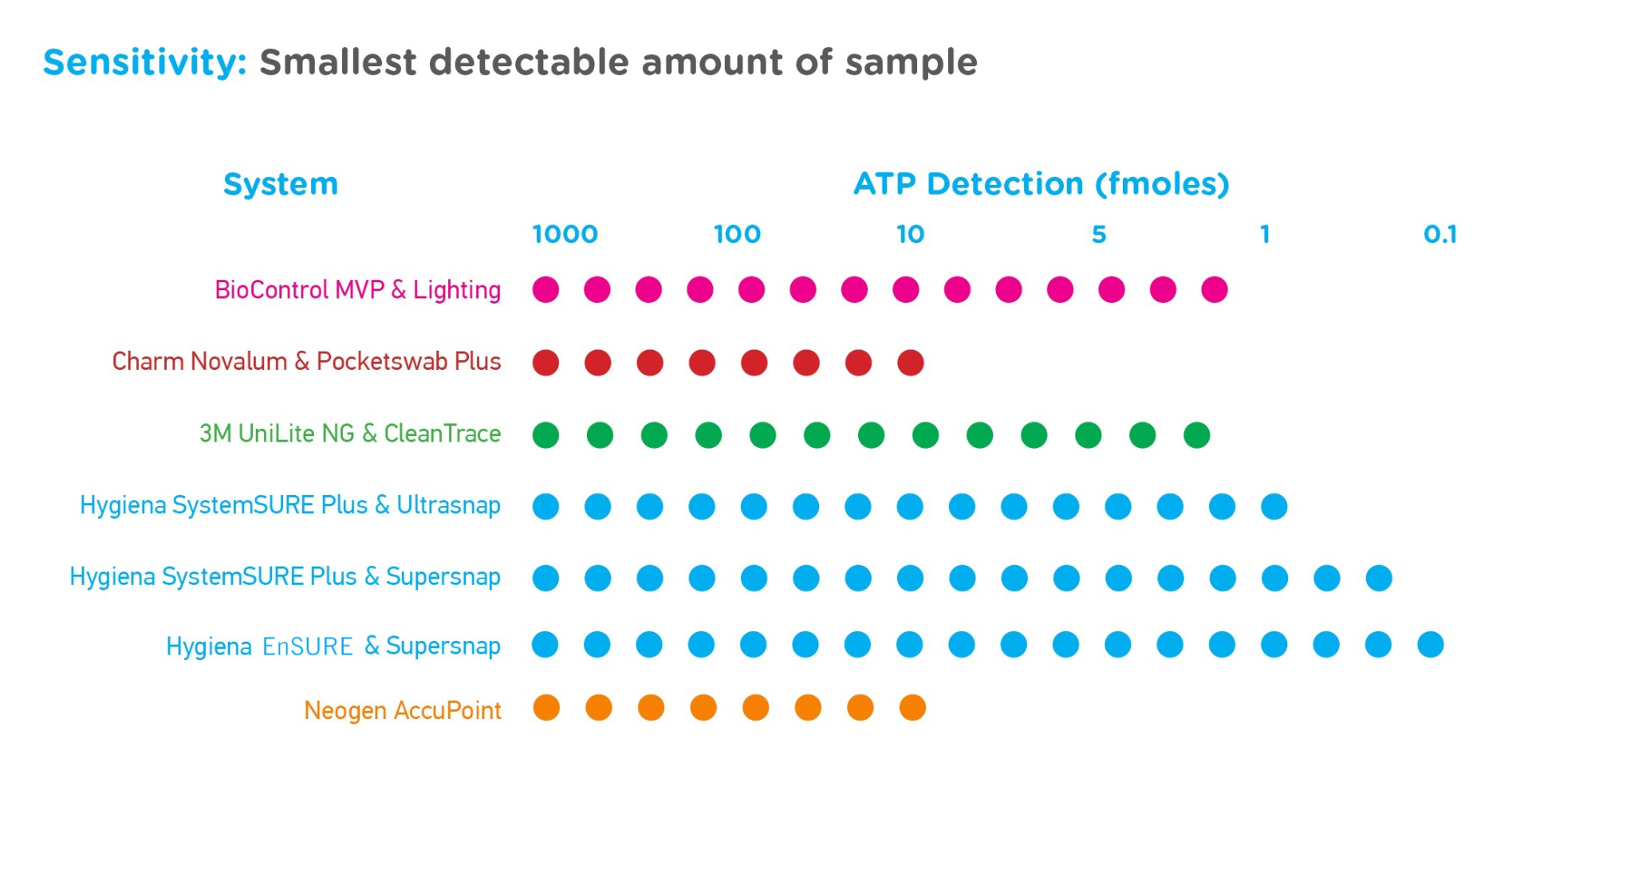
Superior Sensitivity
www.hygiena.com
Notes:
Sensitivity is defined as the Limit of Detection (LoD). It is the smallest amount of ATP detectable above the background noise of the system. Background noise is the RLU detected by the system in the absence of ATP. Background noise may come from both the instrument (as electrical interference), and the reagent swab device (as chemical interference).

Slide 16
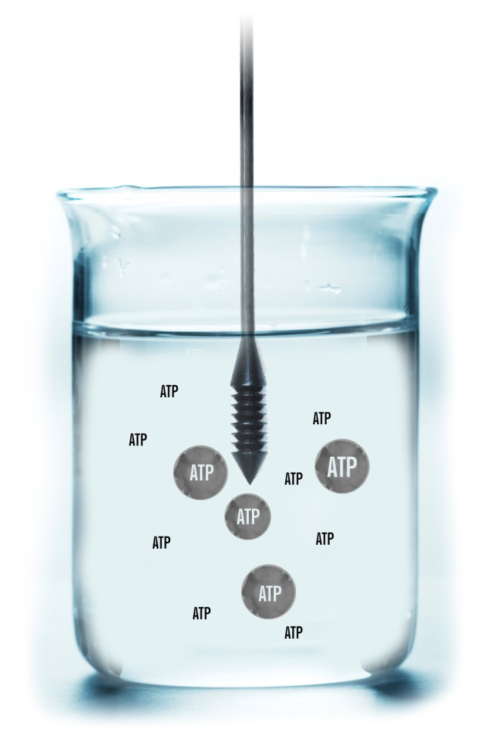
ATP in Water Samples
www.hygiena.com
Consistent sample collection
Estimate microbial load to 10³ CFU
More reliable than dipslides
100% recyclable & non-toxic
Two flavors:
Total: microbial and non-microbial ATP
Free: non-microbial ATP
Notes:
AquaSnap™ tests measures both free and total ATP in solution and microbial ATP. AquaSnap™ Total contains a detergent to release ATP that is bound to microbial or organic matter and inside microbes. AquaSnap is easy to use, economical, and gives real time results. The specifically designed dipper tip collects 100 µl of water ensuring consistent sample collection.

Slide 17
Indicator Organism Tests
www.hygiena.com
Notes:
Hygiena's MicroSnap™ platform bridges the time gap between ATP and bacterial culture results with convenient, 8-hour or less tests for E. coli, Coliform, Enterobacteriaceae, and TVC.

Slide 18
MicroSnap
www.hygiena.com
Get results today
2 device platform
Enrichment
Detection
Total Count
EB
Coliform & E.coli
Notes:
Hygiena's MicroSnap™ measures organisms tests, enabling food and beverage processors to acquire an accurate status of plant hygiene and product quality during the same working day or shift. Knowing test results sooner prevents recalls, reduces waste, shortens hold time, and enables a quicker response when contamination issues arise.

Slide 19
Surface Allergen Prevention
www.hygiena.com
Notes:
An allergen is a type of antigen that produces an abnormally vigorous immune response in which the immune system fights off a perceived threat that would otherwise be harmless to the body. Such reactions are called allergies. Allergens are the number one reason for product recalls in 2016

Slide 20
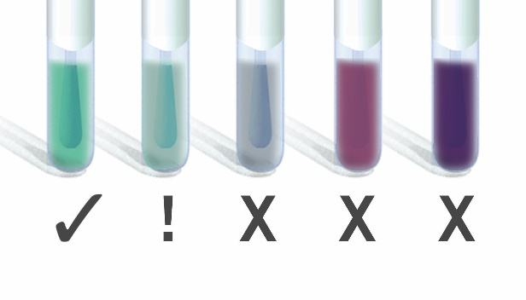
Surface Allergen Prevention
www.hygiena.com
Results in 15-30 minutes
Extremely sensitive, non-specific allergen screening
Recognized by quality schemes
Easy-to-interpret color change
18 month shelf-life at room temperature
100% recyclable & non-toxic
Notes:
AllerSnap™ is a quick and easy way to verify the cleanliness of surfaces by detecting protein residues left behind after cleaning. By simply swabbing the area and activating the device, you release a reagent that turns color, providing a qualitative and semi-quantitative result of the protein levels on the surface: green means clean and purple means re-clean. The more protein present, the quicker the color change to purple and the darker the color.

Slide 21
Surface Residue
www.hygiena.com
Results in 10 minutes
Conveniently designed sample collection
Simple two-part kit includes all materials
Sensitive to 5 µg (ppm) gluten
Easy-to-interpret lateral flow device
No instrumentation required
15 month shelf-life
Notes:
Hygiena™ AllerFlow Gluten Kit is a rapid and convenient test for detection of gluten residue on surfaces as part of an allergen control program. Combining Hygiena's convenient sample collection swab design and classic lateral flow technology, AllerFlow Gluten makes gluten testing easier than ever before.

Slide 22
Pathogen Screening Tests
www.hygiena.com
Notes:
According to the Centers for Disease Control and Prevention, approximately 48 million Americans get sick, 128,000 are hospitalized and 3,000 die each year from food poisoning. Bacteria, viruses and parasites are the sources of many food poisoning cases, usually due to improper cleaning and food handling

Slide 23
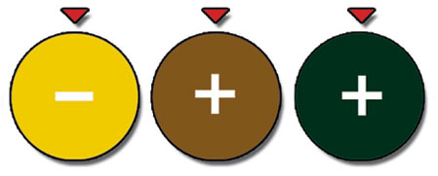
Listeria species
www.hygiena.com
Easy-to-use: Swab, activate, incubate!
Large sponge tip for maximum sample collection
Self-contained: minimizes contamination risk
Easy-to-interpret color change results
Presumptive results in 24 - 48 hours
1-10 CFU/mL Listeria spp.
Notes:
Listeriosis is a serious infection usually caused by eating food contaminated with the bacterium Listeria monocytogenes. An estimated 1,600 people get listeriosis each year, and about 260 die. The infection is most likely to sicken pregnant women and their newborns, adults aged 65 or older, and people with weakened immune systems.

Slide 24
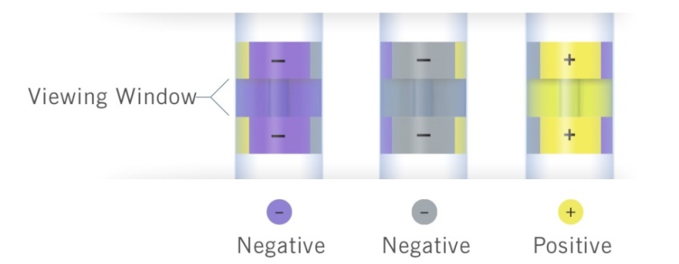
Salmonella species
www.hygiena.com
Easy-to-use with no special preparation
Large sponge tip for maximum sample collection
Self-contained: minimizes contamination risk
Easy-to-interpret color change results
Presumptive results in 24-48 hours
1-10 CFU/mL Salmonella spp.
Notes:
Every year, Salmonella is estimated to cause one million foodborne illnesses in the United States, with 19,000 hospitalizations and 380 deaths. Most persons infected with Salmonella develop diarrhea, fever, and abdominal cramps 12 to 72 hours after infection. The illness usually lasts 4 to 7 days, and most persons recover without treatment. However, in some persons, the diarrhea may be so severe that the patient needs to be hospitalized.

Slide 25
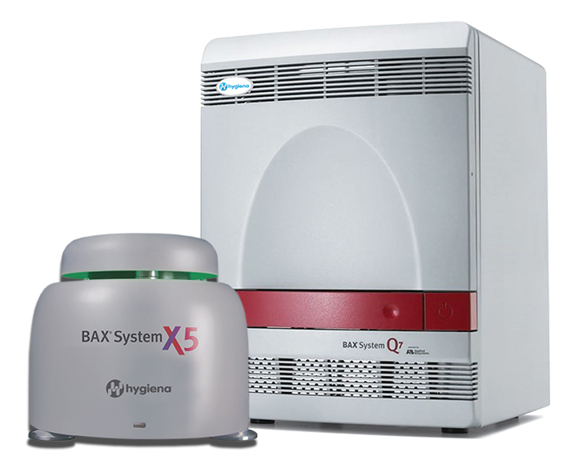
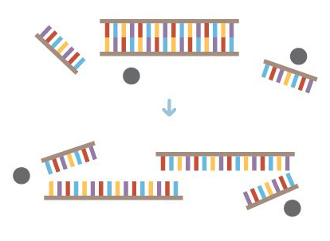
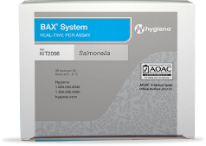
BAX® System | PCR pathogen detection
www.hygiena.com
Detects pathogens or organisms in food and product samples by copying and detecting DNA
Gold standard in rapid methods
Used by government labs, food labs, and large food plants
2 formats, same technology
Dedicated software
iPhone/Android app
Polymerase chain reaction (PCR)

Slide 26
BAX® System | PCR pathogen detection
www.hygiena.com
BAX® System X5
Smaller format.
Assays available:
Salmonella Genus Listeria
Listeria monocytogenes
E. coli O157:H7
BAX® System Q7
Larger format
Real-time and end-point assays
Assays available:
Salmonella
Top 7 E. coli
Genus Listeria
Listeria monocytogenes
Campylobacter
Shigella
Vibrio
S. aureus
Cronobacter
Yeast & Mold

Slide 27
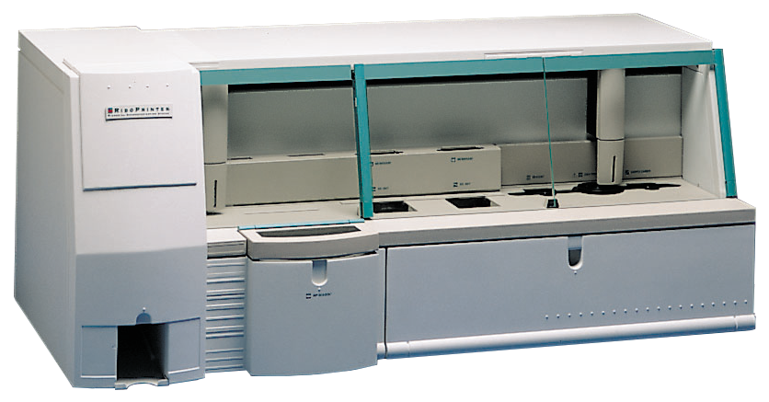
RiboPrinter® System Microbial Identification & Characterization
www.hygiena.com
Catalogs organisms from samples
Characterizes organisms down to the genetic level
Helps users identify recurring problems
Gets to the source of the issue
Used by food labs and very large food plants
RiboPrint™ pattern

Slide 28
Environmental Sample Collection
www.hygiena.com
All-in-one sample collection system
Ready-to-use and convenient
Rehydrates 1 sample-ready plate perfectly
Available in Letheen & BPW
Long shelf life (18 months)
Notes:
Hygiena™ Q-Swab is a ready-to-use sample collection and delivery device for environmental surface sampling. Simply collect an environmental sample and snap the bulb at the top of the device to release 1.0 mL of media into the sample. The media neutralizes residual sanitizers and facilitates recovery of bacteria*. A variety of different medias are available depending on bacteria of concern. After activation, the sample is ready to be poured onto dehydrated media or streaked onto agar plates for culturing. Q-Swab can be used either wet or dry to sample surfaces.

Slide 29
Rapid Dilution Device
www.hygiena.com
All-in-one collection & dilution system
Ready-to-use and convenient
Eliminates needs for pipettes
Rehydrates 1 sample-ready plate perfectly
Available in 3 dilution ratios
Notes:
Hygiena™ QD-Loop device is an all-in-one, sterile, rapid system for accurate and convenient volumetric dilutions. An accurate loop or dipper comes attached to a reservoir where patented Snap-Valve™ technology holds 1mL of Butterfields or Maximum Recovery Diluent (MRD) buffer. Simply break the Snap-Valve after a sample is collected, and immediately a dilution is ready that can be poured onto dry media film or streaked onto an agar plate.

Slide 30
Sample Collection
www.hygiena.com
All-in-one sample collection system
Ready-to-use and convenient
Eliminates needs for pipettes
More broth for high volume samples
Available in Letheen or BPW
Notes:
Hygiena™ Transport Swab is the ideal solution for customers requiring an environmental sample collection device containing more than 1mL of pre-filled liquid broth.Transport Swab is available in 4mL & 10mL volumes. The pre-filled bottles come sterilized and with ample head-space for additional sample. The swab tip sits in the letheen broth which allows for release of organisms from the swab bud. Transport Swab makes sample collection efficient and easy; simply swab a surface, recap, and send to the lab.

Slide 31
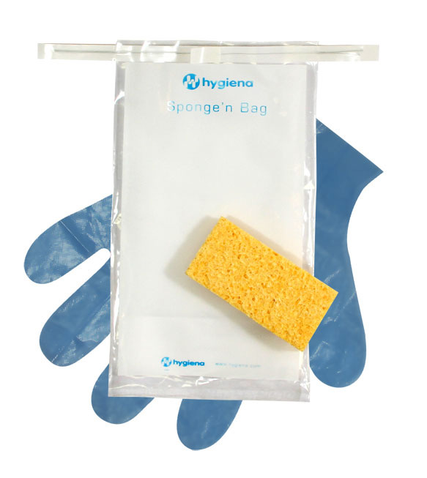
Environmental Sponge
www.hygiena.com
Biocide-free cellulose sponge
Dry or pre-moistened with a variety of diluents
Large sample ID area
Gloves optional
Notes:
Hygiena™ Sponge’n Bags are biocide-free cellulose sponges supplied in a sterile, leak-proof, tie-off bag, providing a simple and convenient device for collecting environmental samples from large surface areas. The sponges may be ordered dry or pre-moistened with a variety of different diluents.

Slide 32
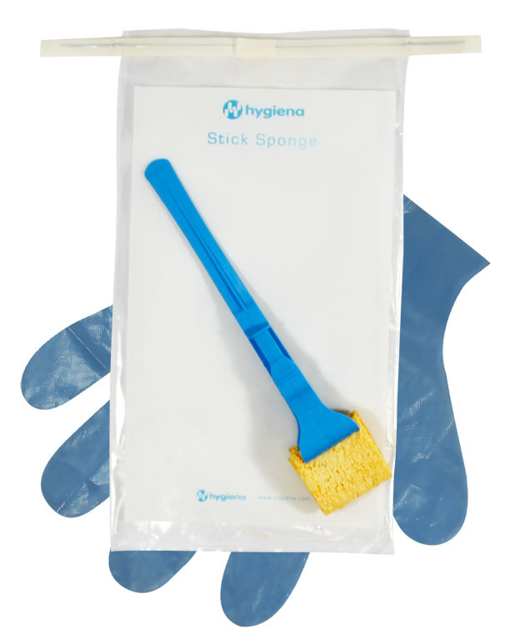
Environmental Sponge
www.hygiena.com
Biocide-free cellulose sponge
Dry or pre-moistened with a variety of diluents
Convenient for hard-to-reach sampling areas
Large sample ID area
Gloves optional
Notes:
Hygiena™ Stick Sponges are biocide-free cellulose sponges attached to a plastic handle and supplied in a sterile, leak-proof, tie-off bag. The sponges are pre-moistened and available in a variety of different diluents. Stick Sponge allows collection of a sample without directly handling the sponge, making it easier to reach into drains, pipes, and around equipment.

Slide 33
www.hygiena.com
Program Setup & Ongoing Support
Unlimited customer service & technical support
Thorough phone/video training
Dedicated Account Management Team available via Office, Mobile, and E-mail
Online resources, FAQ, downloads
Instructional videos
Remote support

