Slide 1
a Food Safety Company

Slide 2
Who we are

Slide 3
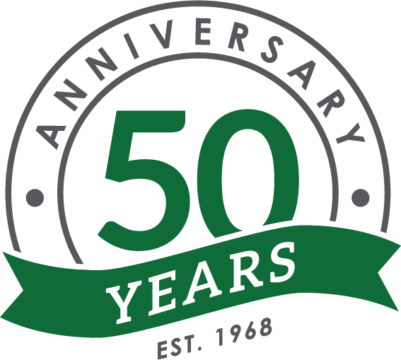
Background
Founded in 1968 by Wes and Marie Funston
PNW Family Company
Manufacturing plants in Lynnwood & Seattle, WA
Pacific Northwest, Alaska, Hawaii
Notes:
Founded in the Pacific Northwest in 1968 by Wesley and Marie Funston, Wesmar Company is a family company. We primarily serve the greater Pacific Northwest, Alaska, and Hawaii. We just celebrated our 50th Anniversary.

Slide 4
Food Safety Company
Products – Cleaning, Sanitation, Water & Waste Water Treatment, Boiler/Cooling Towers
Training & Consultation – Cleaning&Sanitation, FSMA, SQF, BRC, GFSI, State/Local Regulatory
Notes:
We approach Food Safety through effective and efficient Chemistry, basic through advanced cleaning and sanitizing Training (Classroom and in the field), and thorough, efficient Consultation on FSMA, SQF, BRC, State, and local regulatory agency audit requirements.

Slide 5
Service
Plant Service - Sanitation Program Development, in-plant service
Consultation - Operations, Production, Compliance, Inventory
Training – Classroom, Field, Online
Bilingual – English & Spanish
Notes:
Our service includes cleaning and sanitizing consultation in Operations, Production, Compliance, Inventory, Classroom and Field Training. We are Bilingual in English and Spanish. We manage all areas of your costs!

Slide 6
Industries Served
Seafood
Dairy & Cheese
Beverage, Brewery, and Wine
Beef & Poultry
Fruit & Vegetable
Food processing
Water
Waste Water Treatment
Bakery
Vehicle Wash

Slide 7
Chemical Supplier Decisions

Slide 8
Cost of Operation
6-9%
Notes:
Your Operational Pie Chart may be reconciled differently on this pie chart; However, your chemical costs should always average 6%-9%.....SO,
Why do we make the decision on which Chemical vendor to buy from 6%-9% of your cost of doing business?
Vendor Presentation made, price List requested from vendor’s, ultimately the decision to buy is based on a few cents per gallon savings.
What if we save you pennies 7% of your chemical business or dollars in reducing your labor, water, energy, and waste water.

Slide 9
“Scream in Your Sleep”
Notes:
So, you have the best sanitation program in the world, Wesmar, the best! Great Wesmar Rep, great Wesmar chemistry, Audits 100%, trained labor, water and energy costs down, no waste water fines, a great safety record.…..you are sleeping like a baby…..then it hits you and your wake up screaming, “Oh My God, we are loading our product into a delivery truck that isn’t clean or sanitized!”

Slide 10
Loading your product onto a Delivery Truck
CFR Title 21 Sub-chapter B PART 117.93
Warehousing and Distribution
Storage and transportation of food must be under conditions that will protect against allergen cross-contact and against biological, chemical (including radiological), and physical contamination of food, as well as against deterioration of the food and the container.
Notes:
Storage and transportation of food must be under conditions that will protect against allergen cross-contact and against biological, chemical (including radiological), and physical contamination of food, as well as against deterioration of the food and the container.

Slide 11
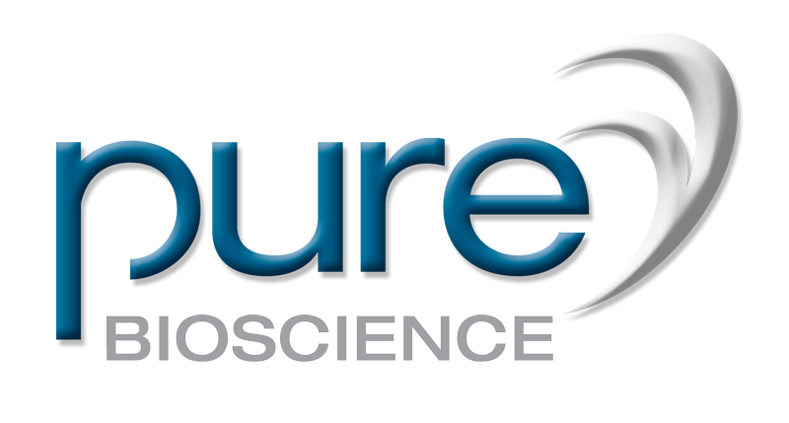
How do you comply?
Wesmar Company Pure Bioscience Program

Slide 12
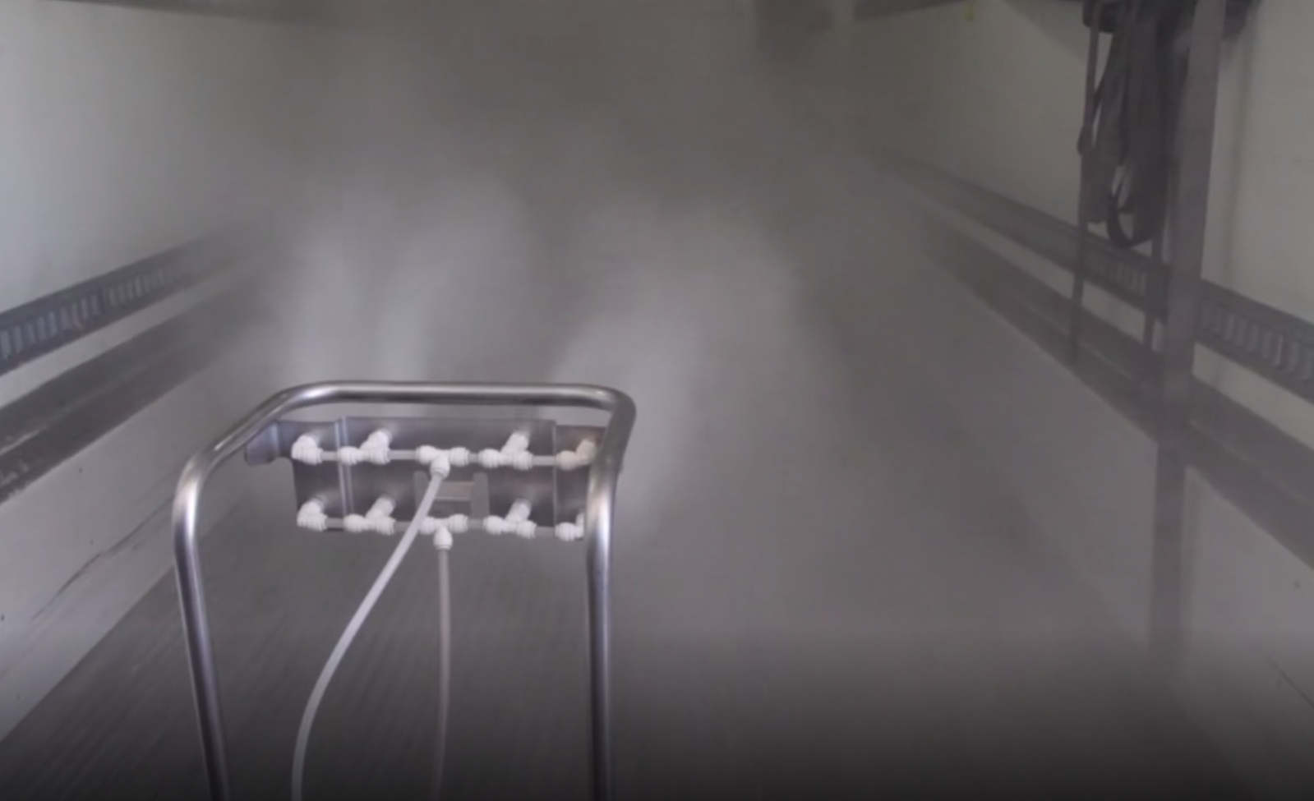
Wesmar Company PURE Bioscience Program
Only formal FSMA compliance program in the PNW for Warehouse and Transportation

Slide 13
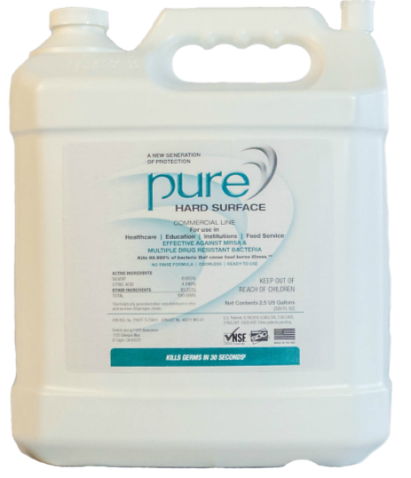
Wesmar PURE Bioscience Program
Silver Ion disinfectant w/NO Rinse
Mist into trucks, CA rooms, warehouse and refer systems-No wait times
EPA 24-hour active residual kill
Non-corrosive / Non-Toxic (GRAS)
Minimum water usage reduces mold
5-log Reduction 30 seconds to 2 minutes – ALL Biofilms
Notes:
The basics of the Wesmar Company Pure BioScience Program for Warehouse and Transportation:
Ready to Use Silver Ion disinfectant solution eliminates solution challenges. Simply Pour and mist. NO Rinsing.
State of the Art Silver Ion Technology provides a 5-log reduction in as little as 30-seconds to 2-minutes on all Biofilms.
1-gallon, when misted, disinfects up to 4,100 square feet or 43,000 cubic feet
Can be applied through spray bottle, room misting, or misting hand wand on all hard surfaces.
The only sanitizer that sanitizes on a disinfectant level and does not require rinsing on food contact surfaces
The only sanitizer on the market with an EPA certified 24-hour active residual kill
Non-corrosive on all metals including refrigeration/chiller units when misting. Turn on the chiller units!
GRAS certified, 100% non-toxic to the environment; Does not have to be captured with run-off water and hauled off to a Toxic Waste dump
Non-Toxic to personnel; Room can be immediately occupied when visibility returns
Minimum water usage even when paired with the Pure High Foam Concentrate Cleaner (1.5 gallons total water usage in 53’ trailer)
Wesmar Company is the exclusive distributor of the PURE BioScience Program in the Pacific Northwest.

Slide 14
Bonus Scream Question
Are you disinfecting your refrigeration and chiller units in your processing rooms, freezer, warehouse, and transportation units?
Btw…Thermal King has certified this product as safe on units when being disinfected with Pure Sanitizer.

Slide 15
Sleep Well…
Gabe Flores
Wesmar Company, Inc.
gflores@wesmarcompany.com
425-248-4300
wesmarcompany.com

