Slide 1
Better Seafood Processing School (BSPS) Cultivating Seafood for the Future
Washington Association for Food Protection Conference
September 20-21, 2018
Angee Hunt
Senior Faculty Research Assistant II

Slide 2
bringing the Seafood Industry together
1993- and beyond:
OSU Surimi School 1993-2017 Dr. Jae W. Park
Seafood Processing Wastewater Workshop
March 21-23, 2018
March 25-27, 2019
Better Seafood Processing School
May 9-10, 2018
May 13-14, 2019

Slide 3
2018 Better Seafood Processing School
Target Audience:
QC/QA, R&D, technical staff
Focus Area Day 1 – morning session:
Utilization
Processing and handling considerations/concerns from a retail perspective
Current seafood processing & handling issues from a processor perspective
Fillet block quality
Seafood nutrition and consideration of processing impacts

Slide 4
2018 Better Seafood Processing School
Focus Area Day 1 – afternoon session:
Innovation
Innovation for inactivating pathogenic and spoilage micoorganisms in seafood
Bioimpedence machine for improved quality assessment
Simplified recovery of food grade soluble protein from seafood process water
Harvest time effects on nutrition and quality
By-product utilization for improved value
Dinner & Team Building Activity

Slide 5
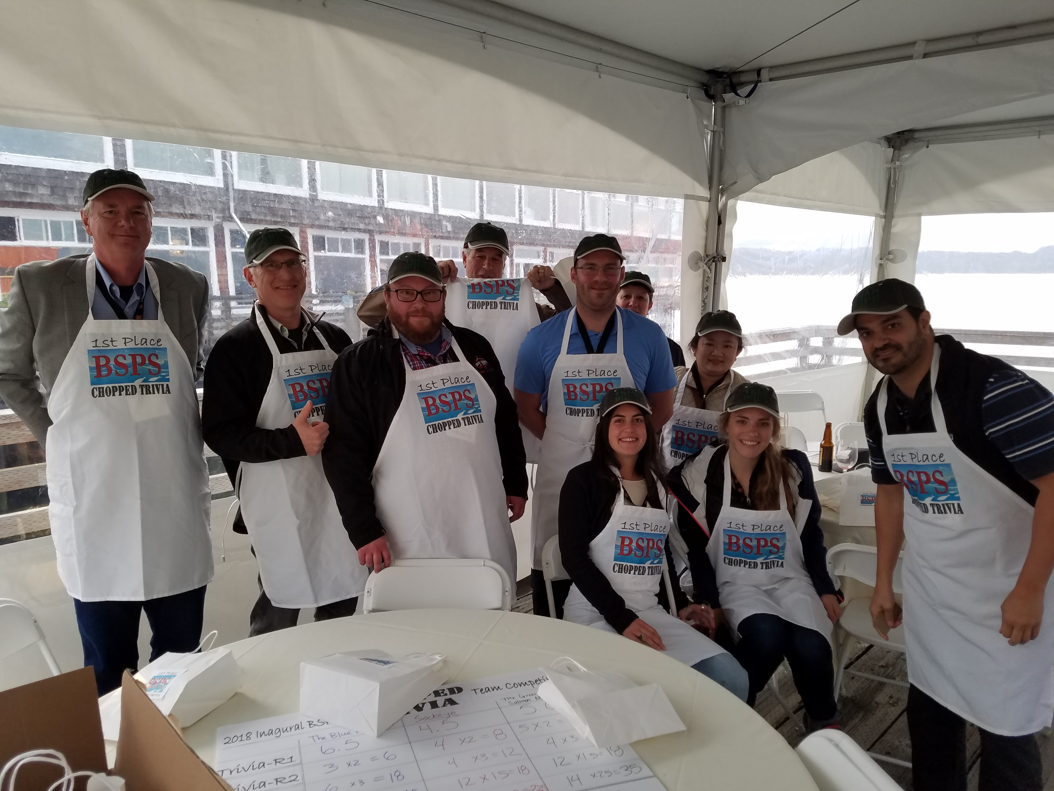
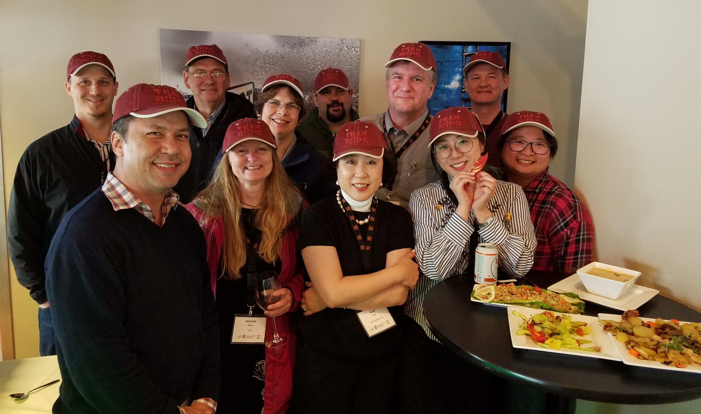
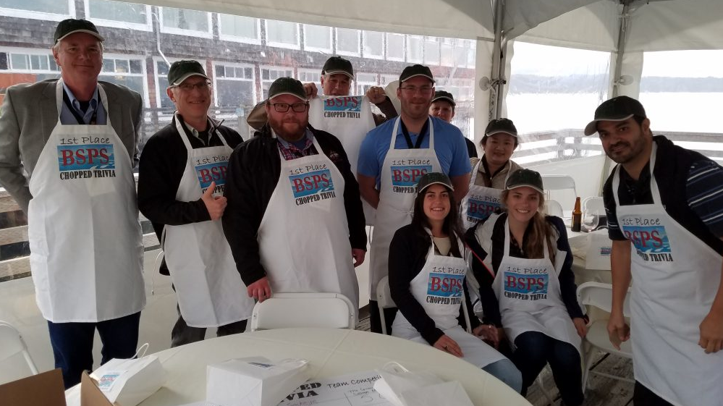
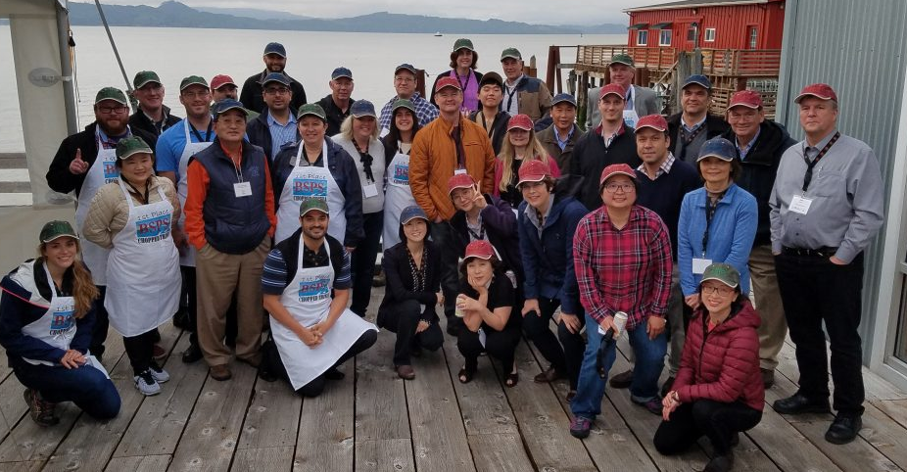
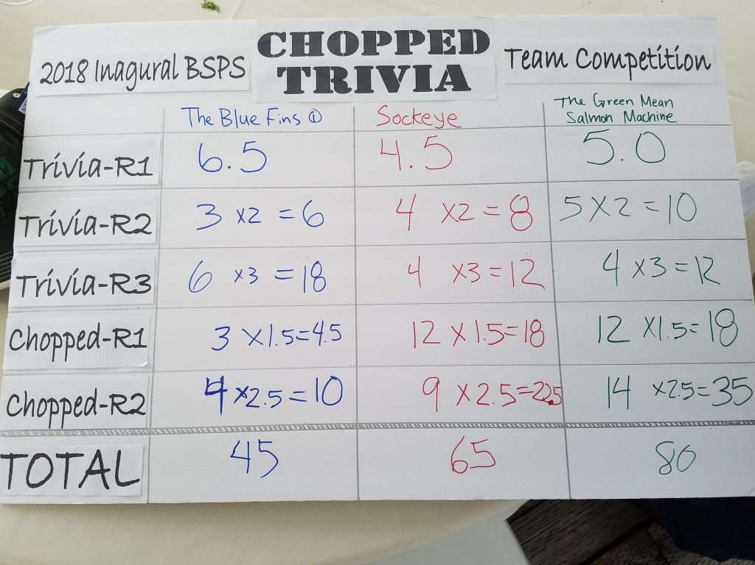
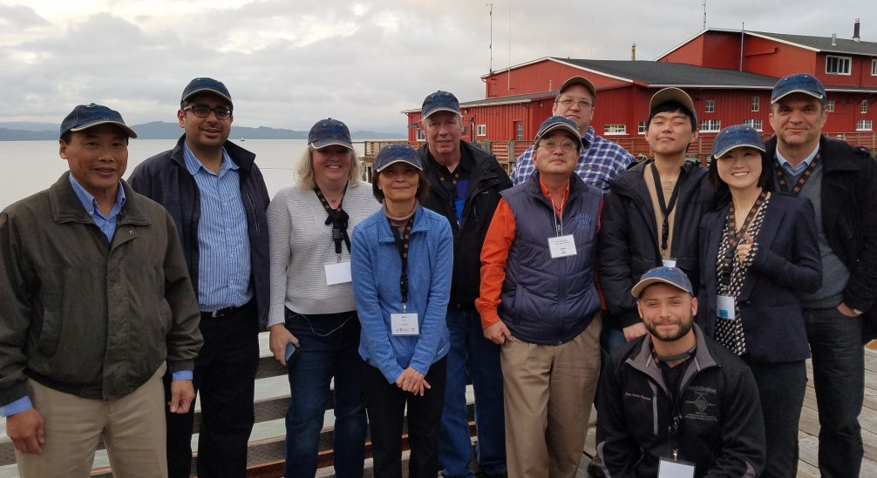
Sockeye
The Green Mean
Salmon Machine
2018 BSPS Chopped Trivia
The Blue Fins

Slide 6
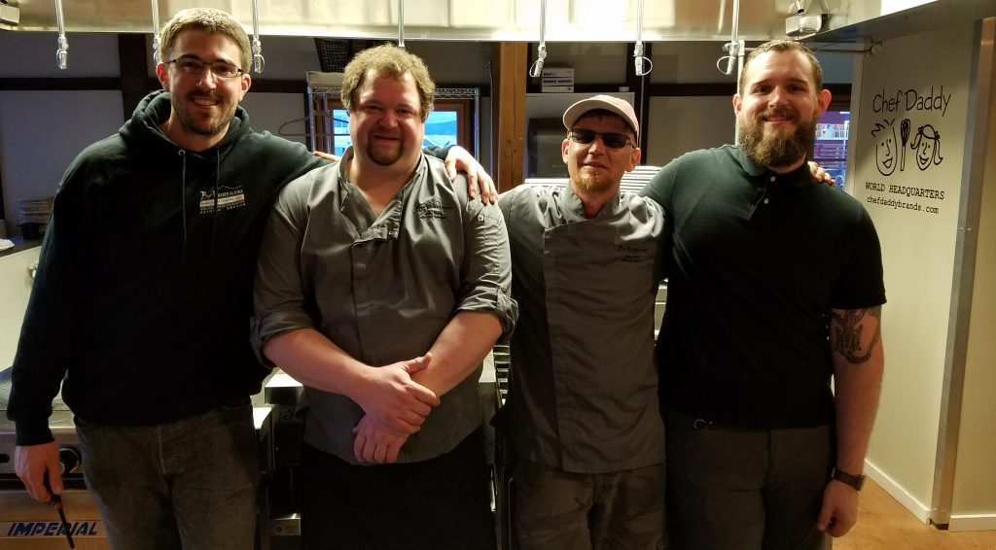
TEAM BAKED ALASKA- Matt, Billy, Chef Beau, & Ben

Slide 7
2018 Better Seafood Processing School
Focus Areas Day 2: morning session
Compliance:
Ensuring truth in seafood labeling: FDA resources for seafood industry
Chemical safety and preventiative measures for employee health
Listeria and RTE seafoods
ATP monitoring, allergen prevention and bacteria/pathogen testing
Checklist for food safety and environmental compliance
Labeling: species/species substation, country of origin, additives.

Slide 8
2018 Better Seafood Processing School
Focus Areas Day 2: afternoon session
Laboratory Trainings –
Lab Equipment: Maintenance, proper use and calibration
Bacterial Lab: Testing for Quality Assurance
Sanitization: How to choose a sanitizer & basic cleaning

Slide 9
2018 Summary
2-Day Program
3 Lecture sessions
3 Lab training sessions
~60 participants
Industry
Government
Academia
13 Sponsors
Participant Survey Results:
Offer Annually
Overall 8.7/10
Individual Sessions=7.5-8.5

Slide 10
2018 Summary
Survey Comments:
“Speakers were great and knowledgeable. Sometimes it seems too crammed with a lot of information.”
“Interactive presentations helps keep the audience more involved.”
“Day 1 less packed with info. If possible, it would have been nice if some of the lectures could have been moved to Day 2.”
“Great info, wonderful course.”
“More Chopped Trivia”

Slide 11
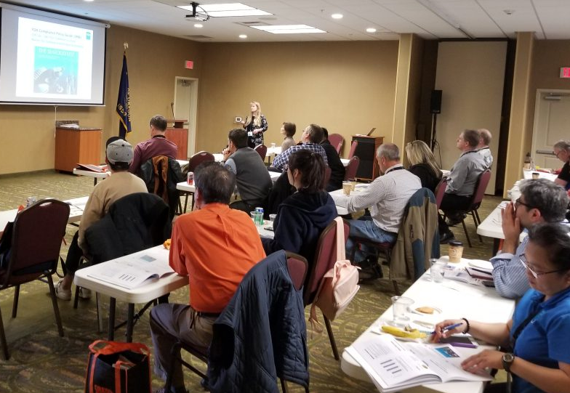
2019 BSPS
May 13-14, 2019
Holiday Inn Express
Astoria, OR

Slide 12
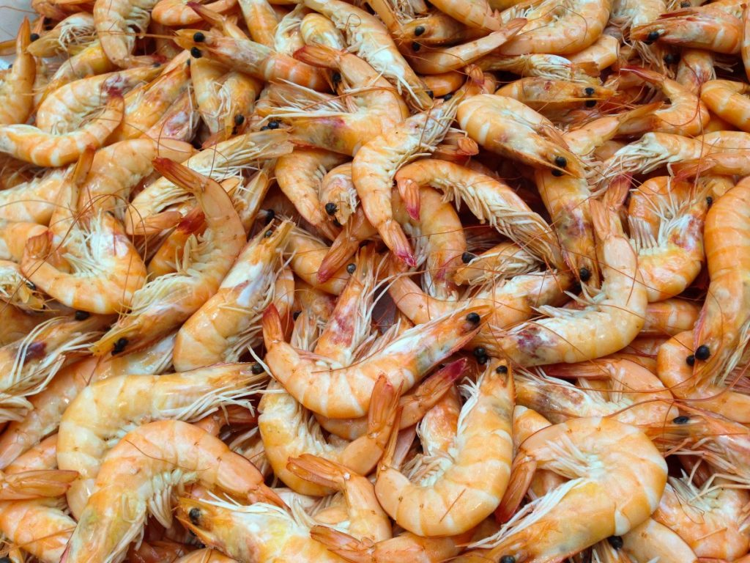
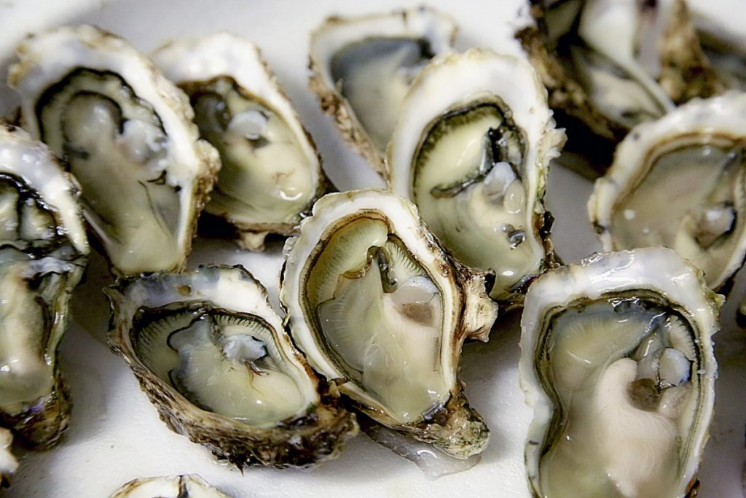
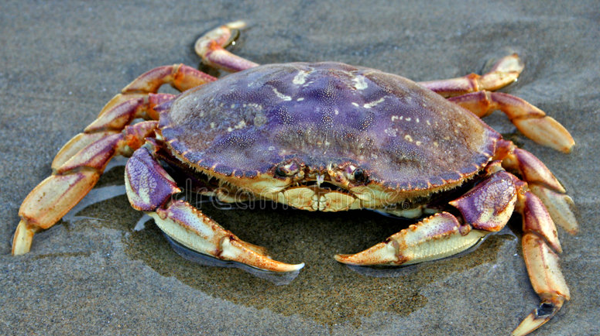
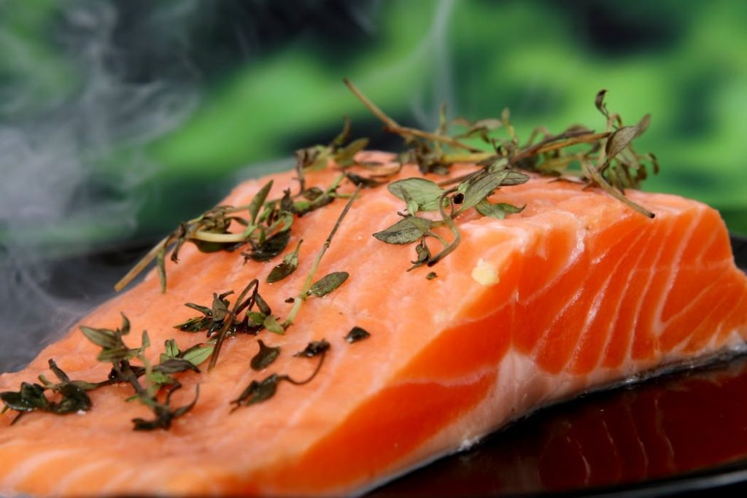
2019 BSPS Program Development
Target Audience
New Talent Development
QA Supervisor/Manager
Session Categories
Compliance
Utilization
Employee Development
Hands-On Training Sessions

Slide 13
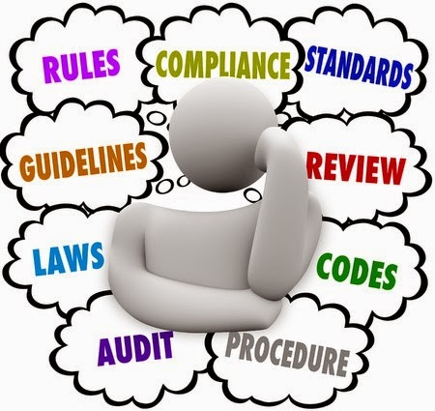
COMPLIANCE
Regulatory Introduction: FSMA's seven rules; seafood HACCP; NOAA SIP program; state laws; etc.
Understanding the FDA Hazards Guidance
The importance of prerequisite programs
Traceability
GFSI Accreditation

Slide 14
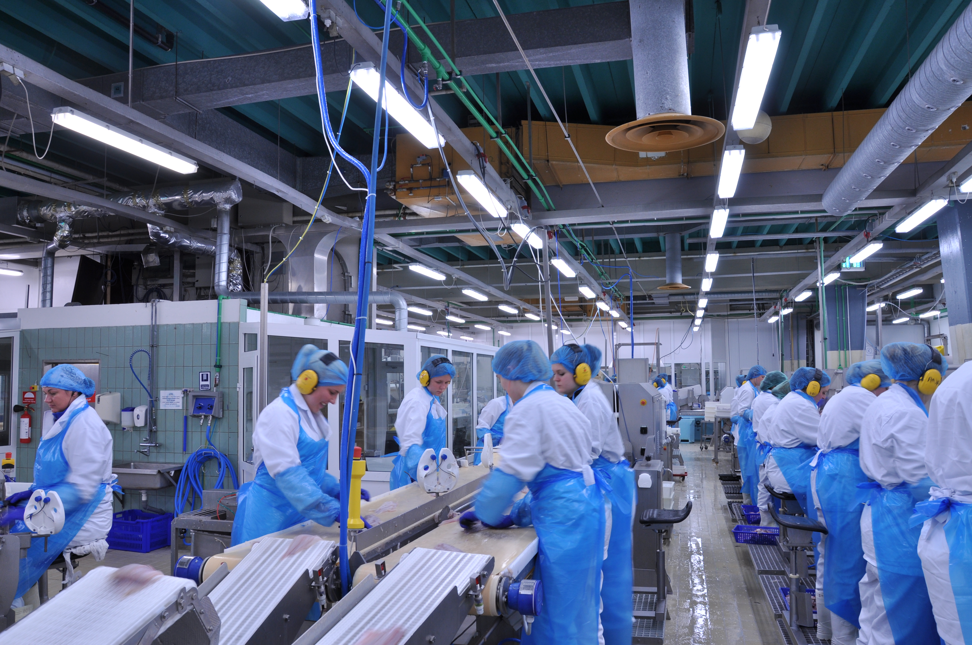
Utilization
PANEL DISCUSSION-Fishery Topics:
Resource management
Methods of harvest/Good fishing practices
Fleet management
Holding fish/what to do with a deck-load
QA Role
PANEL DISCUSSION-Process Control: Developing, understanding, and using specifications.
Equipment use/misuse considerations for process control
Marketing/retail perspective
QA perspective
Basics of Document Control

Slide 15
Employee Development
Worker hazards and welfare: Survival techniques for a wet, cold processing line
Developing training programs: How to train adults, dealing with a multi-lingual workforce, cultural awareness, etc.
Resources and how to use/access them: Academics, regulators, auditors, industry experts, the Seafood Listserv, etc.

Slide 16
Wrap Up Panel Discussion
Holistic Compliance:
Balancing the (sometimes competing) requirements for:
Food Safety & Quality Assurance
Environmental Compliance
Workplace Safety
Social Compliance

Slide 17
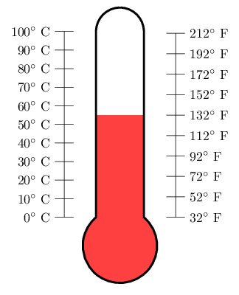
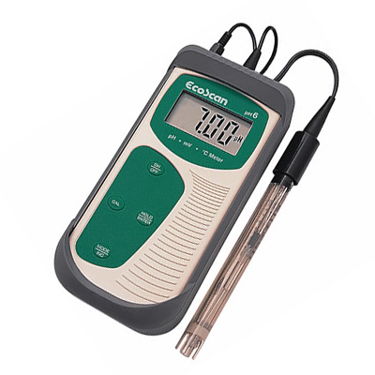
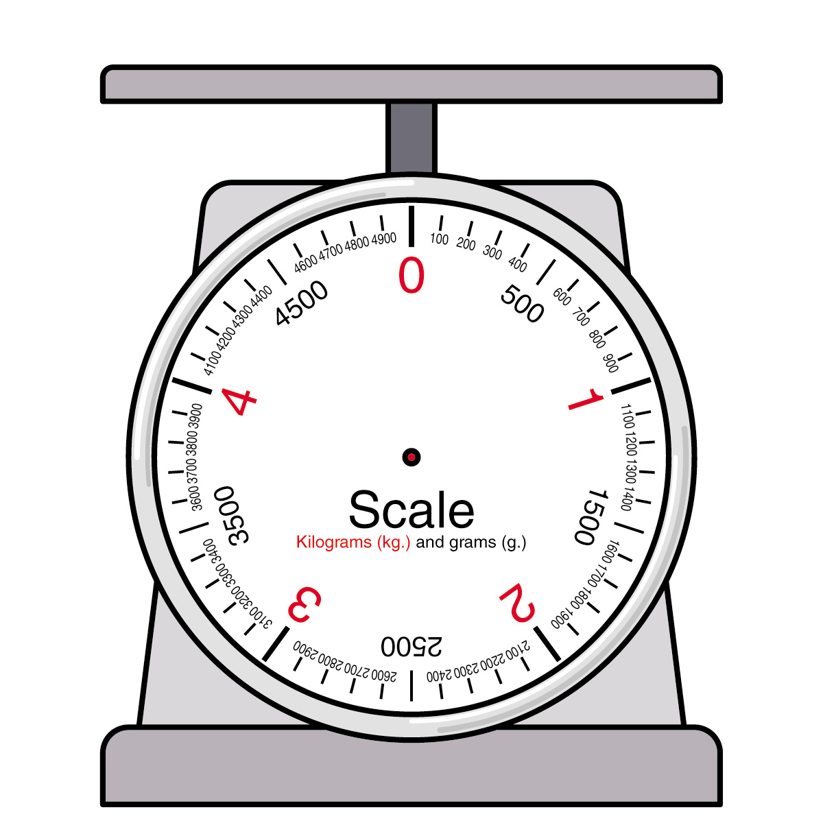
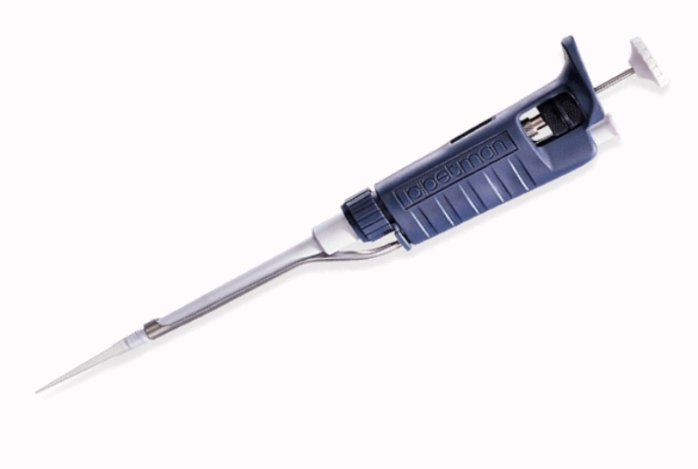
Hands-On Laboratory Sessions
Introduction to seafood sensory evaluation
Surimi Gel Testing
Sanitization: Basic Cleaning and Choosing a Sanitizer
Bacterial Laboratory for QA
Laboratory Equipment: Maintenance, proper use, and calibration

Slide 18
TEAM Building Activity 2.0

Slide 19
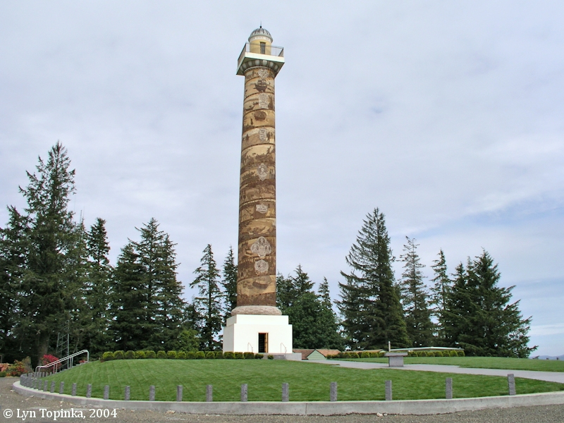
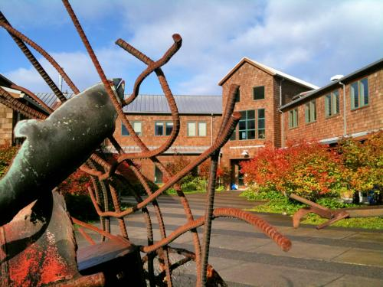
Better Seafood Processing School May 13-14 2019 Astoria, Oregon
Cultivating Seafood for the Future
http://blogs.oregonstate.edu/bsps

