Slide 1
Oregon State University
Si Hong Park, Ph.D.
Assistant Professor of Food Safety Biologist
Department of Food Science and Technology
Oregon State University

Slide 2

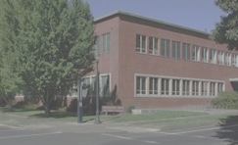
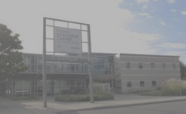
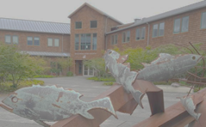
Overview
Food Innovation
Center (FIC)
Seafood
Research Lab
Corvallis

Slide 3
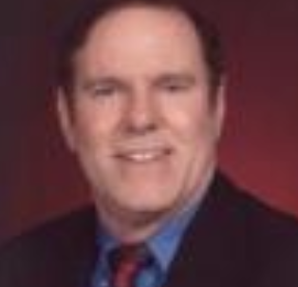
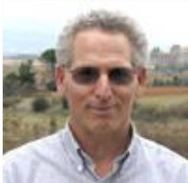
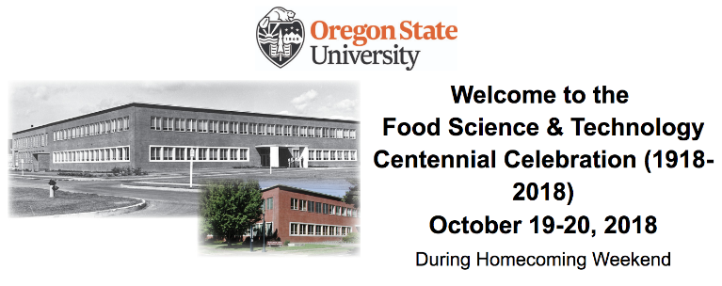
News
Department Head
: Dr. Robert McGorrin will step down (~10/31)
: Internal Interim department head will be elected
Dr. Alan Bakalinsky is retired
: Wine microbiologist
Centennial Event
: 10/19 to 10/20, 2018 at Corvallis, OR
: Taste of Food Science tours (beer, wine and cheese)
: FST Centennial banquet and Keynote (pictorial history)
: http://oregonstate.edu/foodsci/centennial-2018
: Science Pub - Hot topics,
: FST and campus tour
News
Corvallis
FIC
Seafood
Research
Lab
- 3 -

Slide 4
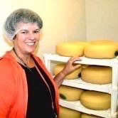
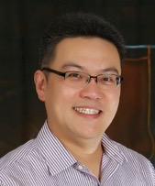
Corvallis
Lisbeth Goddik, Ph.D.
Prof. and Extension Dairy Processing
Food Science and Technology, CAS
Joy Waite-Cusic, Ph.D.
Asso. Prof. of Food Safety Systems
Food Science and Technology, CAS
Si Hong Park, Ph.D.
Assist. Prof., Food Safety Biologist
Food Science and Technology, CAS

Slide 5
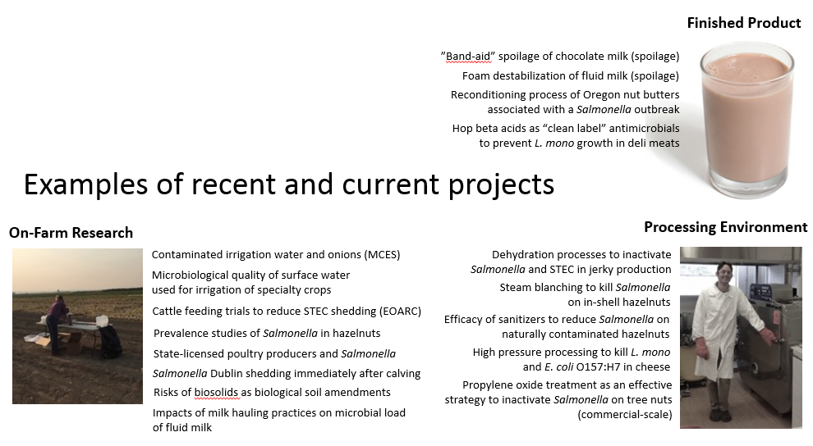
Dr. Joy Waite-Cusic
News
Corvallis
FIC
Seafood
Research
Lab
Slide courtesy by Dr. Joy Waite-Cusic
- 5 -

Slide 6
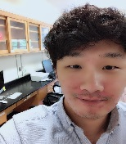
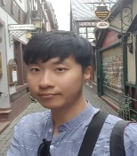
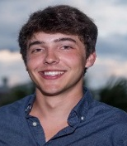
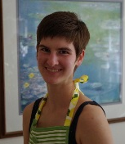
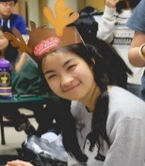
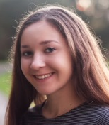
Dr. Si Hong Park
Si Hong’s research group
News
Research Assistant
Sang In Lee
Manage the lab and supervise students
Microbiome in soil collected from a blueberry farm
Corvallis
Graduate Student
Jungmin Choi (Ph.D)
Ian Moppert (MS)
Microbiome during cheese processing
Effects of prebiotics on cheese
FIC
Seafood
Research
Lab
Development of PCR assays for fresh produce
Microbiome in fresh produce
Undergraduate Student
Bryna Rackerby
Sushumna Canakapalli
Phanatchakorn Sutham
Melanie Hanlon
Development of PCR assays for poultry products
Microbiome in ginger beer
Microbiome in poultry products
Microbiome in cheese processing
Microbiome and WGS
- 6 -

Slide 7
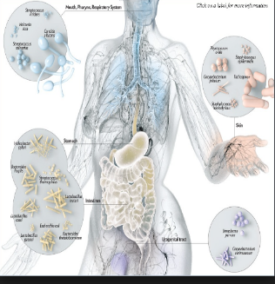
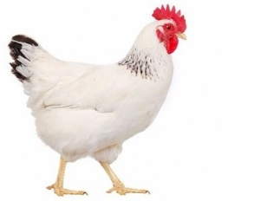
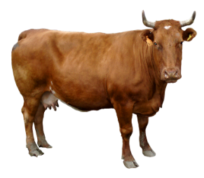
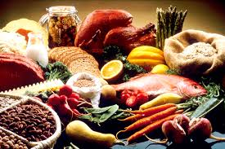
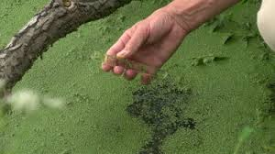
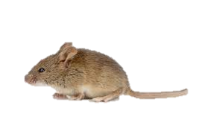
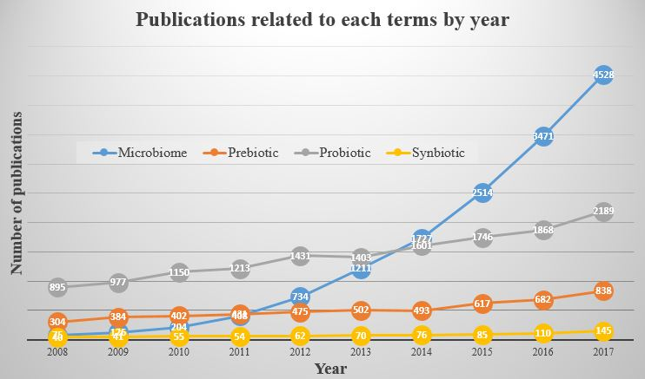
Dr. Si Hong Park
Microflora, Microbiota, Microbial population
News
Definition of microbiome
Genetic materials of microbiota in a certain ecosystem such as human or animal gut, foods and environmental samples
Corvallis
Microbiome
FIC
Seafood
Research
Lab
With microbiome..
Next generation sequencing
Overall microbial populations
Comprehensive information
National Microbiome Initiative
- 7 -

Slide 8

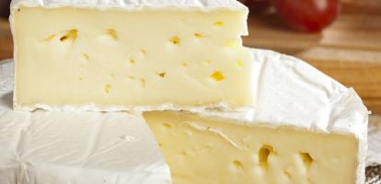
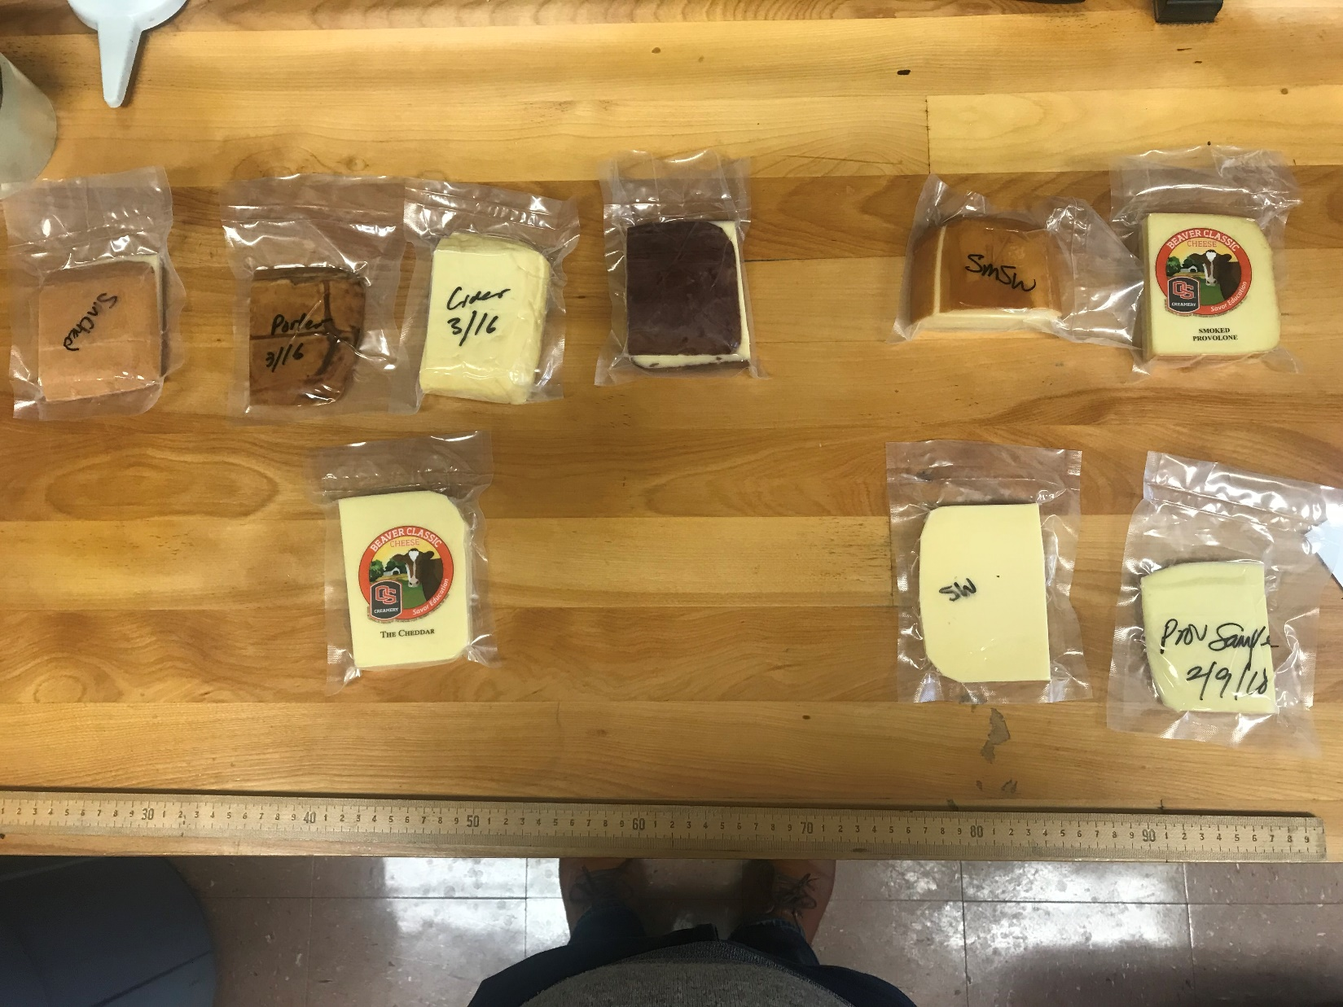

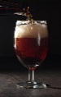

Dr. Si Hong Park
News
Cheese microbiome
Different bacterial populations in various cheeses produced in FST OSU
9 cheese samples
  Cheddar (smoked, porter, pinot & cider)
  Swiss and smoked
  Provolone and smoked
Sampling location
  Rind (outside)
  Inside
  Mix (mixture of rind and inside)
Corvallis
FIC
Seafood
Research
Lab
- 8 -

Slide 9
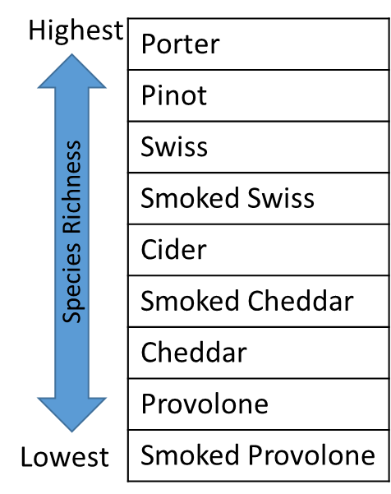
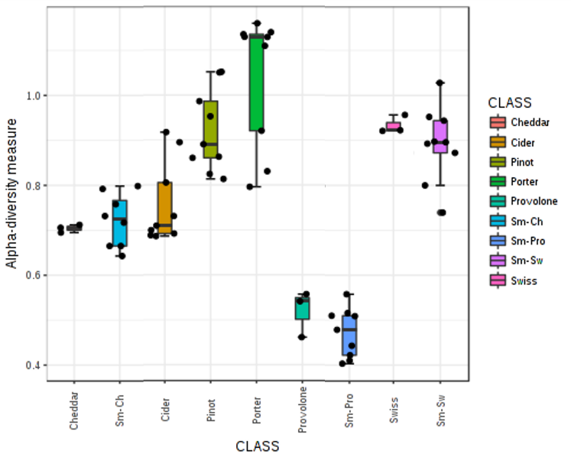
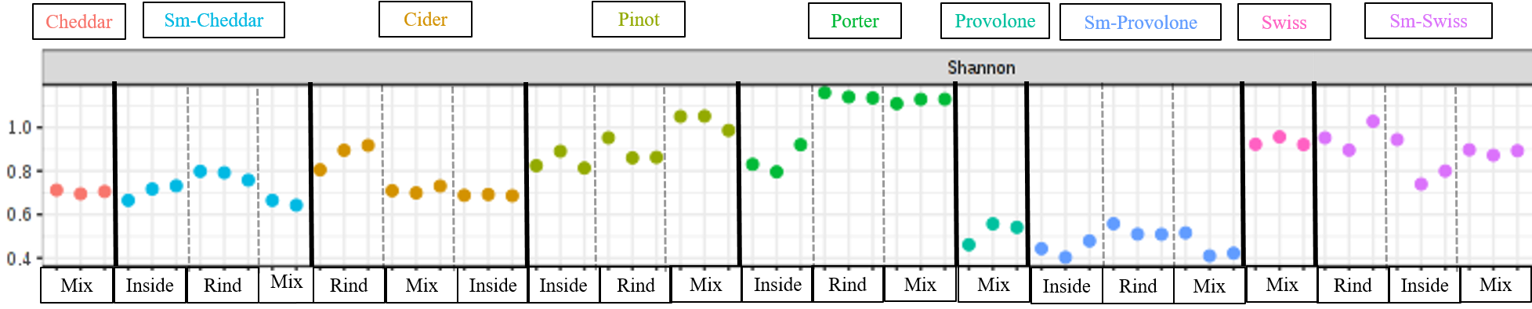
Dr. Si Hong Park
News
Corvallis
FIC
Seafood
Research
Lab
Porter cheese sample exhibited highest species richness
Provolone and smoked provolone were lowest
- 9 -

Slide 10
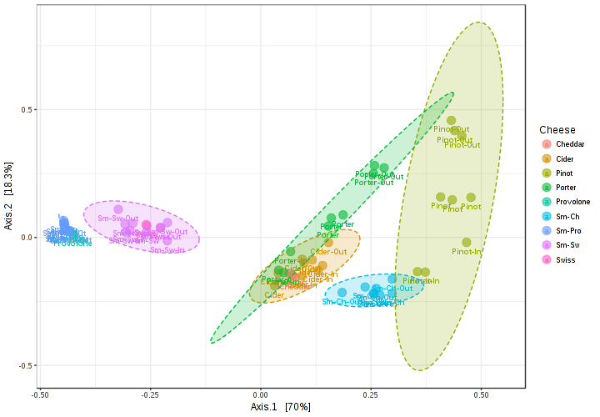
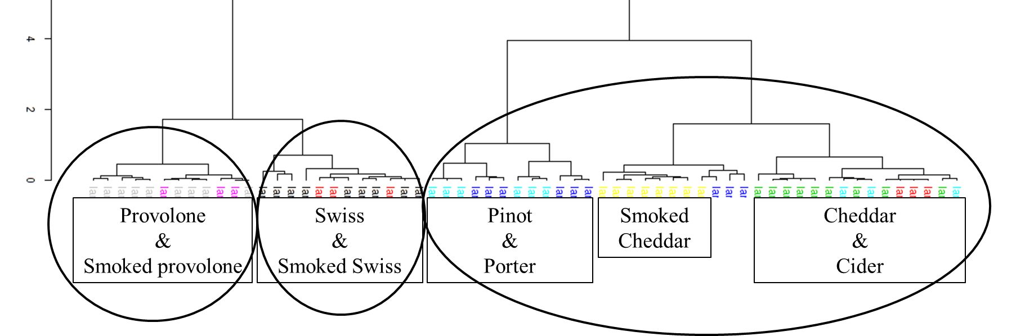
Dr. Si Hong Park
PCoA plot (dissimilarity comparison)
Cheese tends to cluster together
Sampling location
Provolone and smoked provolone
Prebiotics
News
Micro-
biome
Corvallis
App.
In vivo
FIC
Dendrogram
Based on taxonomic relationships
Pinot, porter and cider are from
cheddar cheese
Seafood
Research
Lab
App.
In vitro
App.
Processing
App.
Food
- 10 -

Slide 11
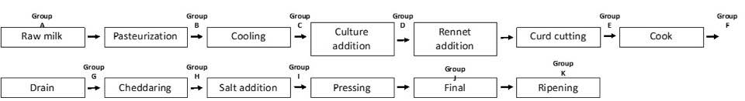
Dr. Si Hong Park
News
Cheese microbiome
: Cheese processing steps
: Prebiotics added cheddar cheese
Corvallis
FIC
Seafood
Research
Lab
Fresh produce
: Multiplex and quantitative PCR for pathogen detection
Poultry product
: Microbiome during storage period
: Conventional and organic chicken
- 11 -

Slide 12
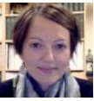
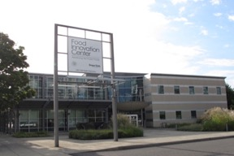
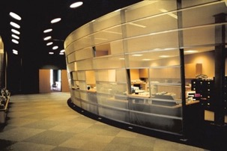
Food Innovation Center (FIC)
Jovana Kovacevic, Ph.D.
Assi. Prof. and Extension Specialist, Food Safety Coordinator, FSMA Western Regional Center to Enhance Food Safety,
Food Innovation Center, Food Science and Technology, CAS

Slide 13
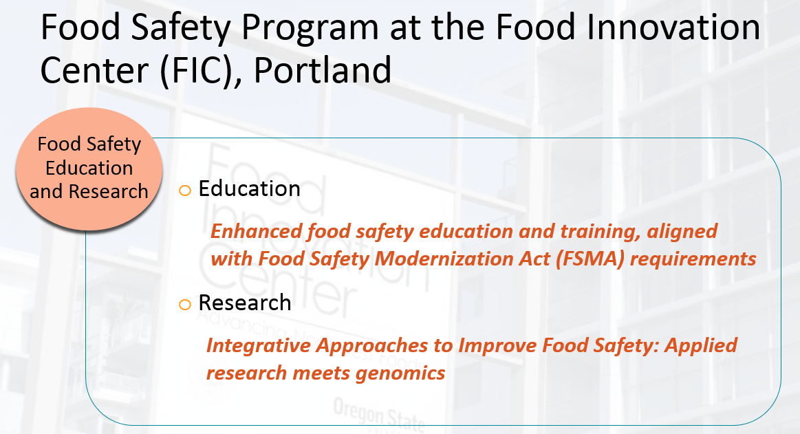
Dr. Jovana Kovacevic
News
Corvallis
FIC
Seafood
Research
Lab
Slide courtesy by Dr. Jovana Kovacevic
- 13 -

Slide 14
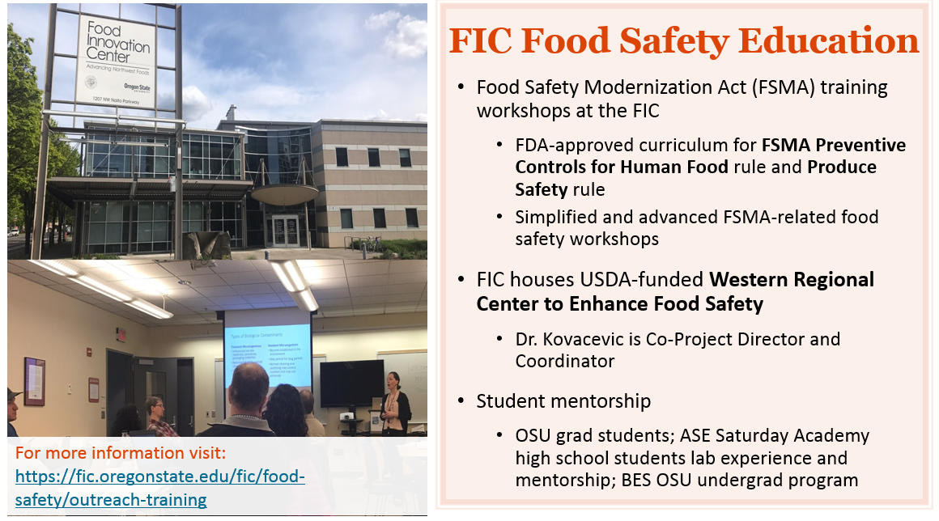
Dr. Jovana Kovacevic
News
Corvallis
FIC
Seafood
Research
Lab
Slide courtesy by Dr. Jovana Kovacevic
- 14 -

Slide 15
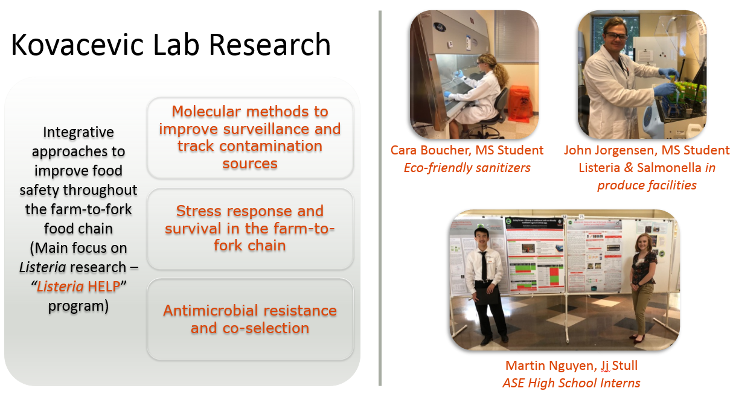
Dr. Jovana Kovacevic
News
Corvallis
FIC
Seafood
Research
Lab
Slide courtesy by Dr. Jovana Kovacevic
- 15 -

Slide 16
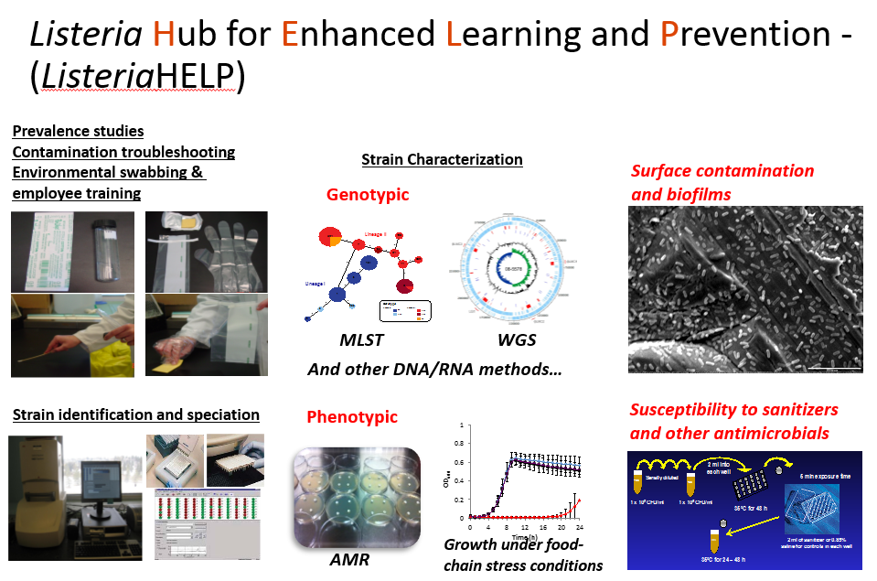
Dr. Jovana Kovacevic
News
Corvallis
FIC
Seafood
Research
Lab
Slide courtesy by Dr. Jovana Kovacevic
- 16 -

Slide 17
Seafood Research Lab (Astoria)
Seafood HACCP (Dr. Christina DeWitt)
HPP and SERS research projects in collaboration with FIC and others from OSU
Depuration and Vibrio project with Dr. Waite-Cusic

Slide 18

Thank you for your attention

