Slide 1
School of Food Science University of Idaho/ Washington State September 20, 2018
Barbara Rasco, PhD, JD
Director, School of Food Science
Rasco@WSU.edu

Slide 2
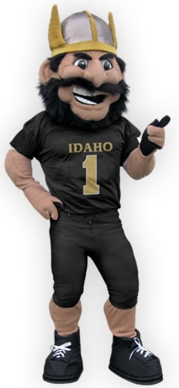
What is The School of Food Science?
A unified, shared resources program
Rated a top 10 high priority program at University of Idaho in program prioritization exercise in 2017
Improve lives by providing highly regarded, relevant education, research, and outreach programs to meet the needs of food industry professionals
Promote an entrepreneurial spirit; bring together the talent and enthusiasm of faculty, staff, students and stakeholders to improve the quality and safety of the food supply
Notes:
sector -Food Science is an applied science encompassing processing, technology, chemistry, nutrition, engineering, microbiology, quality assurance, safety, and management
CAHRS processingquality of life, improve ecological and economic systems, and advance agricultural scie
22 majors 19 minors and 27 graduate programs

Slide 3
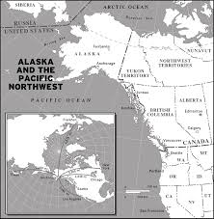
The Regional Food Industry
Large geographical area
Agriculture/fisheries a primary sector in economy of each state
Alaska - $16+ B, growing agriculture sector
Idaho – $50+B industry
Oregon- $23+ B
Washington- $50+B
Widely different needs
Large to very small processing operations
Large to very small production operations
New farmers, urban farming, local foods
Over 300 farm products, over 300 fish species
New food processors (large and small)
New products and sectors; long supply chains (including international)
Notes:
Greenhouse and nursery crops are the fastest-growing agricultural segment in the Last Frontier State, with other important commodities including hay, dairy, potatoes, and cattle and calves. ... Alaska is well-known for its seafood industry, which accounts for more than 60 percent of commercial seafood 650 farms 35m industry Fish is 3 B industry
WA – 300 crops, ag production 49B, 70% US apples, employs 160K people and is 13% of state economy. 15B exported, third largest total in USA. Trade/trans/utilities; health care and edu;ag lumber tourism, high tech Boeing employs 85000.
Idaho – manufacturing, health care, tourism, ag, food processing
Alaska – oil, gas, tourism, fishing
Oregon- adv mgf, business services, food.bev, wood products, high tech
OR farm gate is 34600 farms, mostly family, 2.6B exports, 150000 jobs in farming and processing, 23B, 11% economy. /high tech, lumber food processing
Idaho ag production 10B with processing 50B. 3rdlargest ag state in west
Oregon -

Slide 4
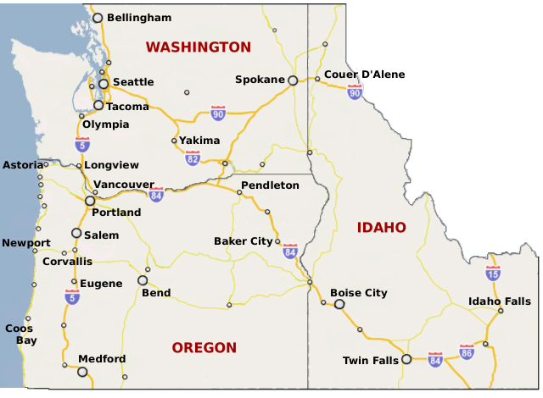
Everett
SFS Operating Locations in Idaho and Washington
Food Science and Management

Slide 6
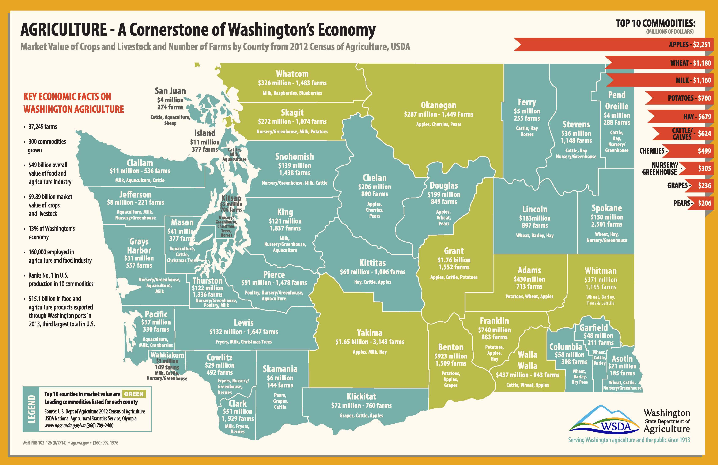

Slide 7
AGRICULTURE - A Cornerstone of Washington’s Economy
Food Processing Industry Gross Sales and Employment by County
KEY ECONOMIC FACTS ON THE FOOD PROCESSING INDUSTRY IN WASHINGTON
San Juan
$1.7 million 64 jobs
Whatcom
$959 million - 1,774 jobs
Pend Oreille*
$15.46 billion industry
Okanogan*
$9 million
Ferry*
Employs 40,000 people
The Washington State Department of Agriculture licenses nearly 3,000:
Food and milk processors
Milk producers
Food storage warehouses
Custom meat facilities
Egg dealers
Skagit
$531 million - 1,287 jobs
Stevens*
$969,000
Island
$6.2 million 62 jobs
Clallam
$9 million - 75 jobs
Snohomish
$300 million 1,549 jobs
Chelan
$94 million 447 jobs
Jefferson
$5 million - 80 jobs
Mason
Kitsap
Douglas*
$285,000
Many food crops grown by Washington farmers are sold to independent food processors or are used by grower cooperatives for processing.
$75 million 182 jobs
King
$6.4 billion 12,780 jobs
Lincoln*
$231,000
Spokane
$566 million 1,472 jobs
Grays
Washington is:
The U.S. leader in potatoes grown for processed foods such as French fries.
The leading U.S. producer of apple juice and a leader of grape and berry juices.
The second-largest premium wine producer in the U.S. with 800 licensed wineries.
Harbor
$87 million 749 jobs
$45 million 444 jobs
Grant
$310 million 2,154 jobs
Pierce
$965 million 1,783 jobs
Kittitas
$12 million - 352 jobs
Adams
$68 million 971 jobs
Thurston
$387 million 567 jobs
Whitman*
$2.3 million
Pacific
$59 million 499 jobs
Lewis
$184 million - 444 jobs
Franklin
$272 million 2,546 jobs
Other major commodities processed include:
Vegetables and Fruit
Dairy foods
Beef
Seafood products
Yakima
$1.1 billion - 3,212 jobs
Garfield*
Columbia*
Asotin*
$645,000
Wahkiakum*
Cowlitz*
$702 million
Benton
$522 million 2,447 jobs
Walla Walla
$1.1 billion
1,865 jobs
Skamania*
Top 10 counties in food processing
Klickitat
$12.3 million - 122 jobs
sales are - Food processing
LEGEND
GOLD
includes foods and beverages
Clark
$364 million 1,029 jobs
Source: Department of Revenue and Employment Security Department, 2012 data
* Gross sales or jobs data not available
AGR PUB 103-127 (R/8/14) • agr.wa.gov • (360) 902-1976
Serving Washington agriculture and the public since 1913

Slide 8
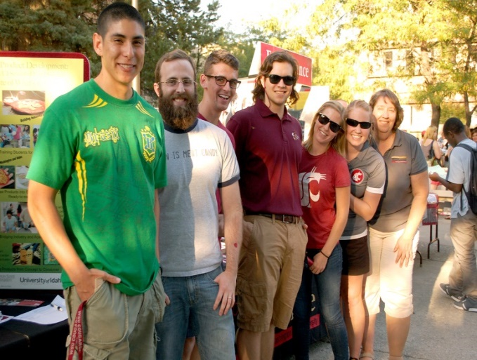
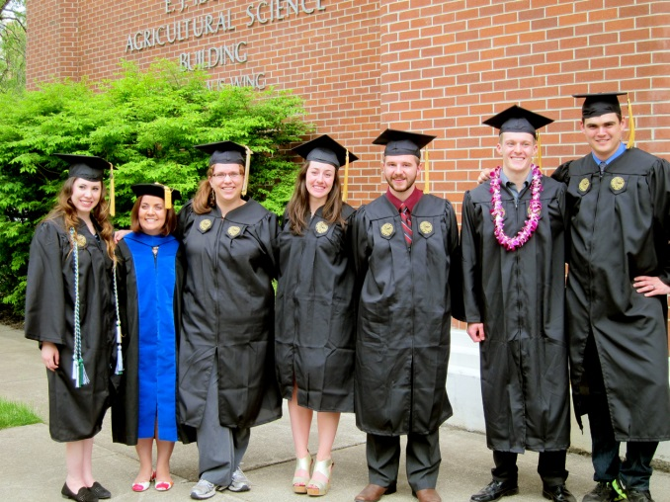
Our Staff and Students – Changes Since 2012
19 faculty (down 30%) and 9 staff
3 tech program managers
WSU Pilot Plant: Frank Younce
WSU Creamery: John Haugen
U Idaho Food Technology Center: Josh Bevan
99 undergraduate students – double from 2012
54 graduate students -50% increase from 2012
85 MS AG FSM students, 57 currently enrolled - up from 3 in 2012

Slide 9
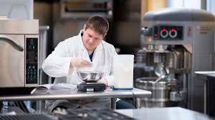
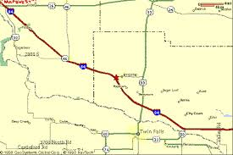
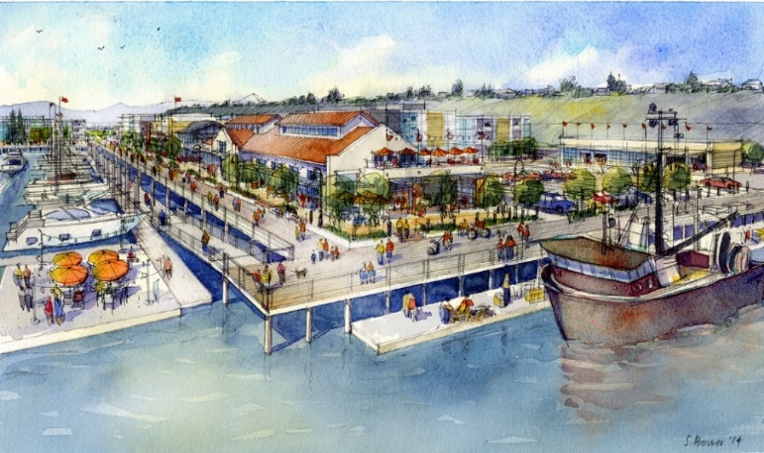
New Initiatives
Teaching
Options for UI degree
To increase enrollment
Attract minors
Joint degree – UI with Law school – JD plus non thesis MS in food science
FSMA Regulatory compliance
Auditing
Options UG WSU
Multidisciplinary food safety degree
SFS role in CAFÉ
Food processing program – College of S Idaho
Western Washington CAFT initiative
Teaching- AFS degree
Applied research and outreach

Slide 10
CAFT Training and Conferences
Seafood and General Food series of technical, safety and quality training
Technical Workshops
Aquaponics and Hydroponics (Greenhouse)
Shrimp School
Quality Control
Refrigeration
New Product Development and Marketing
Product Specific Conferences and Workshops
International/National Conferences
Native American Food Conference – March 2019
Pacific Rim Food Import/Export Conference – May 2019
Food Law Conference – July 2019

Slide 11
School of Food Science Distance Learning
Certificate Programs
Food Science
Seafood and Aquatic Science
Food Inspection & Regulation
2018 – 19 DL Undergraduate and Graduate Courses
MS Ag - Food Science and Management
MS Ag - Seafood and Science (Winter 2019)

Slide 12
School of Food Science Everett Academic Programs
2018 – Masters Program
2018 – Internships
2019 – August Begin Bachelor of Science Program
In cooperation with community colleges
Provide Junior and Senior Year

Slide 13
The University Vision

Slide 14
Problem - A Growing Sector, but Declining Domestic Workforce
Food industry processing capacity
Vertical integration along value chain
Food sector lacks a stable workforce
Affecting food processing sectors in US and EU
Similar problem in agriculture, food service
Notes:
younger folks choose to seek less strenuous and safer livelihoods
Affecting manufacturing in general
Strong Jobs Market
Unemployment at lowest level in 17 years
Comparatively low pay at the seafood production level
Increasing non-labor operating costs
Many fishing/processing companies currently dependent upon a semi to unskilled immigrant and guest worker labor force.
A labor force that is itself becoming more difficult to populate and maintain as Work Visas become harder to secure

Slide 15
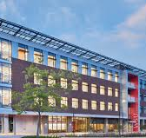
Solution
Industry is modernizing - automating harvest and processing
Food industry is now the fastest growing sector in automation and robotics
Driven by advances in machine vision and control technologies
Providing production control and traceability
Improves safety
Reduced number of employees but increases education and skill level
Respond by
Establishing research programs to develop technological applications
Developing education programs to build a qualified workforce

Slide 16
Phase I Center for Advanced Food Technology
Develop presence on West Side
Building collaborations
WSU CAHNRS Research and Extension Center – Mt Vernon
WSU Hospitality Business Management program
WSU Everett and Pullman Engineering program
Everett Community College AMTEC
Regional experts in biotech, advanced materials, robotics, automation and process control
Office and conference/teaching space
Current collaboration with Extension
Space for short courses, workshops, conferences, meetings

Slide 17
Waterfront Place and Marina Village
CAFT Facility
Conference Center
Initial Offices

Slide 18
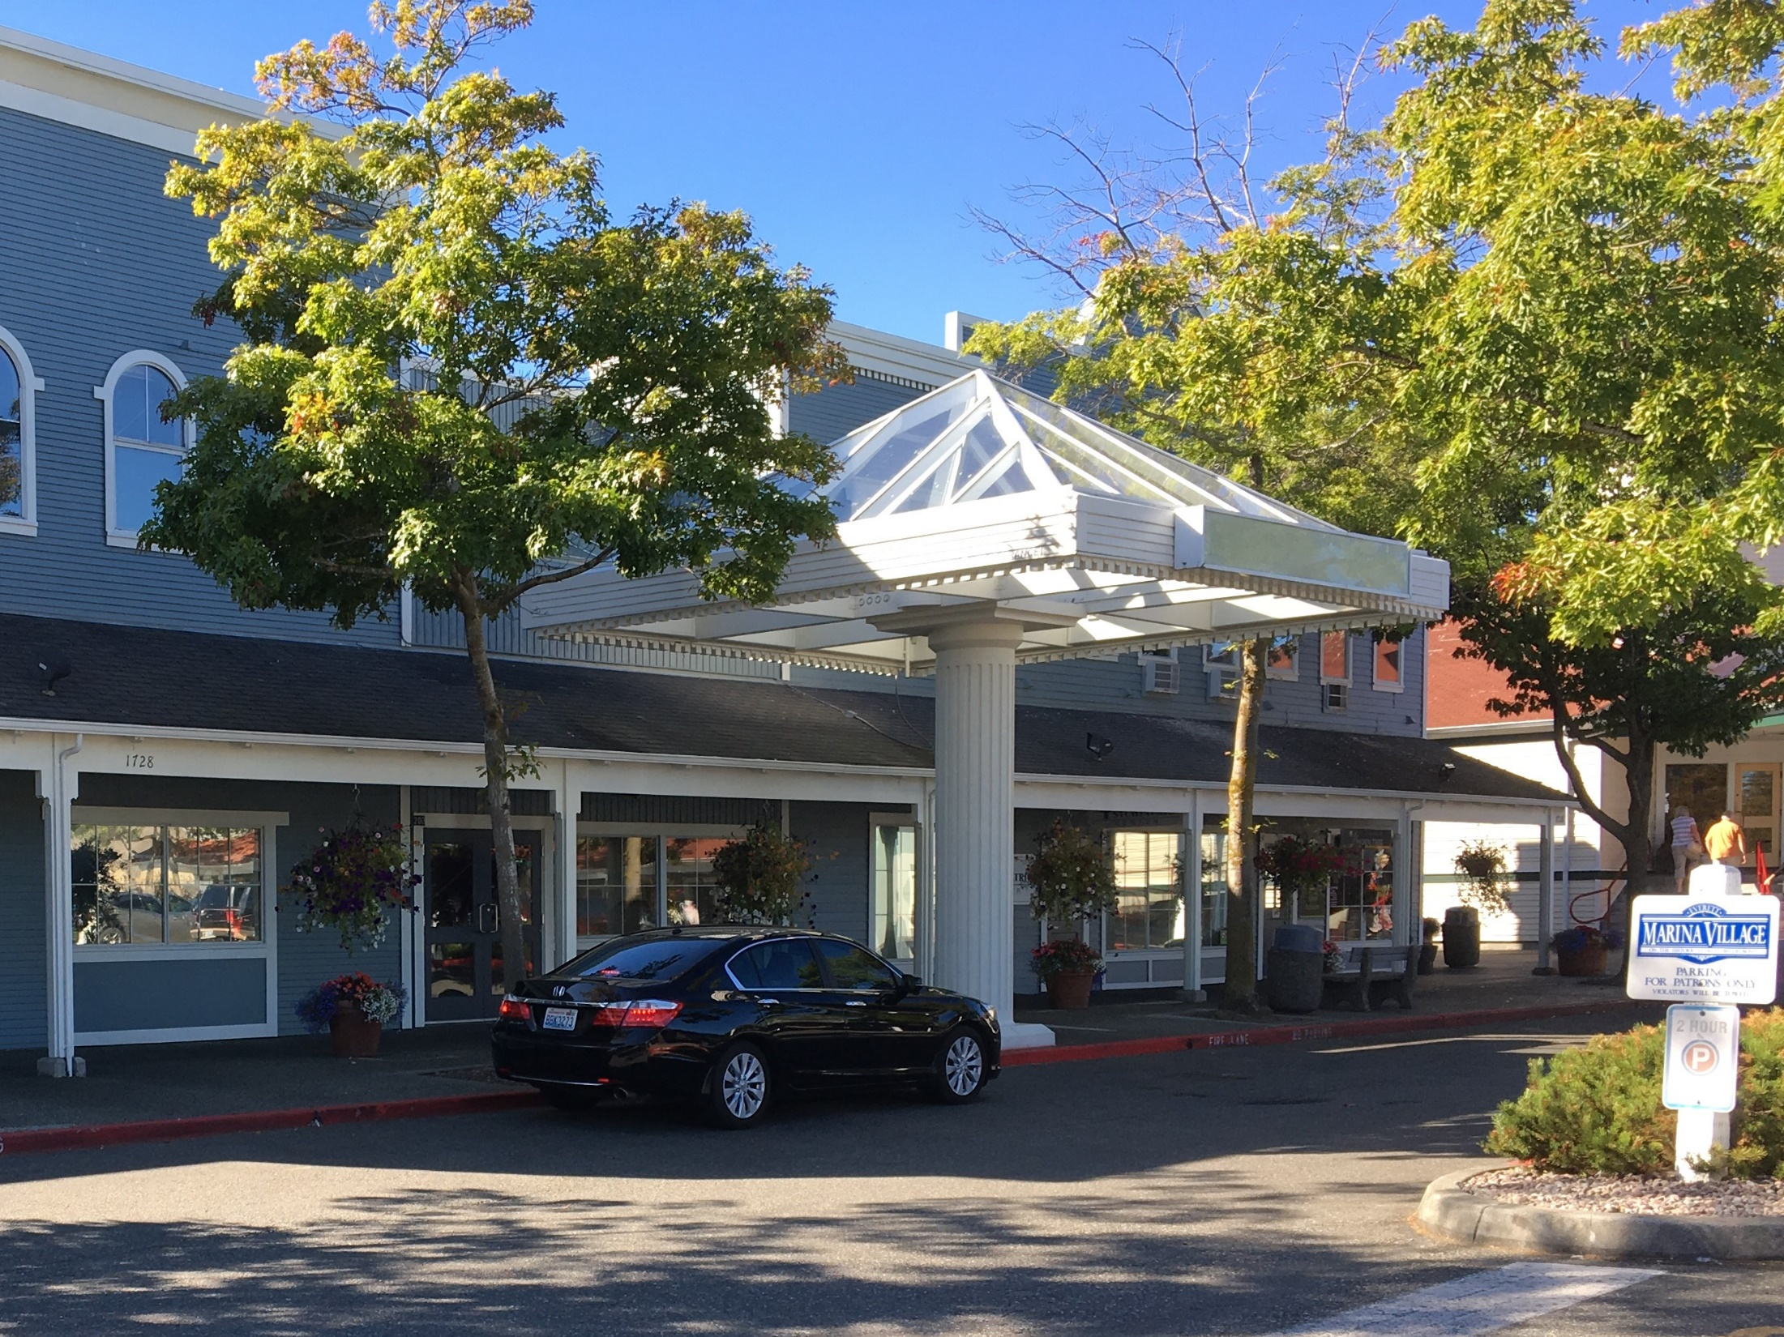
Marina Village Offices

Slide 19
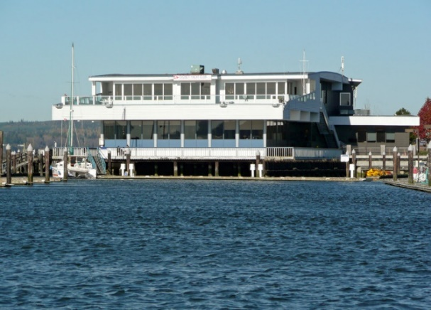
Conference Center

Slide 20
Phase II Center for Advanced Food Technology
Complete planning for the development of the main facility
To be constructed as part of the Port’s “Waterfront Place” economic development project
A multiple discipline facility
Central Location along the Central Marina Waterfront
Two-story building with research pilot plant, laboratories and supporting infrastructure on the main floor
Offices, laboratories, classrooms, conference rooms on the second floor

Slide 21
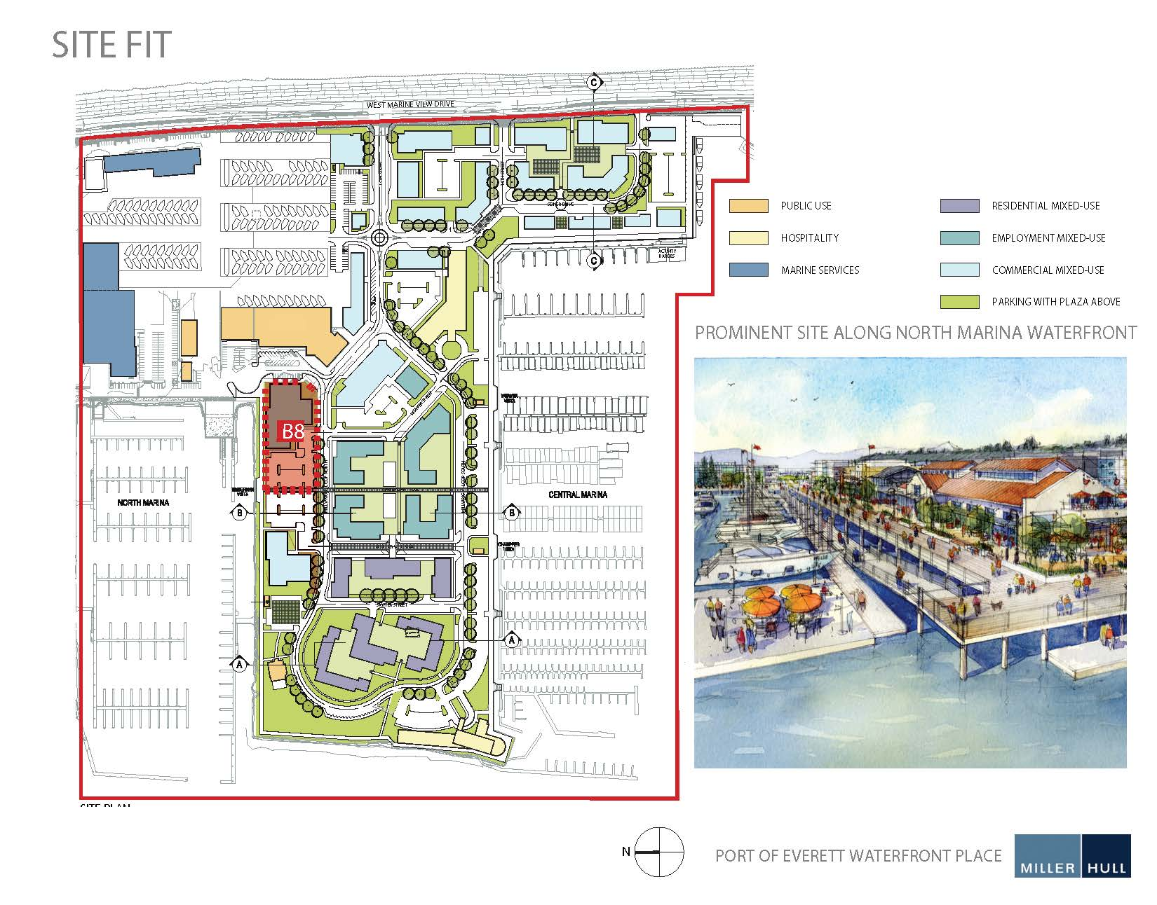
Proposed Center Location

Slide 22
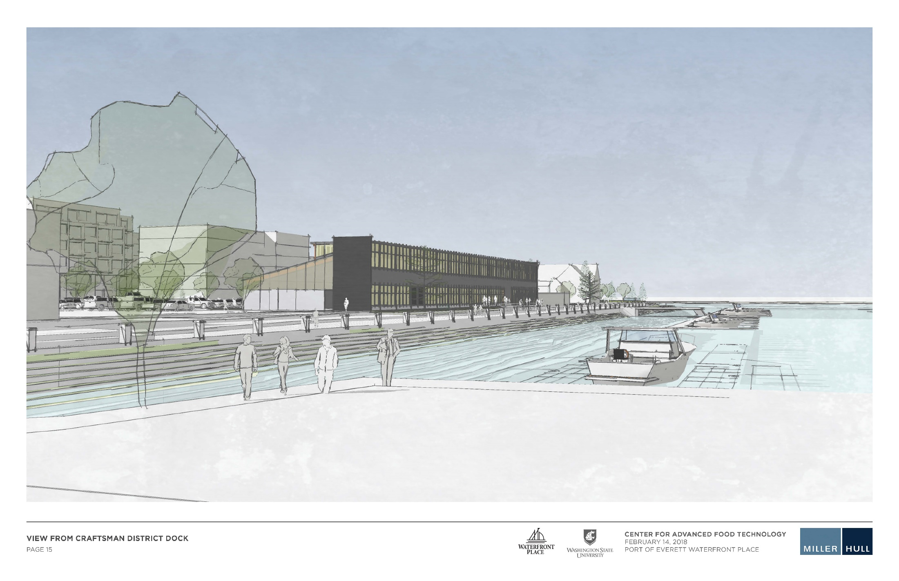

Slide 23
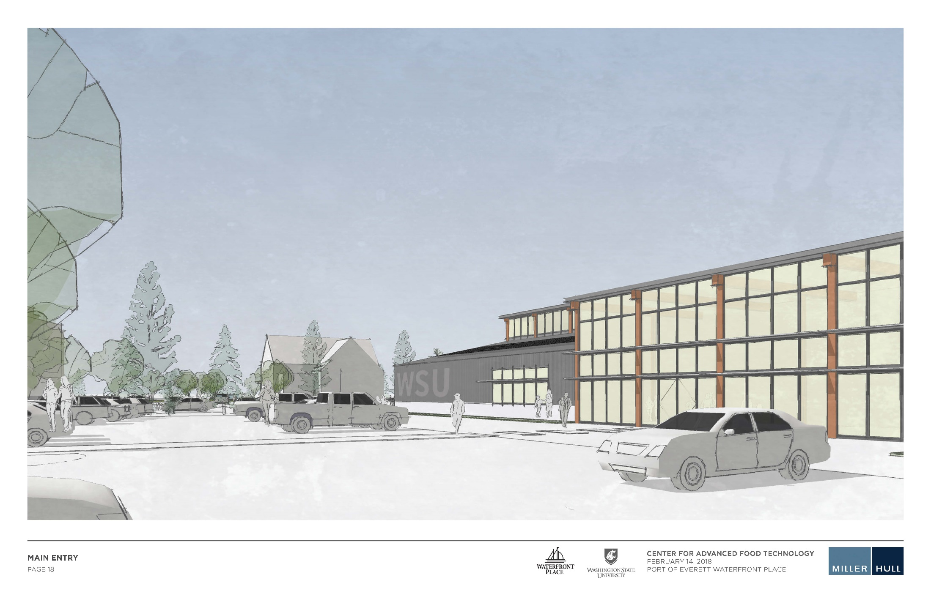

Slide 24
Retail Ferdinands West

Slide 25
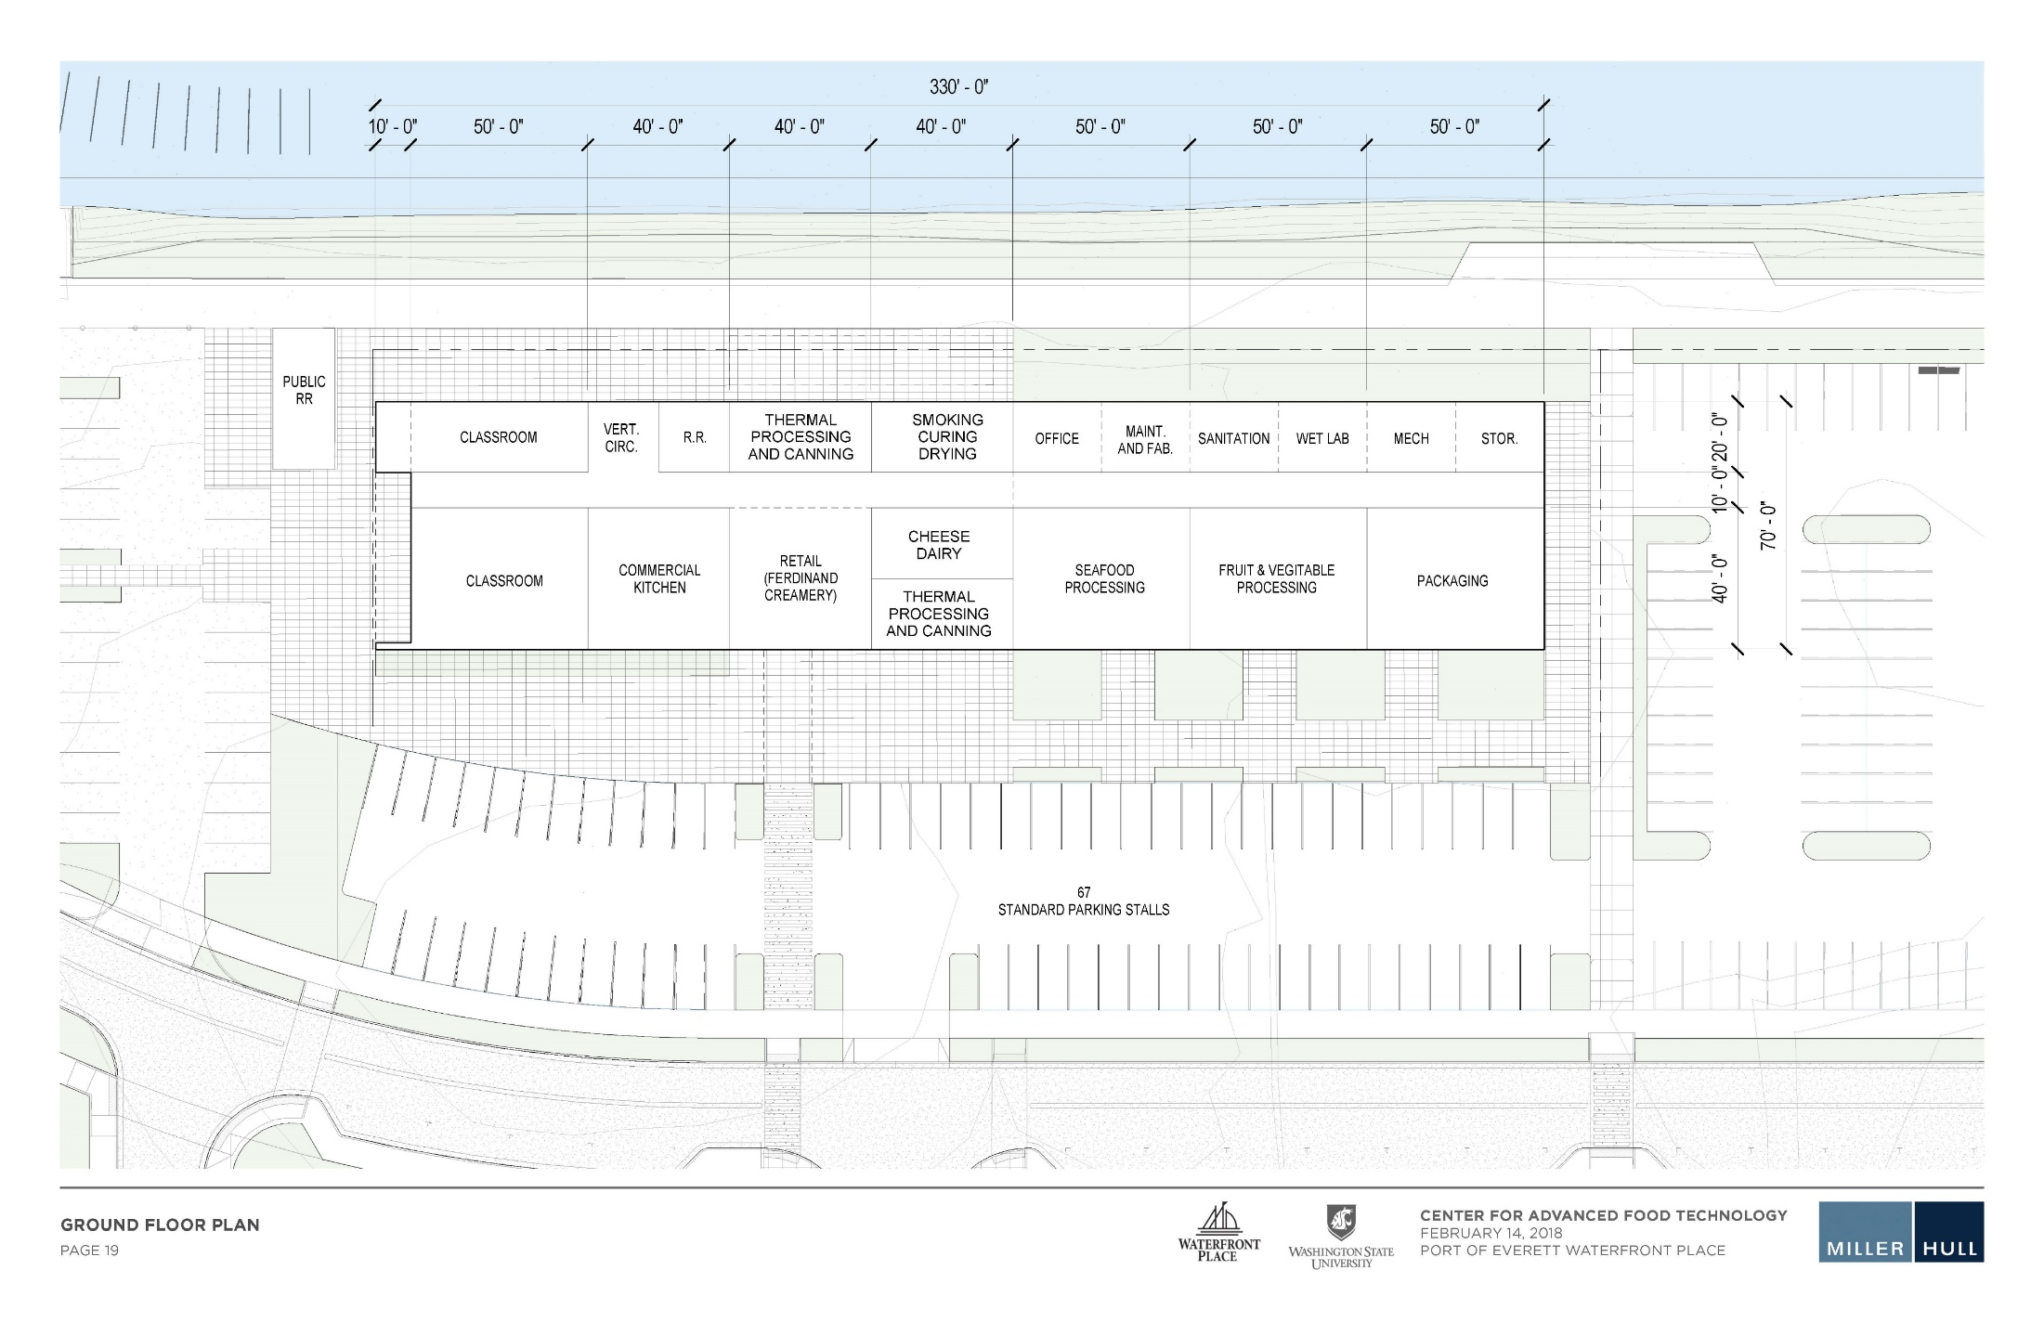

Slide 26
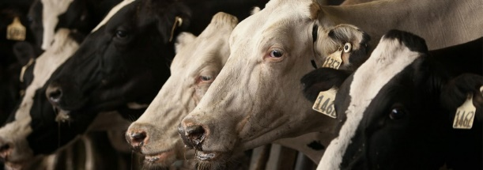
CAFÉ – Statewide Initiative
2000 head dairy
Research
Extension
Education programs with S Idaho partners (CSI) – other Idaho colleges
$15M from state, $15M from university, $15M in private funds

Slide 27
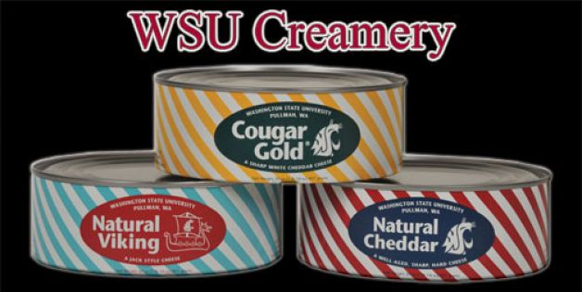
Anthony’s Home Port – Everett & SFS Partnership
Anthony’s in Everett is now selling Cougar Gold Cheese

Slide 28
Questions?

