Slide 1


  Listeria Hysteria!
  How do we get it under control?
Kathleen Glass, Ph.D.
1550 Linden Drive, Madison, WI 53706
Email: kglass@wisc.edu
Washington Association for Food Protection
IAFP Affiliate Speaker Program
September 20, 2018

Slide 2
Key Points
Risk of listeriosis
Case studies
Getting it under control
  Environmental monitoring and control
  Growth inhibition by formulation and temperature control
Summary

Slide 3
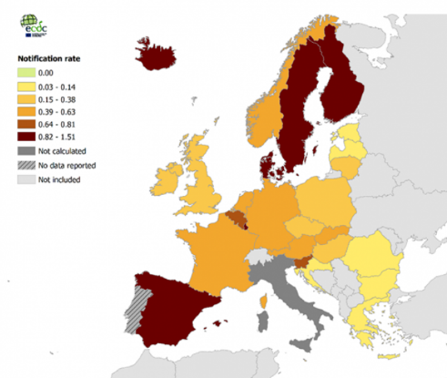
Rates of Listeriosis
Reported confirmed listeriosis cases: age-standardized rate per 100 000 population, EU/EEA, 2014
US, UK, Canada: 0.24-0.37 per cases per 100,000;
  higher rates in other countries
  EU increase rates since 2013
Estimated to cause ~1500 cases in US annually, but responsible for 19% of deaths in US related to foodborne illness
Highest rates in infants/pregnant women and >64 years of age
~90% hospitalizations
~20% mortality
Notes:
United States, Listeria infections cause an estimated 1,460 hospitalizations and 260 deaths

Slide 4
Role of Advanced Genomics in Identifying Outbreaks
Sept 2013 : Whole genome sequencing all L. monocytogenes isolates
  Collaboration: Clinical isolates CDC; food isolates FDA, FSIS
  Match food/environmental isolates with clinical
Identified diffuse “outbreaks” to point source; previously reported as “sporadic” cases
  Ice cream (2010-2015)
  Caramel apples (2014)
  Lettuce (2015-2016)
  Frozen vegetables (2015-2016)
Identify persistent environmental contamination

Slide 5
Recent Listeria outbreaks
 | Food (U.S. unless identified otherwise) | Cases/deaths
2017-2018 | Polony (South Africa) | 1049/209
2018 | Rockmelon (Australia) | 19/6
2017 | Soft, raw milk cheese | 8/2
2015-16 | Pre-packaged lettuce (US, Canada) | 19 (14)/1
2015-16 | Frozen Vegetables | 9
2014 | Stone fruit (e.g. peaches) | 4
2010-15 | Ice Cream | 10/3
2014 | Caramel apples (US, Canada) | 35/7
2014 | Spiced meat roll, salami, hot dogs (Denmark) | 41/17
2014 | Queso fresco | 8/1
2014 | Quesito Casero (fresh curd) | 3/1
2014 | Bean Sprouts | 5/2
2012 | Ricotta Salata Cheese | 22/4
2011 | Cantaloupe | 147/33
2008 | Cold cuts without growth inhibitors (Canada) | 57/22
Notes:
http://www.foodsafetynews.com/2018/03/victims-file-suit-in-listeria-outbreak-more-illnesses-expected/#.Wsev4pch2Ul
Polony = poultry based baloney, hot dogs, sausages
Confirmed cases 687; suspect 982
28% mortality rate
Australia rockmelons (31% mortality rate)

Slide 6
Contributing factors
Susceptible population
Formulation
Storage
time
Storage
temperature
Contamination
Listeriosis

Slide 7
Listeria: Characteristics
Widespread in food processing environment
  Can be resident in processing plants
  Thrives in moist, cool, high salt environments
Killed by normal pasteurization
  More heat- and pressure resistant tolerant than Gram negative pathogens
Grows at refrigeration temperatures
  Survives freezing
High risk foods
  High moisture, high pH with extended shelf-life
    Particularly those without growth inhibitors

Slide 8
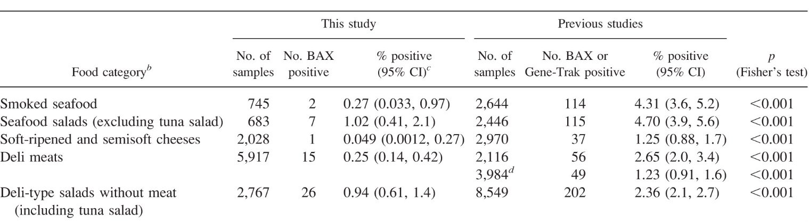
Comparison Incidence of L. monocytogenes at retail, 2003 vs. 2013
Progress made! Reduction in Listeria-positive samples
J. Food Protection 80: 903-921, 2017

Slide 9
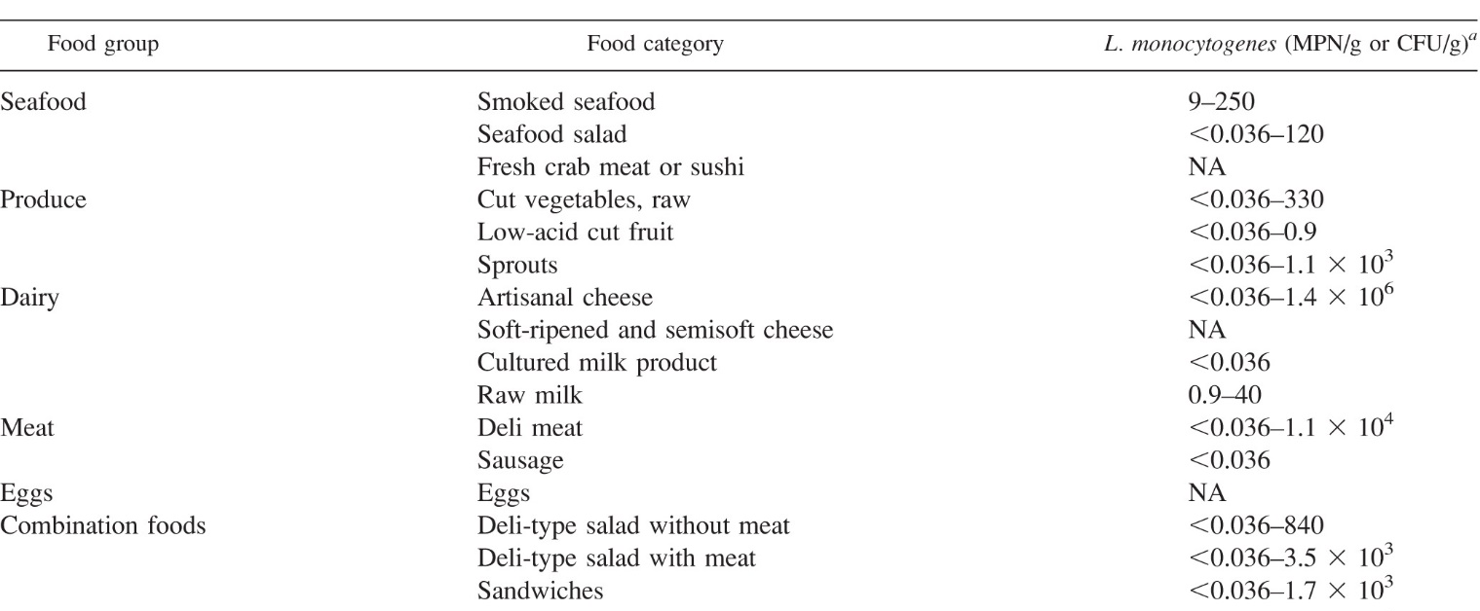
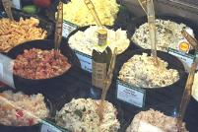
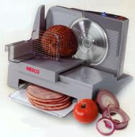
Incidence of L. monocytogenes at retail, 2010-2013
J. Food Protection 80: 903-921, 2017

Slide 10
Case studies: Identifying foods that support growth
Cantaloupe
Caramel apples ice cream frozen vegetables
Expecting the unexpected

Slide 11
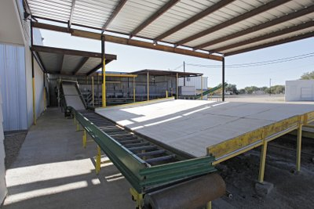
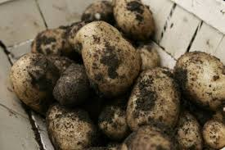
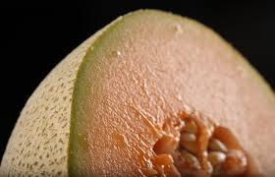
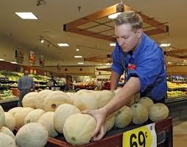
2011, cantaloupe
147 cases, 33 deaths
Use of the same equipment for potatoes and cantaloupe
3/29 environmental swabs + for Listeria
Incursion of Listeria through skin of cantaloupe
Flesh of cantaloupe moderate pH/high moisture = growth @ RT
Potatoes cooked before eating; cantaloupe is not
Remedy: Need to improve environmental controls

Slide 12

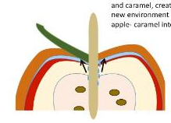
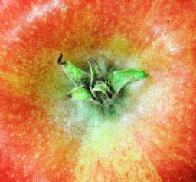
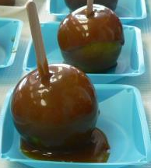
2014 Caramel apple outbreak
35 illnesses/7 deaths
Unlikely food attribution
Linked to single packing facility (CA)
Apple sanitation procedure insufficient
Deep depressions may protect Listeria from hot caramel
Apples “damaged” by penetration of apples with stick
  Juice from apple migrates to surface under caramel
  Create microenvironment for microbial growth
Frequently displayed at ambient temperature
    4 log increase within 3 days at room temp; slower growth if refrigerated
  Remedy: Improve environmental controls/sanitation; refrigeration; growth inhibitors
Notes:
Three cases meningitis otherwise healthy children aged 5–15 years
pH apple 3.6-4.0
A_{w} caramel <0.80

Slide 13
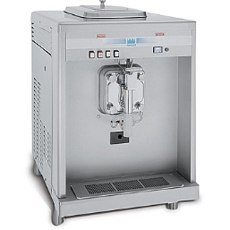
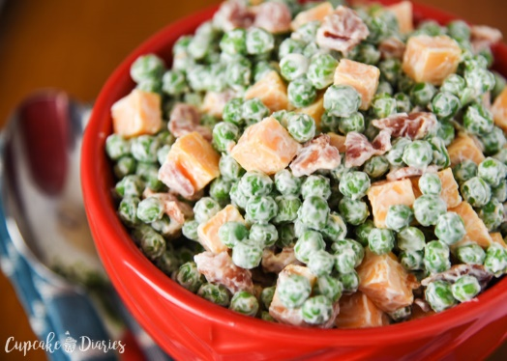
Listeriosis and Frozen Foods???
Foods that don’t support growth…if handled correctly
Ice cream (shakes)
  Localized, persistent outbreak: hospital setting, immunocompromised patients
    Source:
      1. ice cream low contamination; extended storage
      2. ice cream no contamination; insufficient equipment cleaning and extended storage at refrigeration (5°C)
  Diffuse outbreak: hospital setting
    Source ice cream: 95%+ contamination
      Maximum concentration 100/g in survey from ice cream
    Estimated 1 in 10,000 shakes load >26,000 cells (95% Crl 15,600-240,000)
Frozen vegetables
  Not manufactured under RTE food environmental controls
  Vegetables frequently thawed and used in salads
  Lm growth during refrigerated storage
Remedy: Need to improve environmental controls; know end user
Salazar et al., 2018

Slide 14
How do we get Listeria under control?

Slide 15
No single practice will control Listeria in foods
Control Strategy | Reduction of predicted illness
Environmental Control
Enhanced sanitation | 5%
Control contamination at its source | 22%
Control cross-contamination | 34%
Reformulation with growth inhibitors | 96%
Rigorous temperature control (<5°C) | 9%
Source: FSIS Best Practices Guidance for Controlling
Listeria monocytogenes (Lm) in Retail Delicatessens April 2014

Slide 16
Persistence of Listeria in Environment
Cheese | 4 years | Switzerland
Cheese, Blue Veined | 7 years | Sweden
Ice cream | 7 years | Finland
 | 5+ years | US
 | 2+ years | US
Pate | 2 years | UK
Poultry, cooked deli products | 12 years | US
Notes:
Persistent Listeria in shake Machine hospital 2014-2015 Washington State
Shake freezers hold dairy-based ice cream mix at <5C
Ice cream original source of Listeria; (recall; temporary closure of manufacturer, suspension of using shake machine in hospital)
Dissembled, cleaned, sanitized

Slide 17
Environmental Control Program
Refer to FDA and commodity-specific guidelines
  2017 FDA Draft guidelines
  2015 Innovation Center for US Dairy
  2014 FSIS Retail Delicatessens
  Annual Workshops
    Produce Marketing Association
    North American Meat Institute

Slide 18
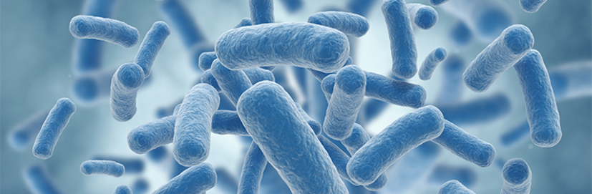
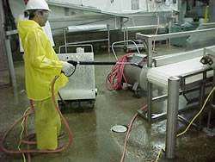
Understand how microbes move
www.microbial-control.com
Arrive via ingredients, personnel, equipment
Move via moisture droplets or aerosols from harborage sites to sensitive areas
  Operations
    Drain back-ups
    Kicked up by hose sprays
  Sanitation
    Kicked up by hose sprays
    From wash areas
By hitch-hiking on dust or lint particles
Through compressed air lines (point of use filter); air from automatic bag openers

Slide 19
Environmental Control program
Traffic pattern control
Clean and dry
Sanitary design of facilities and equipment
  Cleanable
  Disinfect/heat sanitize
  Air handling
Find it (harborage sites) and fix it (corrective action)
  Zones of Control
  Rigorous environmental monitoring
    Indicator organisms
    Targeted and random sampling
    Hygiene checks
Source: North American Meat Institute

Slide 20
Sanitary Zones: focus on indicator Listeria spp.
Zone 4
Locker rooms;
Zone 2
Immediately adjacent to product contact surfaces
Zone 1
Product contact surfaces:
e.g. slicers; conveyors; peelers; tables; utensils; racks; work tables; employee hands
Zone 3
Phones; hand trucks; forklifts; walls; floors; drains
cafeteria;
halls
Exterior of equipment;
chill units; framework;
equipment housing

Slide 21
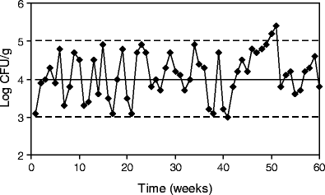
Other testing
Finished product (hold)
Enumeration of other indicator organisms
  Periodic testing of incoming ingredients
  After sanitation step
  After storage of retained samples
Develop process control charts to track out-of-spec conditions
  Identify correlations between indicator organisms and pathogens
  Early warning system
NACMCF Charge 2018-2020
  Appropriate Product Testing Procedures and Criteria to Verify Process Control for Microbial Pathogens or appropriate indicator organisms in Ready-to-Eat (RTE) Foods

Slide 22
Reduce growth Reduce risk
FDA-CFSAN/USDA FSIS 2003 QRA
  Foods that support growth had highest risk of causing listeriosis per serving
FAO/WHO 2004
  Listeriosis cause by consumption of foods with >100 CFU/g
FSIS 2010 deli meats
  Identified difference in rates of listeriosis associated with prepacked meats (with growth inhibitors) vs. sliced in deli (no growth inhibitors)

Slide 23
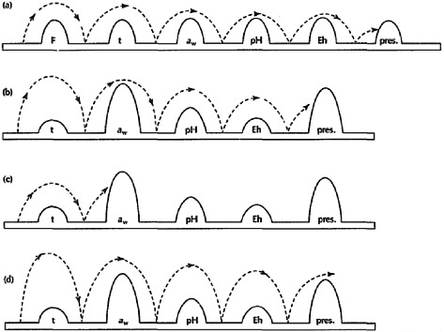
Defining growth/no growth conditions
Codex Alimentarius Commission
  Limit 0.5 log increase during (labeled) shelf-life under “reasonably foreseeable conditions”
Freezing (-18°C)
  Caution: Ingredients might be used in other foods that can support growth
    E.g. milk shakes, salads
Formulation
  pH <4.4
  Water activity <0.92
  Combination of pH < 5.0 and a_{w} < 0.94
  Enhance safety during extended refrigerated storage
    Addition of effective antimicrobials
    Competitive microbes
Temperature Aw pH Preservatives

Slide 24
Antibacterial ingredients
Secondary barrier to delay growth during extended storage or mishandling
Synthetic | Clean Label
Lactate*, propionate* | Cultured sugar, cultured milk (fermentates)
Diacetate*, acetic acid* | Dry vinegar, buffered vinegar
Nitrite* | Cultured celery
Sorbic acid | None (derived from rowanberries)
Benzoic acid | Cranberries, prunes, plums, cinnamon
*Clean label substitute with documented efficacy, but concentration dependent
  Caution: Lot-to-lot variation in inhibitory properties

Slide 25
Validating formulation Safety
Examples
Processed meat
Natural cheese
Competitive microbes on caramel apples

Slide 26
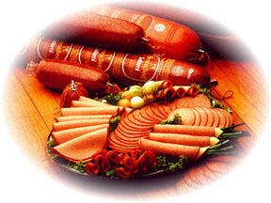
L. monocytogenes
RTE Meats, 41°F (5°C), no growth inhibitors
Critical factors
pH, moisture/water activity
Competitive microflora
Nitrite
Glass and Doyle, AEM, 1989
Notes:
The ability to support listerial growth varies significantly among ready-to-eat meats.
Data published by Glass and Doyle, in 1989, indicated that products with low pH and nitrite (salami) inhibits growth compared with products with relatively high pH (~6), and non-smoked, non-cured products such as turkey. Variation in growth occurs within products groups (ex. wieners) depending on competitive microflora and the amount of phenols on the surface due to smoking.

Slide 27

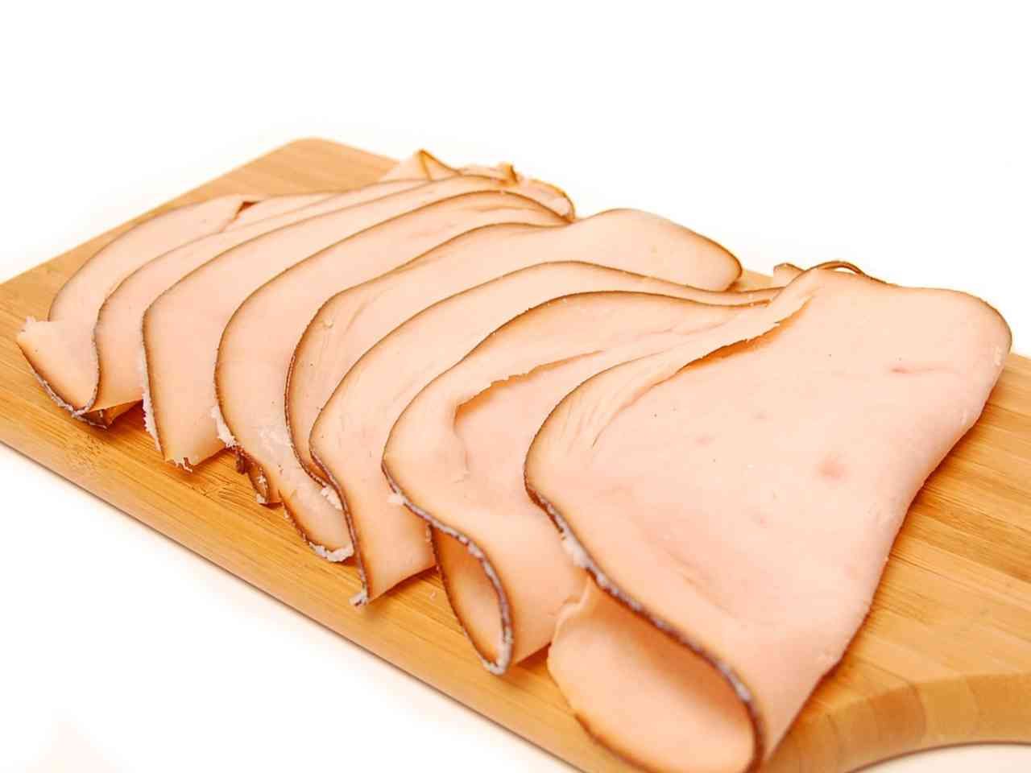
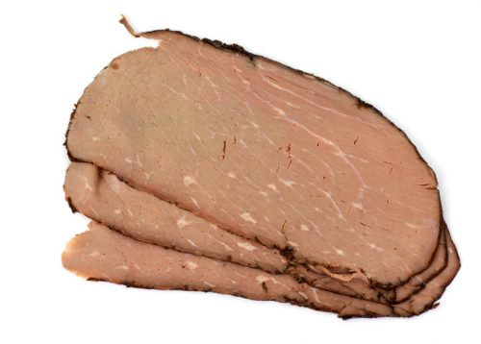
Buffered vinegar, moisture, pH
Uncured RTE Deli Meats: L. monocytogenes
Adapted from JFP 76:1366, 2013
Similar results with 1.5% lemon/cherry/vinegar blend; 3.0% cultured sugar-vinegar blend

Slide 28
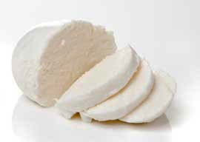

Citric
Lactic
Effect of acid type, pH, and moisture on
L. monocytogenes
Model cheese
L. monocytogenes (log CFU/g)
Acetic
Propionic
Engstrom et al., 2018, manuscript in preparation

Slide 29
Effect of Acid Type
Acetate
pKa 4.76
Lactate
pKa 3.86
Citrate pKa 3.13, 4.76, 6.40
Propionate
pKa 4.87
Journal of Applied Bacteriology 1996, 81, 147-1 53, Metabolic activities of Listeria monocytogenes in the presence of sodium propionate, acetate, lactate and citrate., Y. Kouassi and L.A. Shelef , Department of Nutrition and Food Science, Wayne State University, Detroit, MI, USA
Foodborne Pathogens and Disease 2012, 9, 1126-1129. Comparing Organic Acids and Salt Derivatives as Antimicrobials Against Selected Poultry-Borne Listeria monocytogenes Strains In Vitro. , J.F.R. Lues and M.M. Theron.
Notes:
Now let’s talk about organic acids . . .
These Organic acids - propionate, acetate, lactate and citrate and their salts are widely used as inhibitory agents and provide antimicrobial benefits in various foods.
How do these organic acids work?
Undissociated form penetrates the cell wall and disrupts physiology - I will discuss more details on the mode of action in the next slide.
So, when it comes to the order of effectiveness against pH sensitive bacteria - propionate is more effective than acetate, acetate is more effective than lactate and so forth.
- Some examples of sensitive bacteria: Escherichia coli, Salmonella spp, C. perfringens, Listeria monocytogenes and Campylobacter species
Reference Information
Mode of action of organic acids on bacteria is that non-dissociated (non-ionized) organic acids can penetrate the bacteria cell wall and disrupt the normal physiology of certain types of bacteria that we call pH-sensitive, meaning that they cannot tolerate a wide internal and external pH gradient. Among those bacteria are Escherichia coli, Salmonella spp., C. perfringens, Listeria monocytogenes, and Campylobacter species.
Published data in the Journal of Applied Bacteriology confirmed that the relative inhibitory effect of organic acids was propionate > acetate > lactate > citrate. This study evaluated the effects of acetate, lactate and citrate on cell proliferation, glucose and oxygen consumption, and ATP production in Listeria monocytogenes in growing and resting cells.

Slide 30
Engstrom and Glass, 2018, manuscript in preparation

Slide 31
Engstrom and Glass, 2018, manuscript in preparation
Cultures were previously shown to be active at 10C, no significant activity at 4C

Slide 32
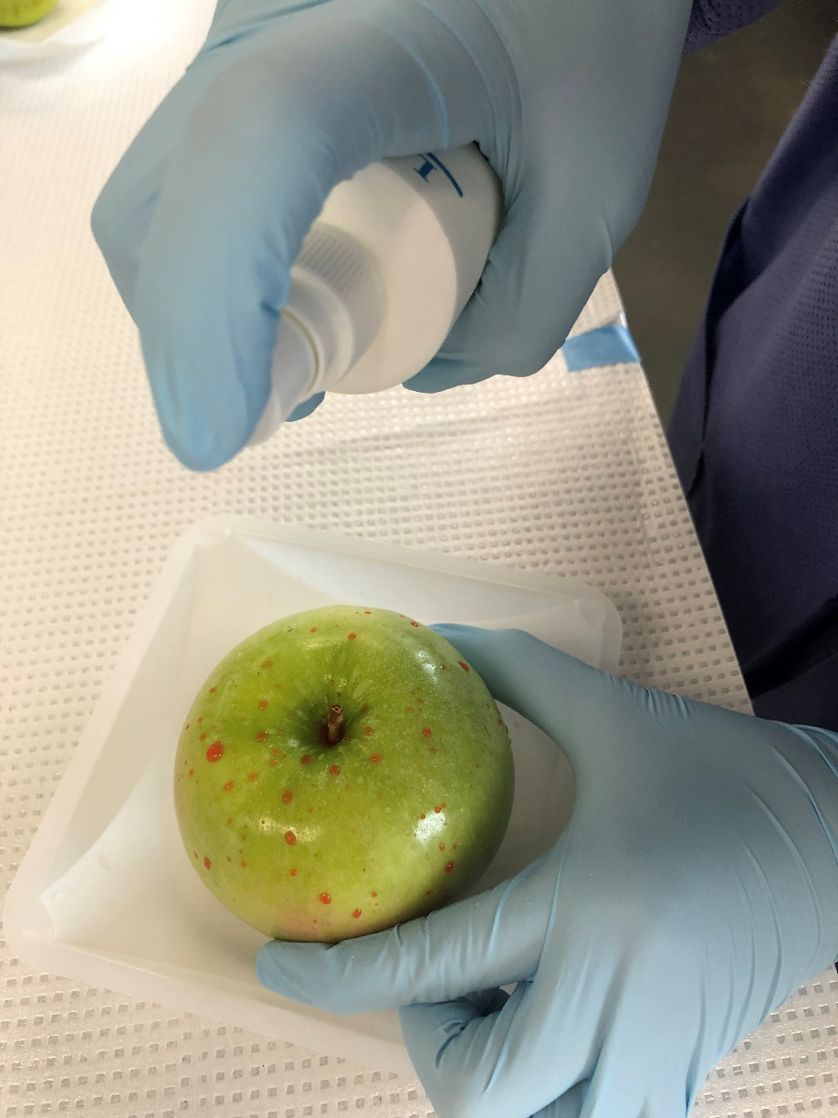
Effect of protective cultures (PC) on caramel apples
Brown and Glass, 2018, unpublished data
Listeria inoculated on entire surface by spraying
PC in stem/calyx only
Notes:
A four-strain mix of commercially-available lactic acid bacteria was used for the protective culture (PC) mixture. (Leuconostoc carnosusm, Pediococcus acidlactici, Lactobacillus sakei, Lactobacillus curvatus)
3-log per apples Listeria, 8 log per apple protective culture

Slide 33
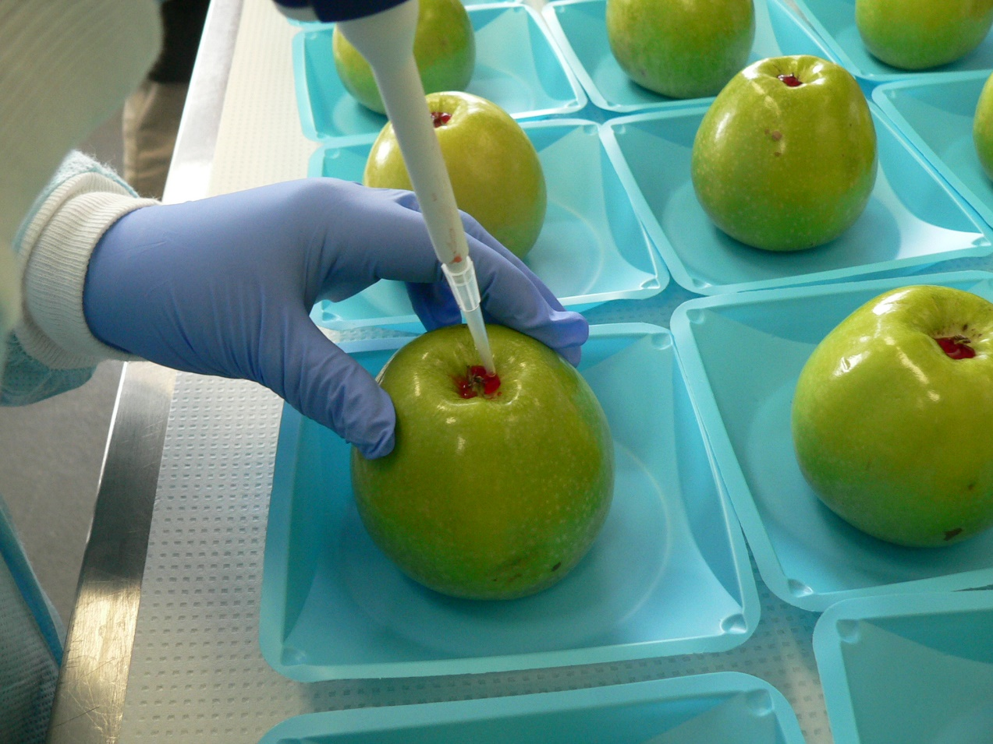
Effect of protective cultures on caramel apples
Brown and Glass, 2018, unpublished data
Listeria inoculated only in stem/calyx
Efficacy requires direct contact between pathogen and protective culture
Notes:
A four-strain mix of commercially-available lactic acid bacteria was used for the protective culture (PC) mixture. (Leuconostoc carnosusm, Pediococcus acidlactici, Lactobacillus sakei, Lactobacillus curvatus)
3-log per apples Listeria, 8 log per apple protective culture

Slide 34
Summary: How do we get Listeria under control
Susceptible population
Storage
Temperature
Contamination
Formulation
Storage
Time
We are making progress for control, but requires constant vigilance and process improvement
“Expect the unexpected” for food vehicles
Rigorous environmental controls are needed
Identify strategies to inhibit Listeria growth in foods
Validate efficacy of intervention strategies (formulation; novel processing)
Listeriosis
Notes:
Pulsed light
Electrolyzed water
Antimicrobial packaging
HPP

Slide 35

Thank you for your attention.
kglass@wisc.edu
www.fri.wisc.edu
www.foodprotection.org
Basics of microbial food safety
Keep them out
  Good quality ingredients
  Good agricultural and manufacturing practices
  Environmental controls
Kill all you can
  Pasteurization, cooking
  High pressure pasteurization
Keep them from growing
  Temperature-time control
  Formulation

